Slide 1

MICROBIOLOGY
Lecture 14
Microbial Taxonomy and Evolution

Slide 2
Outline
Introduction of microbial taxonomy and the theory of three domains
Concepts of prokaryotic species
Microbial diversity
Microbial roles in life evolution

Slide 3
Introduction of microbial taxonomy and the theory of three domains

Slide 4
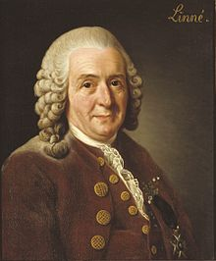
Taxonomy contains two separated but interrelated parts
Classification （归类）
Nomenclature （命名）
Identification of unknown organisms
Arrangement of organisms into groups (taxa, taxon, 分类单元)
Assignment of names to taxa
Binomial nomenclature (双名法，属+种)
Carl Linnaeus (1707-1778)

Slide 5
Hierarchical taxonomic ranks
(层级化的分类阶元)
Life
Domain
Eukarya
Bacteria
Kingdom
Animalia
Bacteria
Phylum
Chordata
Proteobacteria
Class
Mammalia
Gammaproteobacteria
Order
Primates
Enterobacteriales
Family
Hominidae
Enterobacteriaceae
Genus
Homo
Escherichia
Species
Homo sapiens
Escherichia coli

Slide 6
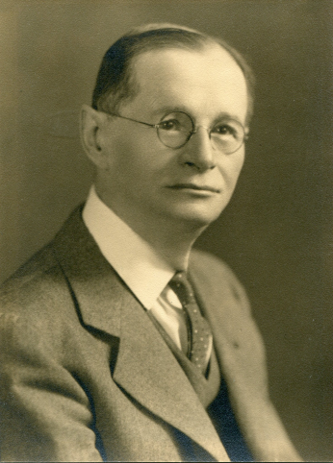
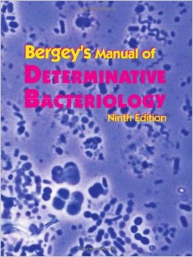



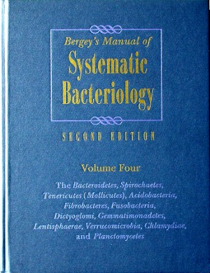
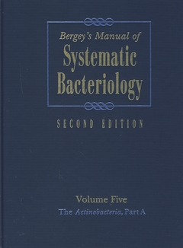
Bergey's Manual of Systematic Bacteriology
The 1st version was published in 1923 by David Bergey and four colleagues
From Bergey's Manual of Determinative Bacteriology (1923-1994) to
Bergey's Manual of Systematic Bacteriology (1984-)
From phenetic taxonomy(表型分类法)
to polyphasic taxonomy (多相分类法)

Slide 7
Volume 1, The Archaea and the Deeply Branching and Phototrophic Bacteria
Volume 2, The Proteobacteria (变形菌门)
Volume 3, The Firmicutes (厚壁菌门)
Volume 4, The Bacteroidetes (拟杆菌门), Spirochaetes, Tenericutes (Mollicutes), Acidobacteria, Fibrobacteres, Fusobacteria, Dictyoglomi, Gemmatimonadetes, Lentisphaerae, Verrucomicrobia, Chlamydiae, and Planctomycetes
Volume 5, The Actinobacteria (放线菌门)

Slide 8
Development of taxonomy at the highest rank
Linnaeus 1735 2 kingdoms | Haeckel 1866 3 kingdoms | Whittaker 1969 5 kingdoms | Woese 1990 3 domains
 | Protista | Monera | Bacteria
 |  | Protista | Archaea
 |  | Fungi | Eukarya
Vegetabilia | Plantae | Plantae
Animalia | Animalia | Animalia
Archaea is an independent top taxon only in Woese’s system!
Combined all eukaryotes into one domain

Slide 9
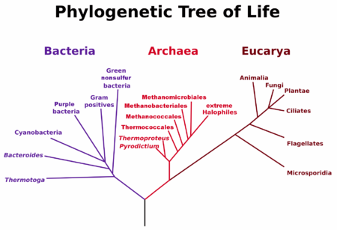
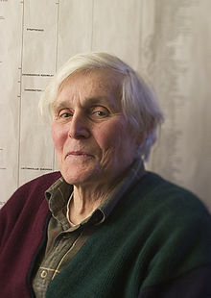

Carl Woese and The Three Domains
Evidence based on 16S ribosomal RNA (核糖体RNA) sequences from many organisms (1977)
Carl Woese
1928-2012
“Ribosomes of the three domains” in University of Illinois at Urbana-Champaign
http://www.igb.illinois.edu/news/remembering-carl-woese

Slide 10
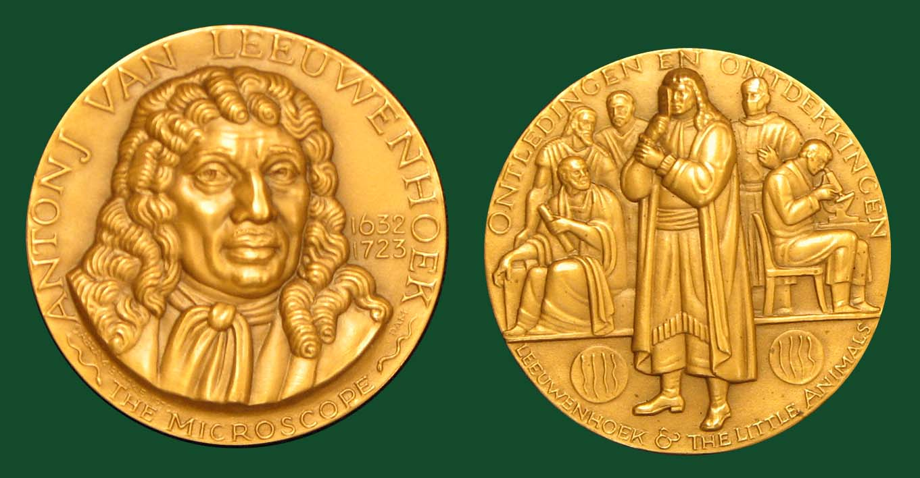
Leeuwenhoek Medal
1877 Christian Gottfried Ehrenberg, Germany
1885 Ferdinand Cohn, Germany
1895 Louis Pasteur, France
1905 Martinus Beijerinck, Netherlands
1915 Sir David Bruce, United Kingdom
1925 Félix d'Herelle, (at the time) Egypt
1935 Sergei Nikolaevitch Winogradsky, France
1950 Selman Abraham Waksman, United States
1960 André Lwoff, France
1970 Cornelius Bernardus van Niel United States
1981 Roger Yate Stanier, France
1992 Carl Woese, United States
2003 Karl Stetter, Germany
2015 Craig Venter, United States of America

Slide 11

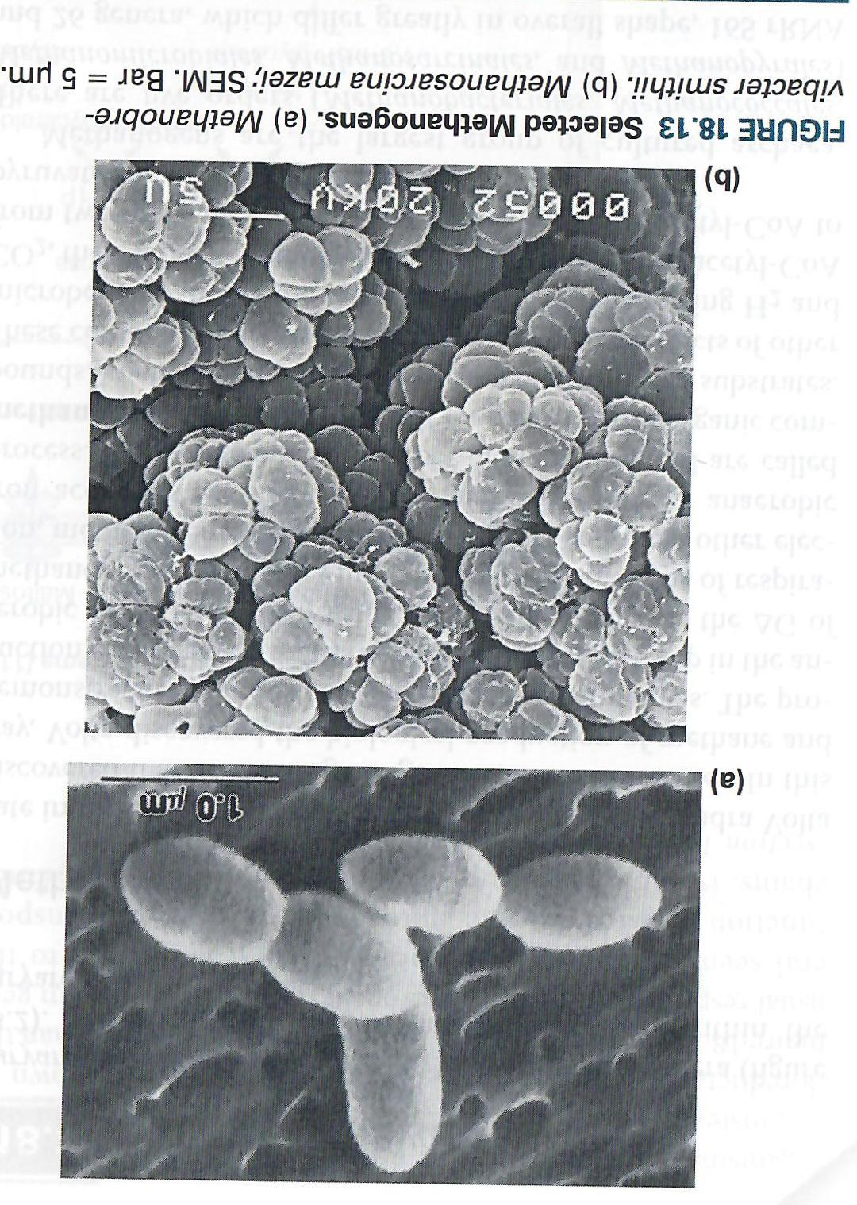
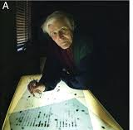
rRNA of methanogens (Archaea) lead to the discovery
"Wolfe, these things aren't even bacteria."
Ralph Wolfe
1921-
`The degree of success depends on attention to details. Assume nothing!'

Slide 12
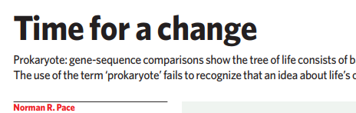
……Now all organisms sit on the well-ordered tips of branches on the universal phylogenetic tree…… (Woese, 2013)
I believe it is critical to shake loose from the prokaryote/eukaryote concept. .... Because it has long been used by all texts of biology, it is hard to stop using the word, prokaryote. But the next time you are inclined to do so, think what you teach your students: a wrong idea.

Slide 13
But why ribosomal RNA?

Slide 14
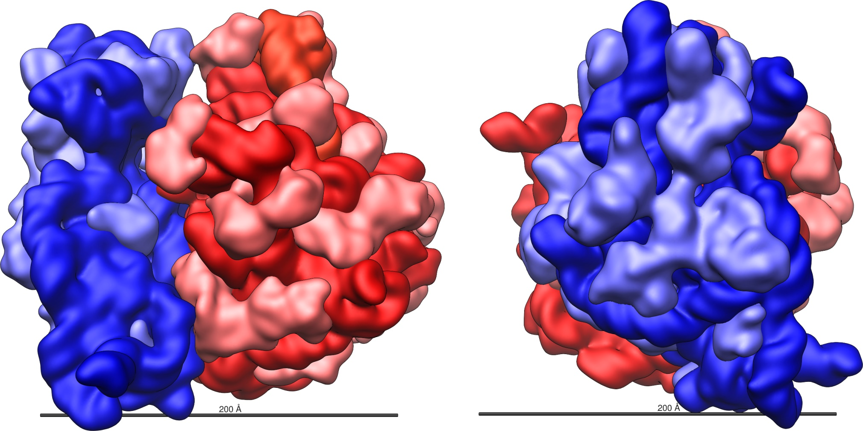
Ribosome (核糖体) of E. coli (70S)
Small subunit (30S): 16S rRNA(1540 nt) + 21 ribosomal proteins
Large subunit (50S): 23S rRNA(2900 nt) + 5S rRNA(120 nt) + 31 ribosomal proteins

Slide 15
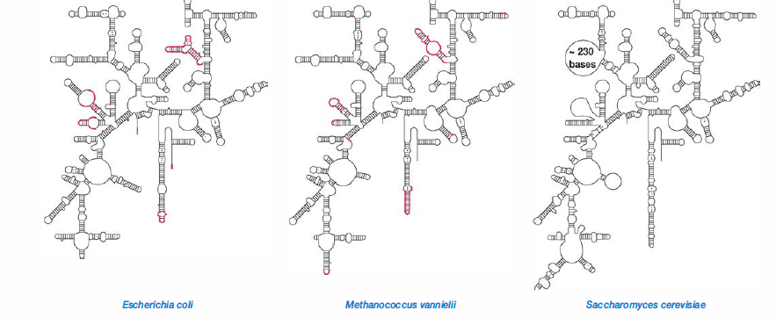
16S/18S rRNA in the three domains
Bacteria
Archaea
Eukarya

Slide 16
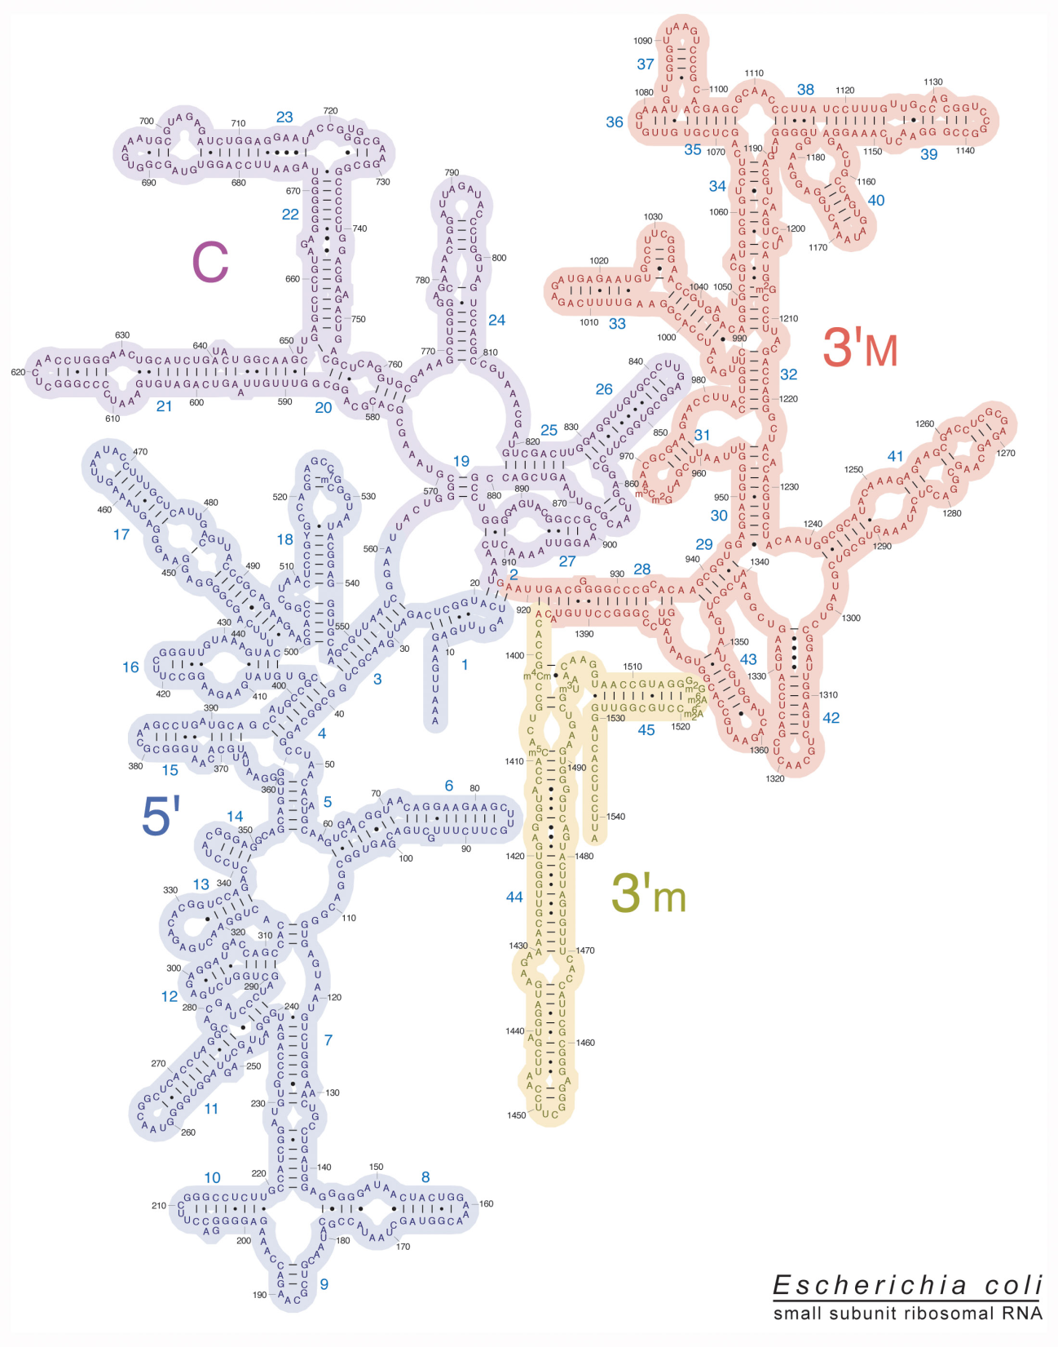
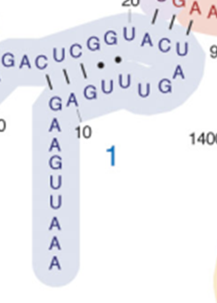
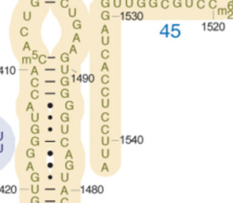
2D-structure of
16S rRNA of E. coli

Slide 17
Align the 16S rRNA sequences from the three domains
E. coli
M. vannielii

Slide 18
Why ribosomal RNA is suitable for phylogenetic analysis at domain level?
Ribosomal RNA
So
is highly conserved comparing with other genes
it is effective for organisms separated over billion of years
exist in all cellular organisms for protein synthesis
all organisms are included
shows no or very rare horizontal gene transfers
it is reliable for comparison
has high copy number in cells
it is easy to get enough molecules

Slide 19







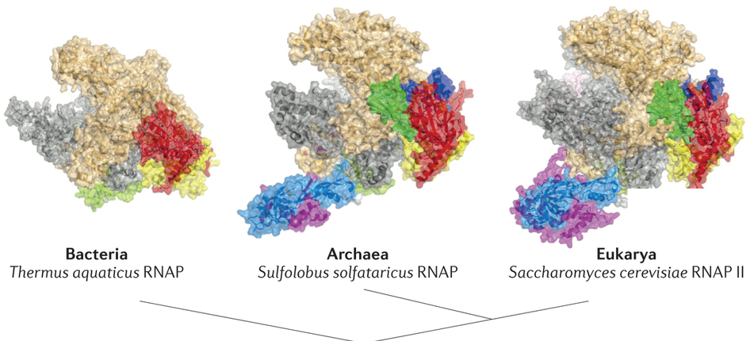









Other cell characteristics supporting the theory
Property | Bacteria | Archaea | Eukarya
Membrane Lipid | Ester-linked | Ether-linked | Ester-linked
RNA Polymerase | Simple | Complex | Complex
ester linkage
醚键
O
branched isoprene chains
H
C
O
P
O
2
C
O
C
H
O
C
O
CH
2
O
C
O
CH
2
C
O
C
H
O
O
H
2
C
O
P
O
unbranched fatty acids
O
ester linkage
酯键

Slide 20
Summary
Domain is the highest taxonomic rank for cellular organisms currently.
Using rRNA sequences lead the discovery of the theory of the three domains
Archaea is an independent domain based on both rRNA sequence and other features

Slide 21
Concepts of prokaryotic species
... I was much struck how entirely vague and arbitrary is the distinction between species and varieties.
Charles Darwin, On the Origin of Species

Slide 22
Species concepts and definitions continue to be one of the most controversial topics in biology.
The three main species concepts
Biological concept of species
Phylogenetic (系统发生) concept of species
Typological (类型学) concept of species

Slide 23

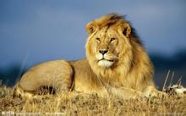

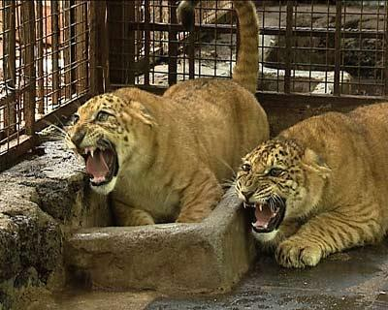
What is a biological concept of species?
In biology, a species is one of the basic units of biological classification and a taxonomic rank. A species is often defined as a group of organisms capable of interbreeding and producing fertile offspring.
Not suitable
for microorganisms!
Inter-subgenus hybridization (亚属间杂交)

Slide 24
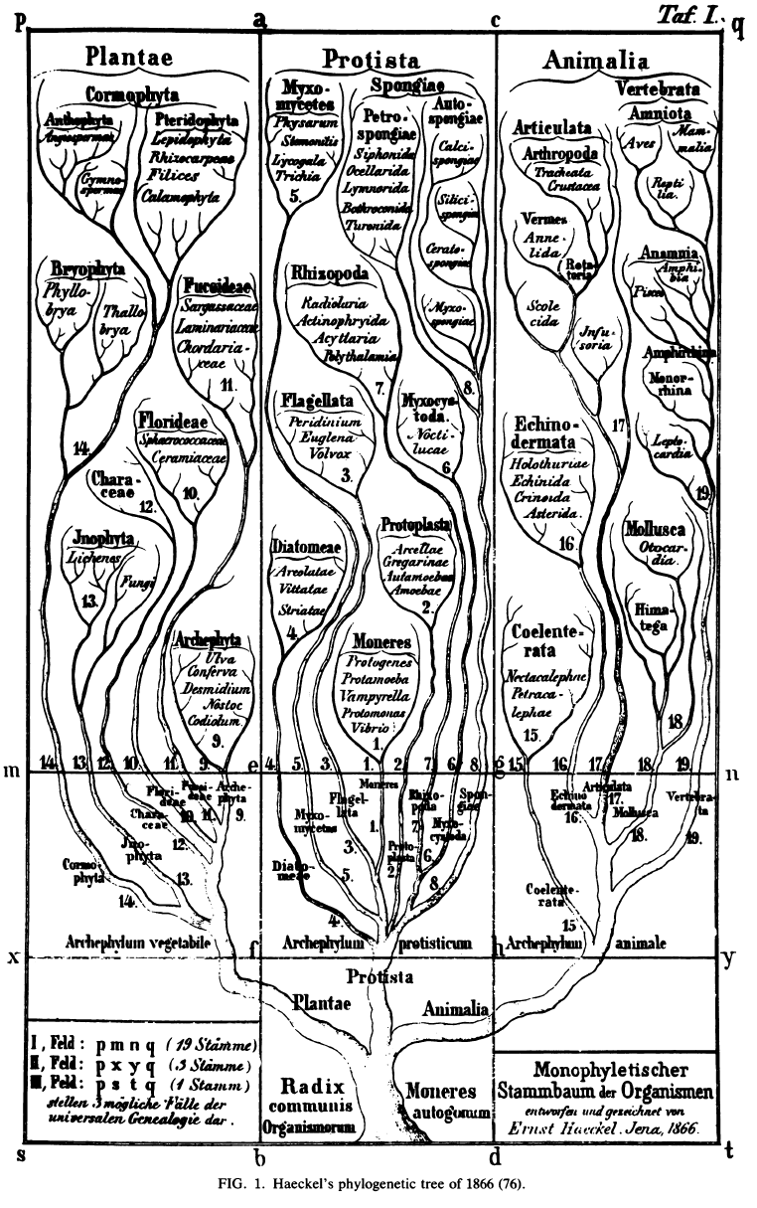
What is a phylogenetic concept of species?
Current taxonomy
Phylogeny: the evolutionary history of groups of organisms.
Time
Taxonomy at this time point

Slide 25
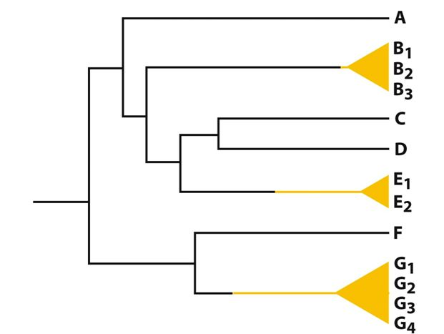
Closely related Individuals having a common ancestor are within the same species.
Seems work for micro-organisms
But how close is close?

Slide 26
What is a typological concept of species?
The concept of a species as a group whose members share certain characteristics that distinguish them from other species

Slide 27
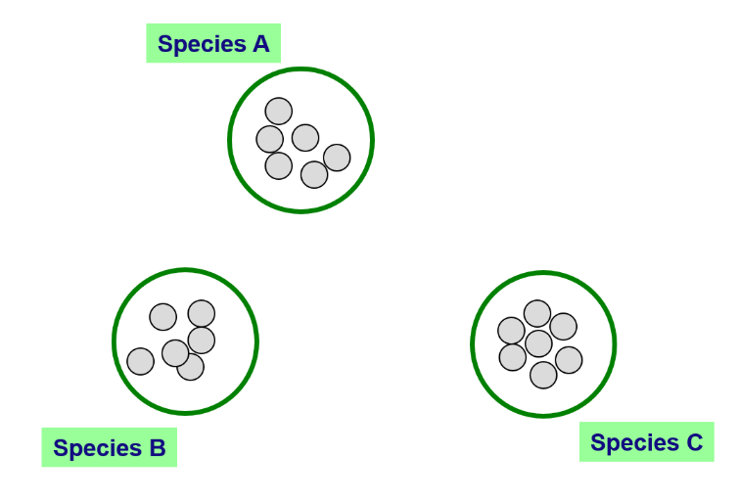
Typological concept of species
Real situation for microorganisms
Ideal situation
Type strain (模式菌株) for species identification
Species A
Boundary of species
Species B
It works for microorganisms.
Again, how to determine the boundary?
Species C
Type strain of species
Classified strains
Undiscovered strains

Slide 28
Polyphasic taxonomy
Phenetic Classification
Phylogenetic
Classification
√
Genotypic
Classification
Morphological structures;
Chemical features;
Physiological/
biochemical features;
et al.
Evolutionary relationships between organisms
Genetic similarity between organisms

Slide 29
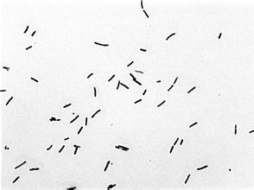
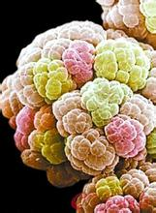
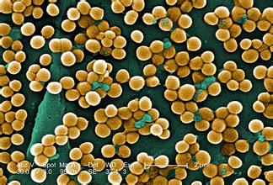
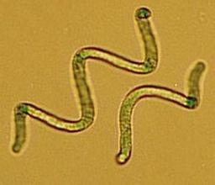
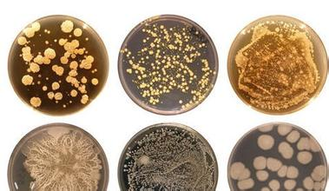
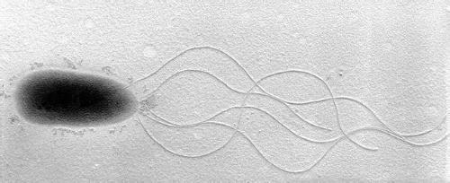
Morphology directed classification
Too simple to be correct!

Slide 30
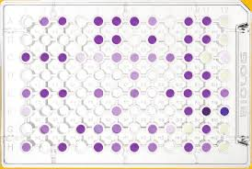
Physiological and biochemical phenotypes based classification
Utilization of various substrates
pH variation during growth (e.g., acid production)
Gas production
……
Microbial identification by the Biolog System
Phenotype: 2^{n} (n=93)
Phenotypes determined by functional genes.
Gene horizontal transfers and loss frequently happen in microbes.

Slide 31
Genomic data for
Species Classification
Genomic data contain information that can be integrated in typological and phylogenetic concepts
Genome determines what we are.
Genome records the evolution history.
DNA-DNA hybridization (DDH)
70% relatedness to a type strain as a cutoff for the species boundary. (Wayne et al., 1987)
It is still an arbitrary standard.

Slide 32
Principles of DNA-DNA hybridization
Organism A DNA (type strain)
Organism B DNA
Combine single
strands of DNA.
Determine degree
of hybridization.
Cool to allow re-naturation
of double-stranded DNA..
Complete hybridization
organisms identical.
Partial hybridization:
organisms related
No hybridization
organisms unrelated

Slide 33
Standards for classification of a microbial species (to a type strain) other than DDH
16S rRNA sequence (>97% similarity)
Phenotypic or morphological similarity
Chemical features (lipids et al.)
Polyphasic taxonomy
If using this criterion, all primates (monkey, apes and you) would be lumped together as a single species!

Slide 34
Summary
Combination of phylogenetic and typological species concepts is suitable for microbes.
Type strain is required for a established species and identification.
Genomic data is superior to phenotypic data. 70% DDH value is a golden standard for species classification.

Slide 35
Microbial diversity
Cultured & Uncultured diversity

Slide 36
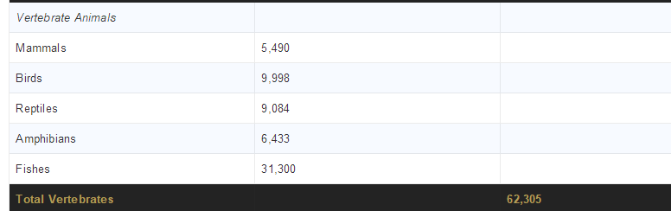
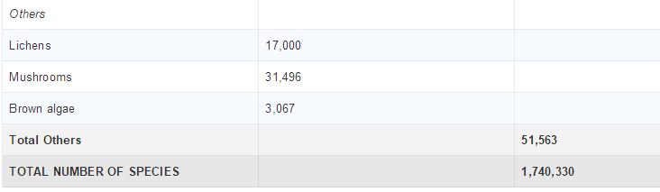
Number of Known Species (non-bacteria/-archaea) in the World

Slide 37
Number of nown bacteria/-archaea species
Total number of published names included in categories covered by the Rules and included in LPSN (as of 25 May 2017)
Rank of class: 106
Rank of order: 188
Rank of family: 399
Rank of genus: 2854
Rank of species: 15,626

Slide 38
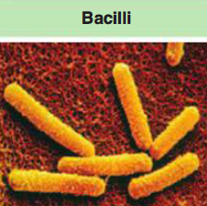
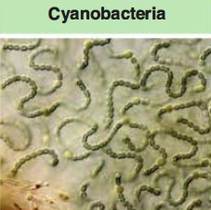
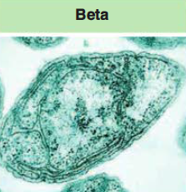
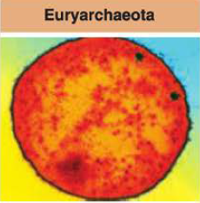
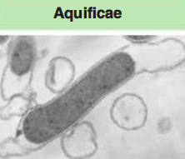
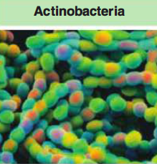
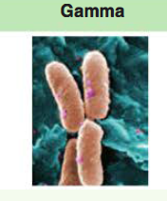
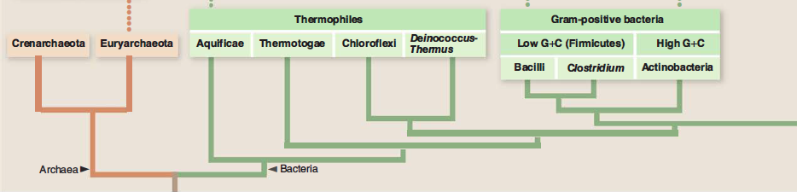
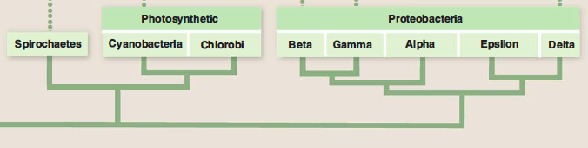
The major divisions (12 phyla) of isolated prokaryotes
泉古菌门
Crenarchaeota
极端环境
Extremophile
嗜热细菌
（4 phyla）
Deeply branched
Photosynthetic
光合细菌
Cyanobacteria蓝细菌门 (oxygenic)
Chlorobi 绿菌门
(non-oxygenic)
广古菌门
Euryarchaeota
产甲烷
Methanogens
G+ （2 phyla）
Firmicutes 厚壁菌门
(Low GC)
Actinobacteria 放线菌门
(High GC)
Proteobacteria
变形菌门
Diverse function and mostly studied

Slide 39
How many microbial species exist?
Estimated from tens of thousands to billions
The larger number might be more correct.
Most environments have not been examined.
Soil vs. Marine
Each insect species may have their unique symbiotic prokaryotes.
High proportion of microbes cannot be cultivated in lab

Slide 40
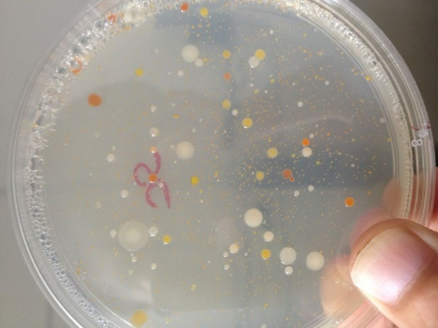
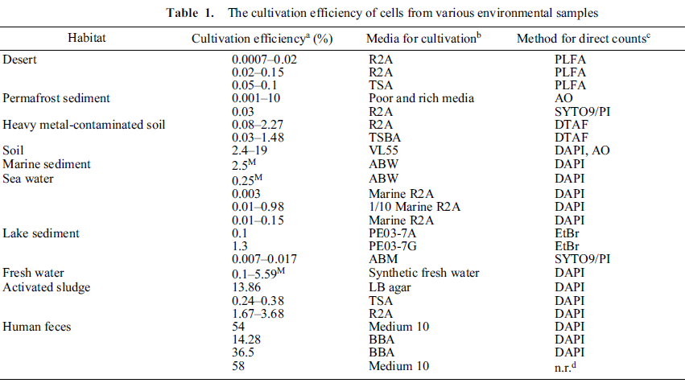
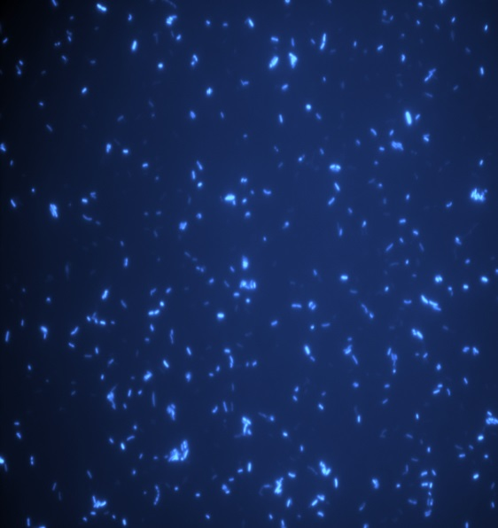
“The great plate count anomaly”—
The uncultured microorganisms
≠
Puspita et al., 2003

Slide 41
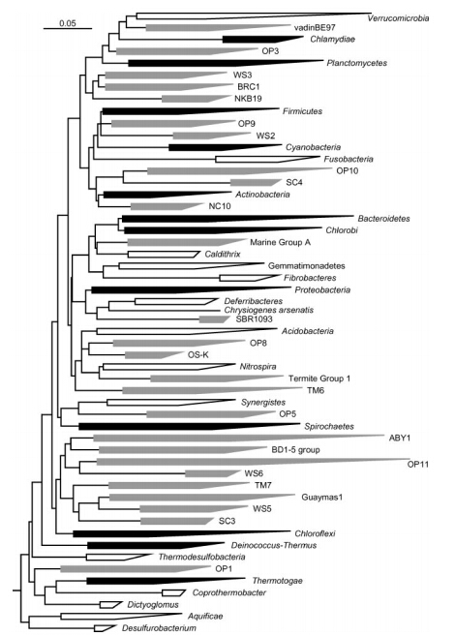
The uncultured bacterial phyla
“Uncultured” means have not been isolated in laboratory yet.
Uncultured phyla until 2003
Phyla established between 1987-2003
Phyla established before 1987
26 cultured and 26 uncultured phyla in 2003
(Rappe & Giovannoni, 2003)

Slide 42
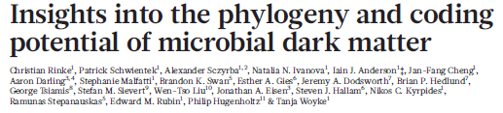
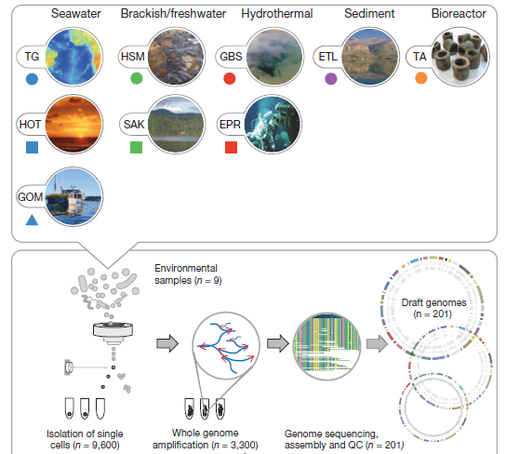
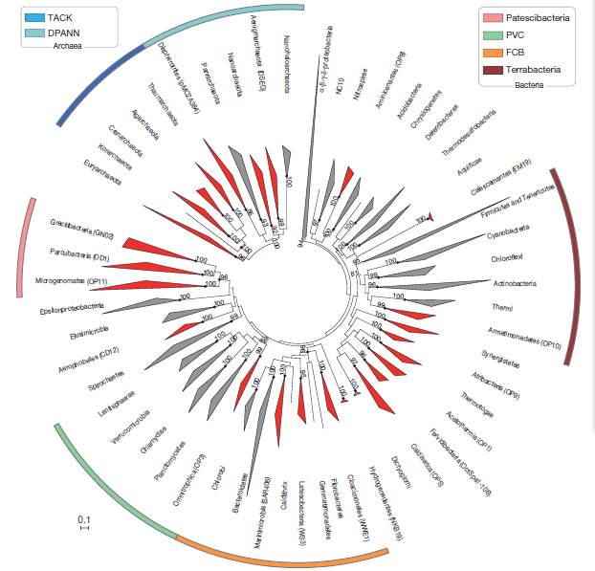
“Microbial dark matters”

Slide 43
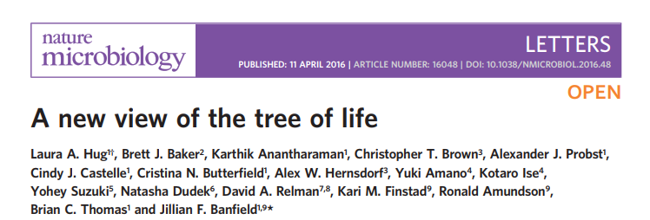
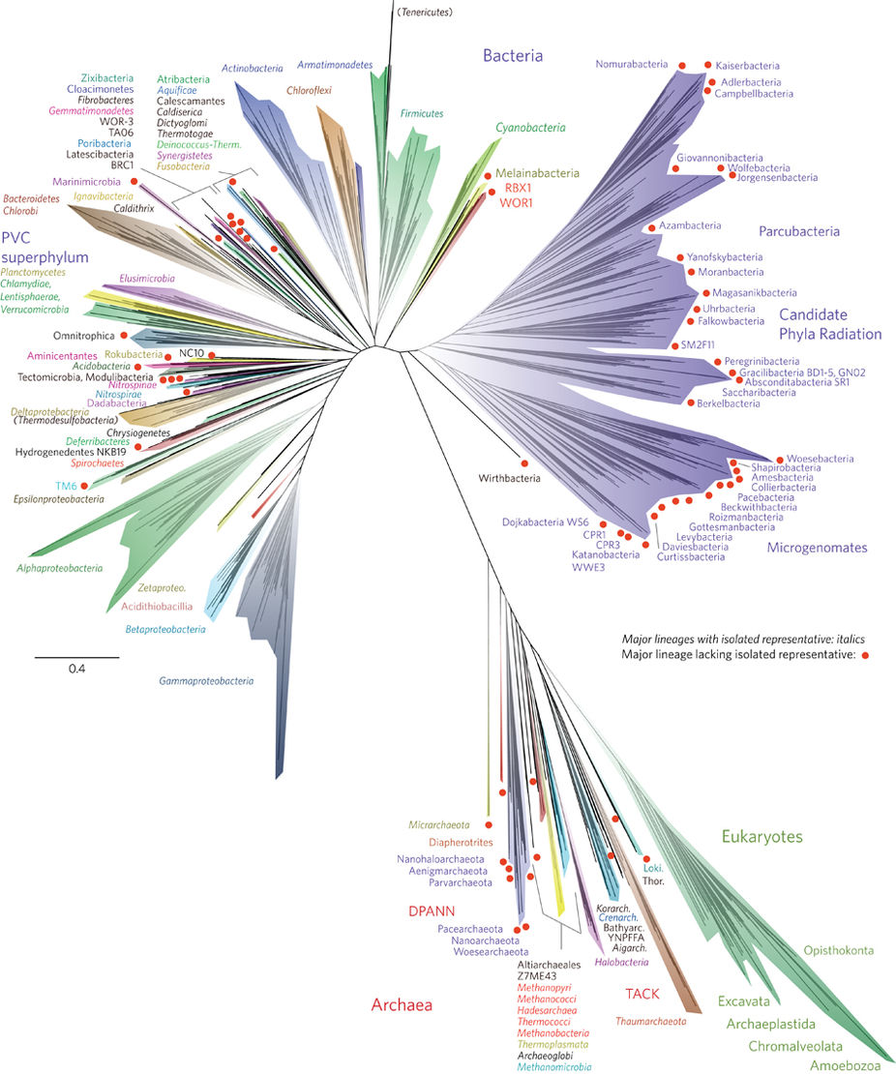
Using ribosomal proteins instead of rRNA as the biomarker
There are 55 and 13 candidatus phyla in Bacteria and Archaea, respectively

Slide 44
Summary
Diverse microorganisms has been isolated in lab and formally described.
The microbial diversity is mainly contributed the uncultivated microorganisms.

Slide 45
Microbial roles in life evolution
Nothing in Biology Makes Sense Except in the Light of Evolution. --Dobzhansky

Slide 46
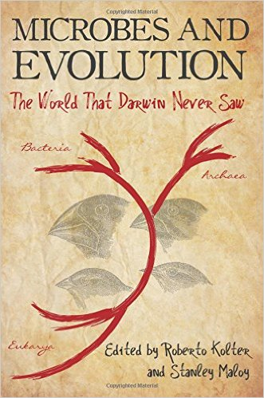


Evolution is the change in heritable traits of biological organisms over successive generations due to natural selection and other mechanisms.
From Wikipedia
Charles Darwin (1809–1882)

Slide 47




The oldest fossil
Microbes and sediments
Microbial mat (微生物垫), the living stromatolites
Stromatolites (层叠石, 3.5b year) in Hamelin Pool Marine Nature Reserve along the coast of Western Australia.

Slide 48

Fossil from 850 M years ago
The oldest fossilized cyanobacteria (3.5 b years)

Slide 49
0
Age of dinosaurs
Cambrian
“Higher”
organisms
Morphological
evolution of
metazoans
Precambrian
(＞500 million years ago)
Origin of metazoans
20%
1
10%
Life evolution and oxygen change in the history of earth
Origin of modern eukaryotes
O₂ (percent in atmosphere)
Development of ozone shield
ime before present(billions of years)
1%
2
Oxygenated environment
Era of microbial life
0.1%
T
races of earliest eukaryotes
Oxic
3
Origin of oxygenic
T
phototrophs(cyanobacteria)
Archaea
Nuclear
line
First
phototrophic
bacteria
Bacteria
Great Oxygenation Event 大氧化事件
4
Origin of life
Chemical
evolution
Prebiotic synthesis
of biomolecules
Anoxic
Formation of the earth
(~4.6 X 10 years before the present)

Slide 50

The origin of oxygen
Most researchers agree that the redox state of the environment evolved through at least three stages, with major oxygenation events occurring ~2.4 billion to 1.8 billion years ago and 800 million to 500 million years ago.
2.4
Changes in element abundances through time.

Slide 51
The biggest evolutionary question: What is the original life?
“The origin of life is a scientific problem which is not yet solved. There are plenty of ideas, but few clear facts.” From Wikipedia
RNA world hypothesis

Slide 52





Liposome
RNA
Probiont: RNA only
Probiont: RNA and proteins
Genetic Central Dogma
遗传中心法则
Evidences:
RNA can replicate itself
RNA can direct protein synthesis
Discovery of ribozyme
ATP is a ribonucleotide
RNA can regulate gene expression
Cellular life: RNA,DNA and proteins
The RNA World Hypothesis for the Origin of Life

Slide 53



































The first eukaryotic cell was from?
Microbial role in the evolution of the eukaryotic cell
Fusion
Engulfment
Archaeal cell
Bacterial
cell
Cell fusion
细胞融合
Endosymbiosis
内共生

Slide 54







Emergency of mitochondria and chloroplast: Endosymbiosis theory (内共生假说)
Plants and algae
(contain mitochondria
and chloroplasts)
Animals,fungi,and protists
(contain mitochondria)
Evidences:
1. Like bacteria, most mitochondria and chloroplasts have a single, circular chromosome and undergo binary fission
2. The size of mitochondria and chloroplasts is similar to a typical bacteria.
3. Mitochondria and chloroplasts have 70S, not 80S ribosomes.
4. Like microbial cytoplasmic membrane, inner membrane of mitochondria is the only place of electronic transport chain in eukaryotes
0
Evolution
Primordial
eukaryotic
cells
Evolution
Billions of years ago (bya)
1
Cyanobacteria.
α-proteobacterium
2
Mitochondria originated
from endosymbiotic
α-proteobacteria.
(b) Chloroplasts originated
from endosymbiotic
cyanobacteria.

Slide 55
Summary
Microbe evolves throughout the history of life.
Microbes (e.g., Cyanobacteria) transformed the atmosphere of the earth, which facilitated the evolution of higher organisms.
The supporting evidences for RNA world & endosymbiosis theory

Slide 56
The last homework
Some people even do not believe that prokaryotic species are truly exist. What’s your opinion on this? Wish you can give considerations on both sides.
Give your suggestions to improve the cultivability of the uncultured bacteria.

Slide 57
Discussion (suggest using PPT)
Consider the finding that bacteria capable of anoxygenic photosynthesis belong to several different phylogenetic lineages. How do you think these bacteria were originally classified, and what types of data do you think were key in making the most recent taxonomic assignments?
What is the G + C content of DNA, and how can it be determined? Why is it not safe to assume that two microorganisms with the same G + C content belong to the same species? In what ways are G + C content data taxonomically valuable?
Introducing a so-far uncultivated microorganism with significant function or role in earth ecosystems.
Introducing rRNA-based fluorescence in situ hybridization (FISH) technology to classmates. Why it is so useful in microbial ecology?
Introducing the concept of OTU (operational taxonomic unit) to your classmates. Why researchers define OTU as taxon in their studies.
For a bacterial isolate, how could you obtain its 16S rRNA gene sequences and conduct taxonomic identification? Please give details as much as possible.

