Slide 1

MICROBIOLOGY
Lecture 22
Microbial Ecology & Applied Microbiology

Slide 2
Outline
Microorganisms in different environments
Microbial carbon and nitrogen cycles
Food microbiology
Biotechnology and industrial microbiology
Applied environmental microbiology

Slide 3
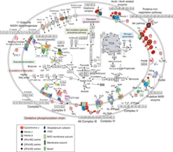
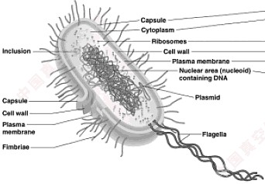
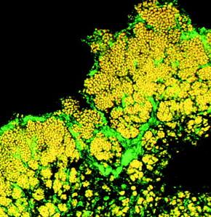
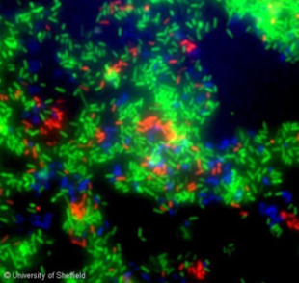
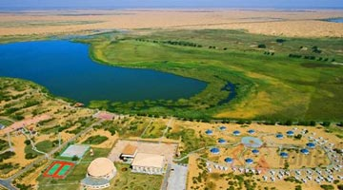
Microbial Ecology
Microbial Ecology： Study of the interrelationships among microorganisms and the environment.
Adaption and changing
Microbes
Environments
Selection
Molecular
Individual
Population
Community
Ecosystem

Slide 4
Questions in microbial ecology
Who does what in where/when?

Slide 5
Microorganisms in different environments
Soil (Nitrogen fixation)
Water (Microbial loop)
Human Microbiome (healthy)

Slide 6
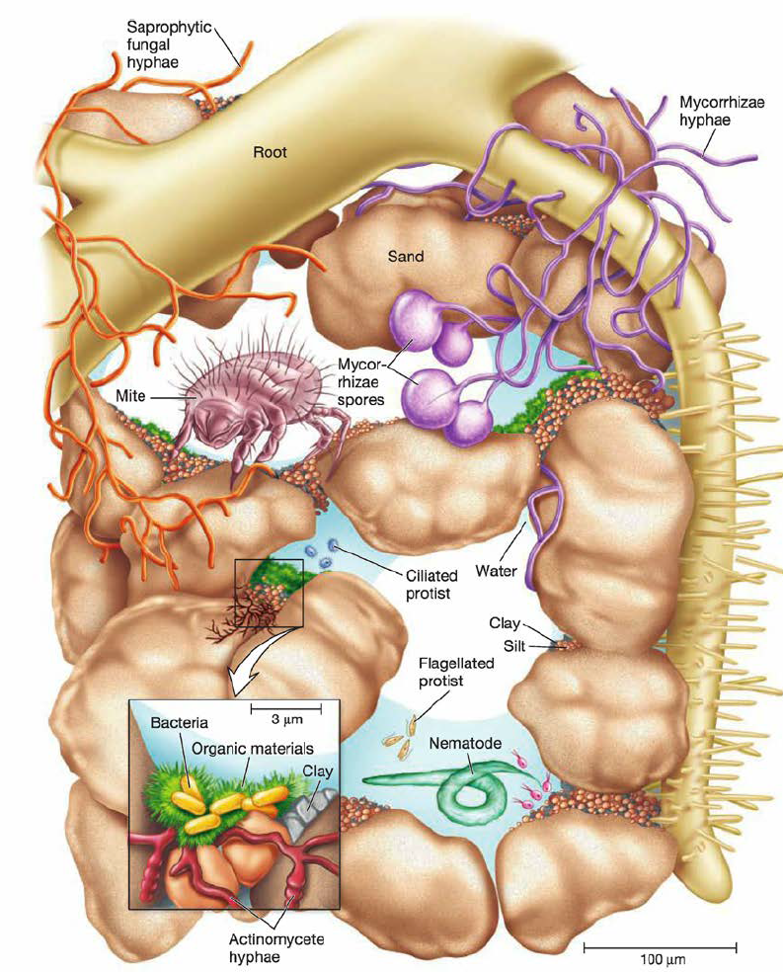
Soil microorganisms
4×10⁷ g⁻¹ in forest soil
2×10⁹ g⁻¹ in cultivated soil
2,000 to 18,000 species per gram
Rhizosphere (根际空间)
The rhizosphere is the narrow region of soil that is directly influenced by root secretions and associated soil microorganisms

Slide 7
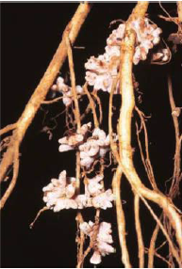
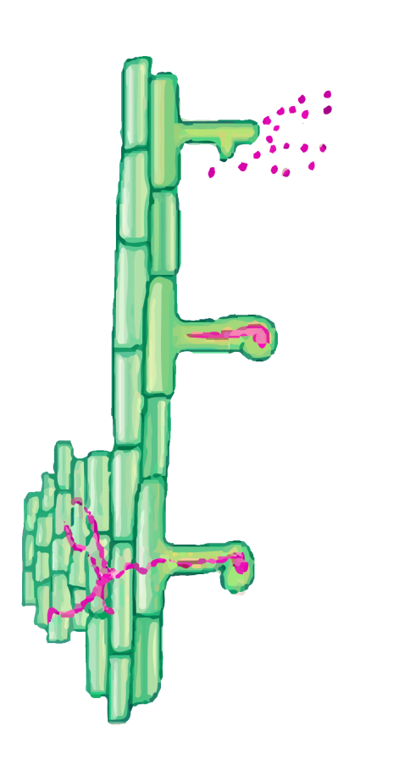

Nitrogen fixation in nodule (Rhizobia)
Nod factor-induced
nodulation
Root hair cell
Rhizobia
Nod factor
Nodule
formation
Infection thread
Entrapped rhizobia
(signaling center)

Slide 8
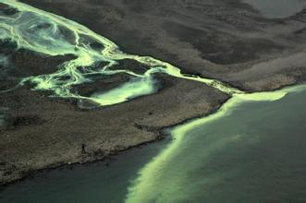
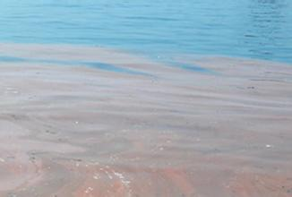
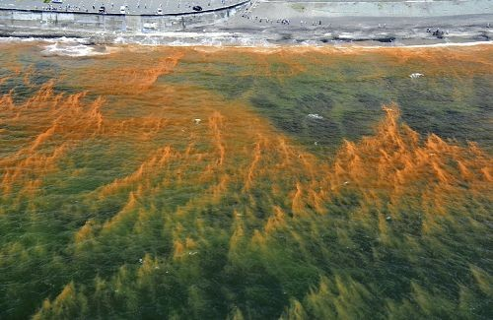
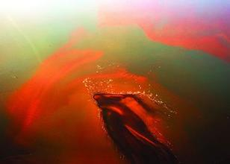
Microorganisms in Marine and Freshwater
Ecosystems
10⁴-10⁶ ml⁻¹ in typical seawater and freshwater.
Cyanobacteria in seawater contribute around half of the primary production (初级生产力).
“Algae” blooming (水华)
Red tide 赤潮

Slide 9
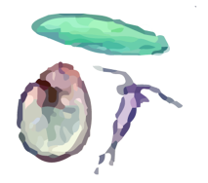

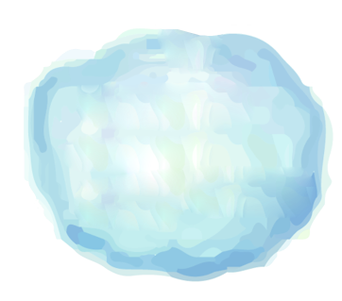



Marine food web and microbial loop (微食物环)
T
ertiary consumers
(fish that eat fish)
Secondary consumers
Traditional food chain
Primary consumers
(heibivores;zooplankton)
Primary producers
(phytoplankton,
cyanobacteria)
Ciliates
Chemoorganotropgic
protists
Microbial loop
Dissolved
organic
matter(DOM)
Bacteria
V
iruses

Slide 10
Human Microbiome
Hair
Actinobacteria＞Firmicutes＞Proteobacteria
External Auditory Canal
Mouth
Firmicutes ＞ Actinobacteria＞
Proteobacteria
Firmicutes ＞Proteobacteria＞
Bacteroidetes＞Actinobacteria＞Fusobacteria
Axlllary Vault
Manubrlum
Firmicutes ＞Proteobacteria
Bacteroidetes＞Actinobacteria
Actinobacteria ＞Firmicutes
Antecubltal Fossa
Glutael Crease
Proteobacteria ＞Firmicutes＞
Bacteroidetes＞Actinobacteria
Actinobacteria ＞Firmicutes
Ingulnal Fold
Gastrolntestlnal Tract
Actinobacteria ＞Firmicutes
Firmicutes ＞Bacteroidetes＞Proteobacteria
Penis
Vagina
Proteobacteria ＞Firmicutes＞
Bacteroidetes＞Actinobacteria＞Fusobacteria
Firmicutes ＞Proteobacteria＞
Actinobacteria＞Fusobacteria＞Bacteroidetes

Slide 11
About Human Microbiome
Microbiome has been called the second genome of human.
Microbial cells are comparable to human cells (～10¹³ cells per person)
Gene from microbes are 3,000,000 (?) comparing with 30,000 of human genome
Microbiome are involved in human health in many ways

Slide 12
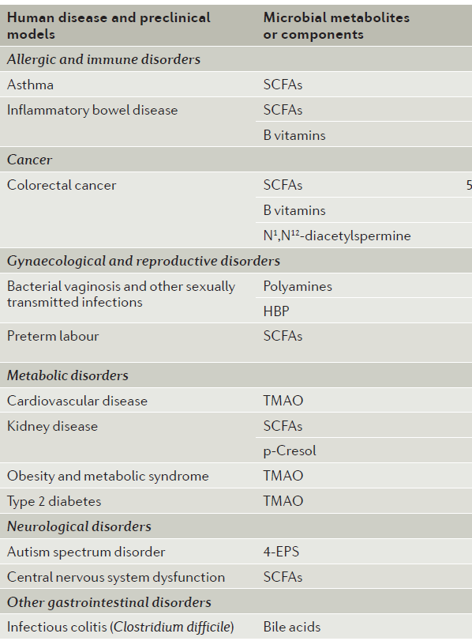
Microbial metabolites or components that are implicated in disease
Rooks and Garrett, 2016

Slide 13
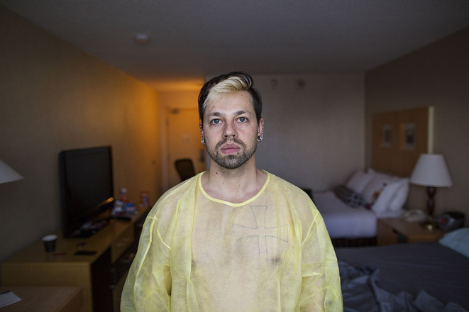
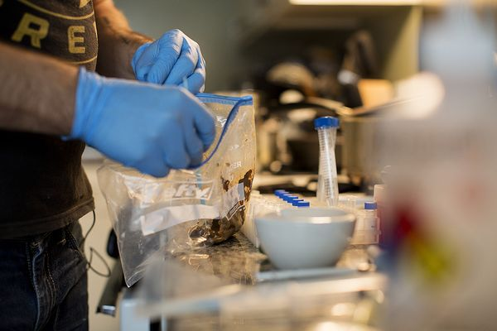

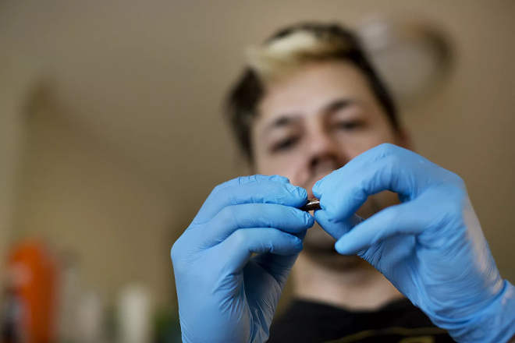

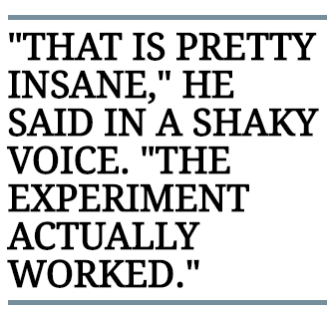
Catherine Duff
Clostridium difficile (艰难梭菌) infection
The Fecal Transplant Foundation
Josiah Zayner
A BITTER PILL

Slide 14

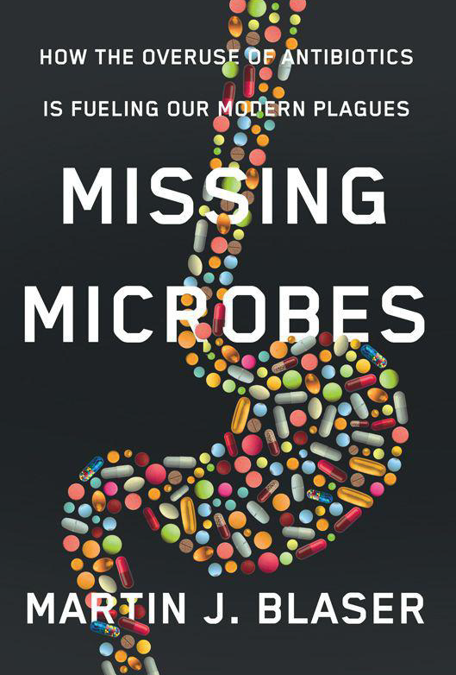
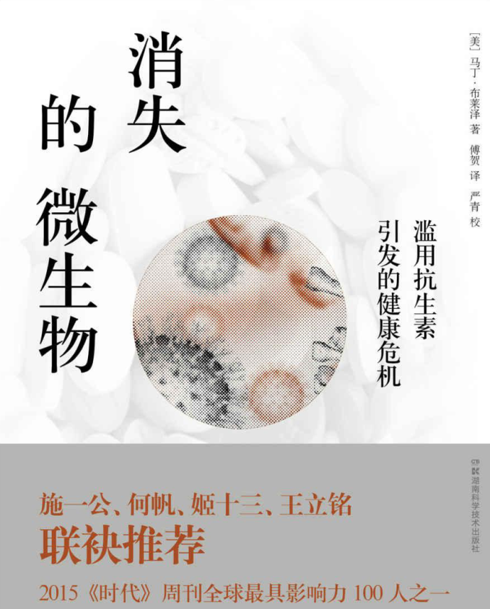
The Missing Microorganisms
Dr. Martin Blaser

Slide 15
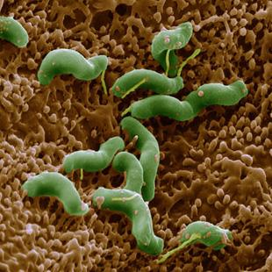
“双面共生”（amphibiosis）
发达国家感染率低
与胃癌成正相关（概率大六倍）
人际传播/易在儿童阶段获得
“幽门螺杆菌的消失已经导致了一种新的环境——古老的平衡被打破了，免疫、激素与胃酸之间的调控紊乱”
与胃灼热、哮喘等疾病负相关
Helicobacter pylori
一级致癌物

Slide 16
Microbial carbon and nitrogen cycles

Slide 17
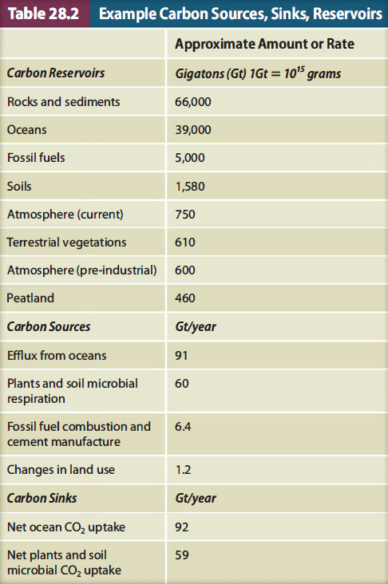
Carbon sources (源), sinks (汇) and reservoirs (库)
Carbon emission trading
碳排放交易

Slide 18

Carbon cycling
Autotrophs
Methano-and
methylotroph
Reductive
Oxidative
Organic
matter
CO
CH4
2
Respiration and
fermentation
Reductive
Heterotrophs
Methanogens
The Microbial Carbon Cycle

Slide 19
Nitrogen cycling
Denitrification
The Microbial Nitrogen Cycle

Slide 20

Microbial processes in N cycle
Nitrogen fixation (固氮)
Nitrogen fixation bacteria
Soil, natural water systems and so on.
Ammonia oxidization bacteria/archaea (AOB/AOA)
Seawater (including deep sea), soil, wastewater
Ammonia oxidization (氨氧化)
Nitrification (硝化)
Nitrifying bacteria (NOB)
Seawater (including deep sea), soil, wastewater
Denitrification (脱氮/反硝化)
Denitrifier (bacteria)
Seawater (including deep sea), soil, wastewater
Anammox (full name? 厌氧氨氧化)
Planctomycetes (浮霉菌门bacteria)
Sediment, wastewater

Slide 21
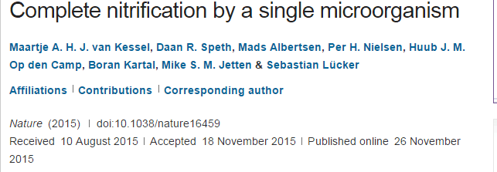

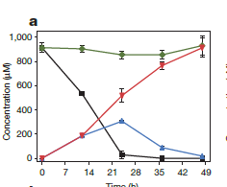
Comamox

Slide 22
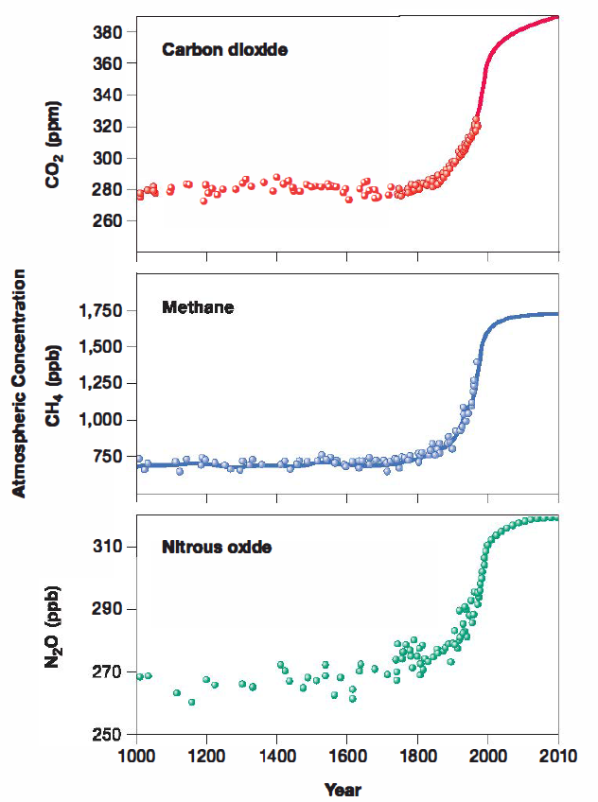
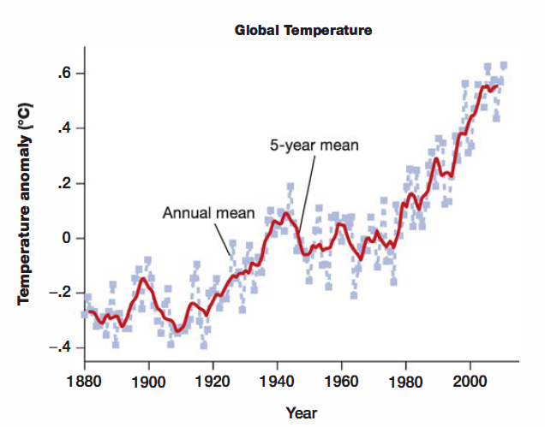
The green house gases
温室气体当量
1
25
～300

Slide 23
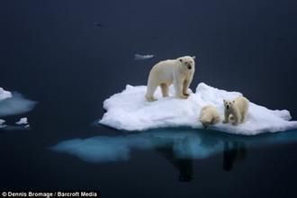
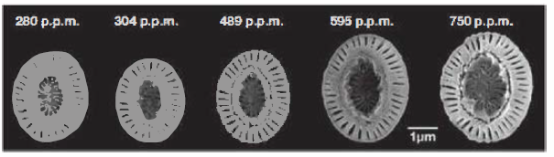
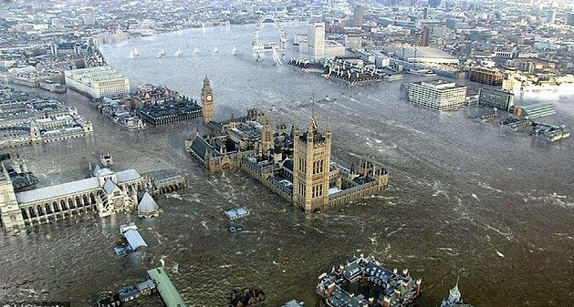
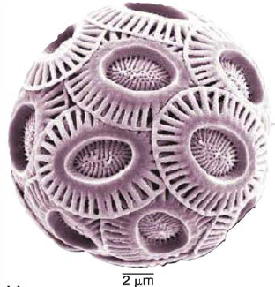
Impacts of greenhouse gases and climate change
glacier ablation
(冰川消融 )
Sea level rise
(海平面上升)
Ocean acidification
（海洋酸化）
Emiliania huxleyi

Slide 24
Microorganisms & greenhouse gases
CO₂: (heterotrophs; autotrophs)
CH₄: (Methanogens; Methano-and methylotroph)
N₂O: (Denitrifiers)

Slide 25
Food Microbiology
Food spoilage
Typical food production by microorganisms

Slide 26
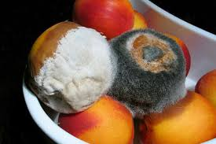
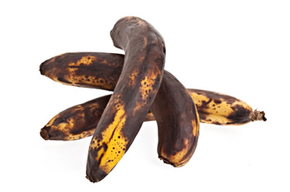
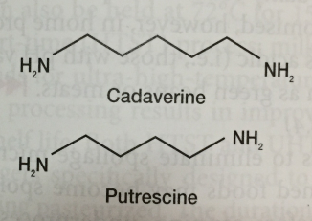
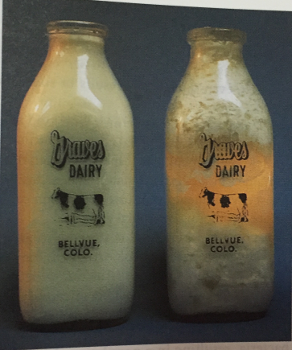
Food spoilage
Moulds (霉菌)
尸胺
Lactococcus
腐胺

Slide 27
Controlling food spoilage
Temperature (low and high T)
Listeria (李斯特菌) can grow below 10ºC
Chemical based preservation
Benzoate (苯甲酸盐,0.1%); Nitrite (亚硝酸盐, 120ppm)
Microbial product-based inhibition
Bacteriocins (细菌素 produced by closely related bacteria)
Bacteriophages

Slide 28
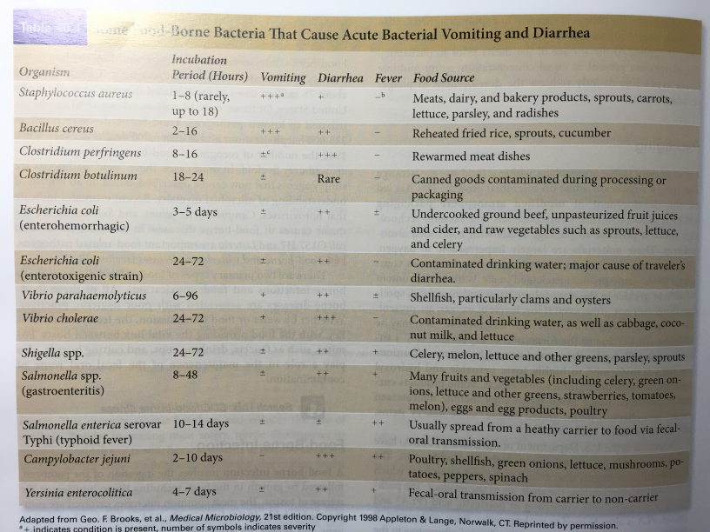
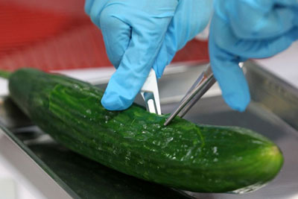
Main food pathogens
蜡状芽胞杆菌
大肠杆菌 O104：H4
产气荚膜梭菌
肠出血型大肠杆菌
肠毒素型大肠杆菌
霍乱弧菌
志贺氏菌

Slide 29
Microbial food
Alcohols
Fermented milk
Bean products
Fermented vegetables/fruits
Flavoring 调料

Slide 30
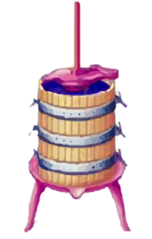


Fermentation of different foods
Processing step
Biological change
Grape pressing
Sterilization
Yeast addition
Elimination of contaminats
Addition of desired organisms
Fermentation
Alcohol production from sugars
Excess yeast
Setting vat
Malolactic fermentation
Excess yeast
Aging
Possible racking
Bottling

Slide 31
Fermented Milks
Type | Temperature ºC | Microorganism | Raw material | Product
Mesophilic fermentations | 20 to 30 | Lactobacillus spp. and Lactococcus lactis 乳酸乳球菌 | Skim milk (脱脂乳) Cream (奶油) | Buttermilk (酪乳) Sour cream (酸奶油)
Thermophilic fermentations | 45 | Streptococcus Salivarius 唾液链球菌 Lactobacillus delbrueckii | low-fat milk | Yogurt
Yeast -Lactic fermentation | ambient temperature | yeasts, lactic acid bacteria and acetic acid bacteria | Raw milk | Kefir 酸乳酒

Slide 32
Probiotics (益生菌)
FAO-WHO:
“live microorganisms, which, when administered in adequate amounts, confer a health benefit to the host”
Lactobacillus (乳酸杆菌) & Bifidobacterium (双歧杆菌)

Slide 33
Biotechnology and industrial microbiology

Slide 34
Major Products of Industrial
Microbiology
Antibiotics (Drugs, what taxa?)
Amino Acids (nutritional supplements, food, How?)
Organic Acids (preservatives防腐, food)
Biopolymers (gelling, food&pharmacy)
Biosurfactants (multi-functions, glycolipids)
Biocatalysts (enzymes, chemicals&pharmacy)
Vaccines
Biofuel

Slide 35
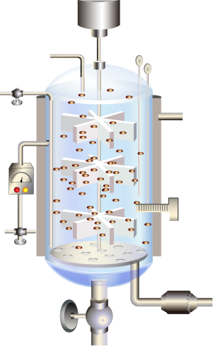
Industrial fermentation
Motor
Culture or
nutrient addition
pH probe
Dissolved oxygen
probe
Sample
line
Valve
Cooling
water out
Impellers
Temperature
sensor and
control unit
Cooling
jacket
Biosensor
unit
Cooling
water in
Control:
Temperature
pH
Dissolve oxygen
Stirring
Nutrient addition
etc.
Valve
Air in
Valve
Harvest
line
Air ifilter
.

Slide 36
100
Glucose
feeding
1.45 g/liter-hour
1.31
1.15
90
Nitrogen
feeding
18 mg/liter-hour
80
Penicillin Fermentation
70
Lactose
60
1
Penicillin
50
Biomass(g/liter),carbohydrate,ammonls,
The synthesis of penicillin begins when nitrogen from
ammonia becomes limiting.
40
penicilline (g/liter X 10 )
Biomass
30
20
10
Ammonia
0
0
20
40
60
80
100
120
140
Fermentation time(hours)

Slide 37
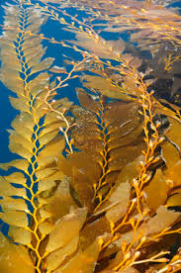
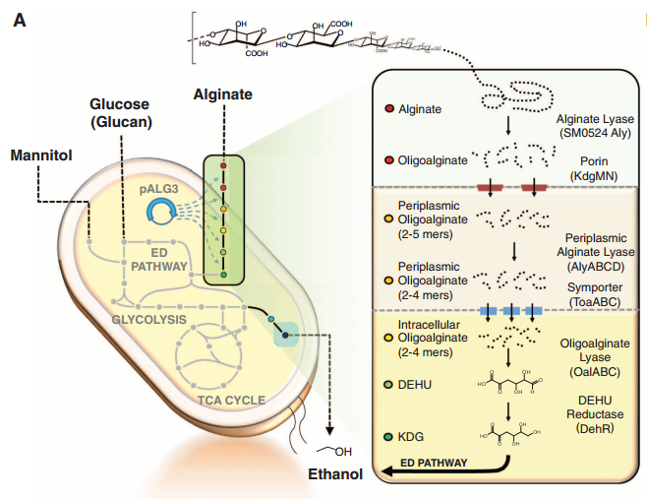
From alginate to ethanol
Wargacki et al., 2012

Slide 38
Applied environmental microbiology
How to apply microbiology to solve environmental problems?

Slide 39
Examples for applied environmental microbiology
Water sanitary analysis
Wastewater treatment

Slide 40
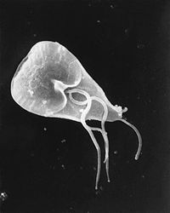
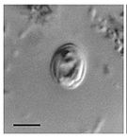
Water purification and sanitary analysis
Two protozoa
Giardia贾第鞭毛虫
Cryptosporidium隐孢子虫
Bacteriological standards
Total bacterial number < 100 CFU/mL
Total coliform group <3 CFU per 100mL
Total fecal coliform (not detected)
Legionella spp. (?)

Slide 41
Water sample
Coliform bacteria ferment lactose with the production of acid and gas when incubated at 35-37ºC
Presumptive
10
10
10
10
10
1.0
1.0
1.0
1.0
1.0
0.1
0.1
0.1
0.1
0.1
( m
L
)
( m
L
)
( m
L
)
Lactose or LST medium
Negative presumptive.
The absence of gas in
broth tubes indicates
coliforms are absent.
Incubate an additional
24 hours to be sure.
24 2 hours
After 24 hours of incubation,the tubes of lactose broth are examined for gas production.
35
℃
Negative
Positive
MPN counting
Confirmed
All positive presumptive cultures are
inoculated into tubes of brilliant green
lactose bile broth.
Positive
Plates of Levine EMB agar are
streaked from positive tubes and
Incubated at 35℃ for 24+2houes.
’
Completed
Brilliant green
lactose bile
brothor lauryi
tryptose broth
After 24 hours of incubation,make a
Gram-stained slide from the slant.
If the bacteria are Gram-negative
nonsporing rods and produce gas from
lactose,the completed test is positive.
Nutrient agar slant

Slide 42
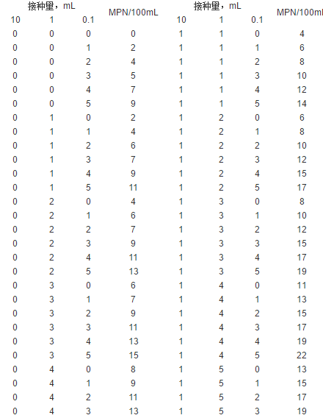
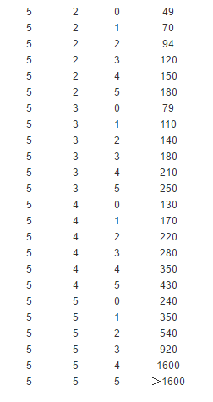
MPN (most probable number) table for E. coli test

Slide 43
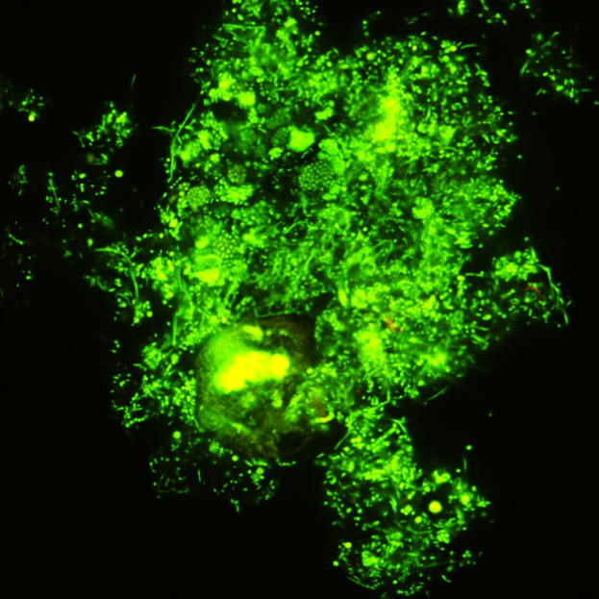

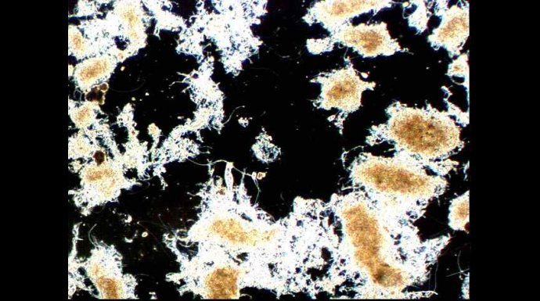

Wastewater treatment
water from primary clarifier
Mixers for aeration
Aeration basin
Organic matter processing
Final clarifier
by suspended biomass
Treated
Water
release
Activated sludge biomass return
Sludge
Waste
sludge to
disposal

Slide 44
Microbiology in biological wastewater treatment
Nitrogen
AOB,NOB and denitrifier
Inorganic
pollutants
Phosphorus
PAOs
GAOs
Competition
Heavy
Metal
Metal oxidizing bacteria
Biosorption
Influent
进水
Many heterotrophic bacteria
Hydrolyser
Fermentor
Carbohydrate
Organic
pollutants
Protein
Lipid
POPs
Special degraders
Bulking
Filamentous bacteria
Operational
problems
Foaming
Hydrophobic cells
Effluent
出水
Hygiene
Human pathogen

Slide 45
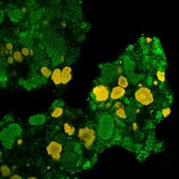
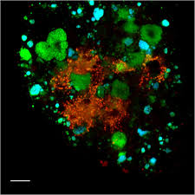
Fluorescence in situ hybridization (FISH) for AOB and NOB in activated sludge
AOB in yellow color
NOB in cyan color

Slide 46
The End?
Thanks

Slide 47
Discussion
What is the difference between assimilatory nitrate reduction and denitrification? Which reaction is performed by many microbes, and which is a more specialized metabolic capability?
Describe the buffering system that regulates the pH of seawater. What might be the implications of this stable buffering on microbial evolution? You may also talk about acidification of the ocean.
Introducing the concept of “enterotype” to classmates.
Why ANAMMOX bacteria is so promising for nitrogen removal in sewage treatment that many engineers wants to set up ANAMMOX processing in full-scale wastewater treatment plants?
Introducing probiotics, prebiotics and synbiotics to classmates.
Compare TOC, COD, and BOD: how are these similar and different?
*Select one from all discussion topics in the course of Microbiology. Presenting it by using PPT and send your PPT file to the TA.(for those who have not participated the discussion yet)

