Slide 1
Lecuture 1
Introduction to Microbiology
Microbiology

Slide 2




Lecturers of microbiology
张连茹
田蕴
袁晶
郭峰

Slide 3
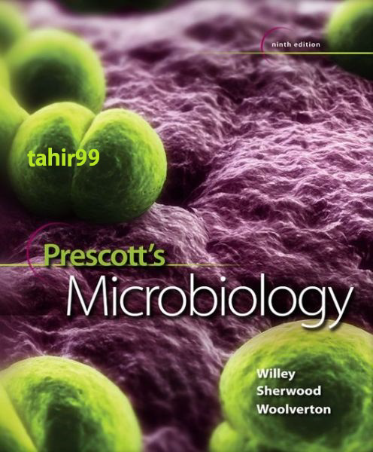
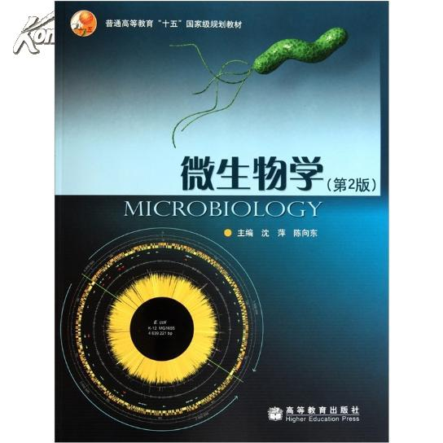
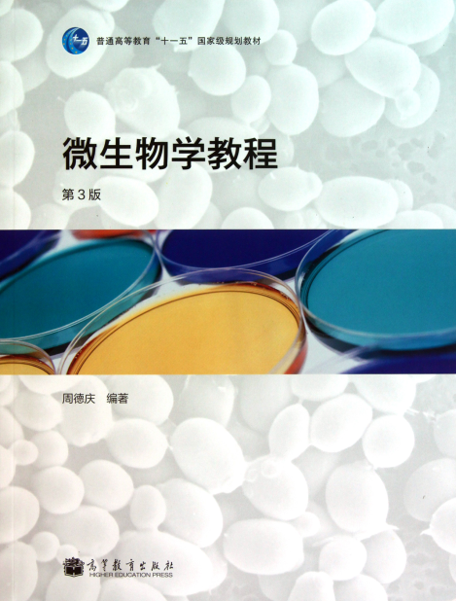
Textbook and reference books

Slide 4
Outline for this course
Brief introduction to microbiology (2, GF)
General structure of bacteria, archaea, fungi and acellular microbes (10, ZLR)
Microbial nutrition, growth and control (6, GF)
Mid-term examination
4. Microbial metabolism (10, TY)
5. Microbial molecular biology and genetics (12, YJ)
6. The diversity of the microbial world (3, GF)
7. Microbial ecology and applied microbiology (3, GF)
Final examination

Slide 5
Final score
4-6 topics each time
5-8 min per topic
Be well prepared!
课堂讨论
10%
Metabolism
Genetics
Diversity, ecology and applications
期末考 35%
考勤与作业
15%
Keys to score>=60!!
MOOC成绩
15%
期中考 25%
Introduction
Structure
Nutrition and control
重修同学的最终成绩只由期中考和期末考决定，
（下载ppt自学，强烈建议学习MOOC）

Slide 6
讨论形式
负责讨论同学的顺序根据学号
课前准备（提前下载ppt，最后一页提供讨论题和负责同学学号）
讨论环节包括负责同学陈述观点和其他人提问，负责同学回答
教师打分记录

Slide 7
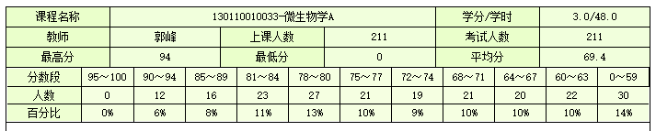
2016年期末成绩

Slide 8
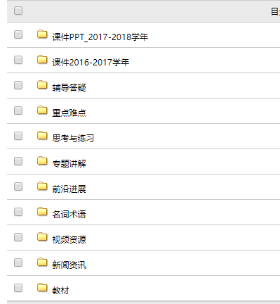
Course平台
教材下载/每次课程PPT预习
明确下堂课负责讨论题的同学(预习与搜集资料)
其他资源
http://course.xmu.edu.cn/

Slide 9
如何加入MOOC/SPOC

Slide 10

1.登录与身份认证
登录爱课程（www.icourses.cn）， 点击“学校云”，输入“厦门大学”并点击进入。

Slide 11


点击“学生入口”——点击“学生认证”

Slide 12
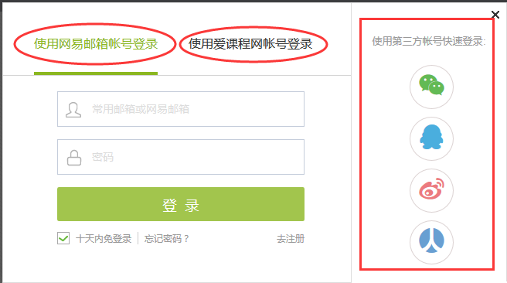
平台支持多种账号登录方式，可以选择注册账户登录或者直接使用第三方账号登录。
注意：
1.如果没有注册账号，建议使用第三方账号登录方式。
2.务必记住本次进入的方式，身份认证后，只能以该方式登录学习本校的专属课程。

Slide 13
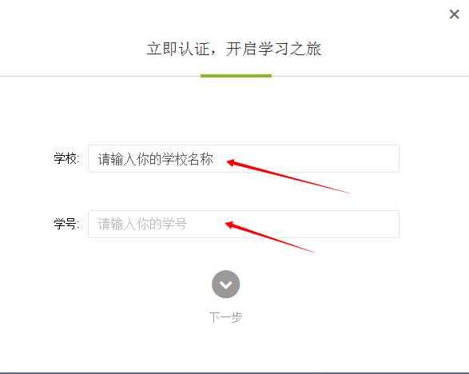
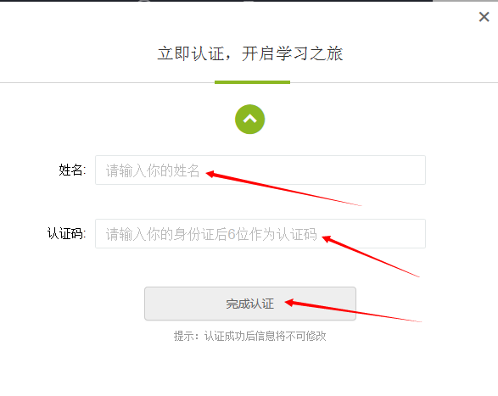
登录后，进行身份认证(后台认证，需提前提供学号/姓名/身份证后六位信息)：

Slide 14
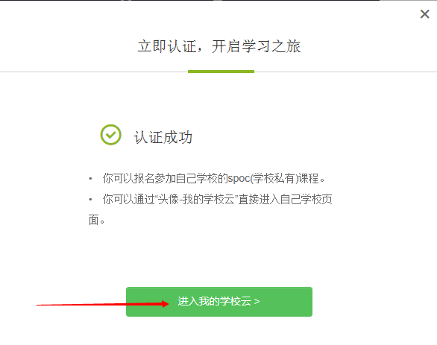
身份认证后，进入我的学校云，准备选课。

Slide 15

附：认证后，学生进入本校的“在线课程中心”还可在MOOC平台任意界面右上角，点击 “个人中心”，从页面上的“我的学校云”进入

Slide 16

2.“微生物学”课程选课与学习
认证以后，在我的学校云就能够看见本校专属课程，选定“微生物学 ”。

Slide 17
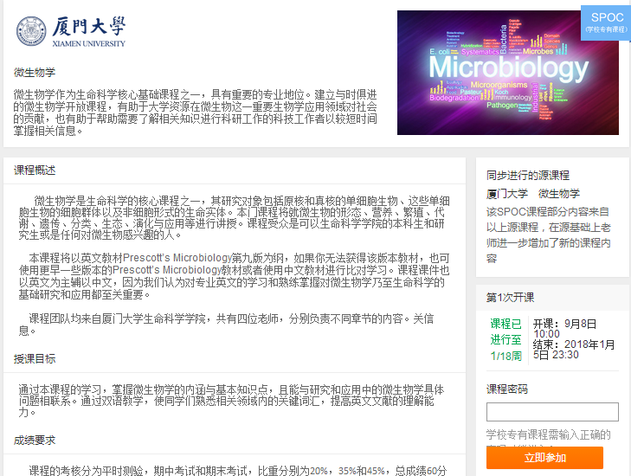
输入课程密码“life_xmu”，点击 “报名参加”该课程的学习

Slide 18
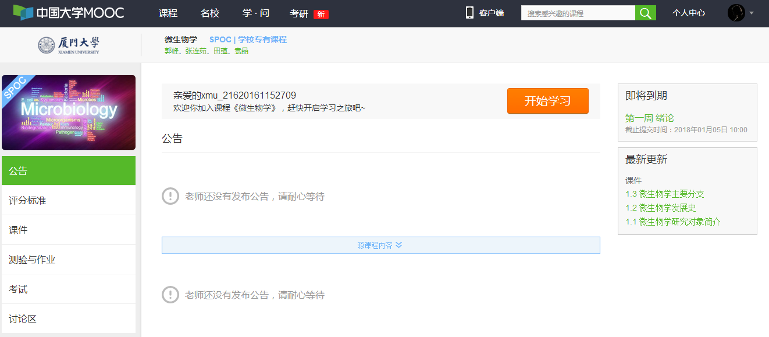
加入课程以后，课程界面如图所示，点击“开始学习”即可参与该门课程的在线学习。

Slide 19

3.昵称修改
指针放置于右上角头像上，会出现设置与退出按钮，选择“设置”，进入个人设置。

Slide 20

2.规范昵称，昵称统一为“xmu_学号”（如红框内所示），并填写真实姓名。填写完毕后，下拉到底端，单击“保存”按钮。

Slide 21
MOOC学习+平时考勤+讨论认真准备
≈ 60-70分

Slide 22
Chap. 1 The Evolution of
Microorganisms and Microbiology

Slide 23
Outline
What is microbiology and what does it study?
Primary features of microbes
Microbes in the evolution of life
History of microbiology
Modern microbiology and its branches

Slide 24
What is microbiology?
From Wikipedia:
Microbiology is the study of microscopic organisms, those being unicellular (single cell), multicellular (cell colony), or acellular (lacking cells).

Slide 25
Objects of Microbiology
Organisms and
biological entities
studied by
microbiologists
can be
Virology
Protozoology
Phycology
Mycology
Bacteriology
Acellular
Cellular
Fungi
Protists
Bacteria
Archaea
Viruses
Viroids
Satelites
Prions
e.g.
e.g.
e.g.
e.g.
composed of
composed of
composed of
composed of
Y
easts
Algae
Escherichia
Methanogens
Protein and
RN
A
Nucleic acid
Protein
Molds
Protozoa
coli
nucleic acid
often RN
A
Slime molds
Eukaryotes vs. Prokaryotes
*A protist is any eukaryotic organism that is not an animal, plant or fungus.

Slide 26
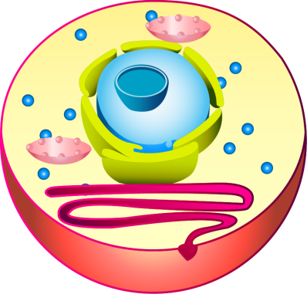
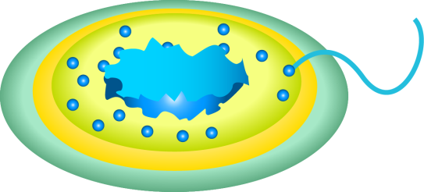
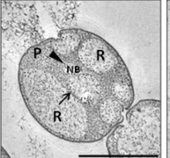
Prokaryote vs. Eukaryotes
Nucleolis
Mitochondria
Nucleoid
Capsule
Nucleus
Flagellum
Cell
Eukaryotes
Ribosomes
Prokaryotes
Cell Membrane
Nucleus enclosed with membrane
Typical cell organelles with membrane
Planctomycetes bacterium?

Slide 27
Diversity of microorganisms
(from small size to large size )

Slide 28
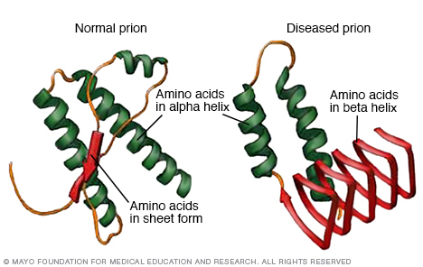
Acellular entities (nanometer scale)
Prion

Slide 29
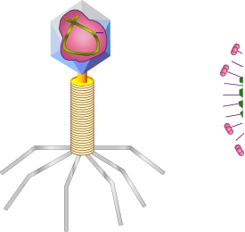
Bacteriophage(噬菌体)
Protein coat
Nucleic acid
DNA
Tail
Fibres

Slide 30
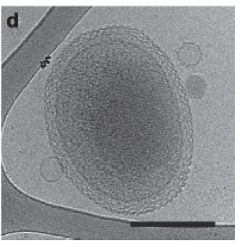
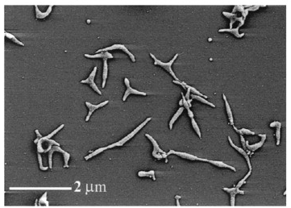
Bacteria and Archaea (0.1μm-?)
Mycoplasma 支原体
Unknown ultra-small microorganism

Slide 31
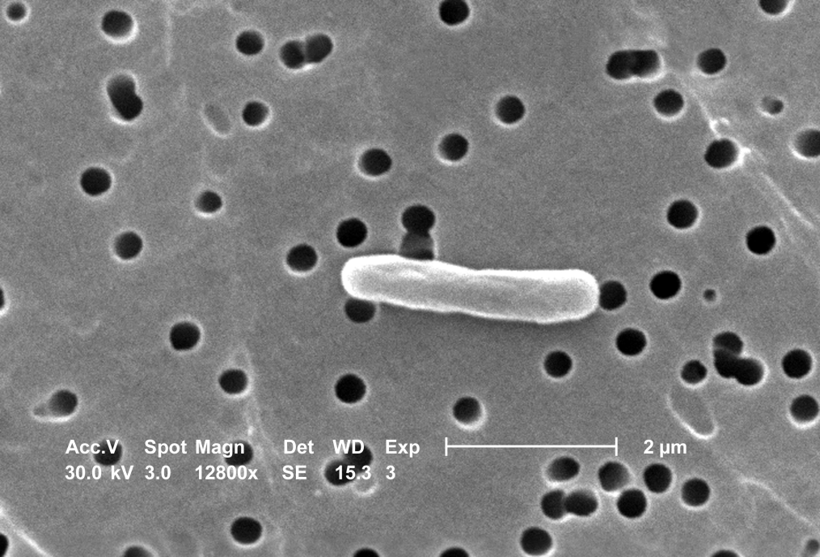
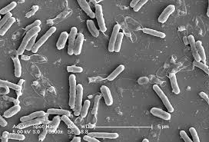
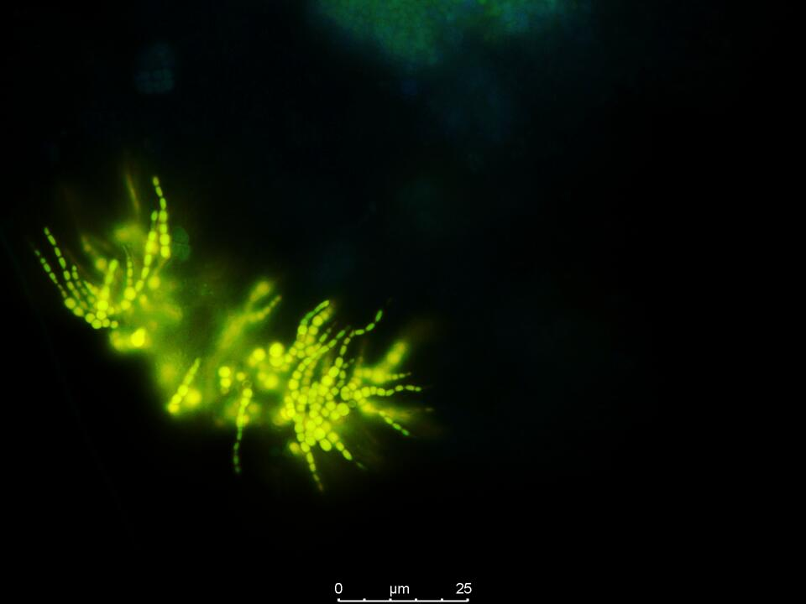
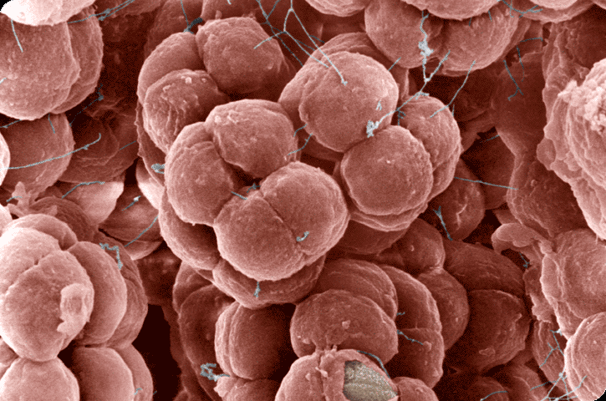
Escherichia coli (大肠杆菌)
Bacillus subtilis（枯草芽孢杆菌）
八叠产甲烷球古菌
Unknown bacteria in a bio-reator

Slide 32
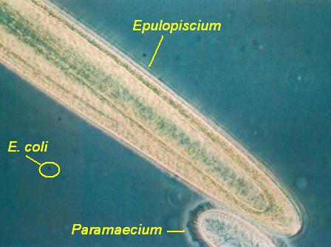
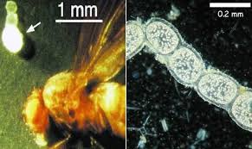
Epulopiscium fishelsoni
Thiomargarita namibiensis

Slide 33
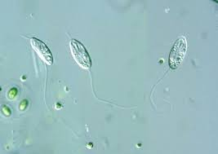
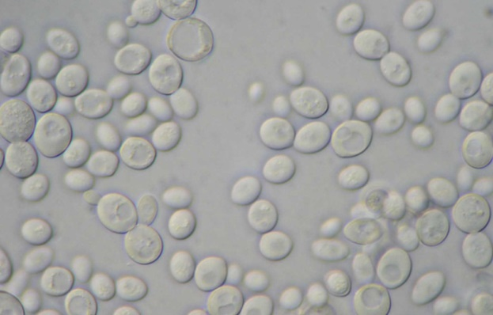
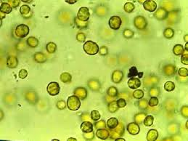
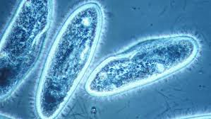
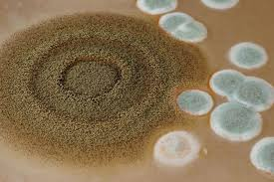
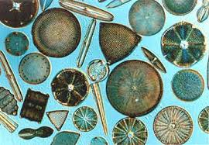
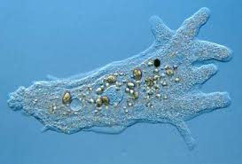
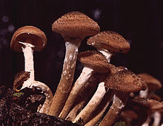
Eukaryotic microorganisms
Several μm to ?
Fungus (Fungi)
真菌
Protozoa 原生动物
Yeast
酵母
Flagellate
鞭毛虫
Green algae
绿藻
Ciliate
纤毛虫
Mold
霉菌
Diatom
硅藻
Ameba
变形虫
Mushroom
大型真菌
Microalgae单细胞藻类

Slide 34
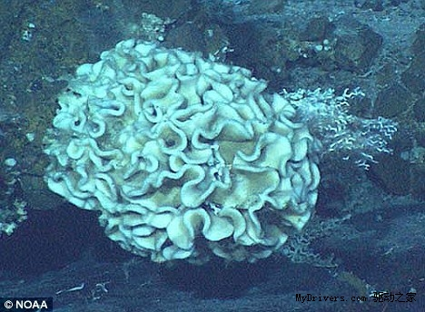
Xenophyophore (a protozoa over 10 cm)

Slide 35
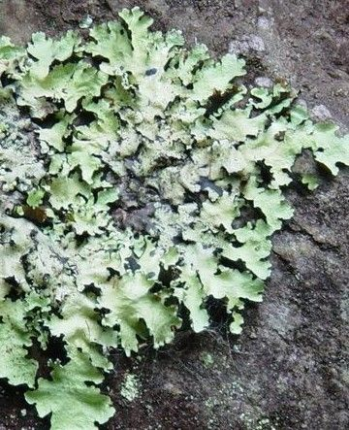
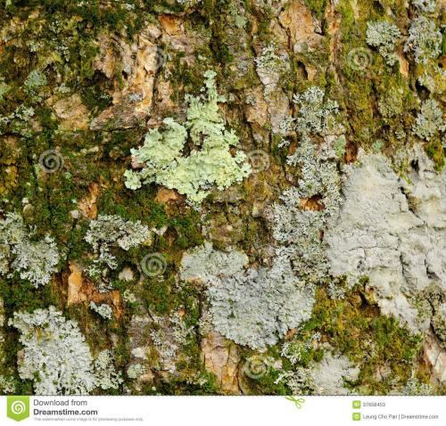
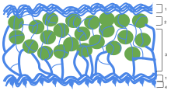
What is a lichen(地衣)?
A lichen is a composite organism that arises from algae or cyanobacteria living among filaments of multiple fungi in a symbiotic relationship.

Slide 36
Microbes have so diverse types and so many shapes!

Slide 37
Huge number of microorganisms on our planet
Sample | No. of prokaryotic cells
Soil (per gram) | 10⁹
Seawater (per mL) | 10⁴-10⁶
Freshwater (per mL) | 10⁴-10⁶
Tap water (per mL) | 10³
Clean air (per m³) | 10⁵
Human feces (per gram) | 10¹¹
Skin (per person) | 10¹²

Slide 38
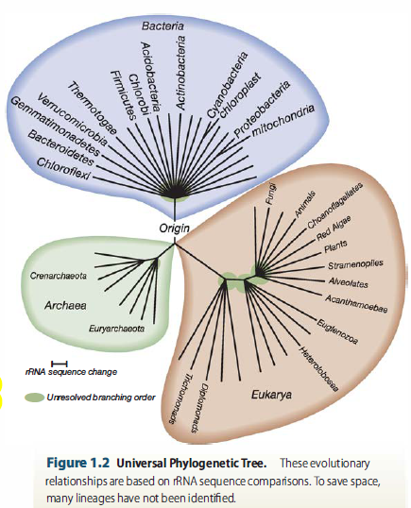
Microbes in the evolution of life
The Three Domains of Life
The six kingdoms:
Animalia, Plantae, Fungi, Protista, Archaea/Archaeabacteria, and Bacteria/Eubacteria
<D>Domain (域)
<K>Kingdom (界)
<P>Phylum (门)
<C>Class (纲)
<O>Order (目)
<F>Family (科)
<G>Genus (属)
<S>Species (种)

Slide 39
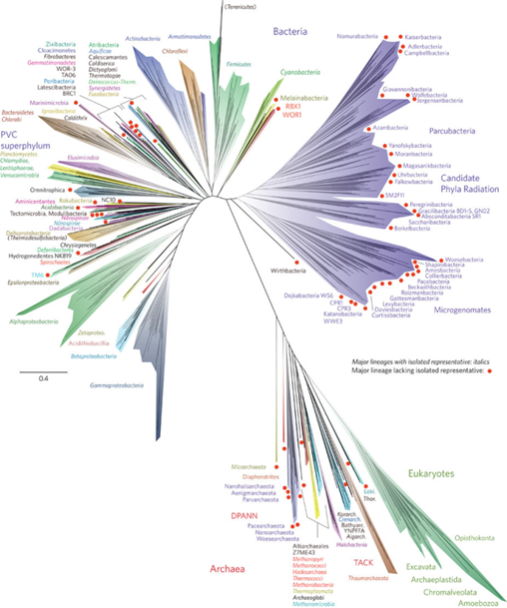
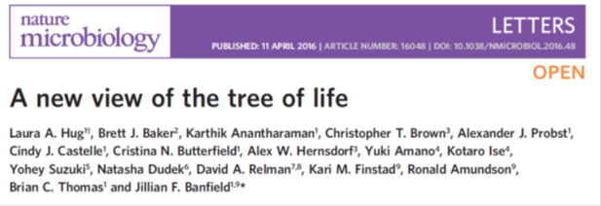

Slide 40
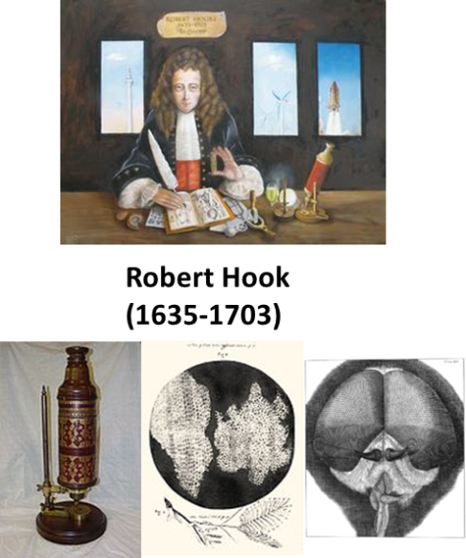
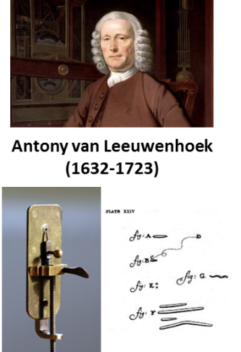
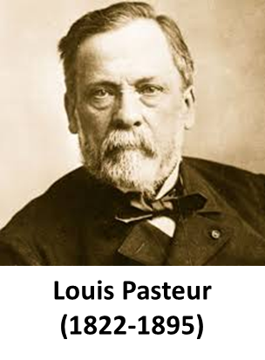
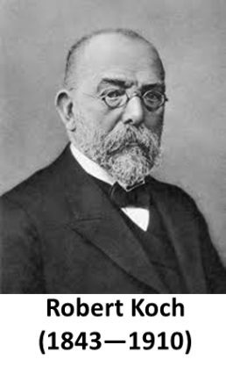
1665, Hook published Micrographia
1674-1676, Leeuwenhoek discovered microorgansims
Timeline of Microbiology
Mid-late 19th century
Pasteur’s three main contributions to microbiology
Koch’s two main contributions to microbiology
1995 the first prokaryotic genome was sequences
1928, Griffith discovers bacterial transformation
1929, Fleming discovered penicillin
1944, Avery verified was the carrier of genes in cells
1977, Woese separated Archaea from Bacteria

Slide 41
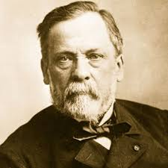
Pasteur ‘s contributions:
Louis Pasteur
1822-1895

Slide 42
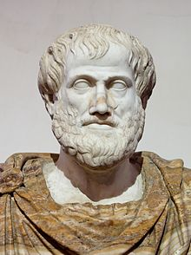
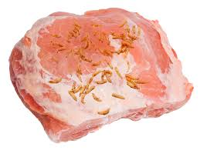
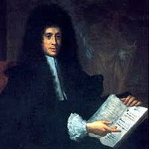
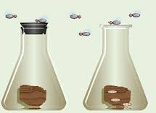

I. Settle (refute) the matter of spontaneous generation (生命”自然发生说”, living organisms could be directly generated from nonliving matters)
Aristotle
Larvae of fly generated from rotten meat
Francesco Redi
1626-1697
Seal the rotten food and larvae do not present
Lazzaro
Spallanzani
Use tightly sealed flask
No growth！
Need air for change?
1745, John Needham
Because of contamination
Georg Schroder
No growth！
Freshly boiled and sealed broth
Cloudy because of presence of microorganisms
Use cotton to filtrate air
Growth!
Felix Pouchet

Slide 43
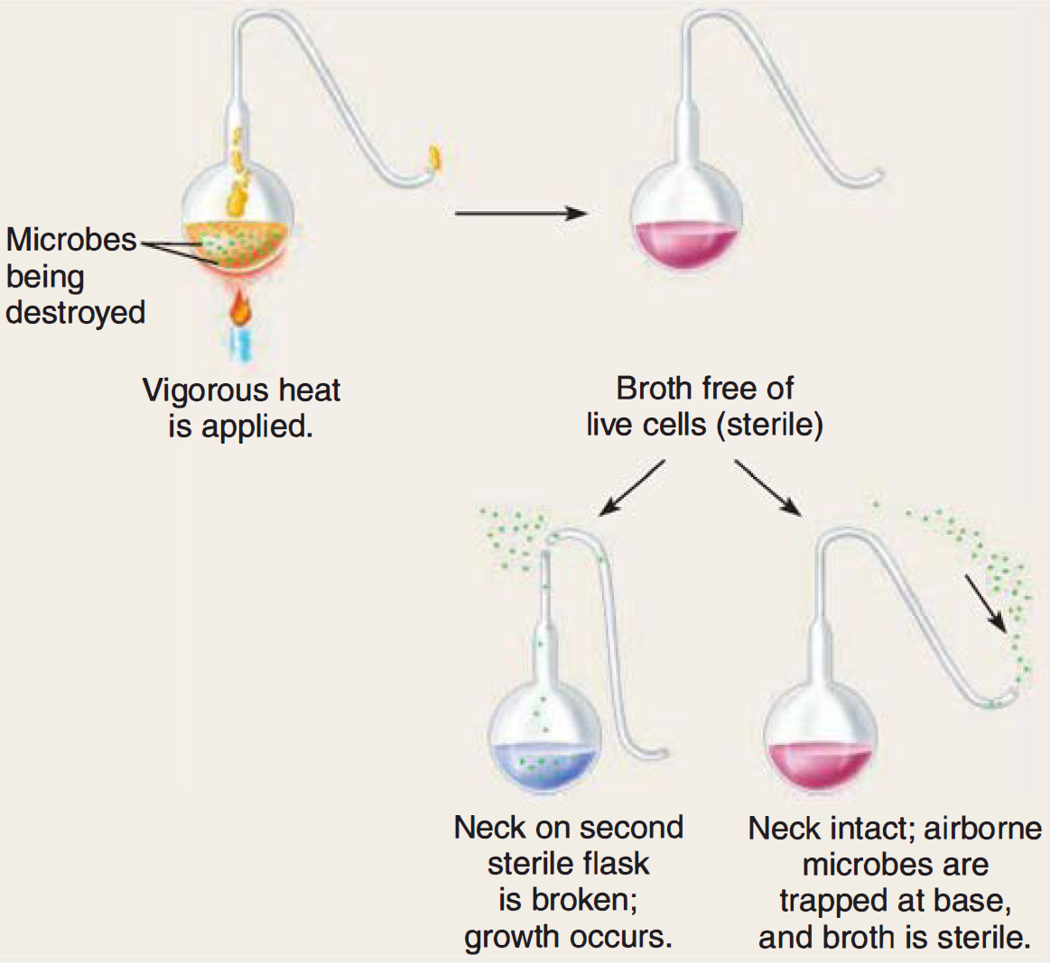
Significances of this contribution:
Break the obstacle to the development of microbiology as a scientific discipline
Developed liquid media for culturing microbes and methods for sterilizing media and maintaining their sterility
Only rigorous and well-designed experiments give reliable conclusions!

Slide 44
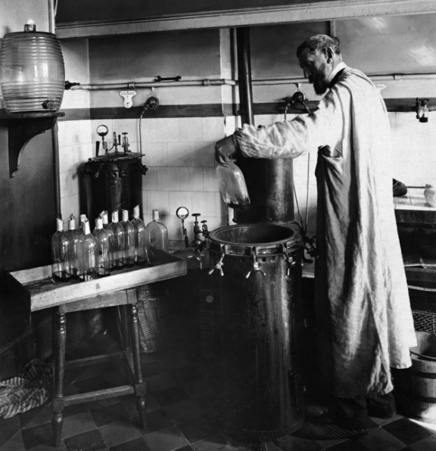

II. Fermentation by microorganisms
Fermentation is a metabolic process that consumes sugar in the absence of oxygen
Yeast cells contaminated with bacteria

Slide 45



Fermentation products from different microorganisms
Glucose
NAD+
NADH
Pyruvic acid
Organisms
Propionbacterium
Lactobacillus
Saccharomyces
Clostridium
Escherichia
Fermentation
products
Propionic acid
Lactic add
Ethanol
Acetone
Acetic acid
Isopropanol
Swiss cheese
Cheddar cheese
Wine,beer
Nail polish remover
Vinegar
yogurt,soy sauce
rubbing alcohol
Industrial market helps the development of microbiology.

Slide 46


III. Invention of vaccine as a pioneer of immunology
In 1770s, Edward Jenner had used material from cowpox (牛痘) lesions to protect people against smallpox (天花)
Vaccine for chicken cholera
In the fields of observation chance favors only the prepared mind.
Louis Pasteur
Injection
Aged culture of
choled bacferium
Healthy
chicken
Free from
cholera
Pasteur invented anthrax vaccine (炭疽疫苗)
and rabies vaccine (狂犬疫苗) lately
Injection
Chicken injecled
with aged culfure
Free from cholera
Injection
Fresh cullure of
cholera baclerium
Normal heallhy
chicken
Dead due to
cholera
Notes:
In his research campaign against disease Pasteur first worked on expanding what was known about anthrax, but his attention was quickly drawn to fowl cholera. This investigation led to his discovery of how to make vaccines by attenuating, or weakening, the microbe involved. Pasteur usually “refreshed” the laboratory cultures he was studying—in this case, fowl cholera—every few days; that is, he returned them to virulence by reintroducing them into laboratory chickens with the resulting onslaught of disease and the birds’ death. Months into the experiments, Pasteur let cultures of fowl cholera stand idle while he went on vacation. When he returned and the same procedure was attempted, the chickens did not become diseased as before. Pasteur could easily have deduced that the culture was dead and could not be revived, but instead he was inspired to inoculate the experimental chickens with a virulent culture. Amazingly, the chickens survived and did not become diseased; they were protected by a microbe attenuated over time.

Slide 47

Koch‘s contributions:

Slide 48



I. Pure culture on agar plate
The pure culture is the foundation for all research on infectious disease.
----Robert Koch
Utilized by many microbes and melt at 37ºC
Microorganisms are changed from time to time in broth medium.
(contamination)
Potato slice
Gelatin
Agar
Polysaccharide from algae
Not degradable for most microbes
Not melt below 90-100ºC
Transparent
Not suitable for growing many microorganisms!

Slide 49
Koch‘s contributions:
II. Koch’s Postulates to determine the causative microorganism of a disease
Postulate 1
The same microorganisms are present in every case of the disease.
Golden standard for determining pathogen!
Universality
(普遍性)
Postulate 2
Postulate 4
Microorganisms could be isolated in pure culture
The identical microorganisms are isolated and re-cultivated from the tissue specimens of the experimental animal.
Uniqueness
(唯一性)
Postulate 3
Reproducible causality
可重复的因果性
Microorganisms form the pure culture are inoculated into a healthy, susceptible animal. The disease is reproduced.

Slide 50



Pathogens isolated by Koch
Bacillus anthraci (炭疽杆菌)
Pathogen for anthrax
Mycobacterium tuberculosis (结核分支杆菌)
Pathogens for tuberculosis
Vibrio cholerae 霍乱弧菌; Pathogen for cholera

Slide 51





Other Milestones in Microbiology
(Details will be introduced in corresponding chapters)
In 1928, Griffith's experiment, reported by Frederick Griffith, suggests that bacteria are capable of transferring genetic information through a process known as transformation.
In 1929, Penicillin was discovered by Alexander Fleming.
In 1944, Oswald Avery verified DNA was the carrier of genes in cells
Protease
Mouse dies
Rough nonvirulent
strain
Dead smooth
virulent strain
DNase
Mouse lives

Slide 52


Universal phylogenetic tree of life based on rRNA gene sequence
In 1977, Frederick Sanger sequenced the first genome of bacteriophage φX174.
Carl Woese
(1928—2012)
From 1995, the genomics era
In 1977, the three domains of all cell organisms
1995, the first Bacteria genome
1996, the first Archaea genome
1997, the first fungi genome
……

Slide 53


Chinese microbiologist：
汤飞凡（1897-1958）
Chlamydia trachomatis
沙眼衣原体
“衣原体之父”

Slide 54
Major branches in modern microbiology
Modern microbiology
Medical microbiology
Microbial ecology
Agricultural microbiology
Industrial microbiology

Slide 55


Medical microbiology
Severe acute respiratory syndrome (SARS, 2003)
Infection is the invasion of an organism's body tissues by disease-causing agents, their multiplication, and the reaction of host tissues to these organisms and the toxins they produce.
In 2010 about 10 million people died of an infectious disease. (from Wikipedia)

Slide 56


Ebola virus
Symptoms of
Ebola
Headache
Pharynx and lugs
Red Eyes
- Hiccups
Sysemic
- Sore throat
- Fever
- Difficulty breathing
- Lack of appetite
- Difficulty swallowing
- Internal bleeding
Muscular
Chest pain
-
Aches
Stomach
-
Weakness
- Pain
-
Vomiting
Skin
- Rash
Joints
- Bleeding
-
Aches
Intestines
- Diarrhea

Slide 57



Antibiotic resistance pathogens
Super bacteria, also referred to as super bugs, are bacteria that have grown resistant to most antibiotics.
MRSA 耐甲氧西林葡萄球菌 化脓感染
Resistance to antibiotics could lead to the deaths of ten million people a year globally by 2050.
MDR-TB
多重抗药性结核分支杆菌
结核病
VRE 抗万古霉素肠球菌 败血症

Slide 58


“伤寒玛丽”的故事
“健康带菌者”
1869-1938
Salmonella typhi
At least three deaths were attributed to her, …
some have estimated that she may have caused 50 fatalities

Slide 59

Microbial ecology
Fossil fuel
combustion
CO
Reductive
Oxidative
CO2 fixation
Photo-and
chemoautotrophy
Methano-and
methylotrophy
Organic
matter
CO
CH4
2
Respiration and
fermentation
Methanogenesis
Oxidative and redox neutral
Reductive
The Microbial Carbon Cycle

Slide 60
The Microbial Nitrogen Cycle

Slide 61

Industrial microbiology
Industrial fermentation
Motor
Culture or
nutrient addition
pH probe
Dissolved oxygen
probe
Sample
line
Food:
Critic acid
Lactic
Oils
Fatty acids
Polysaccharides
etc.
Non-food:
Antibiotics
Vitamins
Amino acids
etc.
Valve
Cooling
water out
Impellers
Temperature
sensor and
control unit
Cooling
jacket
Biosensor
unit
Cooling
water in
Control:
Temperature
pH
Dissolve oxygen
Stirring
Nutrient addition
etc.
Valve
Air in
Valve
Harvest
line
Air ifilter
.

Slide 62

Agriculture microbiology
Bacterium with
selected gene
Chromosome
Chromosome
Ti plasmid
Agrobacterium 根癌农杆菌 cell
Isolated
gene for
herbicide
resistance
Gene spliced into Ti plasmid
Recombinant Agrobacterium
Genetic engineering of agriculture
Agrobacterium with Ti
plasmid vector
Plant cell
Process
in plant
Plants.
modifed
becterium

Slide 63
Microorganisms are in
the air
water
food
ourselves
……
Microbiology are involved in all our life.

Slide 64
Homework
Parasites (寄生虫) are objects of microbiology. Is it right? Why?
2016全球最受公众关注的科学成果中，生命科学部分的10个成果的2项与微生物学直接相关。其中“科学家人工合成仅473个基因的`最小` 细菌”，请查询资料并就你的理解，介绍该成果的意义。

Slide 65
The next lecture:
Bacterial Cell Structure

