Slide 1

MICROBIOLOGY
Lecture 5
Microbial Nutrition, Growth and Control (I)

Slide 2
Outline
Types of nutrients*
Nutritional types (see 11.1)*
Reproductive strategies
Bacterial cell cycle
Influences of environmental factors on growth
Laboratory culture of cellular microbes
Growth curve

Slide 3
Nutrition vs. Nutrient
Reduction vs. Oxidization
Oxidization (Energy production)
Fe
Fe²⁺
Fe³⁺
H₂S
S
SO₃²⁻
SO₄²⁻
ETC
e⁻
ATP
NH₃
NO₂⁻
NO₃⁻
(CH₂O)_{n}
nCO₂
Reduction (Energy consumption and biomolecule buildup)

Slide 4
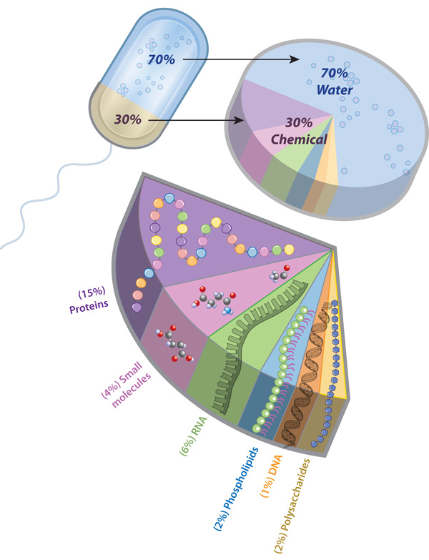
Elements required for growth
Macroelements
Molecule | Elements
Proteins | C, H, O, N, S
Lipids | C, H, O, P
Carbohydrate | C, H, O
Nucleic acid | C, H, O, N, P
Metal elements: K, Ca, Mg, and Fe
Microelements (trace elements): Mn, Co, Mo, Cu, etc.
serve as cofactors of enzymes (酶的辅助因子)
required in trace amounts
some unique substances may be required (Si for diatom)
Bacterial cell composition

Slide 5
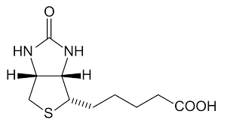
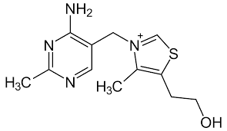
Growth factors
Organic compounds
Essential cell components (or their precursors) that the cell cannot synthesize
Must be supplied by environment if cell is to survive and reproduce
Carboxylation, one-carbon metabolism
amino acids
purines and pyrimidines
vitamins
  function as co-enzyme(辅酶)
Biotin (生物素)
Aldehyde transfer
Thiamine (硫胺素，B1)

Slide 6
Microbial production of growth factors
Microorganisms can synthesize many growth factors
Large-scale industrial production of growth factors, such as vitamins

Slide 7
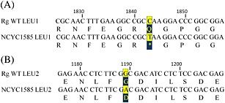
Nutritionally deficient mutant= auxotroph
In genetics, a strain is said to be auxotrophic if it carries a mutation that renders it unable to synthesize an essential compound.
A mutation converting a prototroph （原营养型） into an auxotroph （营养缺陷型）
谷氨酰胺to终止密码子
甘氨酸to天冬氨酸
Two leucine auxotroph mutants of yeast
Lin et al., 2012

Slide 8
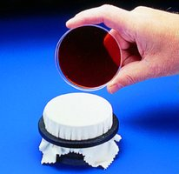
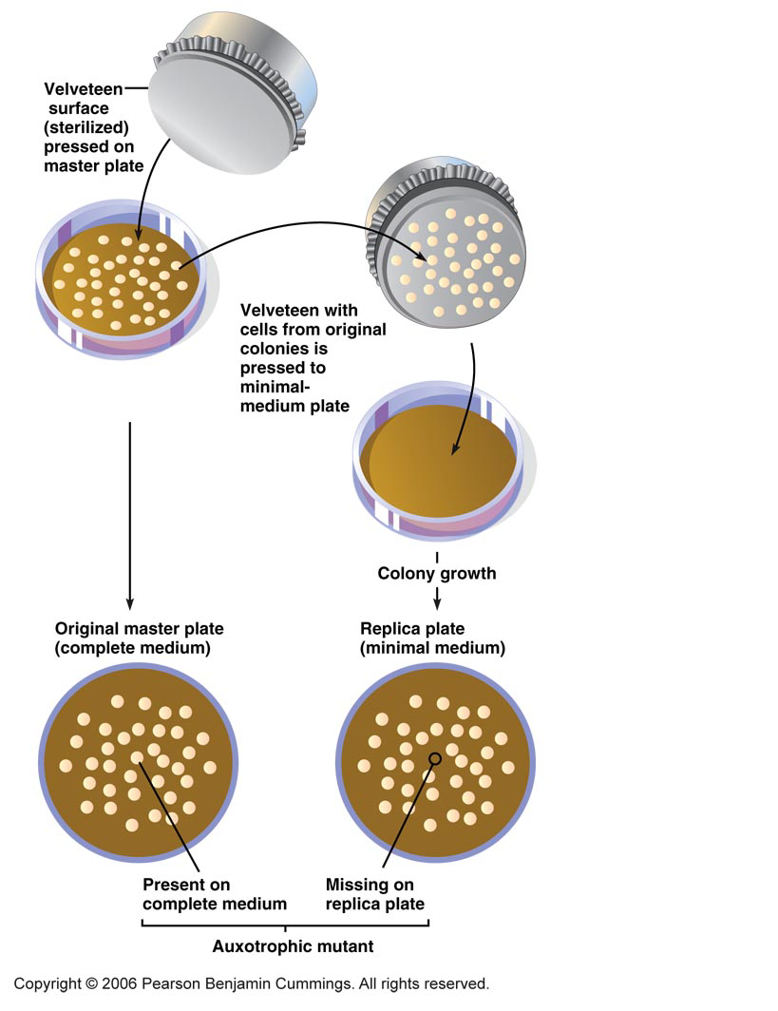
^{How to screen the auxotroph?}
Replica plate (影印平板) for auxotroph screening
 | Prototroph | Auxotroph
Complete medium (all nutrients) | + | +
Minimal medium (lack of certain growth factor) | + | -

Slide 9
Nutritional Types

Slide 10




Nutritional types are determined by energy source, carbon source and electron source.
Energy source
Chemo
---chemicals
Phototroph
---light
A
T
P
ETC
Carbon source
Autotroph
---CO2
Precursor
monomers
metabolites
and other
Macromolecules
Heterotroph
---organic molecules
building blocks
Electron source
Organotroph
---organic molecules
Reducing power (electrons)
Lithotroph
---inorganic molecules

Slide 11
Diversity of microbial nutritional types
Nutritional Type | Carbon Source | Energy Source | Electron Source | Type organisms
Photo-litho-autotroph (光能无机自养型) (similar with plants) | CO₂ | Light | Inorganics | Cyanobacteria Green/purple sulfur bacteria
Chemo-organo-heterotroph (化能有机异养型) (similar with animals) | Organics | Organics | Organics | Most pathogens Most colonies on agar plates
Photo-organo-heterotroph (光能有机异养型) | Organics | Light | Organics | Purple non-sulfur bacteria
Chemo-litho-autotroph (化能无机自养型) | CO₂ | Inorganics | Inorganics | Some nitrogen cycling microbes Sulfur oxidizing bacteria Iron oxidizing bacteria
Chemo-litho-heterotroph （化能无机异养型） | Organics | Inorganics | Inorganics | Some sulfur oxidizing bacteria (Beggiatoa sp.)

Slide 12
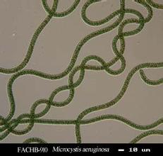
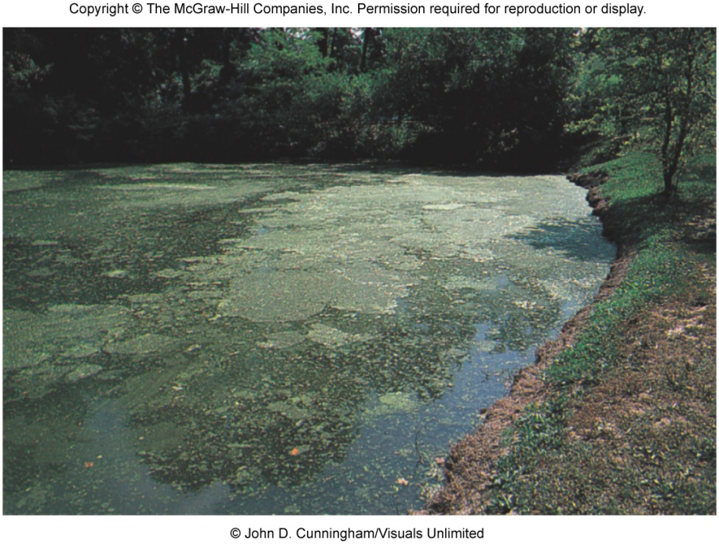
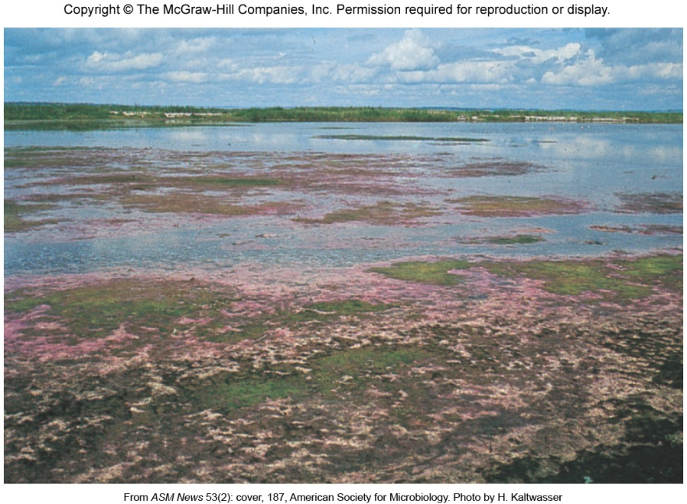
Photo-litho-autotroph
Microcystis aeruginosa
铜绿微囊藻
Cyanobacteria blooming (水华)
Purple sulfur bacteria
Electron source: H₂O
Electron source: H₂S

Slide 13
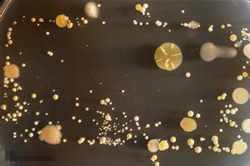

Chemo-organo-heterotroph
Bacteria on the cellphone screen
cultivated with nutrient agar

Slide 14
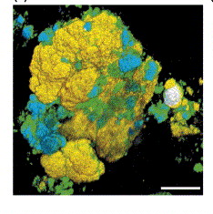
Chemo-litho-autotroph
Atmosphere
N₂
Nitrogen fixer
Denitrifier
NH₃
Ammonia oxidizing organisms
NO₃⁻
NO₂⁻
Nitrifying bacteria

Slide 15
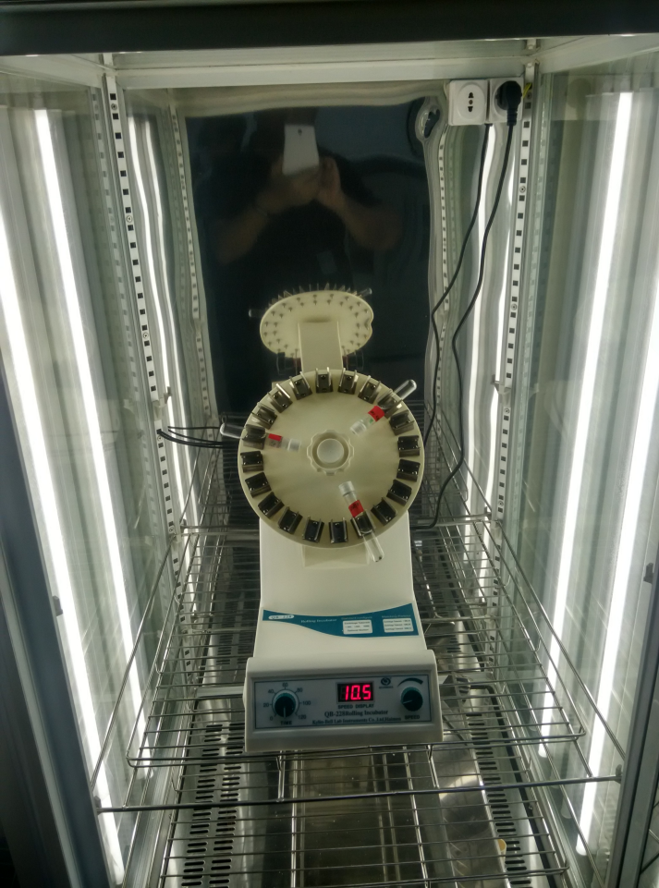
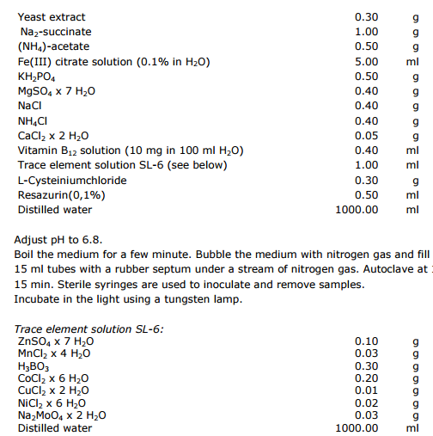
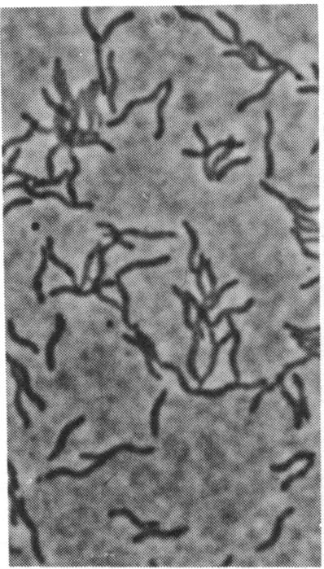
Photo-organo-heterotroph
Rhodocyclus tenuis DSM109

Slide 16
Mixotroph: organism with different nutritional types
Obligate photoorganoheterotroph
Photolithautotroph and facultative chemoorganoheterotroph

Slide 17
Summary
The growth of microbial cells needs macronutrients, micronutrients and growth factors
There are five microbial nutritional types classified by the energy source, carbon source and electronic source

Slide 18
Bacterial growth

Slide 19
Reproductive Strategies
Many eukaryotic microbes exhibit both asexual reproduction（无性繁殖）, involving mitosis （有丝分裂）, and sexual reproduction, involving meiosis （减数分裂）to produce gametes or gamete-like cells.
Unlike eukaryotes, bacterial and archaeal cells are haploid（单倍体）. Most reproduce by binary fission（二分裂）.

Slide 20
Molecules double in amounts for binary fission
Protein
RNA and DNA
Lipids for membrane
Cell wall components
Small organic and inorganic molecules
Each daughter cell have ½ old cell material and ½ new cell material.
All biosynthetic events must coordinate carefully.

Slide 21
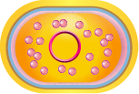
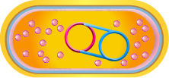
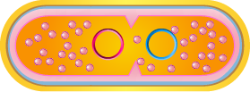


Binary fission
A new cell
Cell
W
all
Cell membrane
Chromosome1
Chromosome2
Ribosomes
DNA replication
Septation starts
Septum (横隔) formation
Two daughter cells

Slide 22
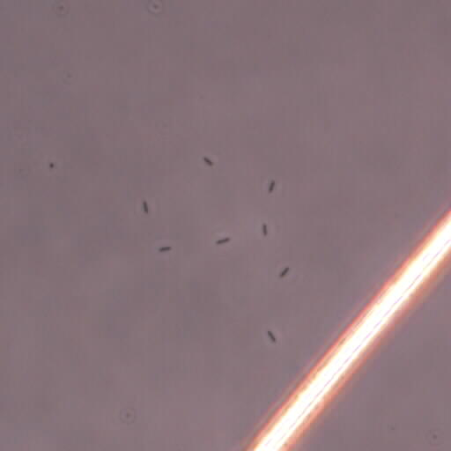
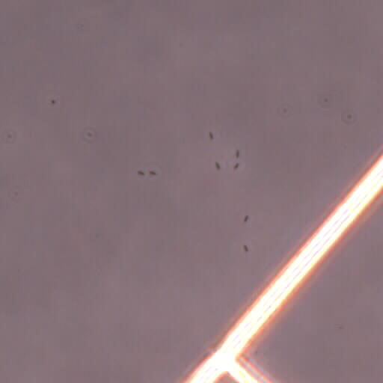
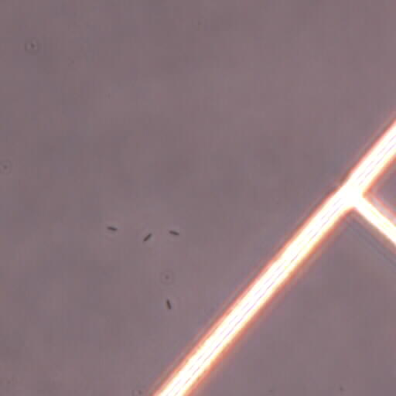
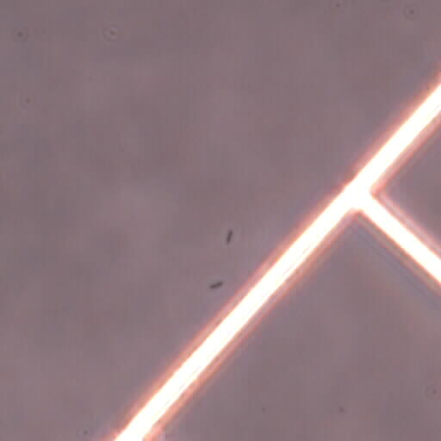
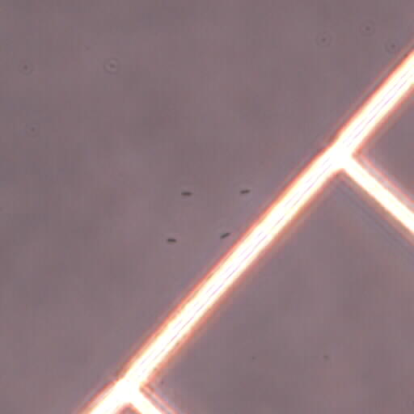
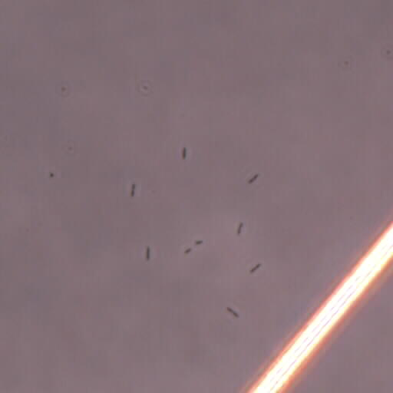
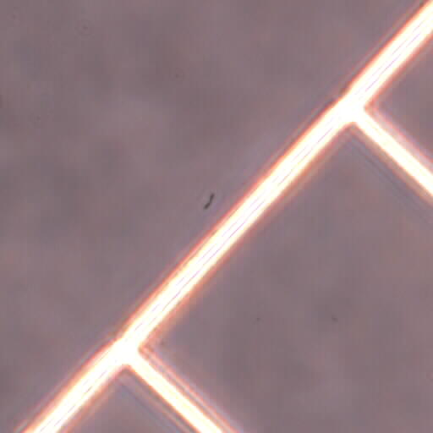
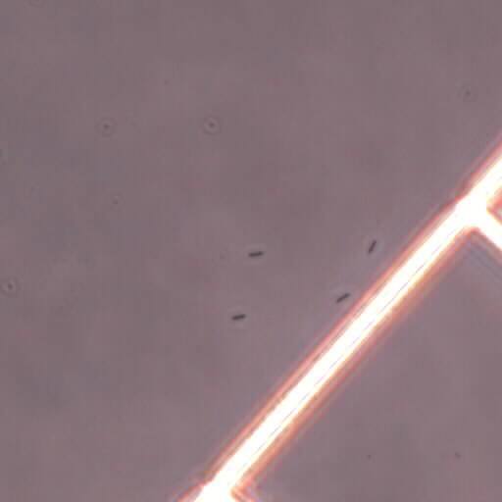
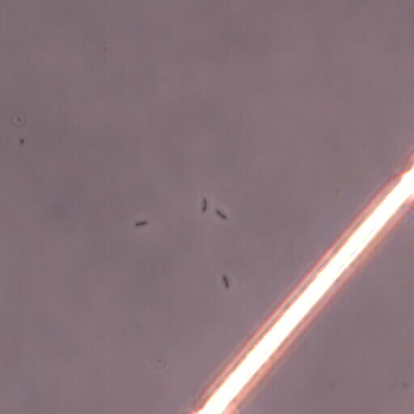
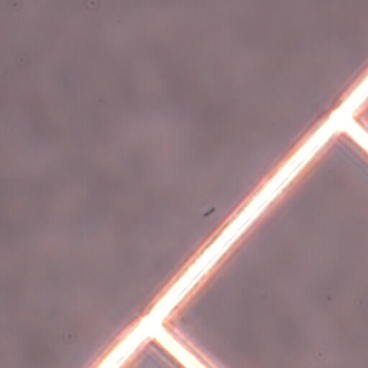
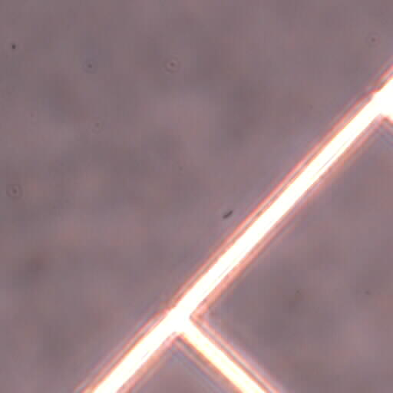
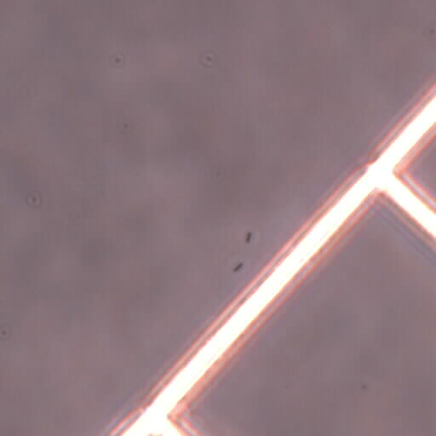
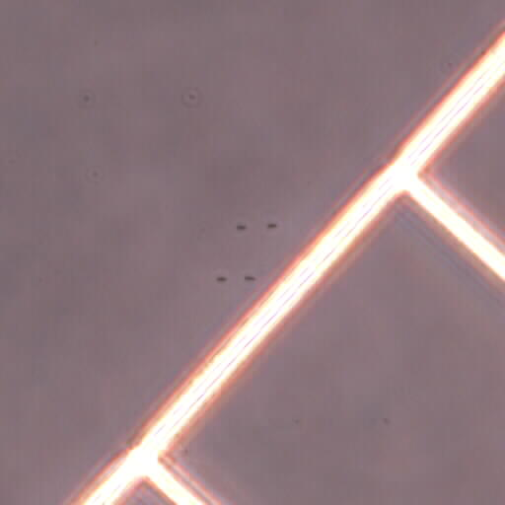
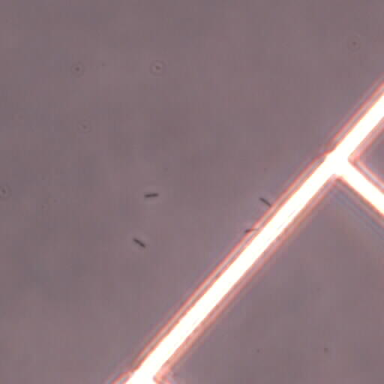
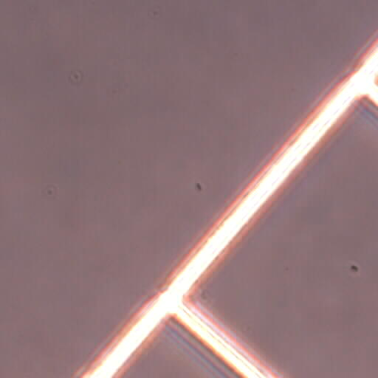
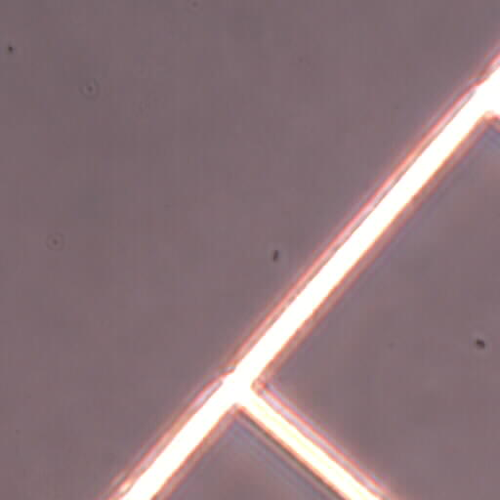
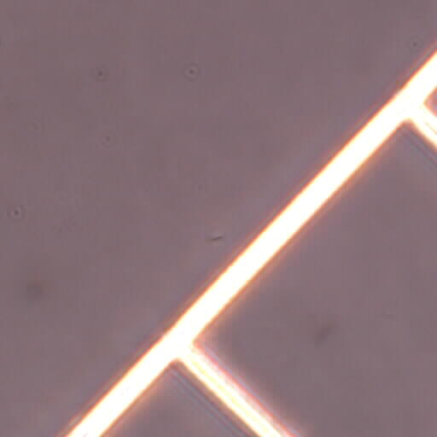
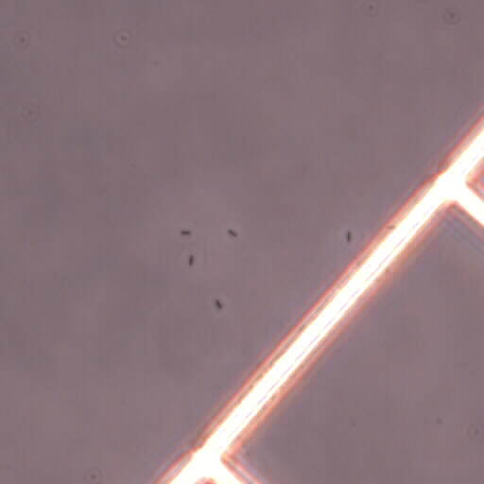
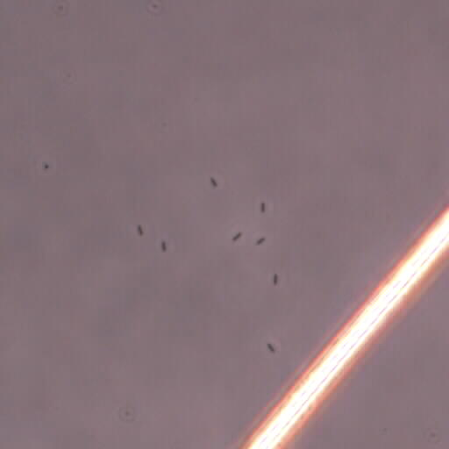
Binary fission
300 min
180 min
360 min
160 min
280 min
220 min
20 min
40 min
240 min
260 min
140 min
60 min
200 min
340 min
320 min
100 min
80 min
120 min
0 min

Slide 23
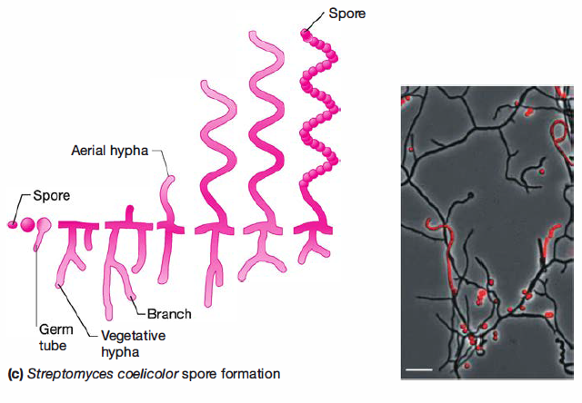
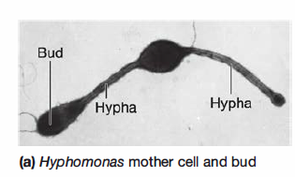
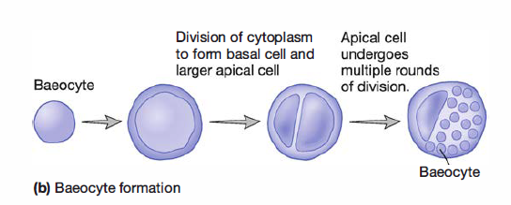
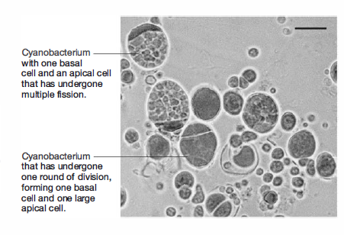
Other reproductive strategies in bacteria
Budding (出芽生殖)
Spore of actinobacteria (放线菌)
小孢子
Multiple fission (复分裂) in Cyanobacteria (蓝细菌)

Slide 24
The cell cycle is the complete sequence of events extending from the formation of a new cell through the next division.
Two events during the bacterial cell cycle:
Replication and partitioning of DNA into the progeny cells
Cytokinesis（胞质分裂）
----formation of the septum (横隔) and progeny cells

Slide 25






Replication and partitioning of DNA
Most bacteria have a single circular chromosome.
Inltiation mass reached
Origin of replication
Bacterium
Cells
Chromosome
T
divide.
erminus
Replisome
Initiation of septum
Initiation of
formation
replication
Origin of replication
Chromosomes
separate.
Orglins
separate.
Terminus
Replisome
Threshold cell length reached
Cell elongates as
replication continues

Slide 26


DNA partitioning?
Replisome (DNA replication fork)
Leading strand synthesis
(DNA polymerase III)
DNA replication from 5’-3’
Leading strand
Replication fork
movement
Lagging strand
DnaB
helicase
primase
Okazaki fragment
（冈崎片段）
SSB
RNA
primer
Inhibit complementary
Separation the chromosome

Slide 27
Cytokinesis
Septation (=cytokinesis) is the process of forming a cross wall between two daughter cells
Septation is divided into 4 steps:
(1)selection of the site where the septum will be formed;
(2)assembly of the Z ring, which is composed of the cytoskeletal protein FtsZ;
(3)assembly of the cell wall-synthesizing;
(4)constriction of the cell and septum formation.

Slide 28
The Z-ring and divisome
Synthesis of peptidoglycan
Anchor Z-ring to plasma membrane
FtsN-C
FtsL
FtsB
Ftsl
Outer membrane
FtsQ
FtsW
Peptidoglycan
FtsK
Periplasma
FtsZ
FtsA
Separation of chromosome
FtsN-C
Zip
A
FtsZ
Polymerized and form Z-ring
Z ring
Plasma membrane
The E.coli divisome
Figure 7.5 The Cell Division
Apparatus in E.coli.
The cell division apparatuts
is composed of numerous proteins.The first step in divisome formation is the
polymerization of FtsZ to form the Z ring.Fts
A
and Zip
A
proteins anchor the Z ring to
the plasma a membrane,and then other proteins in the divisome assemble along the
Z ring.

Slide 29
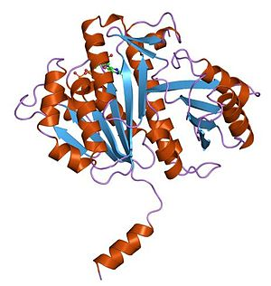
Filamenting temperature-sensitive mutant Z
FtsZ is a prokaryotic homologue to the eukaryotic protein tubulin (微管蛋白)
Also found in dividing chloroplasts and some mitochondria
But why Z-ring forms only in the middle of the cell?

Slide 30
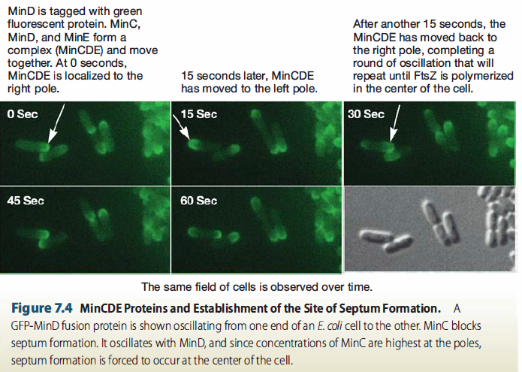
The formation of Z-ring limited in the center of cell by oscillation of MinCDE proteins

Slide 31
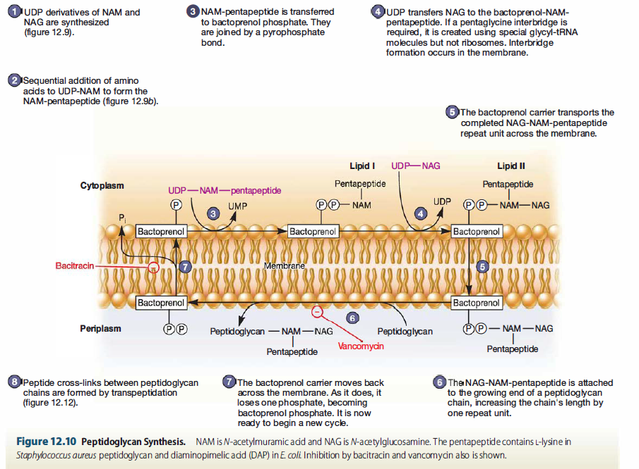
Peptidoglycan synthesis (略)

Slide 32
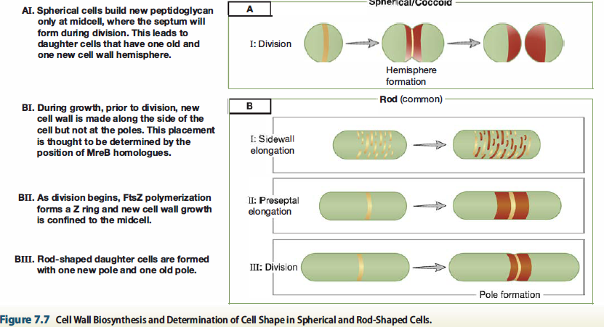
Cell wall synthesis during growth of cocci and rod bacteria

Slide 33
Determination of cell shape
Microbial cell shape is faithfully heritable.
Microbial cell shape is not unchangeable. Some microorganisms show distinct cell shape under different physiological conditions.
Cell wall play a key role for determining the cell shape.

Slide 34
Summary
Most prokaryotic microorganisms reproduce by binary fission
Bacterial cell cycle has two related pathways: replication and partitioning of DNA and Cytokinesis.
Key function of Z-ring (divisome) during cell division

Slide 35
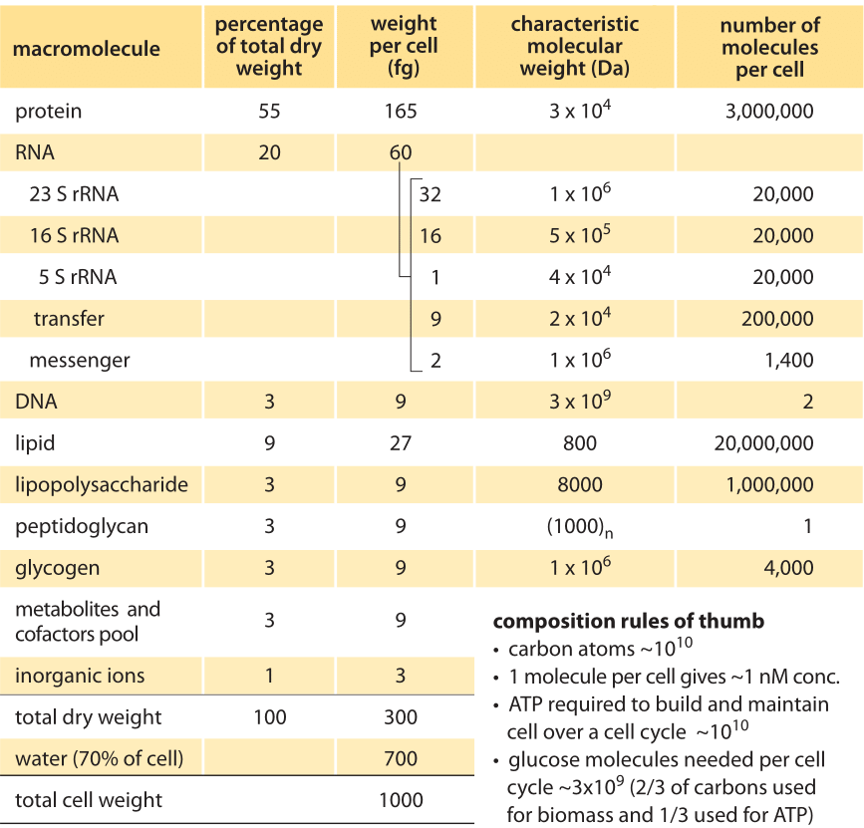
*Molecules in each E. coli cell

Slide 36
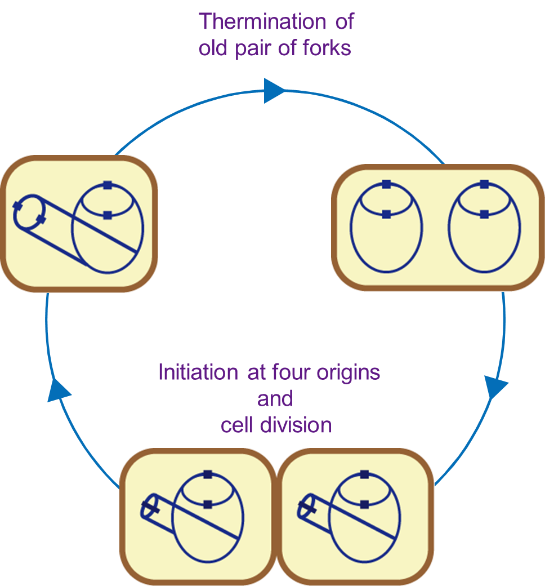
How does an E. coli cell divided each 20 min although its DNA replication will be finished in 40 min?

Slide 37
Influences of environmental factors on growth

Slide 38
Environmental factors
Salinity
Osmotic pressure
pH
Temperature
Oxygen
Pressure

Slide 39
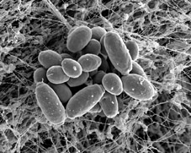
Osmotic pressure or salinity
Nonhalophile | Cannot sustain high salinity
Halotolerant | Grow optimally in low salinity but sustain high salinity
Moderate halophile | Require high levels of salt, usually over 0.2 M
Extreme halophile | Require high or nearly saturated salinity, usually over 2 M
Nonhalophile: Freshwater species
Halotolerant: Staphylococcus spp. (葡萄球菌)
Moderate halophile: Seawater species
Extreme halophile: Brackish water (nearly saturated)
Growth rate
0
1
2
3
4
NaCl concentration(M)
Nonhalophile
Moderate haiophile
Halotolerant
Extreme halophile
Natronobacterium gregoryi

Slide 40
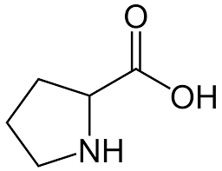
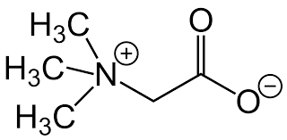
Compatible solutes补偿溶质
Balance the high osmotic pressure outside cell
Potassium chloride
Betaine (甜菜碱), and amino acids such as proline (脯氨酸) and glutamic acid (谷氨酸)
Betaine
Proline

Slide 41
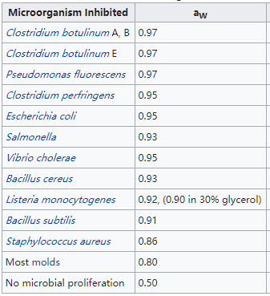

Water activity*
Water activity or a_{w} is the partial vapor pressure of water in a substance divided by the standard state partial vapor pressure of water.
Higher a_{w} substances tend to support more microorganisms. Bacteria usually require at least 0.91, and fungi at least 0.7.

Slide 42



pH
Acidophile | Growth optimum between pH 0-5.5
Neutrophile | Growth optimum between pH 5.5-8.0
Alkaliphile | Growth optimum between pH 8.0-11.5
[H+]
pH
pH opyima of some microbes
1 M
ACIDIC
0
Ferroplasma spp.(A)
-1
1
10 M
Human stomach fuld
Dunaliella acidophila(E)
-2
2
Lemon juice
Cyanidium caldarium(E)
10 M
Acid mine drainage
Thiabacillus thiooxdans(B)
-3
3
Grapefruit juice
Suifolabus acido caldarius(A)
10 M
Oranges
-4
4
Beer
10 M
T
omato juice
-5
5
10 M
Cheese
Physanum polyciphalum(E)
-6
6
Beef
Lactobacillus acidophilus(B)
10 M
E.coli,Pseudomonas aeruginosa(B)
7
Milk
-7
10 M
NEUTRAL
Pure water
Human blood
Staphylacoccus aureus(B)
-8
8
10 M
Seawater
Nitrosomonas spp.(B)
-9
9
10 M
Baking soda
-10
10
Soap
Microcystis aeruginosa(B)
10 M
-
1
1
1
10 M
1
Bacillus alcalaphilus(B)
Household ammonia
-12
12
10 M
Bleach
-13
13
10 M
-14
14
10 M
ALKALINE

Slide 43

Temperate
Psychrophile(嗜冷) | Growth at 0ºC and has an optimal growth temperature of 15ºC or lower
Psychrotroph(耐冷) | Can grow at 0-7ºC; has an optimum between 20-30ºC and a maximum around 35ºC
Mesophile(嗜温) | Has growth optimum between 20-45ºC
Thermophile(嗜热) | Can grow at 55ºC or higher; optimum often between 55 and 60ºC
Hyperthermophile (超嗜热) | Has an optimum between 85 and about 113ºC
Hyperyhrmophiles
Thermophiles
Mesophiles
Growth rate
Psychrotrophs
Psychrotrophs
-10
0
10
20
30
40
50
60
70
80
90
100
1
10
120
T
eenperature(
℃）

Slide 44





Thermus aquaticus
栖热水生菌
Taq DNA polymerase
Pyrococcus furiosus
Pfu DNA polymerase

Slide 45
Oxygen concentration
Obligate aerobe 严格好氧菌 | Complete dependent on atmospheric O₂ for growth
Facultative anaerobe 兼性厌氧菌 | Does not require O₂ for growth but grow better in its prescence
Aerotolerant anaerobe 耐氧厌氧菌 | Grow equally well in presence or absence of O₂
Obligate anaerobe 严格厌氧菌 | Does not tolerate O₂ and die in its presence
Microaerophile 微需氧细菌 | Require O₂ levels between 2-10% for growth and is damaged by atmospheric O₂ level
Oxic zone
Questions for thinking:
Why there are anaerobic environments? Give some examples of anaerobic environments.
Anoxic
zone
Obligate
Facultative
Aerotderant
Strict
Microaerophle
aerobe
anaerobe
anaerobe
anaerobe
Enzyme content
+SOD
+SOD
+SOD
-SOD
+SOD
+Catalase
+Catalase
-Catalase
-Catalase
+/- Catalase
(low levels)

Slide 46


Pressure
Piezophile or barophile | Growth more rapid at high hydrostatic pressures
Seawater: 10m = 1 atm
Crust(地壳): 3-4m= 1 atm
Barotolerant (耐压) vs. Barophilic (嗜压)
Increase the amount of unsaturated fatty acids in their membrane lipids as pressure increases
Shorten the length of their fatty acids
Photobacterium profundum
grow under 0.1 MPa to 70 MPa

Slide 47
Laboratory Culture of Cellular Microbes

Slide 48


Culture Media
Basis for classification | Types
Chemical composition | Defined (synthetic), complex
Physical nature | Liquid, semisolid, soild
Function | Supportive基本, enriched丰富, selective选择, differential鉴别
M9 medium for E. coli
LB meidum
Yeast extract酵母粉 5.0g/L
Tryptone蛋白胨 10.0g/L
NaCl 10.0g/L

Slide 49



Agar
Swimming
Polar flagellum
端生鞭毛
Agar
Swarming
Peritrichous flagellum
周生鞭毛
Sánchez-Contreras et al., 2002

Slide 50


Functional types of media
Supportive media: general purpose and sustain the growth of many microorganisms
Enriched media: other nutrients may be added to supportive media to encourage the growth of fastidious microbes.
Selective media: allow the growth of particular microorganisms, while inhibiting the growth of others.
Differential media: distinguish among different groups of microbes and even permit tentative identification of microorganisms based on their biological characteristics.
EMB medium
伊红美蓝培养基
TCBS Medium

Slide 51

Culture methods
Culture in solid and liquid medium
Used in both cell counting and isolation
CFU (colony forming unit)
colony from a single viable (可育的) and cultivable cell

Slide 52



Inoculation on agar plate
Streak plate (Isolation)
Spread plate (Cell counting and isolation)
Pour plate (Cell counting and isolation)

Slide 53






1 ml
1 ml
1 ml
Sample
9 ml dilution
10⁻¹
9 ml dilution
10⁻²
9 ml dilution
10⁻³
Agar pour
1 ml
1 ml
1 ml
After pouring, mix with
circular motion.
Plate 1
colonies
Plate 2
colonies
Plate 3
colonies
Any difference between the pour plate and spread plate?

Slide 54




Cultivation of anaerobes (厌氧微生物)
Glovebox手套箱
Need H₂ and palladium catalyst (钯触媒) to keep oxygen-free

Slide 55
Growth Curve

Slide 56

Refer to growth in the size of a population;
Grow in liquid medium;
Grow in batch culture (a closed system);
Although it is “life in the lab”, it is important for understanding the growth in natural environments.

Slide 57

senescence衰老期
稳定期
指数期
死亡期
Why?
延滞期

Slide 58
Lag phase
Cell synthesizing new components
Adapt to new medium or other conditions
Varies in length (in some cases can be very short or even absent)
Notes:
replenish（补充）

Slide 59

Exponential phase
y=2^{x}
also called log phase
rate of growth and division is constant
population is most uniform in terms of chemical and physiological properties during this phase
usually used in biochemical and physiological study
Linear y value
y=2^{x}
Logarithmic y value
late
mid
early

Slide 60

Growth rate in the exponential phase is determined by
Microbial characteristics
The nature of the medium
The environmental conditions
Notes:
双曲线的hyperbolic

Slide 61

Stationary phase
Closed system population growth eventually ceases, total number of viable cells remains constant (active cells stop reproducing or reproductive rate is balanced by death rate)
stress
Essential nutrient limitation
Limited oxygen availability
Toxic waste accumulation

Slide 62
Senescence (细胞衰老) and death phase
Two alternative hypotheses:
Cells are Viable But Not Culturable (VBNC)
Cells are alive, but dormant, capable of new growth when conditions are right
2. Programmed cell death (PCD)
Fraction of the population genetically programmed to die (commit suicide, altruists, 利他主义者)

Slide 63
Mathematics of Growth
Given N₀(cell number or density at beginning), N_{t} (cell number or density at time point t)
and t (time point)
Growth rate= [log₂(N_{t}/N₀)]/t (why log₂? )
Generation time (代时) =t/[log₂(N_{t}/N₀)]
How to determine N₀ and N_{t}?

Slide 64
Discussion
If you wished to obtain a pure culture of bacteria that could degrade benzene and use it as a carbon and energy source, how would you proceed?
Design an experiment to screen an auxotroph of E. coli that cannot synthesize proline. How can you verify it at gene-level?
Suppose you discovered a new bacterial strain from the permafrost of Alaska. You are able to culture the bacterium in a define medium, but it grows very slowly. How could you optimize its growth? Explain your choices.
Give one bacterial example of chemolithoautotroph and describe the relationships between its distribution and function
Introduce the event https://en.wikipedia.org/wiki/GFAJ-1 to classmates. You may give your personal comments on the false discovery.
What are peptones, yeast extract, beef extract, thioglycollate and agar? Why are they used in media?

