Slide 1
Lecture 6
Microbial Nutrition, Growth and Control (II)
Microbiology

Slide 2
Outline
Microbial growth in natural environments
Measurement of microbial population size
Principles of microbial control
Physical, chemical and biological control
Antibiotics
Bacterial resistance to antibiotics*

Slide 3
Microbial Growth in Natural Environments
(Different from lab cultivation)

Slide 4
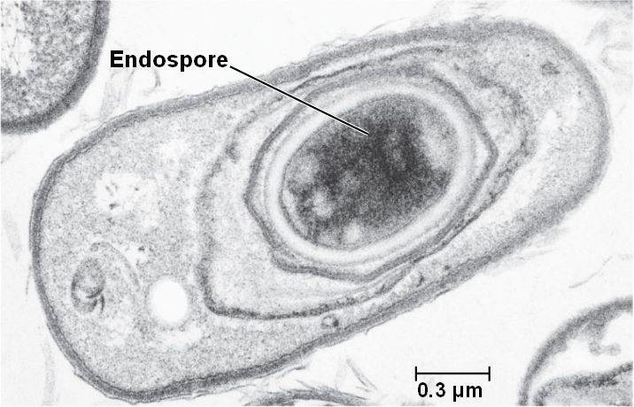
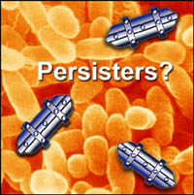
Oligotrophy (寡营养) in natural environments
To survive starvation conditions:
1. Form endospores (spore vs. endospore)
2. Form persisters
3. Function of RpoS (Transcription in bacteria)
4. Function of starvation proteins
a. increase peptidoglycan cross-linking and cell wall strength
b. protects DNA
c. prevent protein denaturation and renature damaged proteins

Slide 5





























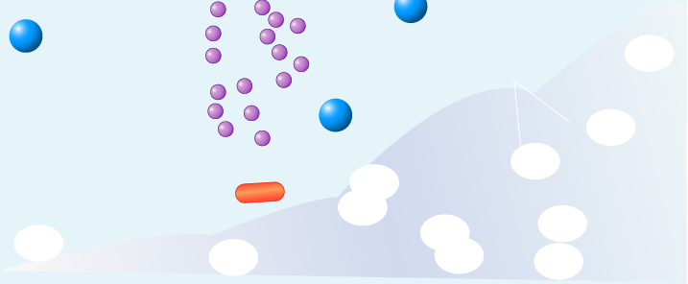































Growth in biofilm(生物膜)
1
Substratum preconditioning
by ambient molecules
Although ecologists observed as early as the 1940s that more microbes in aquatic environments were found attached to surfaces than were free-floating, only relatively recently has this fact gained the attention of microbiologists.
4
Desorption
Convective
and di
f
2
Cell
6
fusive
deposition
Transport of O2
9
Secre tion of
and nutrients
polysaccharide
matrix
Convective
8
Detach ment
5
and di
erosion,and
f
fusive
sloughing
tran sport of O2
3
Cell
and nutrients
adsorption
7
Replication
and growth
Biofilm vs. membranes
“The attached microbes are members of complex, slime-encased communities called biofilms.”

Slide 6
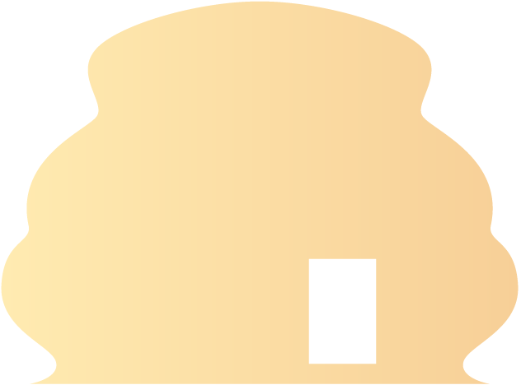
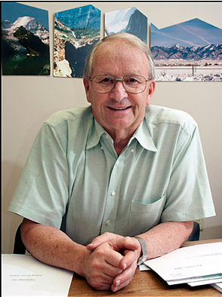



Heterogeneity in biofilm
Charged matrix
Cell-to-cell
Positively charged
signals
antimicrobial
(binds to negatively
charged slime)
Change in
physiology
Persister
Nutruont grationt
Few
cells
nutrients
Prof. Costerton
Oxygen gradient
Low O2
“In a paper in Science in 1999, we said 65 percent of all diseases in the developed world are biofilms,” Costerton said. “Now the NIH says 80 percent.
Genetic
diversity
Slow
Fast growers
growers

Slide 7
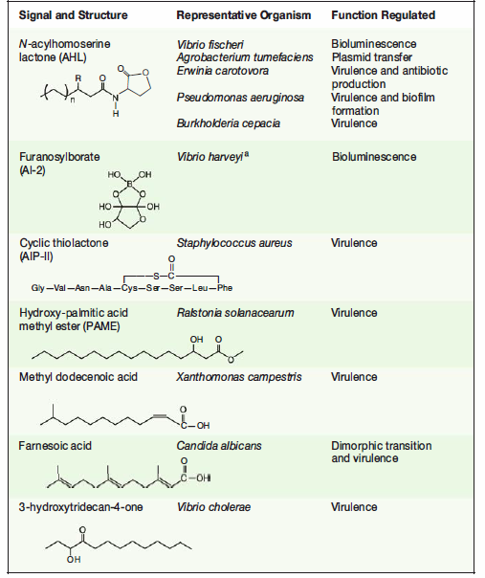
Cell-cell communication within microbial populations
Quorum sensing (群感效应)：Bacterial cells use molecular signals to communicate with each other in a density-dependent manner.
AHL(N-酰基高丝氨酸内酯): G-/AI-1
Furanosylborate (呋喃酰硼酸): AI-2
Quorum sensing often relates with bacteria in biofilm. Why?
Peptide(寡肽): G+

Slide 8
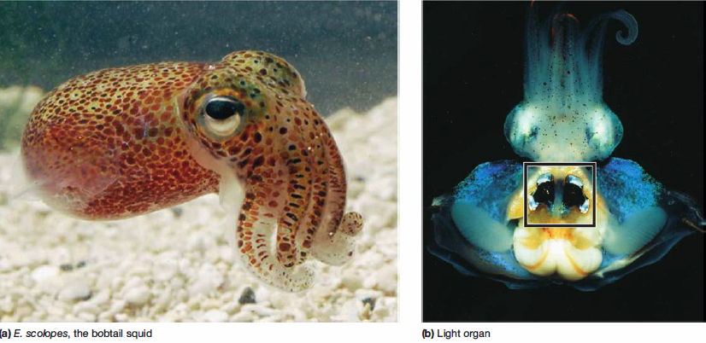

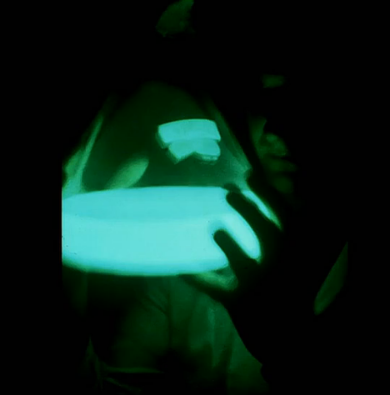
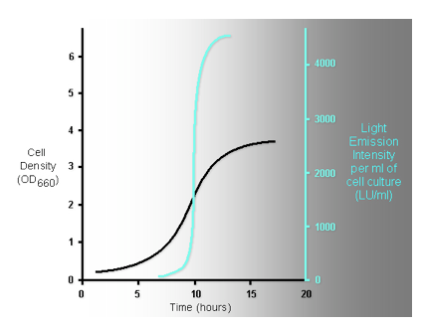
A story from squid (see“视频资源”)
a
Biofilm
Bioluminescense
Toxin Production
Phenctypes
Threshold
Quorum Sensing On
Quorum Sensing
Off
Signal Molecule Conentration
b
Signal Molecules
T
ime(growth)
AHL:AI-1
AIP
AI-2
O
O
R
O
HO
B
OH
HO
CH3
O
N
(CH2)
Ser
S
C
Met
HO
O
O
CH3
HO
OH
H
T
yr
T
yr
Cys
IIe
O
O
n=3-
Asp
Phe
1
1;R=-H,-OH,=O
HO
HO
Gram Negative
Gram Positive
Gram Negative&Positive
Bacteria
Bacteria
Bacteria

Slide 9
Measurement of Microbial Population Size

Slide 10
Direct measurement of cell numbers
Viable counting methods
Measurement of cell mass

Slide 11
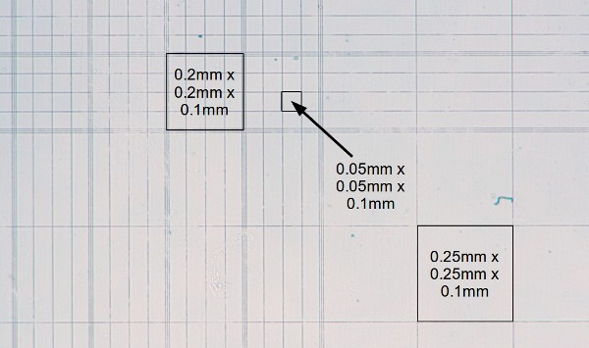
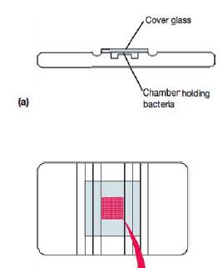
Using counting chambers (计数板)
Volume= 2.5×10⁻⁴ ul
=2.5×10⁻⁷ mL
1 cell in each of the area= cell density?
Petroff-Hausser counting chamber
easy, inexpensive, and quick
count all cells
cannot distinguish living from dead cells
can only determine relatively high concentration of cells

Slide 12
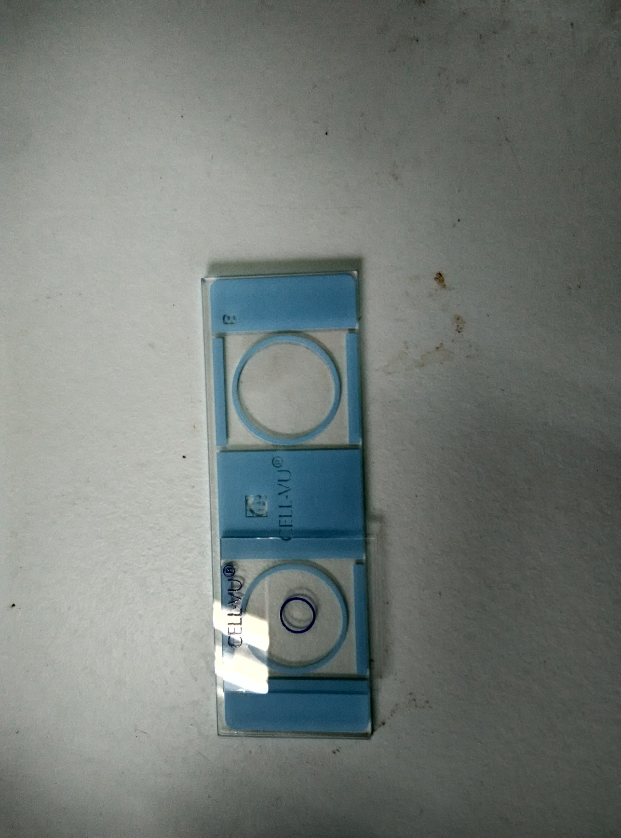
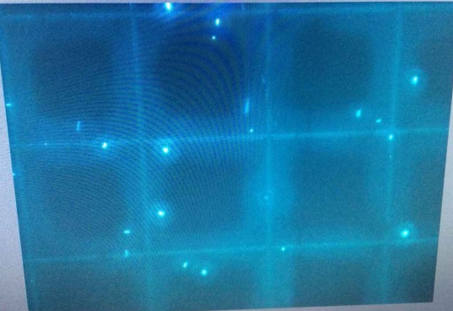
Use thinner chamber (10-20 μm) and fluorescence (more specific and clearer)

Slide 13
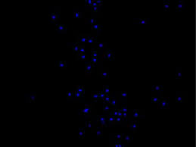
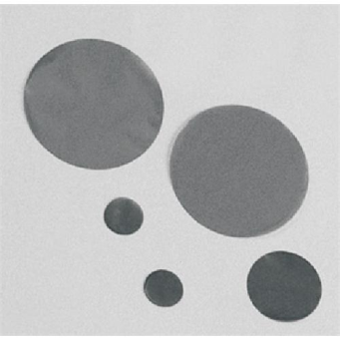
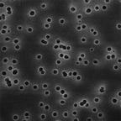
Filtration and fluorescent microscope
Black polycarbonate membrane (poresize: 0.2μm)
DAPI stained microbial cells
Cell density (no. of cells mL⁻¹) =
1cm²(10⁸ μm²)
100×100=10⁴μm²
100 cells
(Total filter area/Area of a field)×average cell number per field
volume of filtered water
10 mL
10⁵ mL⁻¹

Slide 14
Viable Counting Methods
Live
Actively metabolizing cell
Cell with reduced metabolic activity
Some metabolic activity and plasma membrane intact, but RNA content is reduced
Viable cell ≈ CFU
Plasma membrane intact, but no detectable metabolic activity
Extensive damage to plasma membrane
Cellular DNA degraded
Cell fragmented
Dead

Slide 15

























































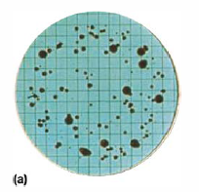
Membrane filter
Water sample
removed and
Membrane
filter through
place in plate
filter on a
membrane filter
0.45 um
containing the
Incubation
filter support
appropriate
for 24 hours
medium
T
ypical
colonies
Pour plate 倾注平板 and
spread plate 涂平板 are also work.
Typically 30-300 CFUs are preferred.
Labor-consuming (need cultivation equipment) and time-costing
Only count cultivable cells
uncultivable microbes （about 90-99.9% for nature environments）
Can obtain the isolates
Good detective limitation (think about filtration of 100 mL water)

Slide 16
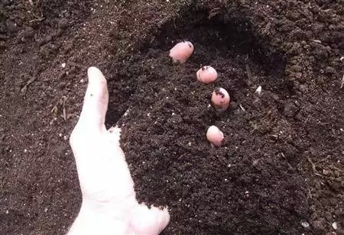
How to quantify CFU in soil sample?

Slide 17
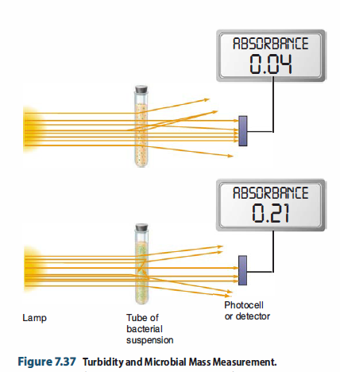
Measurement of cell mass
Weighing (balance, 天平)
measuring the turbidity (spectrometer, 分光光度计OD 600)
Convenient
can only determine relatively high concentration of cells
Not distinguish live/dead cells
Not comparable among different microorganisms
OD600=1, for
Escherichia coli, around 1×10⁹ cell per ml
Saccharomyces cerevisiae (酿酒酵母), around 3×10⁷ cell per ml

Slide 18
How to measure the growth of Mycoplasma (支原体) cells in broth medium by weighing?
Sample preparation?
The precision of balance?
How to calculate the growth rate?

Slide 19
Principles of Microbial Control

Slide 20
Terminology
Sterilization (灭菌)
All living cells, spores, and acellular entities are either destroyed or removed from an object or habitat.
Disinfection (消毒)
Killing, inhibition, or removal of microorganisms that may cause disease.
Antisepsis (组织防腐)
Chemical agents applied to tissue to prevent infection by killing or inhibiting pathogen growth.
Chemotherapy (化疗)
Use of chemical agents to kill or inhibit the growth of microorganisms within host tissue
Cases: 1. boiling water; 2. use mercurochrome (红药水) on wound

Slide 21
Three examples of microbial control agents
A
Antisepsis
C
B
Disinfection
Log (microbial population)
Sterilization
0
Time or concentration

Slide 22
Terminology
suffix –cide (杀菌物, live/dead)
Bactericide (杀细菌剂)
Fungicide (杀真菌剂)
Viricide (杀病毒剂)
-static (抑菌物, growth/no growth)
Bacteriostatic (抑细菌剂)
Fungistatic (抑真菌剂)
The same agent can be -cide or -static under higher and lower concentration, respectively.

Slide 23
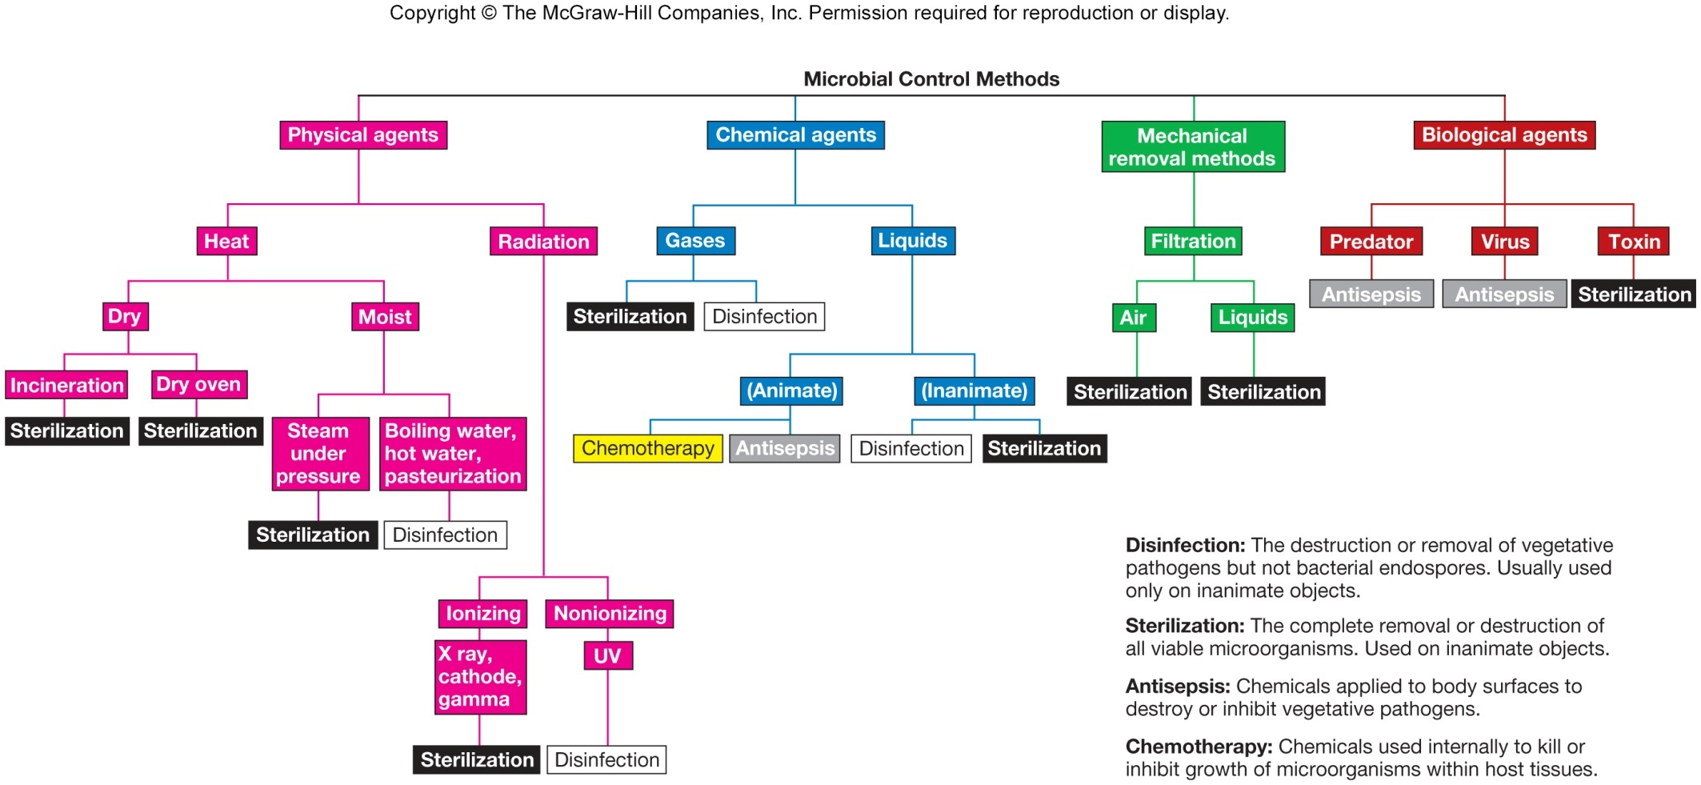

Slide 24
Physical, Chemical and Biological Control

Slide 25
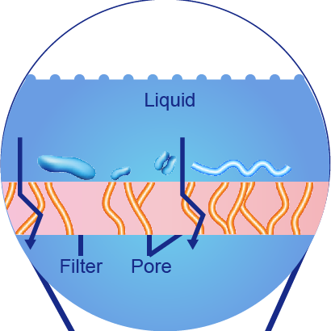
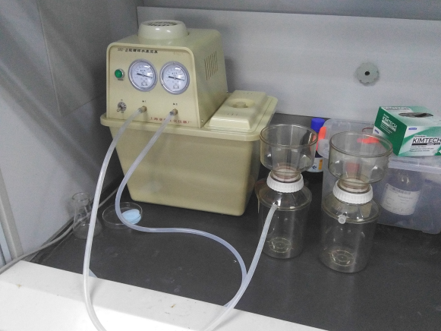
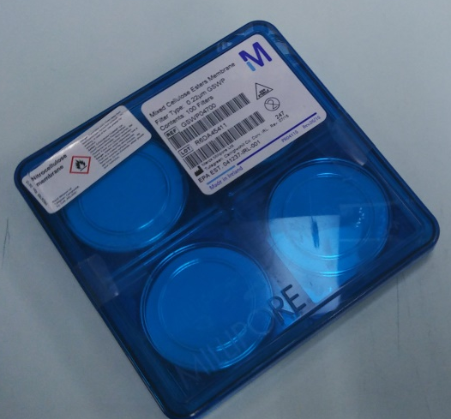
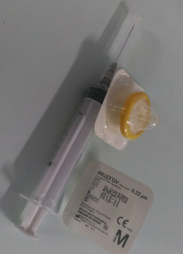


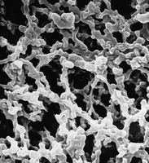
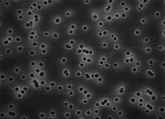


Mechanical Removal Methods
Liquid
Filter
Pore
Filter
Isopore membrane
Mixed cellulose
membrane
Vacuum pump
Sterilized fluid
Usually use 0.2 μm poresize membranes

Slide 26
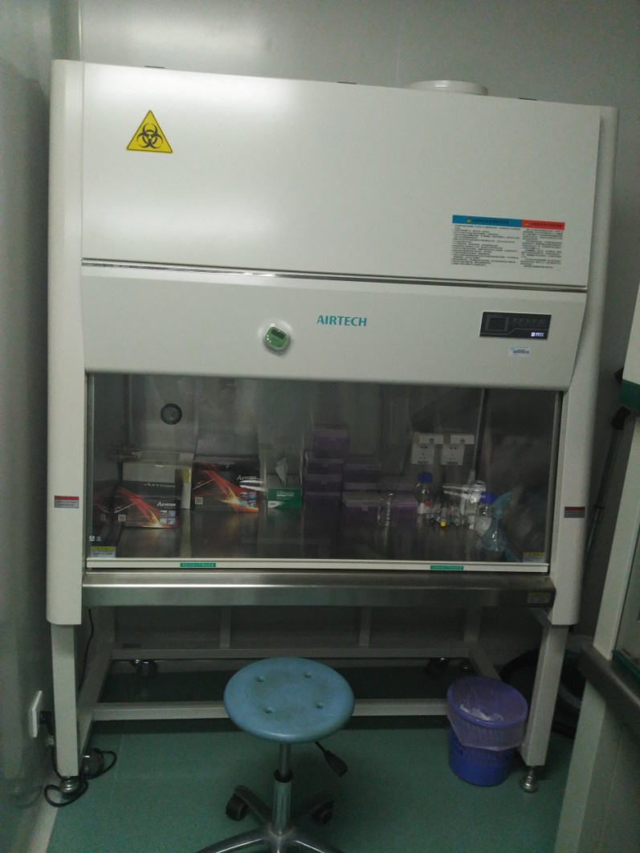

Air filtration in lab (biosafety cabinet)
Operational zone
Room air
HEPA-filtered air
Contaminated air
Biosafety cabinet
生物安全柜
Side view

Slide 27
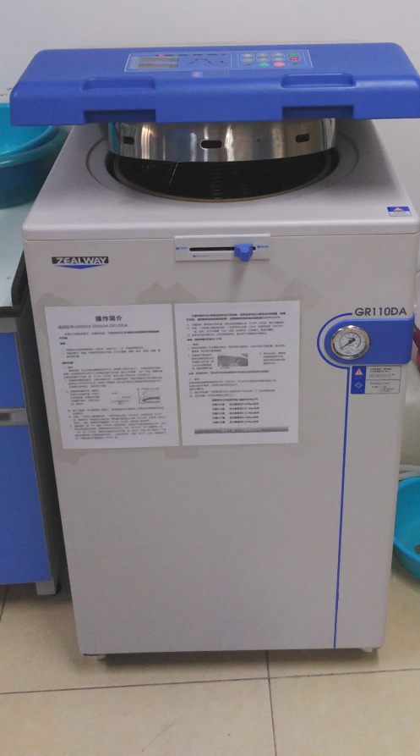
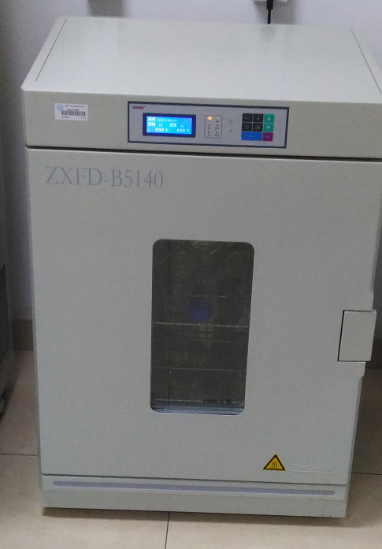
Physical Control Methods
(Heat)
Heating and boiling
Excluding air by generating steam
T at 121 ºC and the pressure at 0.1 Mpa
Keep 15-30 min and excluding steam
Usually 160-170 degree C and 2-4 h
in oven (烘箱)
Autoclave
灭菌锅
121 ºC and 0.1Mpa
Cooling down
Dry heat
Moist heat

Slide 28



Pasteurization (70-85ºC, 15 s)
Fresh
milk in
Pasteurized
milk out
Heating
section
Cooling
section

Slide 29
Radiation
Ultraviolet (UV)
260 nm
DNA damage
poor penetration
Ionizing radiation (致电离辐射)
gamma radiation and electron beams
dislodge electrons from atoms or molecules
suitable for antibiotics, hormones, and plastic disposable

Slide 30
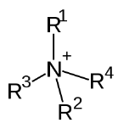
Chemical Control Agents
Chemical | Commonly used concentration | Activity level
Ethylene oxide (环氧乙烷，气态) | 450-500 mg/L | High
Formaldehyde (甲醛) | 6-8% | High to intermediate
Hydrogen peroxide (过氧化氢) | 6-30% | High to intermediate
Alcohols (酒精类) | around 75% | Intermediate
Chlorine (氯，主要是次氯酸) | 500-5,000 mg/L | Intermediate
Quaternary ammonium (季铵盐类) | 0.1-0.2% | Low

Slide 31
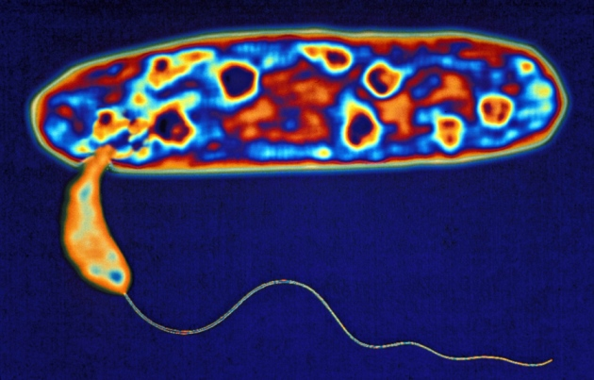
Bdellovibrio (蛭弧菌) And Like Organisms, BALOs
Biological Control of Microorganisms
G- cell with periplasmic space
1
2
BALO cell
3
7
6
Reardon, 2015
5
4

Slide 32
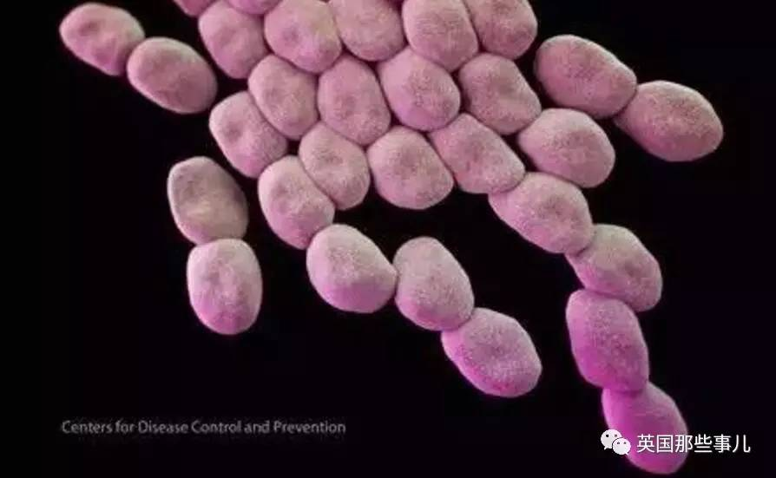

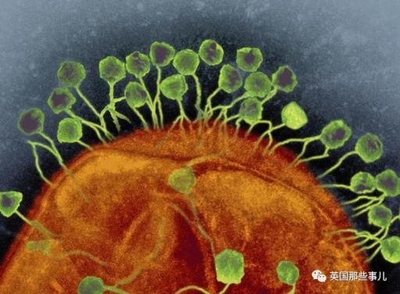
Use phage to control bacteria
超级细菌—鲍曼不动杆菌
Acinetobacter baumannii
ESKAPE (六大超级细菌)
Steffanie Strathdee and her husband
UC San Diego’s Global Health Institute
噬菌体疗法

Slide 33
Evaluation of antimicrobial agent effectiveness
Population size
Larger size requires a longer time to die
Population composition
Susceptibility of different cells
Concentration or intensity of an antimicrobial agent
Mostly positive but not always
Contact time
Temperature
Local environment (pH/free-living or biofilm)

Slide 34
Antibiotics

Slide 35
Antimicrobials & Antibiotics
In general, any chemical, physical, or biological product that controls microorganisms is referred to as an antimicrobial agent.
Antibiotic: a microbial product or its derivative that kills susceptible microorganisms or inhibits their growth.
Antibiotics are chemotherapeutic agents (化疗药物).

Slide 36
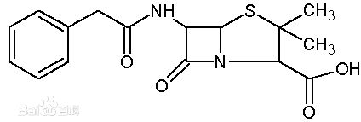
Some typical antibiotics
Fleming accidentally rediscovered penicillin (青霉素) from mold Penicillium notatum (青霉菌) in 1928
Streptomycin (链霉素), chloramphenicol (氯霉素), neomycin (新霉素), oxytetracycline (土霉素), and tetracycline (四环素) were discovered from Streptomyces (链霉菌属), an Actinobacteria (放线菌).

Slide 37
General Characteristics of
Antimicrobial Drugs
Therapeutic index (治疗指数)
Toxic dose(毒性剂量)
Therapeutic dose (治疗剂量)
Larger is better!
Types of antibiotics:
Naturally produced
Synthetic
Semisynthetic
Narrow-spectrum drugs
Broad-spectrum drugs
Cidal
Static

Slide 38
Determining the Level of
Antimicrobial Activity
Minimal inhibitory concentration (MIC)
Minimal lethal concentration (MLC)
Methods to determine MIC
Dilution Susceptibility Tests (稀释法药敏试验)
Disk Diffusion Tests (纸片扩散实验)

Slide 39
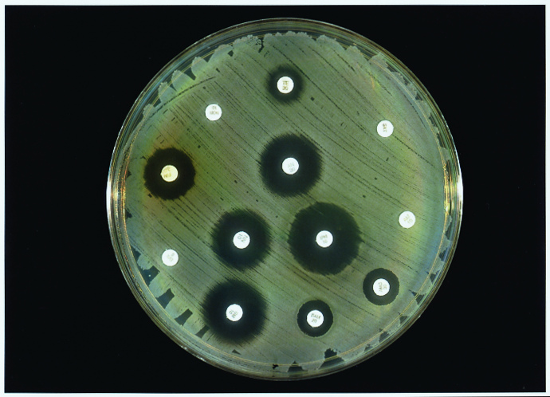
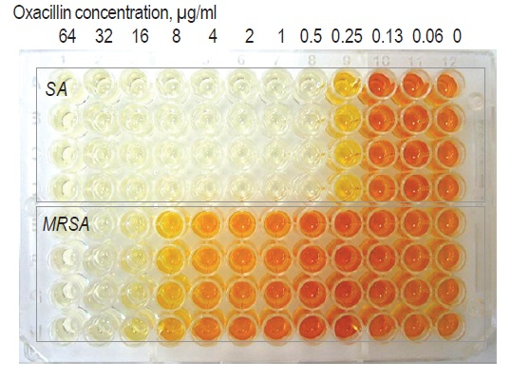
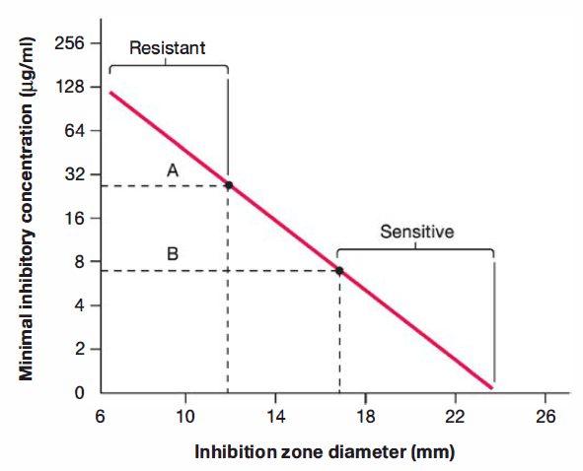
Kirby-Bauer method
Dilution susceptibility tests on 金黄色葡萄球菌
Think about how to determine MLC?

Slide 40
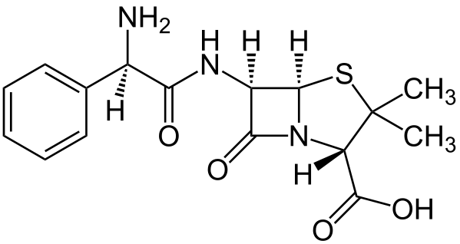
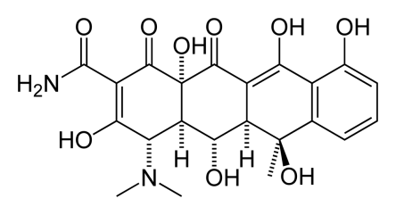
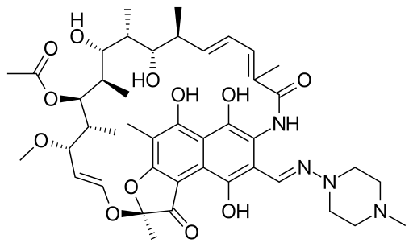
Examples of antibiotics
Antibiotics | Primary Effects | Spectrum | Mechanism
Ampicillin (氨苄青霉素) | Cidal | Broad (G+ and some G-) | Cell wall synthesis inhibition (transpeptidation enzyme)
Oxytetracycline (土霉素) | Static | Broad | Bind to small ribosomal subunit protein S30 and inhibit protein synthesis
Rifampin (利福平) | Cidal | Broad (Mycobacterium et al.) | Inhibits bacterial DNA-dependent RNA polymerase
Why antibiotics do not affect host’s cellular functions?

Slide 41
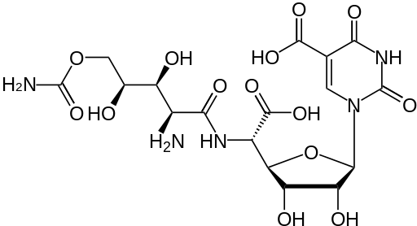
Antifungal Drugs
Treatment of fungal infections are usually much more difficult than the bacterial ones. Why?
Polyoxyin (多氧菌素) D targeting on chitin synthase in fungi

Slide 42
Factors Influencing Antimicrobial
Drug Effectiveness
First, drug must be able to reach the site of infection.
unstable in stomach acid
not well absorbed from the intestinal tract
Second, the pathogen must be susceptible to the drug.
Third, dose must high enough at the site of infection.
Drug resistance in bacterial pathogens

Slide 43
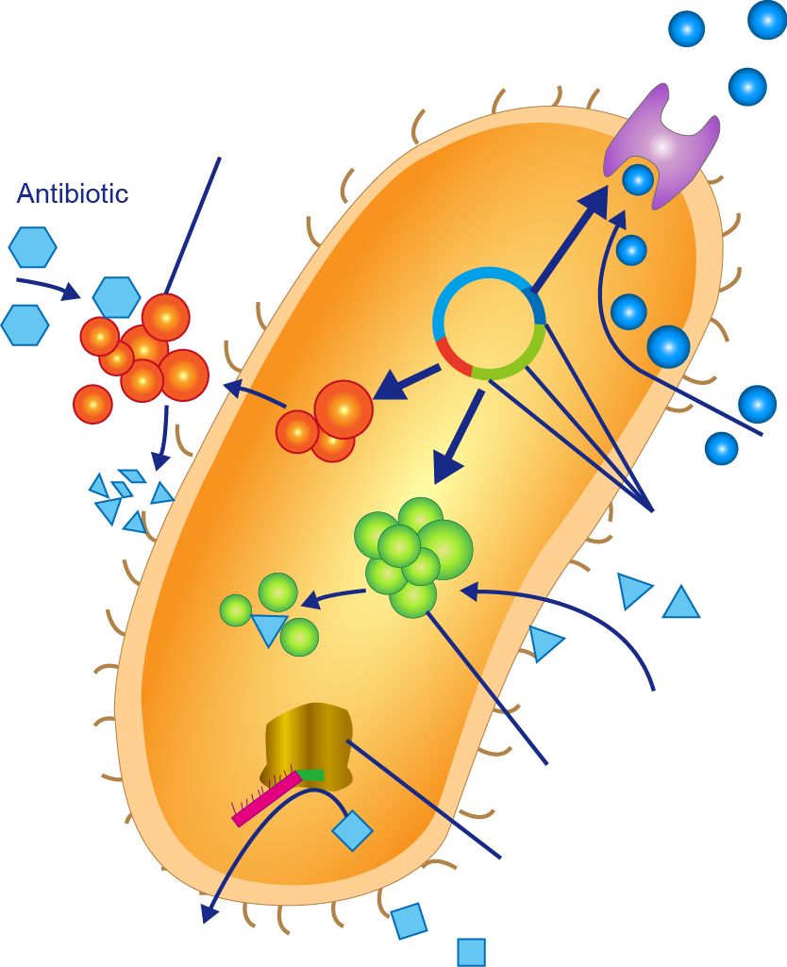
Mechanisms of Drug Resistance
Eflux pump
Antibiotic-degrading enzyme
4
2
Antibiotic
Antibiotic-reslstance genes
3
1
Antibiotic
Antibiotic altering enzyme
Alter antibiotic target
Antibiotic

Slide 44
超级细菌”ESKAPE”
Enterococcus faecium (屎肠球菌)
Staphylococcus aureus (金黄色葡萄球菌)
Klebsiella pneumoniae (肺炎克雷伯氏菌)
Acinetobacter baumannii (鲍氏不动杆菌)
Pseudomonas aeroginosa (铜绿假单胞菌)
Enterobacter spp. (肠杆菌)

Slide 45
Discussion
Consider cell-cell communication: bacteria that "subvert“ and "cheat" have been described. Describe a situation in which it would be advantageous for one species to subvert another, that is, degrade an intercellular signal made by another species. Also, describe a scenario whereby bacterial cheaters-defined as bacteria that do not make a molecular signal but profit by the uptake and processing of signal made by another microbe-might have a growth advantage
Which physical or chemical agent would be the best choice for sterilizing the following items: glass pipettes, tryptic soy broth tubes, nutrient agar, antibiotic solution, interior of a biological safety cabinet, wrapped package of plastic Petri plates? Explain your choices.

Slide 46
3. How would you explain to a patient that a virus can be used to eliminate a bone infection caused by bacteria that do not respond to antibiotics?
4. Suppose hospital custodians have been assigned the task of cleaning all showerheads in patient rooms to prevent the spread of infectious disease. What two factors would have the greatest impact on the effectiveness of the disinfectant the custodians use? Explain what that impact would be.
5. What advantage might soil bacteria and fungi gain from the synthesis of antibiotics?
6. You are a pediatrician treating a child with an upper respiratory infection that is clearly caused by a virus. The child's mother insists that you prescribe antibiotics-she's not leaving without them! How do you convince the child's mother that antibiotics will do more harm than good?

