Slide 1

MICROBIOLOGY
Lecture 2
Bacterial Cell Structure
(Chapter 3)
张连茹
Email:ru898@xmu.edu.cn
Tel:18965158521
Office: C-426

Slide 2
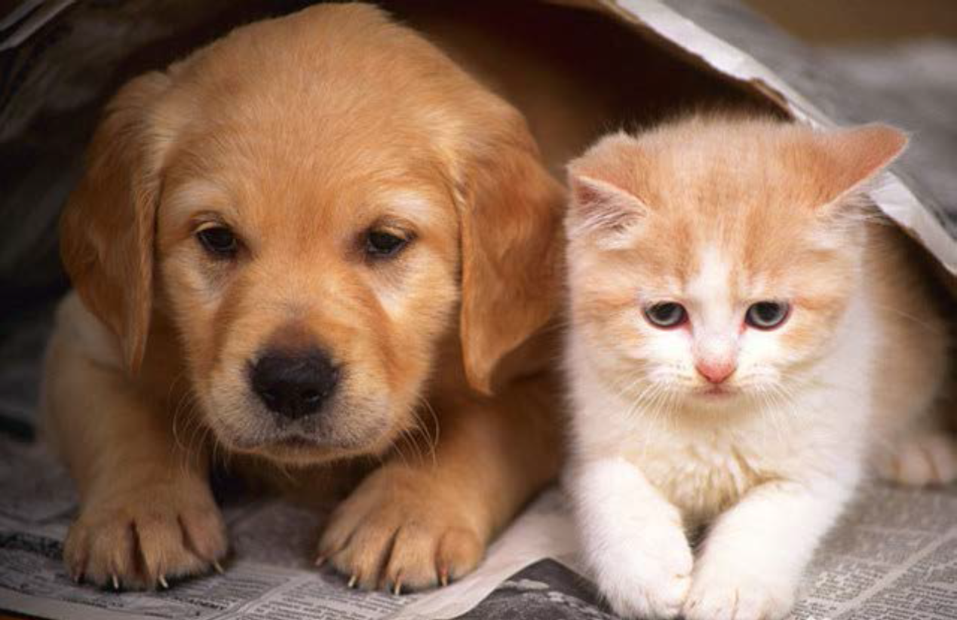

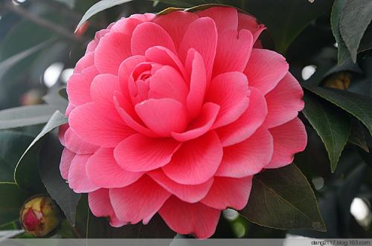

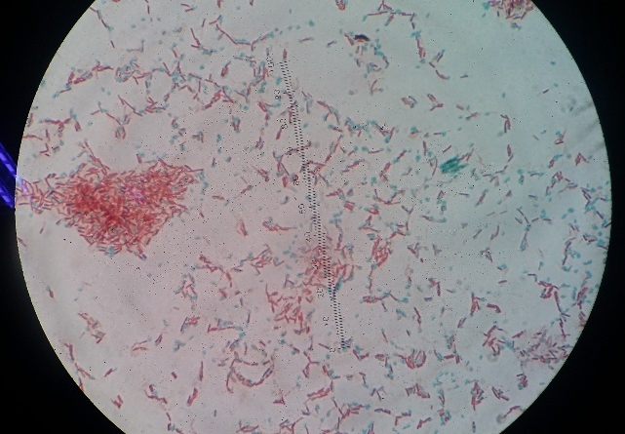
Animals Plants
Microorganisms
Notes:
大家养过宠物没有？ 养过微生物吗？

Slide 3
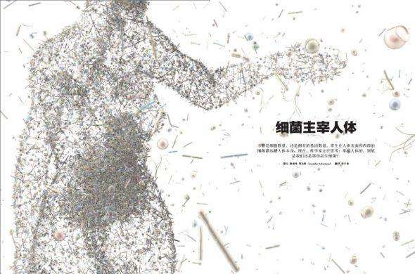
People are indulged in the ocean of microorganisms
Tao Ding, Patrick D. Schloss. Nature, 16，2014;
How to prove the bacterial such as HP exist in stomach?

Slide 4
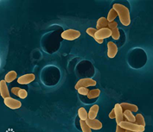
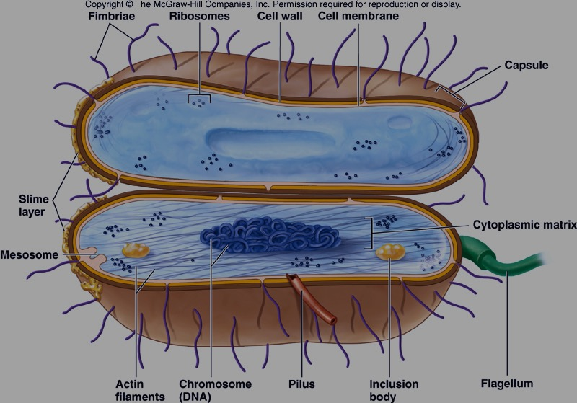
Episode 1
What is a bacterium?
Features of bacteria
The morphology of bacteria
Size-
Shape and arrangement-
Survive strategies-S/V
Only 1% microbes are culturable

Slide 5
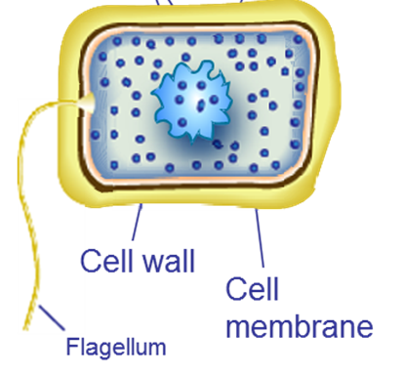
What are bacteria?
Structure Simple-Prokaryote
R. Stanier and C. B. van Niel
described prokaryotes in terms of what they lacked in comparison to eukaryotic cells.
Prokaryote –unicellular organisms, lack nuclei and membrane-bound organelles.
3.1 The "Prokaryote" Controversy
What is your opinion about of The "Prokaryote" Controversy?
Please use three or more evidences to support your opinion.
Notes:
60年代分子生物学遗传学等的发展，发现古菌与细菌截然不同的类别。

Slide 6
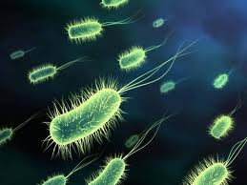
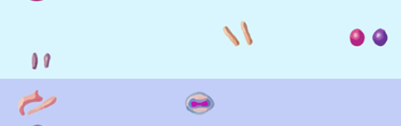
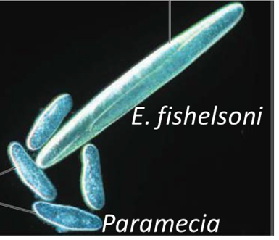
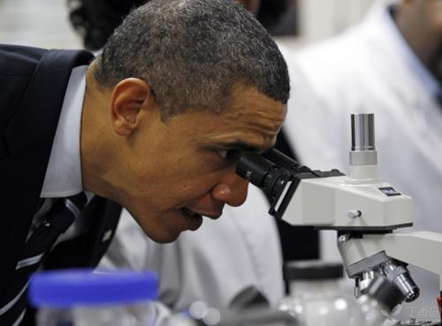
3.2 A Typical Bacterial Cell
3.2.1. Size of Bacterial-Small
Bacteria are measured in micrometers(μm).
Average rod – 1.1 - 1.5 x 2 – 6 μm (E. coli)
Smallest – 0.1x0.3 μm (Mycoplasma)
Largest-80x600 μm
Filter pore size:0.22 μm
What is this?
Notes:
用光学显微镜观察时，要用高倍镜，
最好油镜观察；过滤除菌的膜的孔径不要太大！

Slide 7
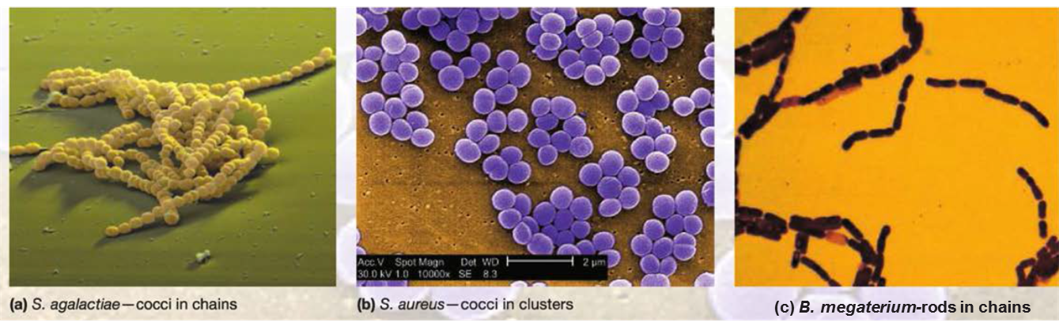
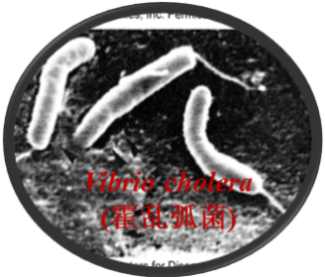
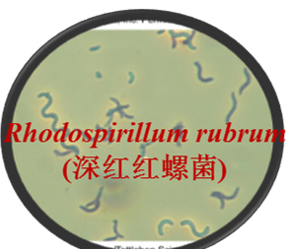
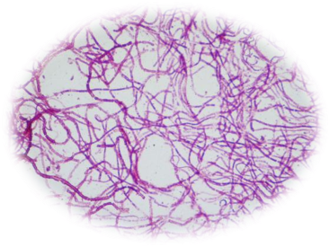
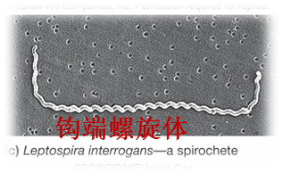
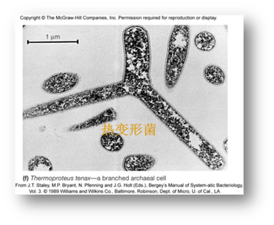
3.2.2 Shape and Arrangement
The two most common shapes are cocci and rods
Cocci-balls
Bacilli – rods
Coccobacilli – very short rods
Vibrios – resemble rods, comma shaped
Spirilla (s., spirillum) – rigid helices
Spirochetes – flexible helices
Mycelium-hyphae
Pleomorphic – organisms that are variable in shape.
Notes:
螺旋菌(spirilla)与螺旋体(spirochetes)形态很相似，均是弯曲、螺旋形，都属于原核生物。它们的主要区别是螺旋菌菌体坚韧，有鞭毛，以鞭毛作为运动器官，vibrios弧菌 百日咳杆菌(百日咳博德特氏菌Bordetella pertussis
Bacillus is single, but bacilli pl/ coccus=a single cocci(many coccus)

Slide 8

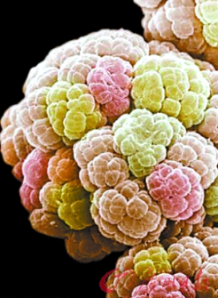
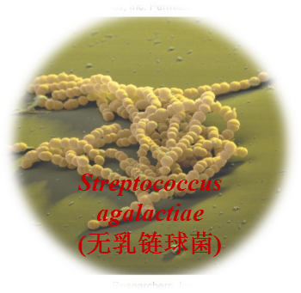
3.2.2 Shape and Arrangement
1.They can exist singly or can be associated in characteristic-arrangements.
Why ?
  2.Determined by plane of division(1,2,3)
  3.Determined by separation or not
  Such as the genus Sarcina, cocci divide in three planes,
  Long chains of cocci result when cells adhere after repeated divisions in one plane (Streptococcus, Enterococcus, and Lactococcus)
What causes a bacterial species to have a particular size and shape?
Notes:
1. pleomorphic 多型的：以多种不同形态、形式存在的；表现多型性的 multinucleate 多核的

Slide 9

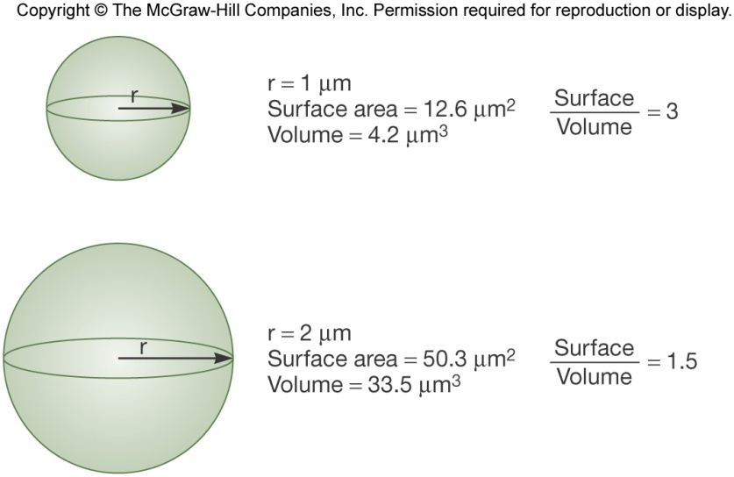
3.2.3 Size – Shape Relationship(S/V)
Microbe has a small volume but a large surface (S/V: surface to volume ratio)
Small size may be protective mechanism from predation
A large surface is important for nutrient uptake efficiently.
How and where to uptake nutrient of microbe?
Notes:
predation - 捕食

Slide 10
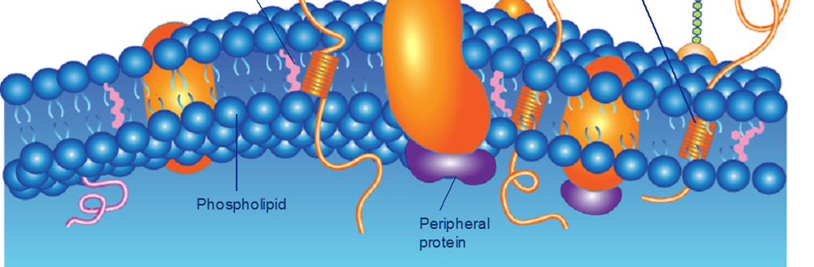
Episode 2
Uptake of Nutrients with Plasma Membrane

Slide 11
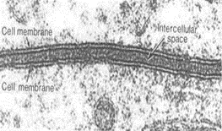
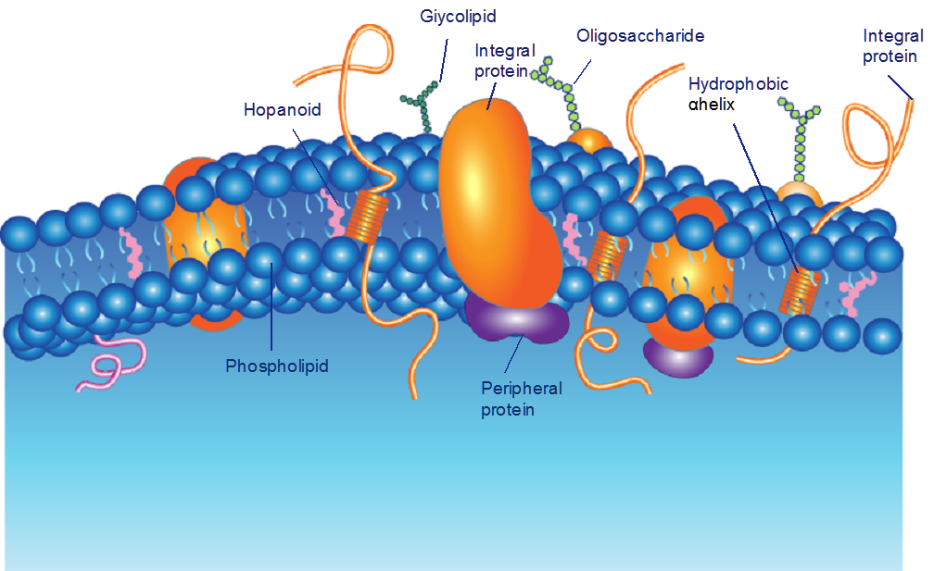
3.3 Bacterial Plasma Membranes
The most widely accepted model for membrane structure is the:
fluid mosaic model of membrane structure
Singer and Nicholson
The model was established using a variety of experimental approaches, including TEM and AFM.
Lipid bilayers with floating(25%) and integral-mosaic(75%) proteins

Slide 12
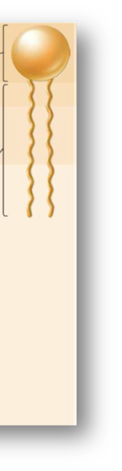
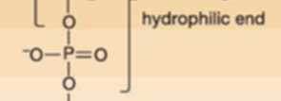
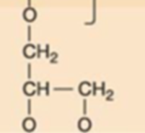
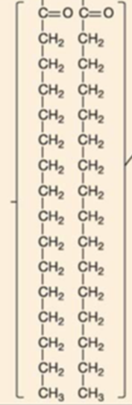
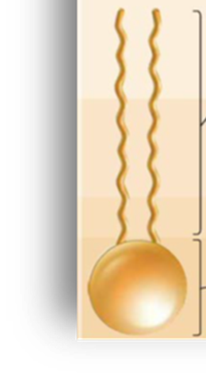
3.3.1 Bacterial Lipids
Component:phospholipid
The lipid composition varies with environmental temperature.
Bacteria growing at lower temperatures have more unsaturated fatty acids in their membrane phospholipids;
Why? To remain fluid.
Notes:
symmetry

Slide 13
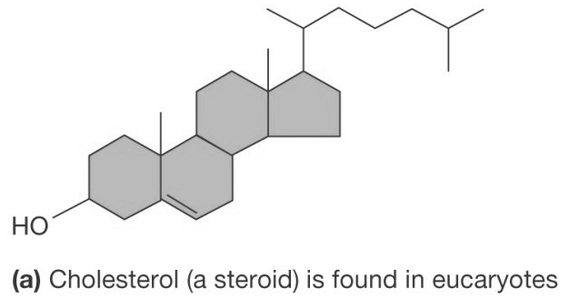

3.3.1 Bacterial Lipids
Bacterial membranes lack sterols but do contain sterol-like molecules, hopanoids
  Synthesis from the same precursors as steroids
  Stabilize membrane
  Found in petroleum(in sediment)
Summary
Lipid bilayers: phospholipid(hopanoids)
Floating proteins: soluble(E?)
Integral-mosaic proteins: insoluble, amphipathic (ETC, transport protein, etc)
Notes:
（low T, more unsaturated lipid.

Slide 14
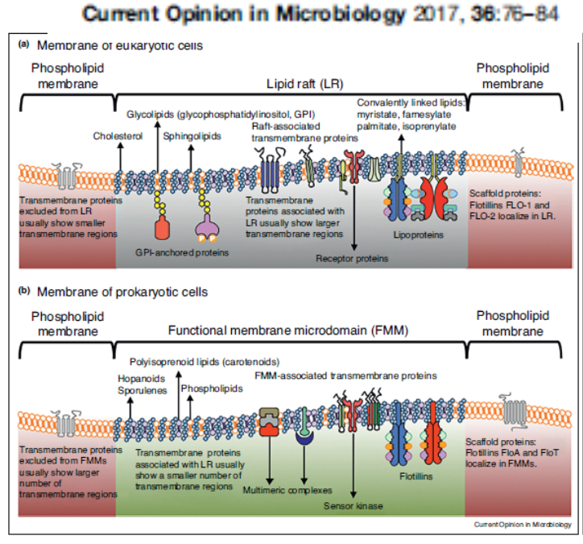
3.3.2 Model of Plasma Membranes(PM)
Is it perfect? What is the flaw of this model?
However, the presence of microdomains enriched for certain lipids and the observation that some integral proteins are present at only certain sites do not support this view.
Notes:
马赛克（Mosaic）原义为：镶嵌,镶嵌图案,镶嵌工艺。

Slide 15
3.3.3 Bacterial Plasma Membrane Function
Encompasses the cytoplasm
Selectively permeable barrier(e.g. uptake nutrient)
Interacts with external environment
  Receptors for detection of and response to chemicals in surroundings
  Transport systems
  Metabolic processes
  Mesosome(中介体)-like a mitochondria

Slide 16
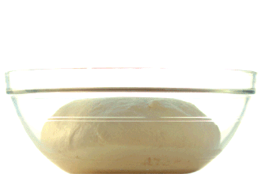
3.3.3. Uptake of Nutrients
What are nutrients?
Elements(macro-; micro-;trace-)
C,O,H,N,S,P,K,Ca,Mg,Fe;
Mn,Zn,Co,Mo,Ni,Cu
Growth factor (AA, Base, Vitamin is essential for some bacteria)
How to uptake? (mechanisms)
  Passive diffusion- concentration gradient
  Facilitated diffusion – all microorganisms
  Active transport – all microorganisms(energy)
  Group translocation(energy) –
Bacteria can uptake soluble nutrients

Slide 17
3.3.3.1. Passive Diffusion
被动扩散
Molecules move from region of higher concentration to one of lower concentration between the cell’s interior and the exterior
Movement of molecules is not energy dependent
H₂O, O₂, and CO₂ often move across membranes

Slide 18
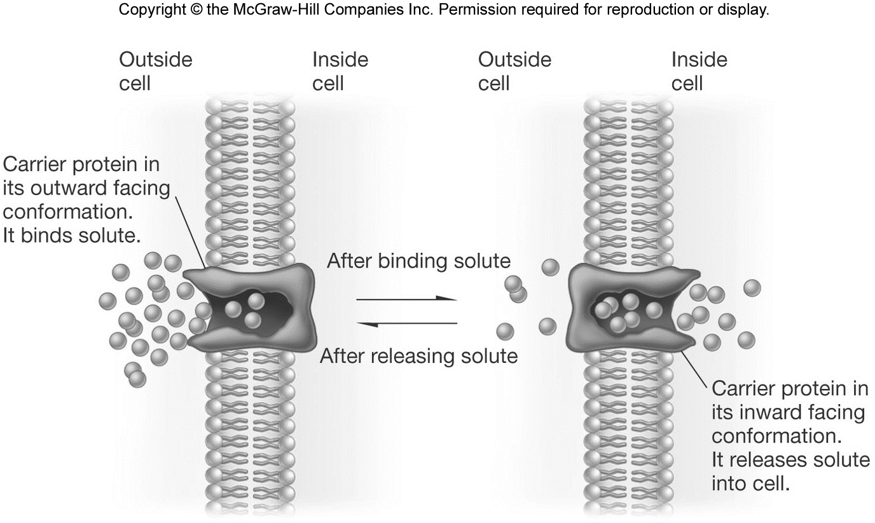
3.3.3.2. Facilitated Diffusion
促进扩散
Similar to passive diffusion
Differs from passive diffusion
  Uses membrane bound carrier molecules (permeases)(glycerol, sugars, and amino acids)

Slide 19
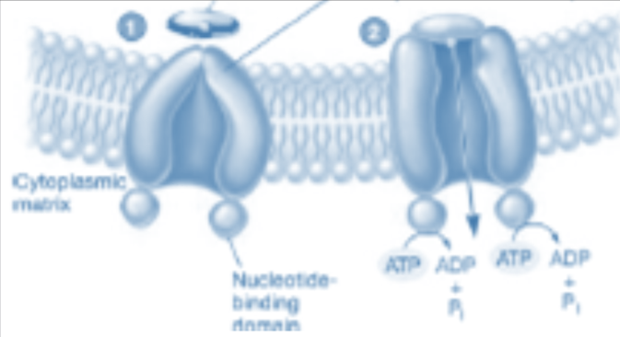
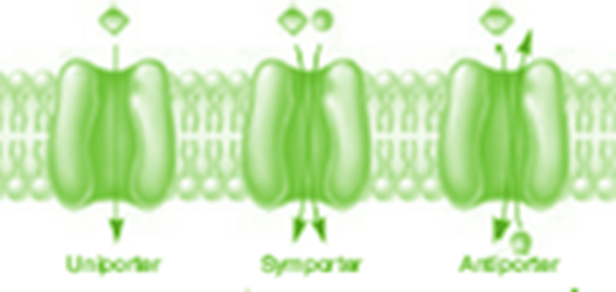
3.3.3.3 Active Transport
主动运输
Primary(ATP)
Energy-dependent process
  ATP(primary) or proton(secondary) motive force used
Move molecules against the gradient
Involves carrier proteins (permeases)
AA(glu, leu) (K⁺)
Secondary(cotransporters)
Notes:
Primary and secondary

Slide 20
3.3.3.4. Group Translocation
Energy dependent transport that chemically modifies molecule as it is brought into cell
Best known translocation system is phosphoenolpyruvate(PEP): sugar phosphotransferase system (PTS)
  sugar PEP (metabolite, high energy)
  P-sugar(in)
  ?
out
  in

Slide 21
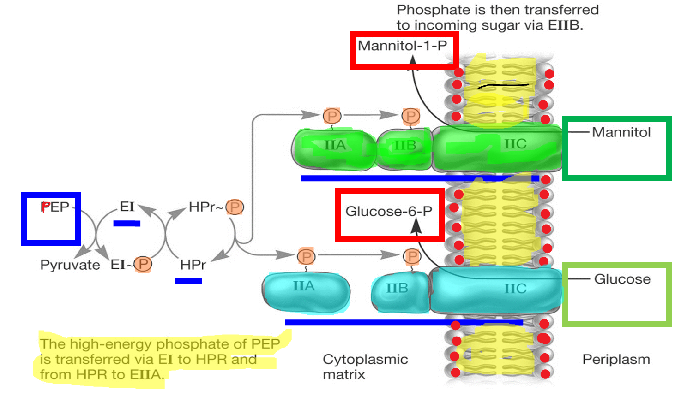
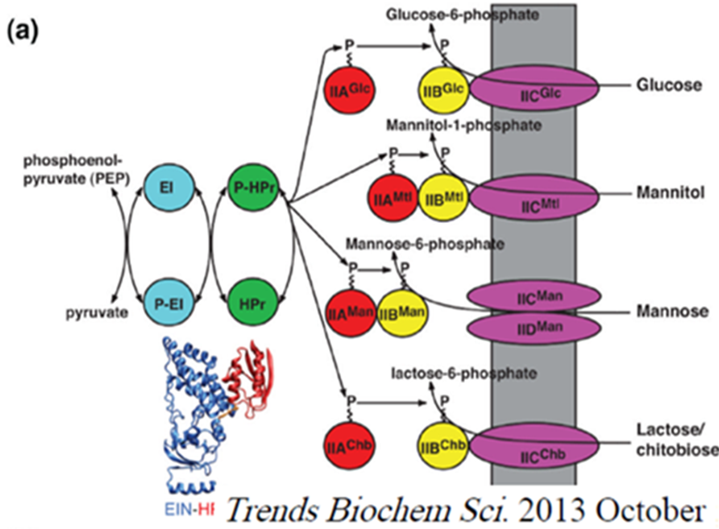
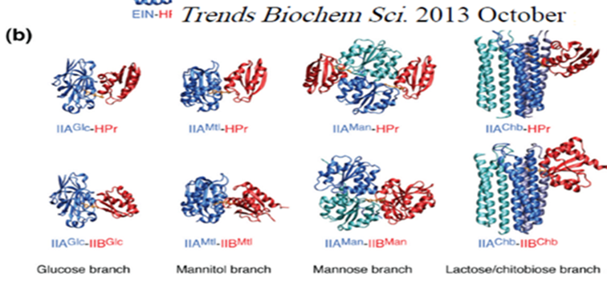
3.3.3.4. Group Translocation
How to uptake an insoluble nutrient?

Slide 22
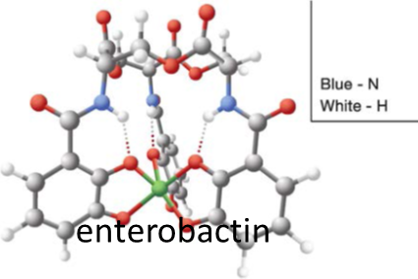
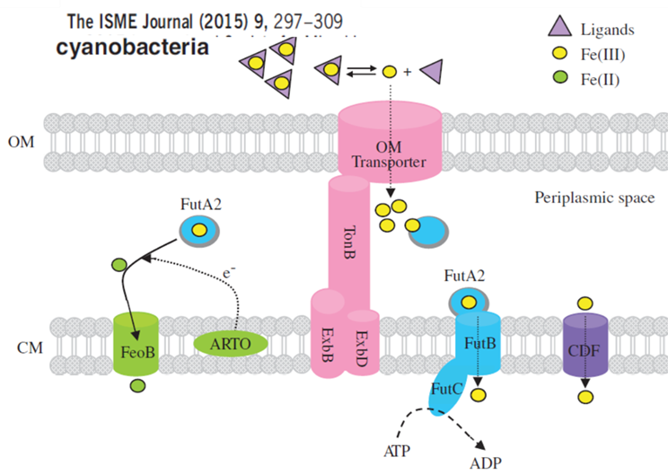
3.3.3.5. Iron Uptake
Fe ³⁺ is very insoluble so uptake is difficult
Microorganisms secrete siderophores to aid uptake
Siderophore complexes with Fe ³⁺ then transported into cell
Notes:
铁载体(siderophores) (ferric iron)

Slide 23
Summary
Size- 0.1-10 um
Shape-simple coccus/rods
  Shape was determined by plane of division and separation or not
S/V is a survive strategy.
The nutrients uptake
PTS uptake system and iron uptake mechanism

Slide 24
Comments
  Passive diffusion- concentration gradient
  Facilitated diffusion
  Active transport (energy)
  Group translocation(energy)
Above four mechanisms, which one is the best for bacteria?

Slide 25

For human cells, the plasma membrane is enough, but microorganism cells need more……Why?
Next we will talk about of the outside structure of membrane ……
Thanks!
Please try to discuss the mechanism of Gram stain.
Notes:
Like a egg.

Slide 26
Mechanism of Gram Staining
What is the procedure of Gram stain?
How to prove cell wall is the main factor for Gram stain?
What is the main difference of G+ and G- in cell wall?
Try to explain the mechanism of Gram stain.

