Slide 1

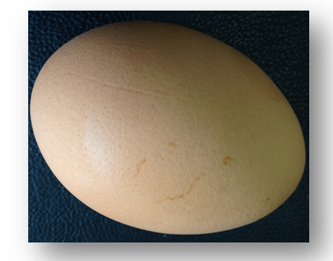
MICROBIOLOGY
For human cells, the plasma membrane is enough, but microorganism cells need more……
What?
Lecture 2
(Chapter 3)
Bacterial Structure
张连茹

Slide 2
Outline
1. Cell wall(peptidoglycan)-close to membrane(3.4)
2. Capsule and slime layer-out of the wall(3.5)
3. Bacterial cytoplasmic structures(3.6)
4. Flagella, fimbriae and pili-stretch out(3.7)
5. Bacterial Motility and Chemotaxis(3.8)
6. Endospore(3.9)

Slide 3
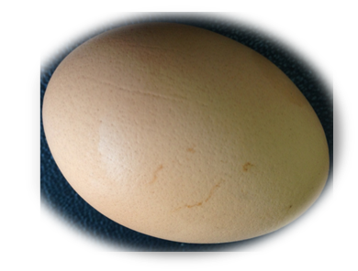
MICROBIOLOGY
Lecture 2
Episode 1
3.4 Cell Wall(peptidoglycan)
1. Peptidoglycan structure
2. Gram stain and the difference between Gram positive and Gram negative
3. Bacteria that lack peptidoglycan or cell walls

Slide 4
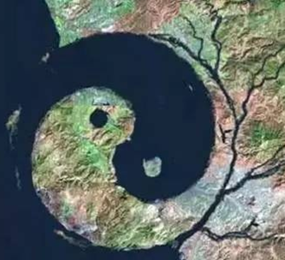
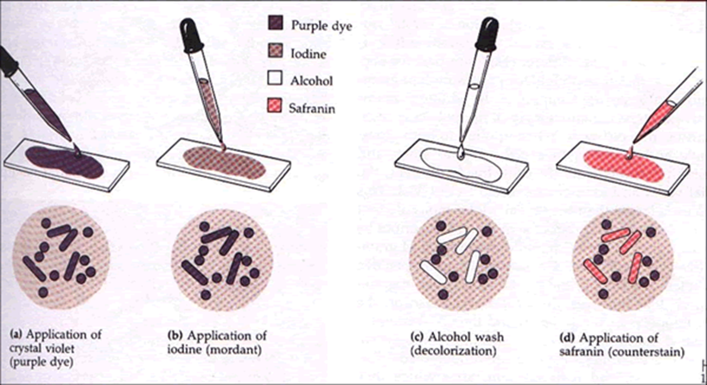
3.4 Bacterial Cell Walls
3.4.1 Overview of bacterial cell wall structure
After Christian Gram developed the Gram stain in 1884, most bacteria could be divided into two major groups（+/-） based on their response to the Gram-staining procedure .
Typical negative bacteria: E. coli ; Typical positive bacteria: Bacillus subtilis
Why?
Peptidoglycan+outer membrane/Peptidoglycan
What is a peptidoglycan(PTG) ?

Slide 5
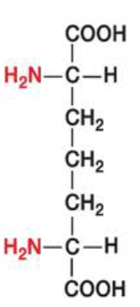
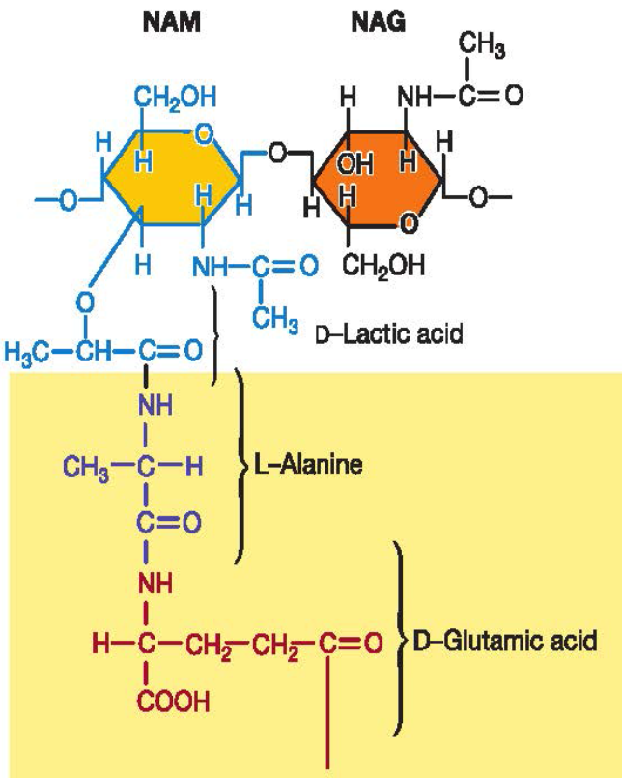
3.4.2 Peptidoglycan Structure
PTG (murein):Meshlike(网状) polymer of identical subunits forming long strands
Building block:
  1) Two sugars:
  N-acetylglucosamine (NAG)
  N- acetylmuramic acid(NAM)
  2) Tetrapeptide:
  L-(ala,lys, gln);
  D-(glu,ala) ?;
  DAP:meso-diaminopimelic acid
  How to connect?
Notes:
mesh

Slide 6

3.4.2 Peptidoglycan Structure
Linkage:
PTG strands have a helical shape(NAM(1,4)NAG)
PTG chains are crosslinked by peptides for strength(NAM-L-ala)
  Interbridges may form PTG sacs – interconnected networks
  Various structures occur-(D-ala)-DAP/(D-ala)-(Gly)₅-(L-lys)interbridge
G⁻
G⁺
How to identify G⁺ or G⁻ ?
Notes:
peptidoglycan sacs 囊pericardial sac 围心腔 pericardium 围心膜 pericaron 核周体 pericarp 果皮 interbrides(G+) peptide bond (G-)?
First amino acid L-ala; second is D-Glu(-)/D-Gln(+); third is DAP(-)/L-lys(+); fourth is D-ala;
Crosslink or bridge take place in position4(D-ala) and position 3(DAP or L-Lys)

Slide 7
3.4.3 Typical Gram-Positive Cell Walls
Most have thick PTG and large amounts of other polymers such as teichoic acids (TA)
The periplasmic space is so narrow that it is often not visible. (exoenzymes)
What is a TA?

Slide 8
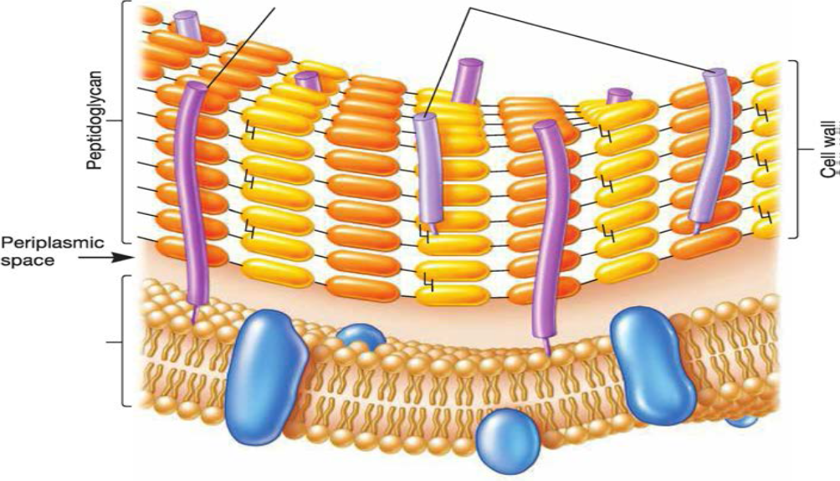
3.4.3 Typical Gram-Positive Cell Walls
TAs are polymers of glycerol or ribitol joined by phosphate groups
TA are covalently connected to PTG or plasma membrane lipids(Lipoteichoic acid,LTA).
Up to 50%
Negative charges
They help create and main­tain the structure and protect the cell from harmful substances in the environment.
How about of G⁻?
Notes:
R. R may
represent o-alanine, glucose, or other molecules.

Slide 9
3.4.3 Typical Gram-Negative Cell Walls
The PTG layer is very thin (2 to 7 nm) and sits within the wide periplasmic space(metabolism).
The outer membrane lies outside the thin PTG layer. It is linked to the cell by Braun's lipoprotein
Lipopolysaccharides
(LPSs)
What is a LPS?

Slide 10
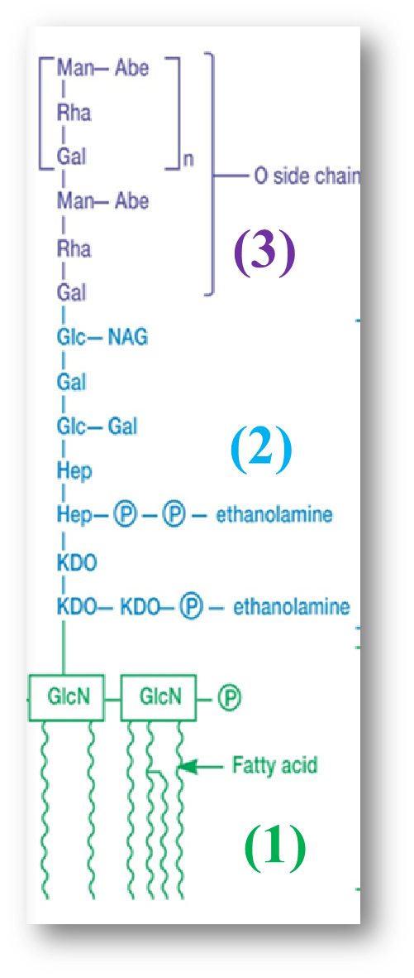
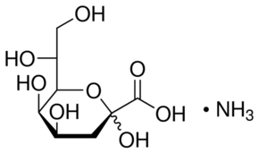
3.4.3 Typical Gram-Negative Cell Walls
LPS:
(3) the O side chain or O antigen extend­ing outward from the core.
(2) the core polysaccharide: Joined to lipid A ,10sugars(KDO) (-)
2-keto-3-deoxyoctonate;
(1) lipid A, contains two GlcN, three fatty acids and phosphate or pyrophosphate attached.
. (Salmonella spp)
Notes:
KDO:2-keto-3-deoxyoctonate;

Slide 11
3.4.3 Typical Gram-Negative Cell Walls
LPS function:
(1) It contributes to the negative charge on the bacterial surface, create a permeability barrier.
(2) LPS also plays a role in protect­ing pathogenic bacteria from host defenses. For example, G⁻ bacteria using the O antigen, such as E. coli O157; here the O side chain is the antigenic type number 157.
(3) The lipid A portion of LPS is called endotoxin.
Outer membrane
More permeable-pore protein

Slide 12
3.4.4 Mechanism of Gram Staining
What is the procedure of Gram stain?
How to prove cell wall is the main factor for Gram stain?
What is the main difference of G+ and G- in cell wall?
Try to explain the mechanism of Gram stain.

Slide 13
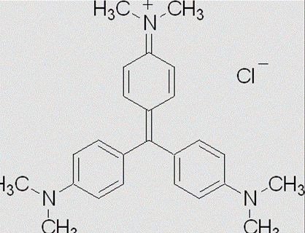
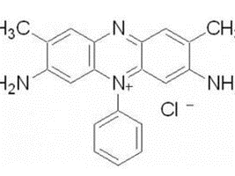
Gram stain
Crystal violet (+)
Iodine
Ethanol
Safranine
Purple/red
Why?

Slide 14
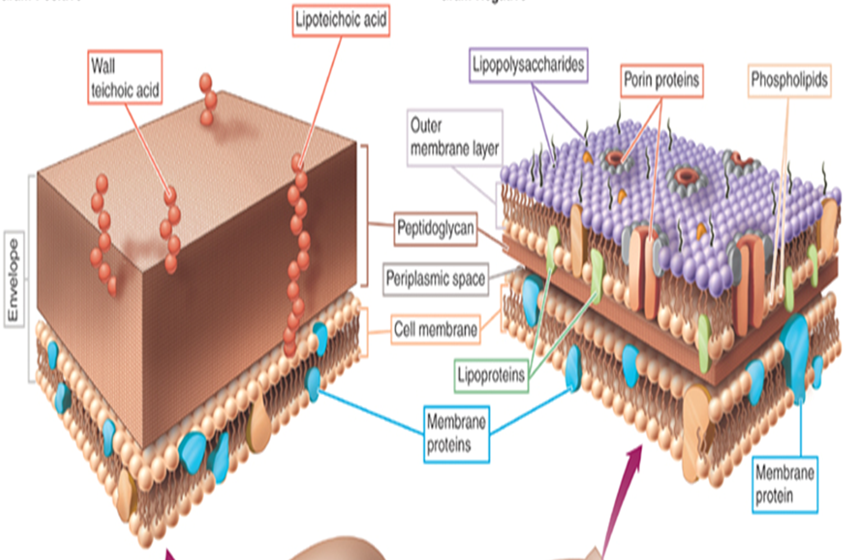
Summary Mononderms and Diderms
G⁺ traits
PTG thick, with TA
Periplasmic space is narrow, with exoenzyme……
Inter-bridge-(Gly)₅ between pentapeptides
Amino acid(L-Lys )
G⁻ traits: double membrane
PTG thin, with LPS
Periplasmic space is wide,
Direct Crosslink-between pentapeptides
DAP
The phyla Fir­micutes and Actinobacteria are G⁺ (Monoderms); Others are negative strains(Diderms).
So, is it much better than the Gram (±)?

Slide 15

What is a consequence of lysis cell wall?
How to lyse or destroy cell wall?

Slide 16
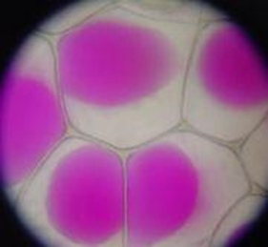
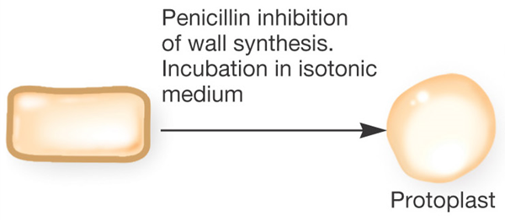
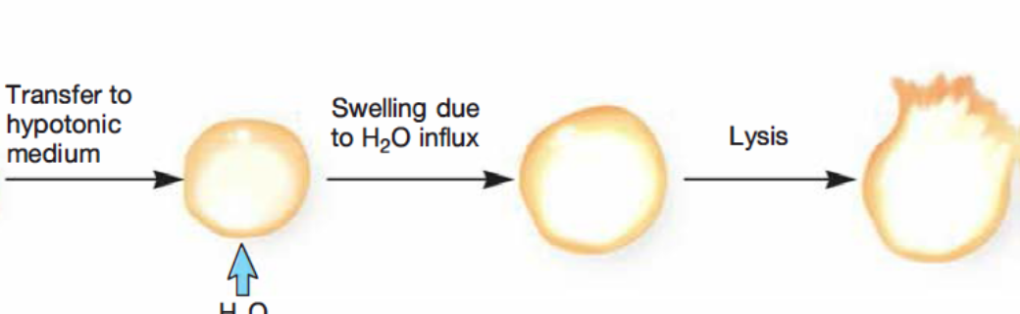
3.4.5 Cell Walls and Osmotic Protection
Hypotonic(低渗):swells-
Hypertonic（高渗): Plasmolysis(质壁分离)
In isotonic solution(等渗）?
Breaks the bond between NAM-NAG (β-1,4 linkage)-lysozyme; Inhibits peptide bridge-penicillin
Protoplasts(原生质体) G⁺ ;
Spheroplasts（球质体) (with little wall or out membrane) (G⁻)?
Do they take place spontaneously in bacteria?

Slide 17
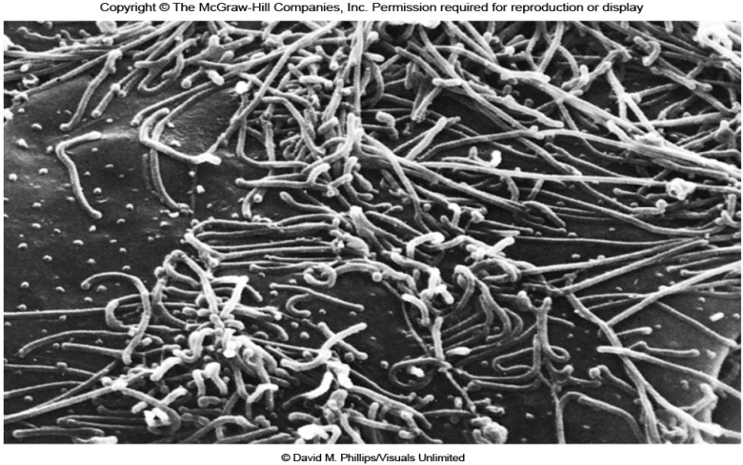
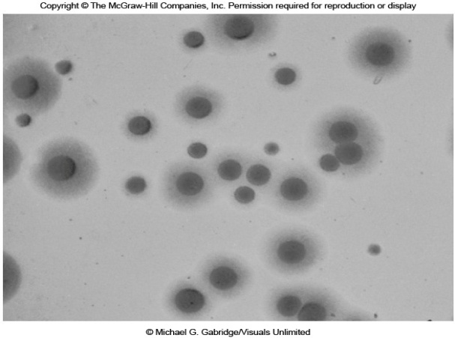
3.4.6 Bacteria that Lack Peptidoglycan or Cell Walls
Some stain G⁻ do not have PTG in their cell walls: phyla Chlamydiae(initial body) and Plancto­mycetes, but with outer membrane. Shaped.
Mycoplasma（in nature） （Ｇ+？）
  Does not produce a cell wall (pleomorphic )
  Plasma membrane more resistant to osmotic pressure
  Sterols may stabilize plasma membrane
Mycoplasma pneumoniae
Ureaplasma urealyticum
L-form bacteria: cell wall-deficient (CWD) bacteria, are strains of bacteria that lack cell walls (in lab). They are likely to develop resistance for antibiotics.(?)
Notes:
原生质球 (Spheroplast) 指细胞壁未被全部去掉的细菌细胞，它呈圆球状，可以人为地通过溶菌酶或青霉素处理革兰氏阴性细菌而获得。该类菌细胞壁肽聚糖虽被除去，但外壁层中脂多糖、脂蛋白仍然保留，外壁的结构尚存。所以，原生质球较之原生质体对外界环境具一定抗性，并能在普通培养基上生长。? 革兰阴性菌肽聚糖层受损后尚有外膜保护，又称为原生质球（spheroplast）。支原体属支原体属大量寄生的、致病的微生物，它们没有真正的细胞壁，呈格兰氏染色显阴性，但在分类上将其划分为G+，并且生长时需要类固醇（比如胆固醇）。在人体中，是无菌肺炎产生的主要原因

Slide 18
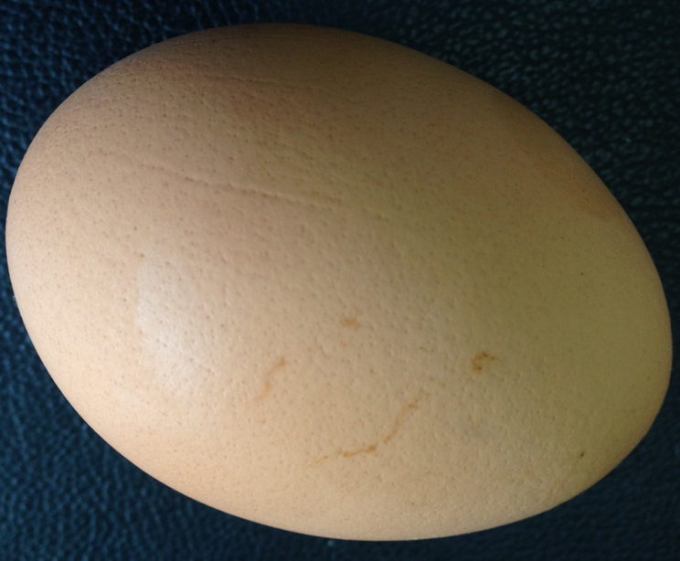
3.4 Bacterial Cell Walls- Summary
The cell wall is the layer that lies just outside the plasma membrane.(location)
It helps maintain cell shape and protect the cell from osmotic lysis; it can protect the cell from toxic substances; and in pathogens, it can contribute to pathogenicity. (function)
Cell walls are so important that most bacteria have them. (essential)
Those that do not have other features that fulfill cell wall function-lack cell wall (but)
Mycoplasma; Chlamydiae and Plancto­mycetes
L-form bacteria;
Protoplasts; Spheroplasts

Slide 19
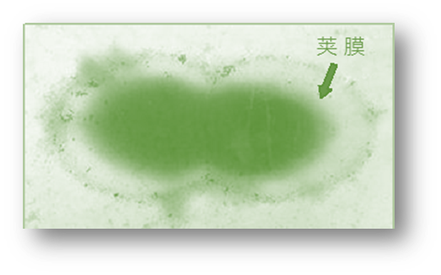
MICROBIOLOGY
Lecture 2
Episode 2
3.5 Cell envelope layers outside the cell wall
张连茹

Slide 20
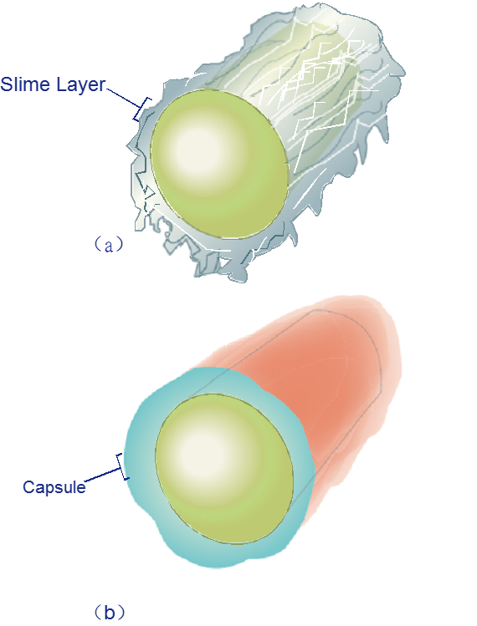
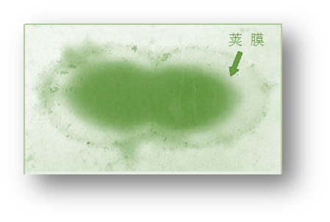
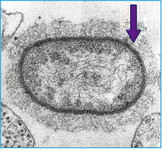
3.5.1 Capsules and slime layer
Glycocalyx – surface coating, made of sugars and/or proteins
    Slime layer:loosely organized and attached(Gliding bacteria)
    Capsule: highly organized, tightly attached
Notes:
[动植物学] fimbriae - 菌毛 flagella
[flə'dӡelə]鞭毛
ˈfɪləmənt

Slide 21
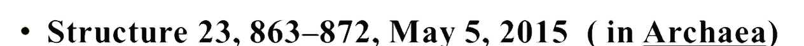
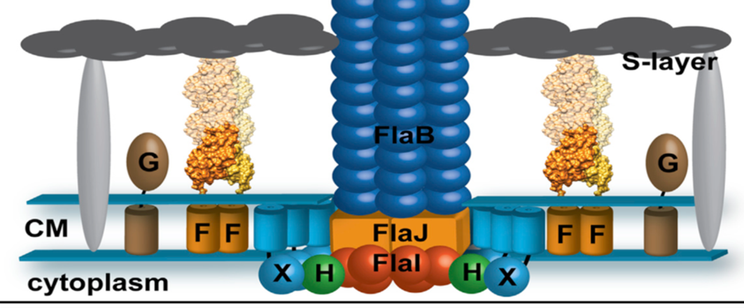
3.5.2 S-Layers
Many bacteria have a regularly structured layer called a S-layer on their surface.
It is composed of protein or glycoprotein.
The S-layer adheres directly to the outer membrane of G-; it is associated with the peptidoglycan sur­face of G+.
S-layer proteins can self-assemble

Slide 22
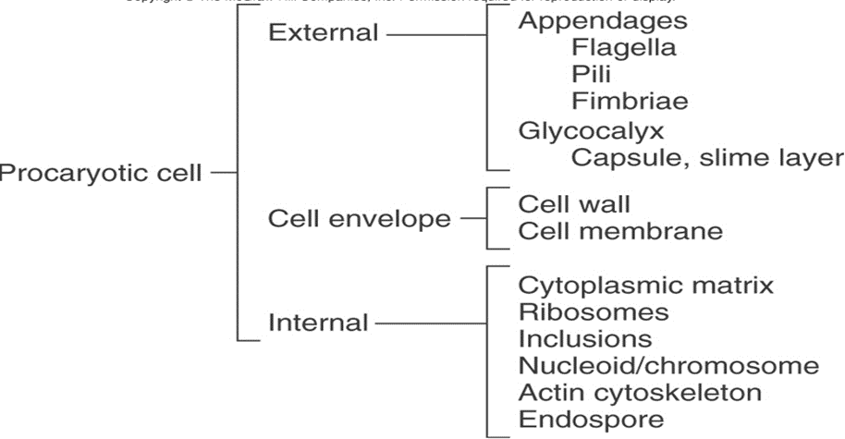
Summary
Outside coat: capsule and slime layer(glycocalyxes); S-layer
Protect cells from dehydration and nutrient loss
Inhibit killing by phagocytosis
Attachment - formation of biofilms
Exclude viruses and detergents
Pathogenicity

Slide 23
MICROBIOLOGY
Lecture 2
Episode 3
3.6 Bacterial cytoplasm
What is you opinion about of Bacterial cells were bags of water in which structures floated?
张连茹

Slide 24
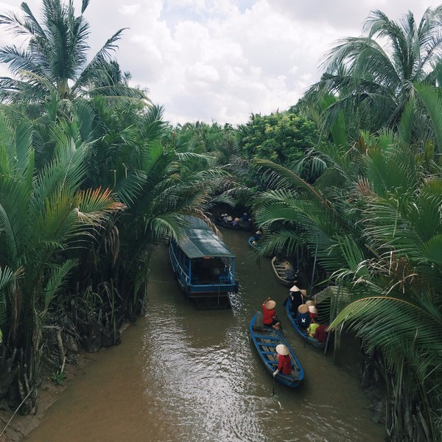
3.6 Bacterial Cytoplasm
  Dense gelatinous solution of sugars, amino acids, and salts
  70-80% water
    serves as solvent for materials used in all cell functions
    Do other`s cellular structures floated in this cytoplasm?

Slide 25
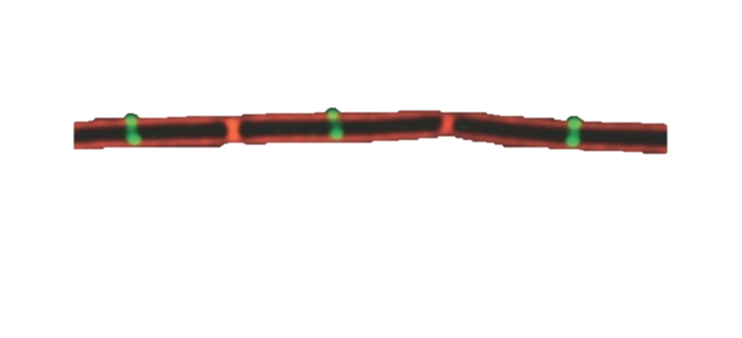
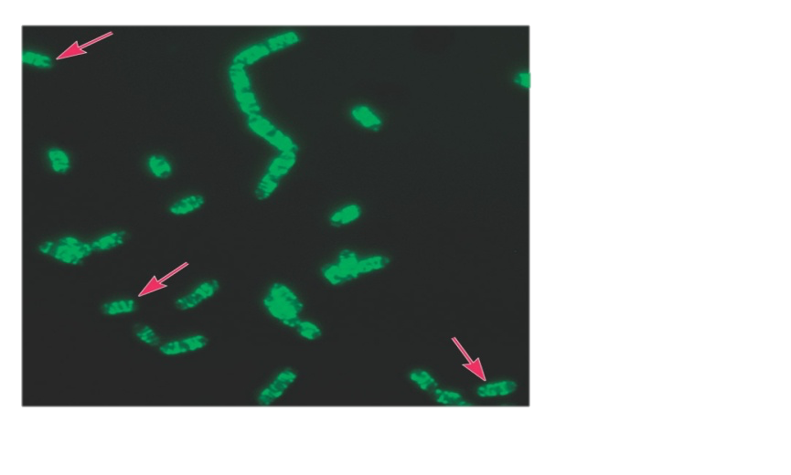
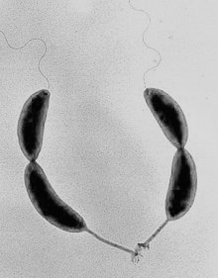
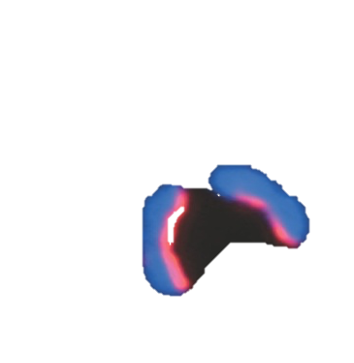
3.6.1 Bacterial Cytoskeleton
Homologs of all 3 eukaryotic cytoskeletal elements have been identified in bacteria
Evidence 1
Tubulin(FtsZ) Actin(MreB)
Filament (CreS)
Caulobacter crescentus
They participate in cell division, localize proteins to
certain sites in the cell, and determine cell shape.
Notes:
Escherichia coli, Bacillus subtilis,Caulobacter crescentus新月柄杆菌; Swarmer cell 游动细胞

Slide 26
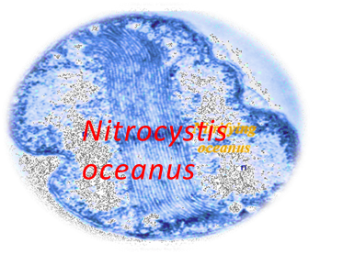
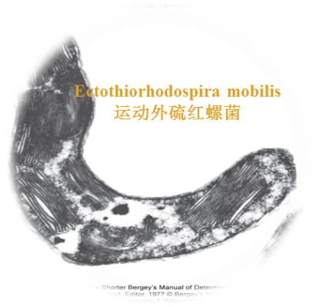
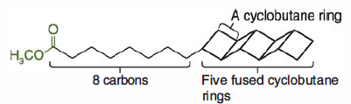
3.6.2 Intracytoplasmic Membranes
Although members of Bacteria do not contain complex membranous organelles, but
Intracytoplasmic Membranes
Observed in many photosynthetic bacteria
    Analogous to thylakoids类囊体of chloroplasts
    Reactions centers for ATP formation
Observed in many bacteria with high respiratory activity(Nitrocystis oceanus)
Anammoxosome厌氧氨氧化体in Planctomycetes浮霉状菌
  organelle – site of anaerobic ammonia oxidation
The anammoxosome membrane contains an unusual group of lipids called ladderane lipids
Notes:
anammoxosome厌氧氨氧化体(anammoxosome)、

Slide 27
3.6.3 Inclusions
The first bacterial inclusions were discovered in the late 1800s.
  Intracellular storage bodies or to reduce osmotic pressure by tying up molecules in particulate form.
  3.6.3.1 Storage Inclusions
  Poly-beta-hydroxybutyrate(PHB),
  It is surrounded by a single-layered shell composed of proteins and a small amount of phospholipids
  In 1925, was isolated
  PHB/PHA- biodegradeable plastics
Notes:
metachromatic - 异染色 趋磁螺菌Aquaspirillum magnetotacticum 聚羟基脂肪酸酯polyhydroxyalkonate;

Slide 28
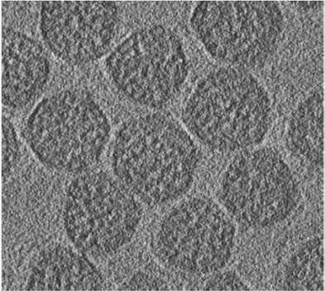
  3.6.3.2 Microcompartments-functional inclusion
They are relatively large polyhedrons formed by one or more different proteins.
Enclosed within the protein shell are one or more enzymes.
Carboxysomes-fixed CO₂
Their polyhedral coat is composed of proteins and is about 100 nm in diameter. Enclosed by the shell is the enzyme carbonic anhydrase碳酸酐酶, which converts carbonic acid into CO_{2,} ,then turn to -COOH

Slide 29
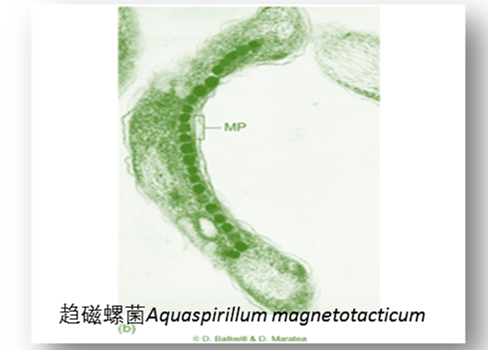
3.6.3.3 Other Inclusions
Gas vacuoles Magnetosomes:Fe₃O₄
Both are involved in bacterial movement.
Anabaena flosaquae
水华鱼腥藻
The gas vacuole provides buoyancy to some aquatic bacteria, many of which are photosynthetic.
For the cell to move properly within a magnetic field, magnetosomes must be arranged in a chain

Slide 30
3.6.3.4 Bacterial Ribosomes
Ribosomes are the site of protein synthesis, and large numbers of them are found in nearly all cells.
Bacterial ribosomes are called 70S ribosomes.
The small subunit contains 16S rRNA+21Proteins;
The large subunit contains 23S, 5S rRNA and 34 Proteins.

Slide 31
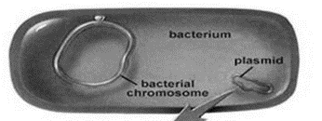
3.6.3.5 Bacterial –DNA
  Chromosome(DNA+NAPs)
  Plasmids are small, double-stranded DNA molecules(circular) that can exist independently of the chromosome.
  Duplicated and passed on to offspring
  Not essential to bacterial growth and metabolism
  May encode antibiotic resistance, tolerance to toxic metals, enzymes and toxins
  Episome: plasmid integrated into host DNA
  Curing: The loss of a plasmid is called curing.
  Curing treatments are acridine mutagens, ultraviolet and thymine starvation, antibiotics, and growth above optimal temperatures.
  Used in genetic engineering- readily manipulated and transferred from cell to cell.

Slide 32
3.6.3.5 Bacterial -Plasmids
Notes:
Anthracis: t

Slide 33
Summary: Bacterial cytoplasmic
Do bacteria move on the surface of Petri dish ?

Slide 34
MICROBIOLOGY
Lecture 2
Episode 4
3.7 External Structures
Many bacteria have structures that extend beyond the cell envelope, these external structures can function in protection and horizontal gene transfer.
张连茹

Slide 35
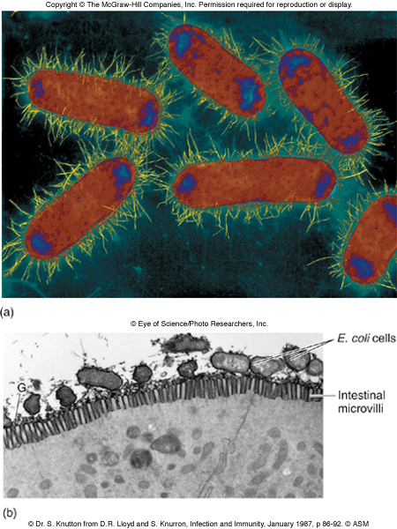
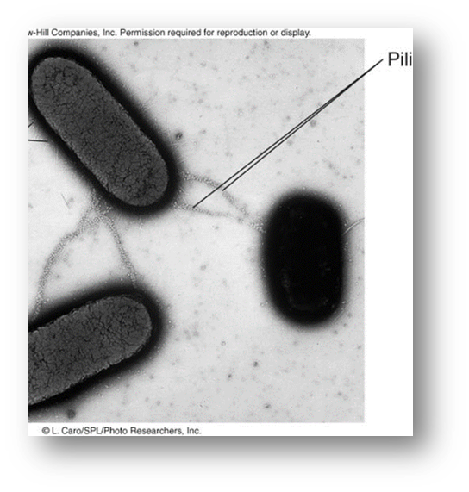
3.7.1 Bacterial Pili and Fimbriae （伞毛/纤毛/菌毛）
Fine, hairlike appendages from the cell surface (1,000 fimbriae)
Function in adhesion to other cells and surfaces(G+)
Type IV pili, are involved in motility and the uptake of DNA dur­ing the process of bacterial transformation.
The difference of Sex pili(10)and fimbriae
Larger than other pili or fimbriae in diameter.
Function to join bacterial cells for partial DNA transfer called conjugation
Notes:
bristle短而硬的毛发, 刷子毛villi长茸毛

Slide 36
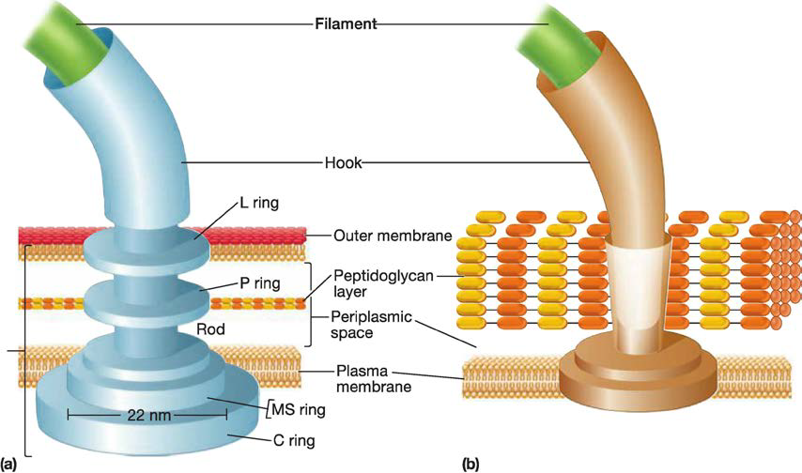
3.7.2 Bacterial Flagella
Many motile bacteria move by use of flagella, threadlike locomotor appendages(20um x 20nm).
  Filament – long, thin, helical structure composed of protein flagellin
  Hook- curved sheath
  Basal body – stack of rings firmly anchored in cell wall
Synthesis by self-assembling
Notes:
lophotrichous偏端丛毛的;丛鞭毛的;两端有鞭毛的; pəˈritrikəs周毛的(指菌)

Slide 37
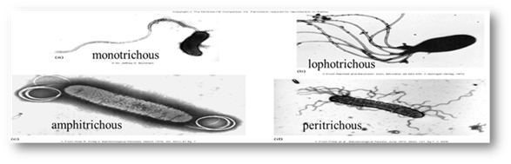
3.7.2 Bacterial Flagella
Flagellar Distribution-are useful in identifying bacteria.
Mo­notrichous bacteria (trichous means hair) have one flagellum
Amphitrichous bacteria (amphi means on both sides) have a sin­gle flagellum at each pole.
Lophotrichous bacteria (lopho means tuft) have a cluster of flagella at one or both ends
Peritrichous (peri means around), flagella are spread evenly over the whole surface

Slide 38
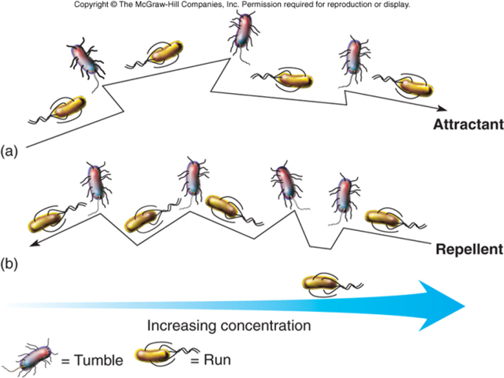
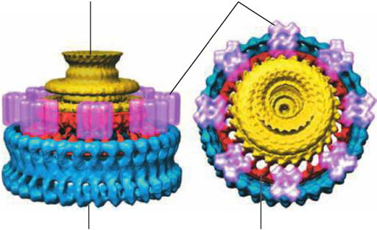
3.8 Bacterial Motility and Chemotaxis
Signal sets flagella into rotary motion:rotates 360º
counterclockwise – results in smooth linear direction – run
clockwise - tumbles
MotA and MotB
create a channel
through which
protons can flow.
This causes the
flagellum to rotate.
Guide bacteria in a direction in response to experimental stimulus:
Chemical stimuli – chemotaxis(趋化性);
Light stimuli – phototaxis(趋光性)
tracking microscope
Notes:
phototaxis

Slide 39
MICROBIOLOGY
Lecture 2
Episode 5
3.9 Bacterial Endospores
Dormant cells formed within a so-called mother cell,
are fascinating bacterial structures.
张连茹

Slide 40
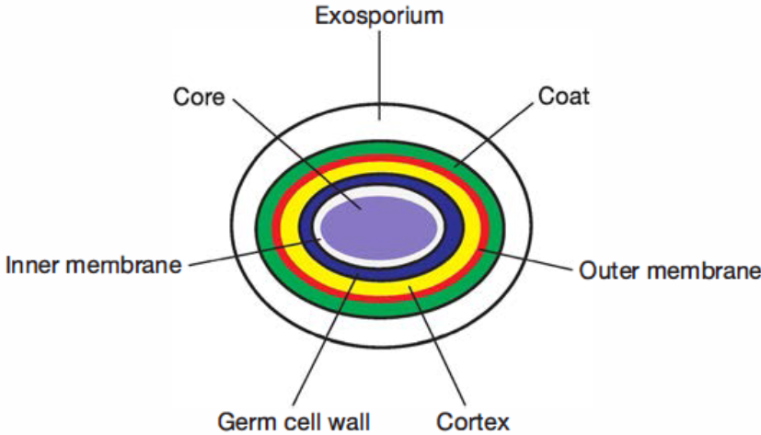
3.9. Bacterial Endospores
  Inert, resting, cells produced by some G⁺ genera: Clostridium梭菌, Bacillus and Sporosarcina芽孢八叠球菌属within the phylum Firmicutes
Resistance: high levels of calcium and dipicolinic acid
Dehydrated（dry), metabolically inactive Longevity verges on immortality - 25,250 million years.
Pressurized steam at 120ºC for 20-30 minutes will destroy
Notes:
dipicolinic acid - 2,6-吡啶二羧酸. calcium (complexed with dipicolinic acid)
small, acid-soluble, DNA-binding proteins (SASPs)
dehydrated core
spore coat and exosporium protect
DNA repair

Slide 41
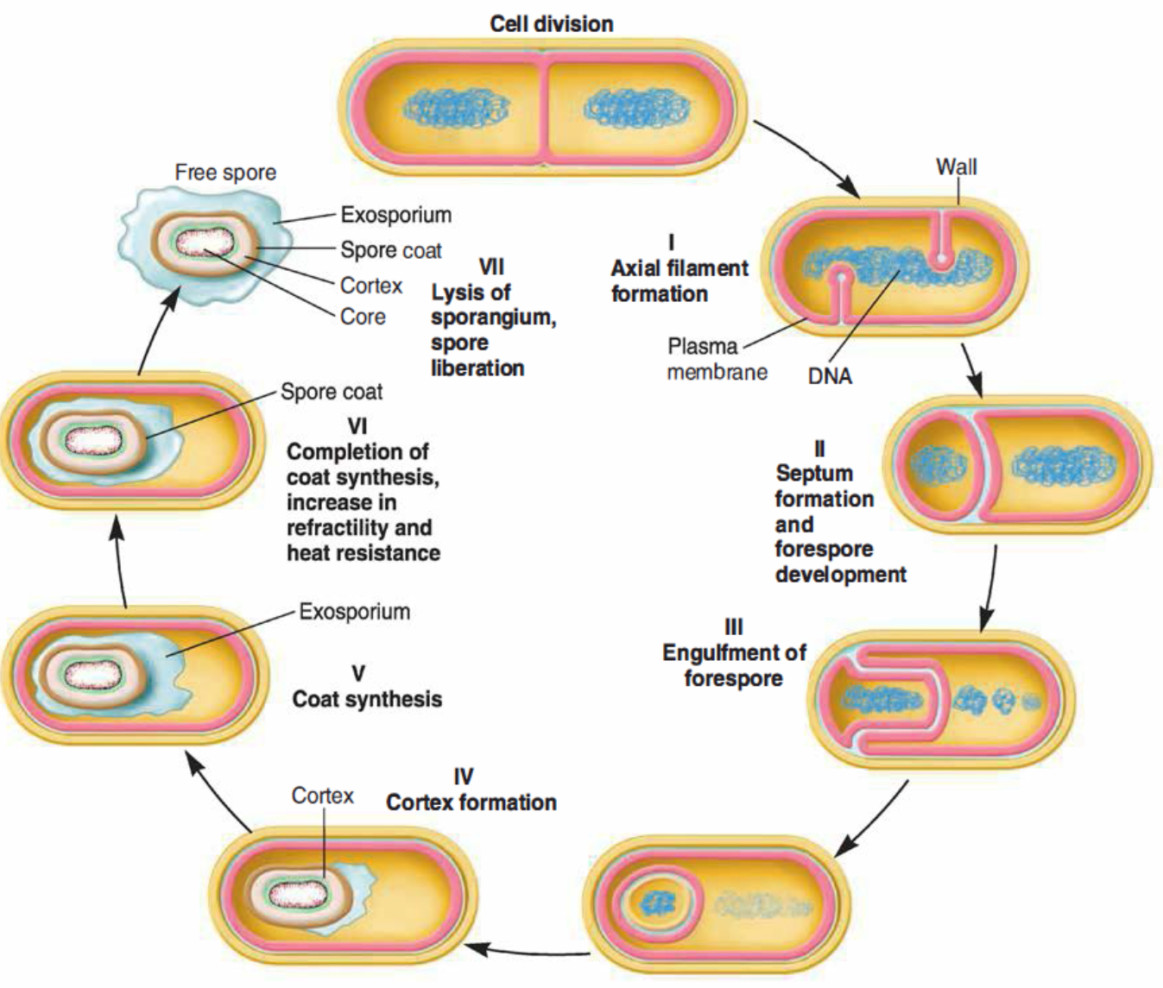
3.9. Bacterial Endospores
  Sporulation -formation of endospores
    Hardiest of all life forms
    Withstands extremes in heat, drying, freezing, radiation,chemicals
    Not a means of reproduction
  Germination- return to vegetative growth
Notes:
dipicolinic acid - 2,6-吡啶二羧酸. calcium (complexed with dipicolinic acid)
small, acid-soluble, DNA-binding proteins (SASPs)
dehydrated core
spore coat and exosporium protect
DNA repair

Slide 42
Bacterial cytoplasmic structures
Cytoskeleton
Cytoplasm; Inclusions
Nucleoid and plasmids
Ribosomes
endospores

Slide 43
Summary
Major prokaryotic cell structures
The difference of bacterial plasma membrane and cell wall
The structure of G- and G+ bacterial cell walls and the Gram reaction
The external structures such as capsules, fimbriae, and flagella; the various arrangements of bacterial flagella
The concept of the bacterial endospore and survive
The s-layer

Slide 44
Thanks!
Next-Archaeal Cell Structure
Discussion:
1. Prokaryotes（What is your opinion about of “The Prokaryote Controversy”?
Please use three or more evidences to support your opinion）
2. Both bacteria and archaea can have S-layers. How does their use as components of the cell envelope differ?
3. Identify three features that distinguish archaeal plasma membranes from those of bacteria.
4. Provide two examples that illustrate the similarity of archaea to bacteria; list two examples of their similarity to eukaryotes.
5. Identify two other molecules that could be used to determine if a microbe having a typical prokaryotic architecture is a bacterium or an archaeon.
6. Compare and contrast nutrient uptake mechanisms observed in bacteria and archaea

