Slide 1

MICROBIOLOGY
Lecture 3
1）Archaeal Cell Structure
2）Fungal Cell
（Chapter 4, 5, 26)
张连茹

Slide 2
Outline
A Typical Archaeal Cell
Archaeal Cell Envelope(Membrane and wall)
Archaeal Cell External Structures
Compare and Discussion
A Typical Fungal Cell (Yeast and Mold)
Fungal Structure
Fungal Reproduction
Fungal Family (Ascomycota)
What is an Archaea?

Slide 3
Discussion
1. Prokaryotes（What is your opinion about of “The Prokaryote Controversy”?
Please use three or more evidences to support your opinion）

Slide 4
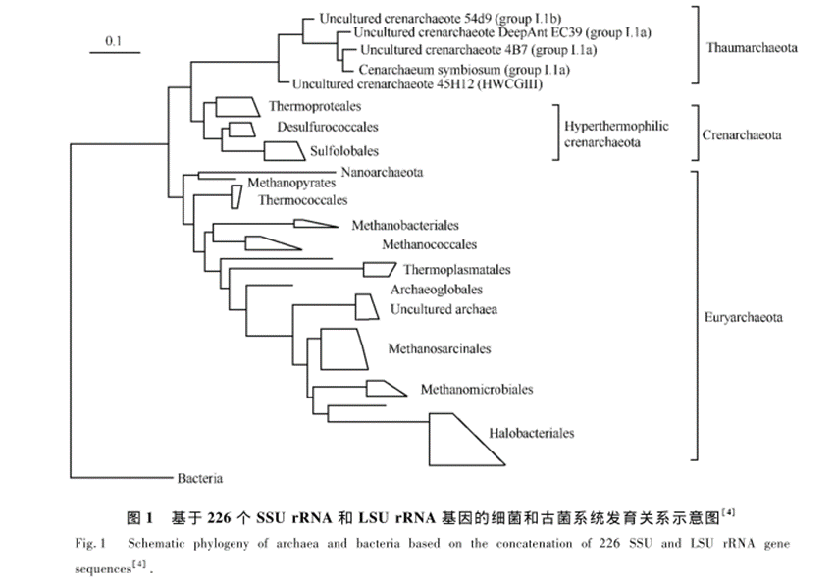
4.1 A Typical Archaeal Cell
Archaeal cells, like bacterial cells.
Archaeal taxonomy is currently in a state of flux, but two phyla are well established:
Crenarchaeota and Euryarchaeota.一个新的古菌类群——奇古菌门(Thaumarchaeota)

Slide 5
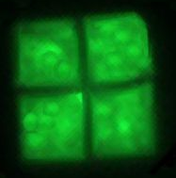
4.1.1 Shape, Arrangement, and Size
Archaeal cells, exhibit a variety of shapes. Cocci and rods are common.
To date, no spirochete-like and mycelial archaea have been discovered（？）.
However, some archaea exhibit unique shapes, such as the branched form of Thermoproteus tenax and the flat, postage-stamp-shaped Haloquadratum walsbyi, an archaeon that lives in salt ponds and measures about 2 μm by 2 to 4 μm and only 0.25 μm thick
InternationaI JournaI of Systematic Bacteriology49
Notes:
Thermoproteus tenax （cell wall is s layer）

Slide 6
4.1.2 Cell General Structure
The unusual lipids were one of the first pieces of evidence to suggest that these microbes are phylogenetically distinct from bacteria.
Most ar­chaea have a cell wall, but their walls are considerably more di­verse than bacterial walls.
Notably, archaeal cell walls lack peptidoglycan.
Capsules are not widespread among those ar­chaea examined thus far.
Within the archaeal cytoplasm, a nu­cleoid, ribosomes, and inclusions can be found.
Finally, many archaea use flagella for locomotion.

Slide 7
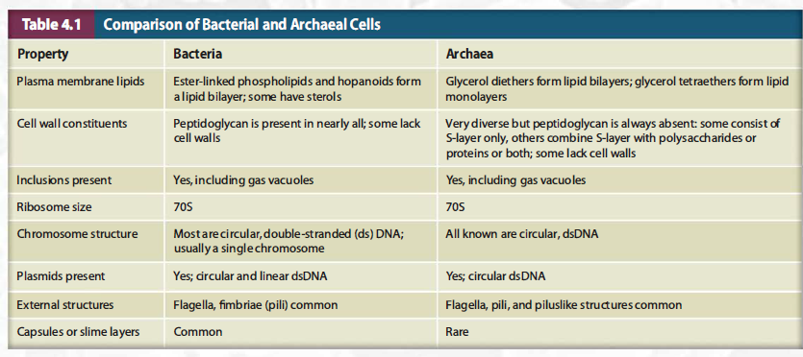
4.1.3 Comparison of Archaeal and Bacterial Cell
We define the cell envelope as the plasma membrane and any layers external to it. One of the most distinctive features of archaeal cells is the nature of their cell en­velopes.

Slide 8
Discussion
Identify three features that distinguish archaeal plasma membranes from those of bacteria.

Slide 9
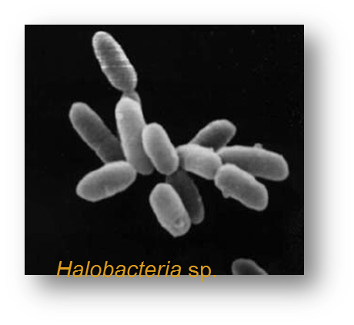
4.2. Archaeal cell envelopes(layers)
Cell envelope as the plasma membrane and any layers external to it. For bacteria, these include the plasma membrane, cell walls, S-layers, capsules, and slime layers.
Differ from bacterial envelopes in the molecular makeup and organization
  S layer may be only component outside plasma membrane(G⁻)
  Pseudomurein may be outermost layer(G⁺)
  Some lack cell wall
  External layers are rare(capsules,slime layer)

Slide 10
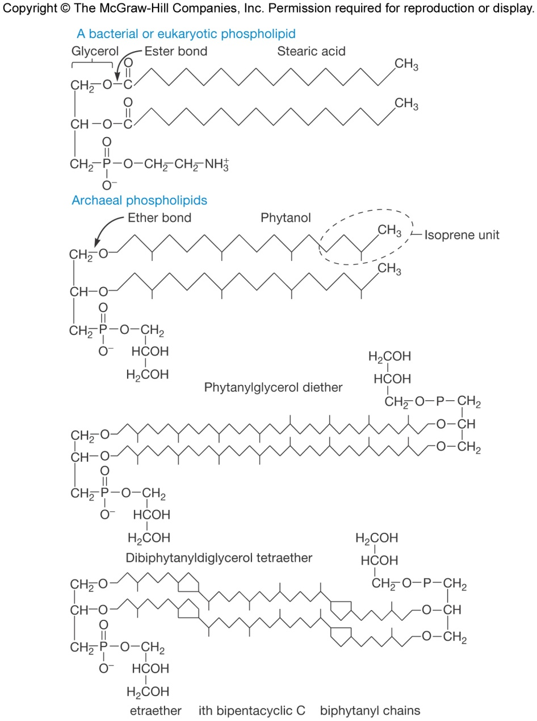
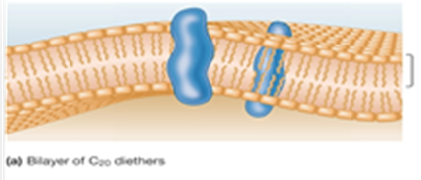
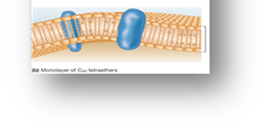
4.2.1 Archaeal Plasma Membranes and Nutrient Uptake
First, the hydrocarbons are branched(?). This is especially important for extremophilic archaea for which membrane fluidity and permeability could be compromised by extreme conditions.
Second, the hydrocarbons are attached to glycerol by ether links (?)rather than ester links.
Some archaeal lipid form monolayers(?).
Notes:
threadlike - 线状;phytanyl:植烷； stearic acid:硬脂酸

Slide 11
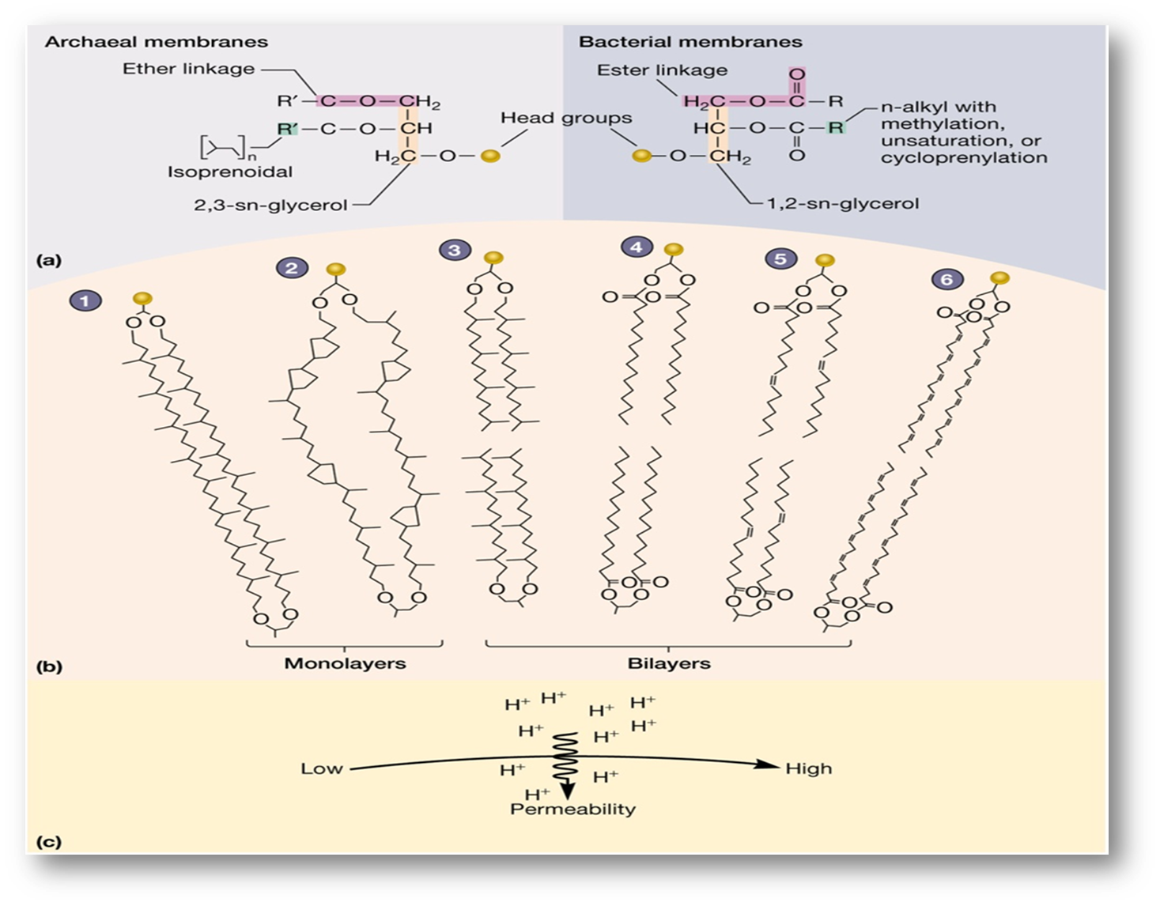
Notes:
Sn立体定向编号(2位在左边）

Slide 12
4.2.1 Archaeal Plasma Membranes and Nutrient Uptake
Archaea typically use primary and secondary active transport systems to obtain nutrients from their environment(often by searching an archaean's genome for the genes encoding components of these systems).
Thus far, group translocation systems such as the phosphoenolpyruvate: sugar phosphotransferase system (PTS) have not been identified in any archaea.
How about of the Gram stain in archaea?

Slide 13
Discussion
Both bacteria and archaea can have S-layers. How does their use as components of the cell envelope differ?

Slide 14
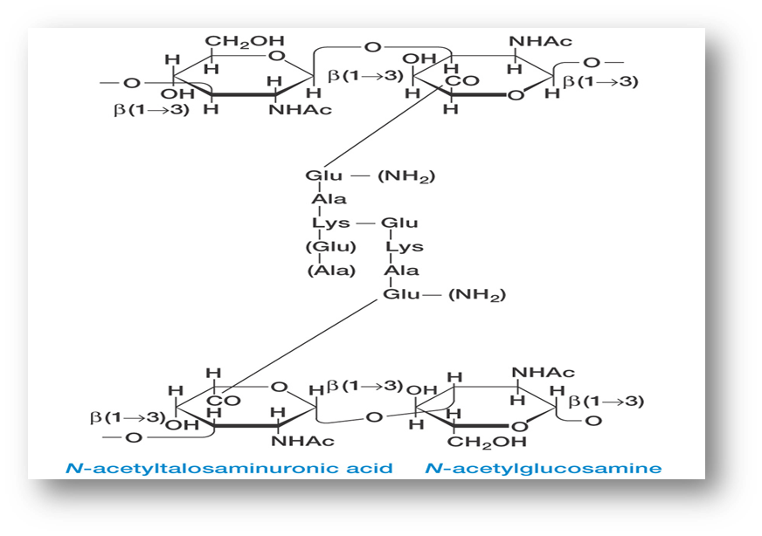
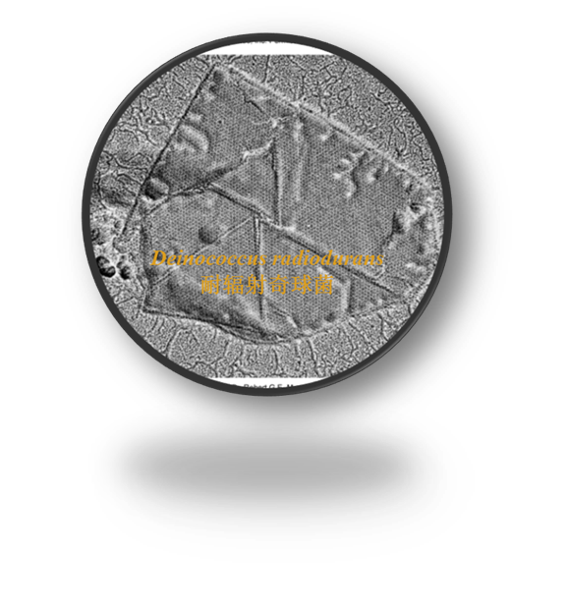
4.2.2 Archaeal cell walls(p84)
Lack peptidoglycan(G⁻)
Pseudomurein may be outermost layer – similar to G⁺
Most common cell wall is S layer
May have protein sheath external to S layer
S layer may be outside membrane and separated by pseudomurein(methan)
Polysaccharides or Slime may be outside(Ferroplasma)
L-amino acids instead of D-amino acids in its cross-links, N-acetyltalosaminuronic acid instead of N-acetylmuramic acid, and (1-3) glycosidic bonds instead of (1-4) glycosidic bonds
Notes:
N-乙酰塔罗糖胺糖醛酸(NAT) 软骨素chondroitin NAT(1-3)NAG Methanolobus taylori. 泰勒氏甲烷叶菌(G-)铁原体属(Ferroplasma) 嗜苦菌科(Picrophilaceae) 嗜苦菌属(Picrophilus) 热原体科(Thermoplasmataceae) 热原体属(Thermoplasma)分类疑物种甲烷... Pyrodictium:热网菌属

Slide 15
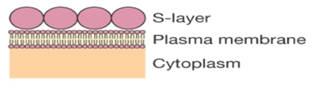
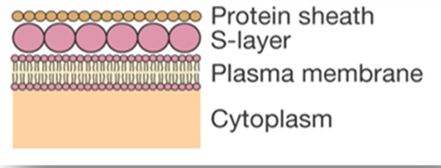
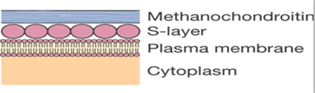
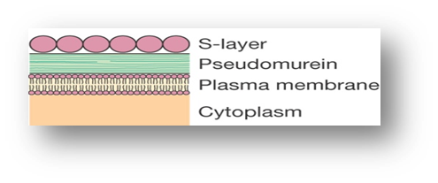
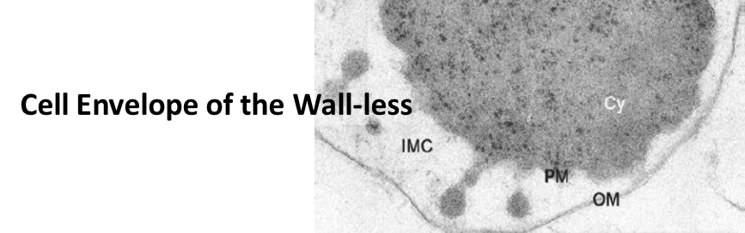
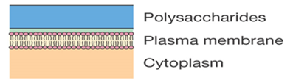
4.2.2 Archaeal cell wall types
(1) S-layer as the cell wall Methanococcus, Halobacterium, Pyrodictium, Sulfolobus, and Thermoproteus cell envelopes.
(2) S-layer+Protein sheath
Methanospirillum cell envelope
(3) Methanochondrotin+S-layer
Methanosarcina cell envelope.
(4)Pseudmurein+S-layer
Methanothermus and Methanopyrus cell envelopes.
(5)Polysaccharides Methanobacterium, Methanosphaera, Methanobrevibacter, Halococcus,
and Natronococcus cell envelopes
(6)OM+ lgnicoccus cell envelope.
Notes:
(Methanopyri) 甲烷火菌目(Methanopyrales) 甲烷火菌科(Methanopyraceae) 甲烷火菌属(Methanopyrus) [编辑] 热球菌纲(Thermococci) 热球菌目
超嗜热古细菌lgnicoccuspacif盐碱球菌属(Natronococcus) 盐碱湖菌属(Natronolimnobius) 盐碱单胞菌属(Natronomonas) 盐碱红菌属(Natronorubrum)甲烷杆菌纲(Methanobacteria) 甲烷杆菌目(Methano...

Slide 16
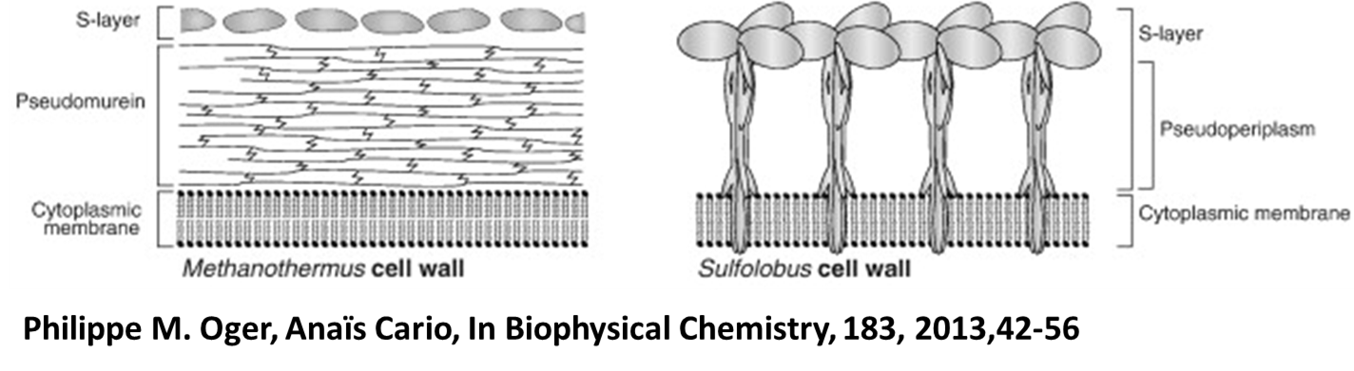
4.2.2 Surface layer (S layer)
Protect from environment changes (e.g.ion and pH fluctuations, osmotic stress, enzymes, and predation)
Maintains shape and rigidity
Promotes adhesion to surfaces
Protects from host defenses(virulence)
Potential use in nanotechnology
  S layer spontaneously associates
Notes:
tile[英] [tail]瓦片, 瓷砖2. 扁平的小棋子
vt.1. 用瓦片、瓷砖等覆盖
vt. & vi.1. 平铺显示，并列显示，瓦片式显示（视窗）

Slide 17
4.3 Archaeal Cytoplasm
Overall, the cytoplasm of archaeal cells is very
similar to that of bacteria. Within it can be found inclusions-PHB, polyphosphate granules, glycogen granules, and gas vacuoles; ribosomes; a nucleoid; and, in some cases, plasmids.
Cytoskeletal proteins have also been identified, crenactin, an actin homologue unique to certain members of the phylum Crenar­chaeota.
Ribsome:70S
rRNA: 5.8S-Eukaryotic
16S etc.-Prokaryotic
Protein: both
Nucleoid(polyploid)
With Histone

Slide 18
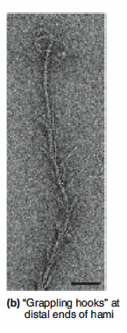
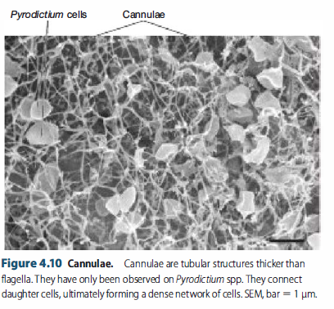
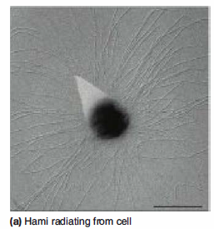
4.4 External Structures(pili,cannulae and Hami)
Many archaea have pili. How­ever, the pilus formed from these proteins(IVpili) is unique in several ways, including the presence of a central lumen. Central lumens are observed in bacterial flagella but not in bacterial type IV pili.
Cannulae, and Hami(unique to archaea)
极端嗜热菌-热网菌
Cannulae are hollow, tubelike structures observed on the surface of thermophilic archaea belonging to the genus Pyrodictium. Function?
Archaeal cells that produce hami are members of biofilm communities generally consisting of a hami-producing archaean and a bacterium.
Notes:
Cannulae套管；Hami钩脉 central luman中央腔

Slide 19
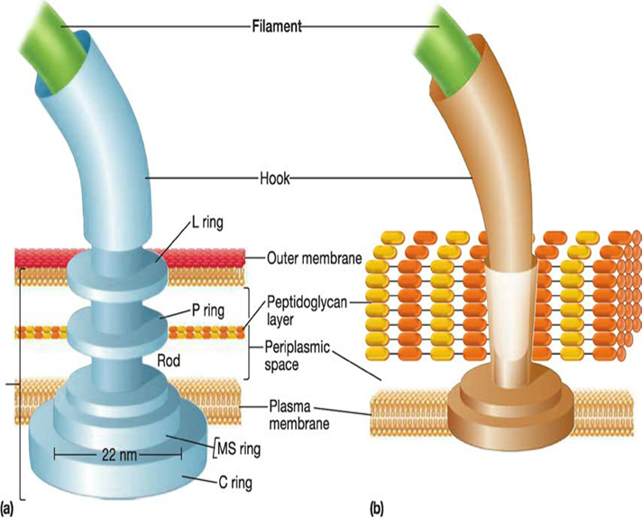
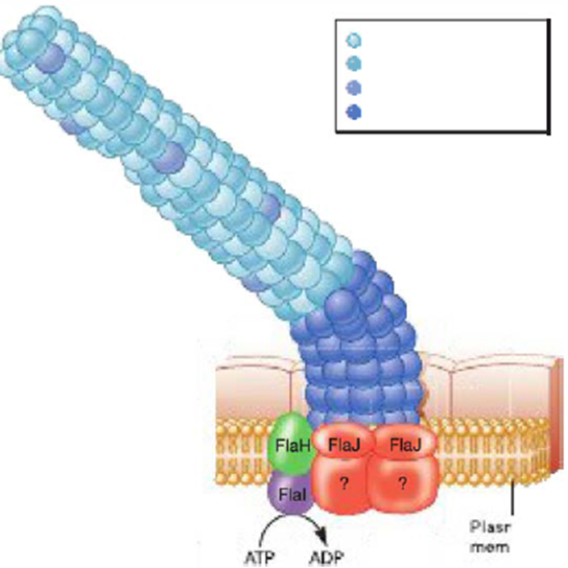
4.4 Archaeal Flagella And Motility
Archaeal flagellum is not hollow,
Archaeal hooks are difficult to distinguish from the filament; they also tend to be longer than bacterial hooks.
A basal body has not been identified, but some preparations of archaeal flagella have a knoblike structure at the end embedded in the cell.
Surprisingly, the machinery controlling che­motaxis and phototaxis in H. salinarum is homologous to that found in bacterial systems.

Slide 20
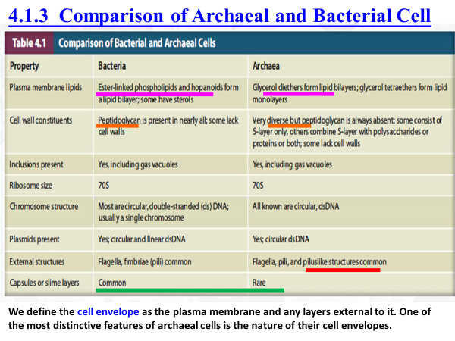
Summary
• One major difference between bacterial and archaeal cells is that they have distinctive cell envelopes. There are also important differences between bacterial and archaeal ribosomes, chromosomes, flagella, and pili.
• How about of the Fungi?

Slide 21

MICROBIOLOGY
Lecture 3-2
Fungal Cell Structure
What are eukaryotes?
What are fungi?
What are yeasts?
What are molds?
张连茹

Slide 22
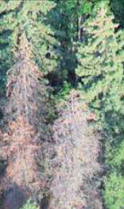
What are eukaryote?
Prominent member of ecosystem.
They have membrane-delimited nuclei, and membranes play a prominent part in the structure of many other organelles. For adequate regulation, metabolic activity, and transport.
Two group: Protists; Fungi
Facilitated diffusion plays a more prominent, also use passive diffusion and active transport.
In addition, eukaryotes have another option for bringing materials into cells: endocytosis.
Fungi May Be Key to Quelling Malaria
Notes:
Thus abundant membrane systems probably are necessary in eukaryotic cells because of their large volume and the need for adequate regulation, metabolic activity, and transport.

Slide 23
What is a fungus?
The term fungus (pl., fungi) describes eukaryotic organisms that are spore-bearing, have absorptive nutrition, lack chlorophyll, and reproduce both sexually and asexually.
Single-cell microscopic fungi are referred to as yeasts, while multicellular masses are called molds.
Fungi also include macroscopic puffballs and
mushrooms.

Slide 24
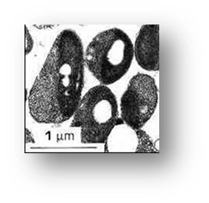
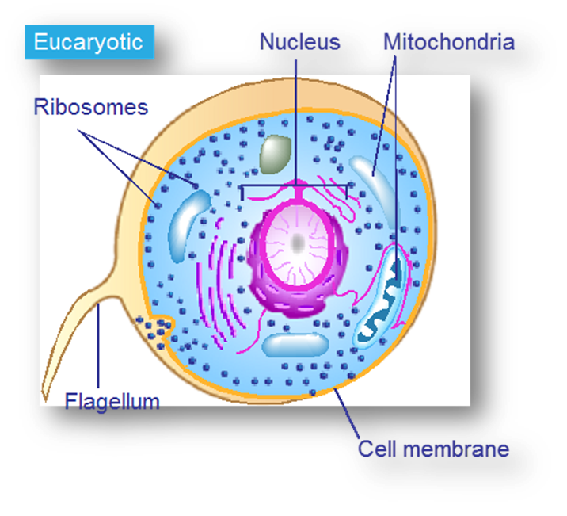
5.1 A Typical Fungal Cell
More structurally complex and generally larger than
bacterial or archaeal cells. The smallest one is Ostreococcus tauri. (a unicellular green alga）
Eukaryotic cells are distinctive because of their use of mem­branes.
Organelles are intracellular structures that perform specific functions in cells.

Slide 25
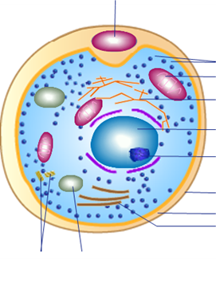
5.2. Fungal distribution and importance
Fungi are primarily terrestrial organisms.
They have a global distribution from polar to tropical regions.
Fungi are important decomposers.
Many fungi are pathogenic for plants and humans（5,000 species-plants，about 20/year new human fungal pathogens are documented).
Conversely, fungi also form beneficial relationships with other organisms(mycorrhizae)菌根菌.
  Industrial importance(drug)
  Research use(model)

Slide 26
5.2. Fungal distribution and importance
Fungi, especially yeasts (single-celled fungi), are essential to many industrial processes involving fermentation.
Examples include the making of bread, wine, beer, cheeses, and soy sauce.
Industrial importance
  Fermentation – yeast used in making bread, wine, beer, cheese, soy sauce
  Organic acids – citric and gallic acid
  Certain drugs – ergometrine麦角新碱, cortisone可的松,
  Antibiotics – penicillin, griseofulvin 灰黄霉素
  Immunosuppressive agents - cyclosporin
In addition, fungi(Saccharomyces cerevisiae) are important research tools in the study of fundamental biological processes.

Slide 27
5.3 Fungal Structure-Cell Membrane
The plasma membrane of eukaryotes is a lipid bilayer composed of a high proportion of sphingo­lipids and sterols.
The distribution of lipids in the plasma membrane is asym­metric. Lipids in the outer leaflet differ from those of the inner leaflet.
There are microdomains that differ in lipid and protein composition. These microdomains are sometimes referred to as lipid rafts.

Slide 28
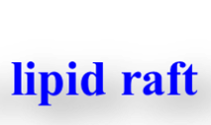
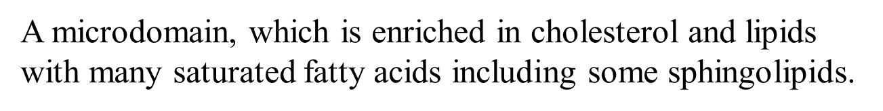
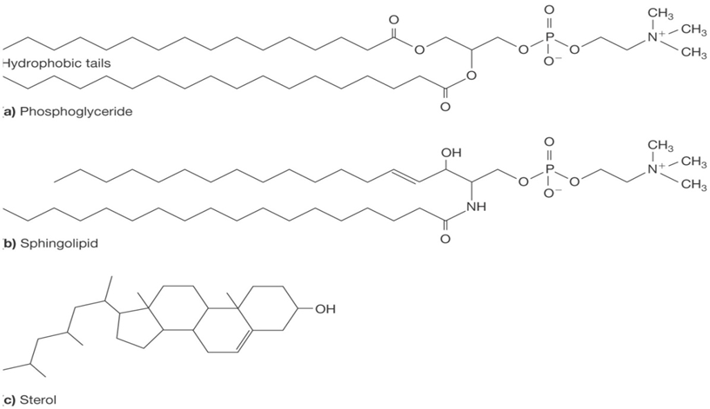
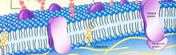
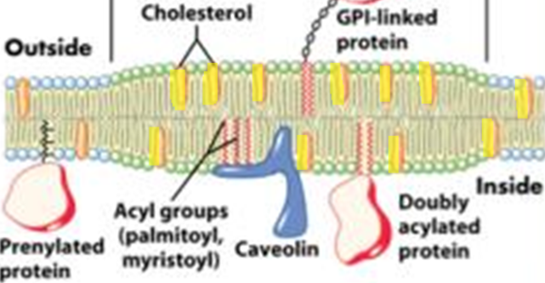
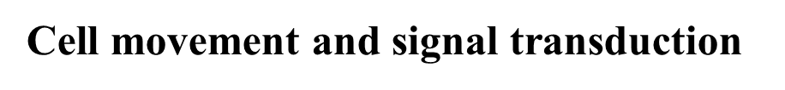
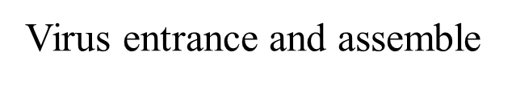
5.3 Fungal Structure- Cell Membrane

Slide 29
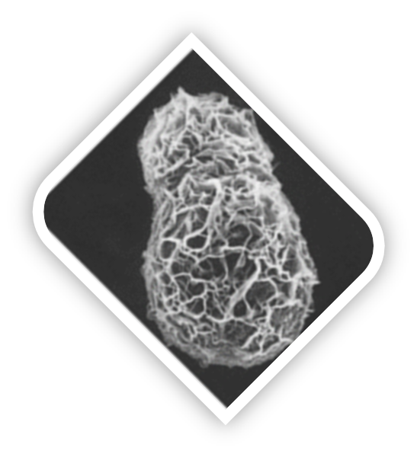
5.3 Fungal Structure-Cell Wall
Fungal cell walls normally are rigid.
Their exact composition varies with the organism; usually cellulose, chitin, or glucan is present.
Chitin is a strong but flexible nitrogen containing polysaccharide consisting of N-acetylglucosamine residues.
They lack flagella and cilia but have most other eukaryotic organelles
What is a Yeast?
Notes:
thallus 扁平体 , 叶状体

Slide 30
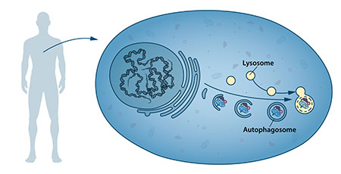
5.4. Typical Fungus-Yeast
A yeast is a unicellular fungus with a single nucleus,
Generally yeast cells are larger than bacteria and are commonly spherical to egg-shaped.
They are often isolated from sugar-rich materials (such as on the skins of grapes, apples, or peaches).

Slide 31
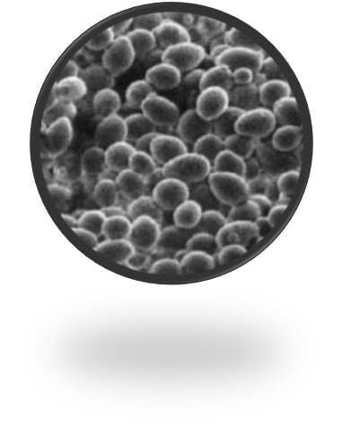
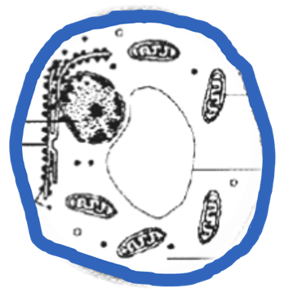
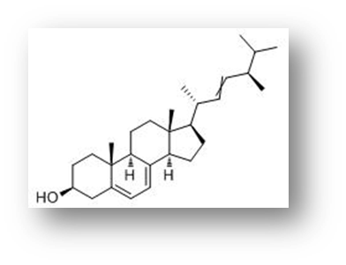
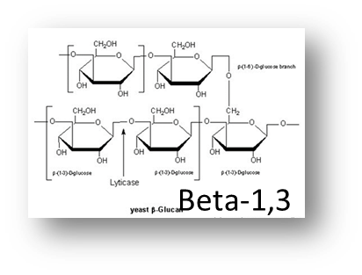
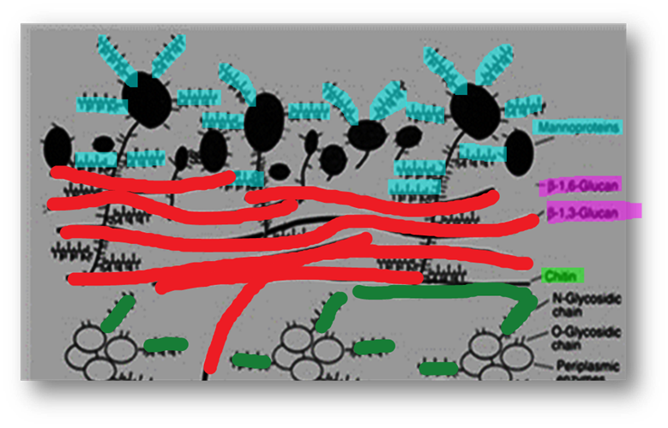
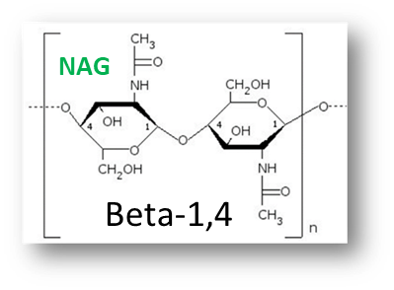
5.4 Typical Fungus-Yeast
Yeasts are unicellular, sizes vary greatly, typically measuring 3–4 µm in diameter, although some yeasts can grow to 40 µm in size.
What is look like?
Membrane: rich in ergosterol (麦角甾醇)
Cell wall: three layers, mannan; glucan and chitin

Slide 32
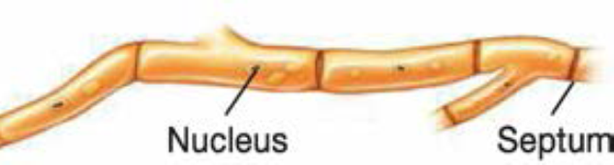
5.4. Typical Fungus -Mold
Molds are multinucleated fungi consists of long, branched, threadlike filaments of cells called hyphae(2-10 µm ) that form a tangled mass called a mycelium.
In some fungi, hyphae are called coenocytic or aseptate hyphae; the other`s hyphae are termed septate hyphae.
The filamentous nature of hyphae results in a large s/v.
This makes adequate nutrient absorption possible.

Slide 33
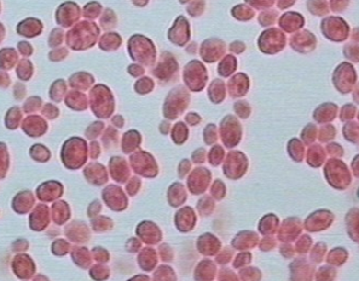
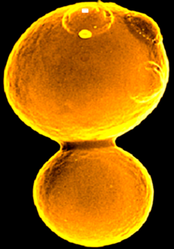
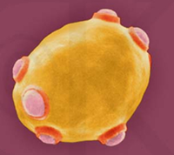
5.5 Fungal Reproduction
Reproduction in fungi can be either asexual or sexual.
Asexual: （mitosis and asexual spores)
1) A parent cell undergoes mitosis and divides into two, or with budding to produce a daughter cell (in yeasts).
2)The formation of asexual spores is usually used as a means of dispersal.

Slide 34
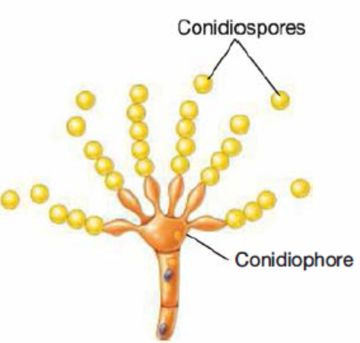
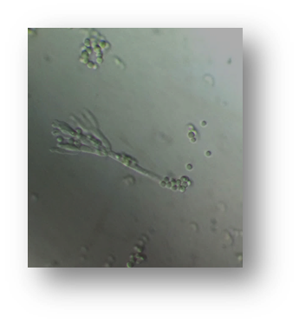
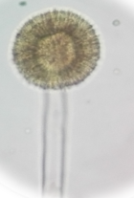
5.5. Fungal Reproduction-Axexual Spores
2)The formation of asexual spores is usually used as a means of dispersal.
There are many types of asexual spores, Arthrospores, Sporangiospores, Conidiospores and Blastospores.
These spores are disseminated by air, water, animals or objects and upon landing on a suitable environment, germinate and produce new hyphae.

Slide 35
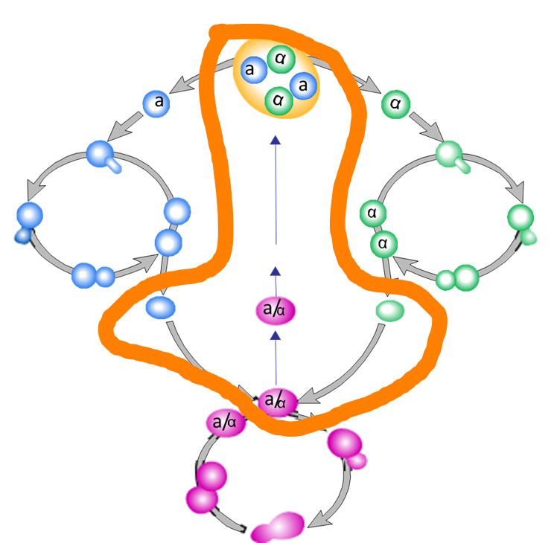



5.5 Fungal Reproduction- Sexual spores
Sexual reproduction in fungi involves the fusion of compat­ible nuclei.
Sexually compatible gametes on the mycelium or spores.
Gamete, gameangia(sac), zygote,
Diploid, haploid, dikaryotic

Slide 36

Summary and Discussion
Alternates between haploid and diploid
  Asexual: in nutrient rich, 1）mitosis and budding occurs； 2）Asexual Spore
  Sexual: nutrient poor, meiosis and haploid ascus containing ascospores formed
    Haploid cells of opposite mating types fuse
    Tightly regulated by pheromones外激素
Why are so important for fungal spores, in both asexual and sexual?
They enable fungi to survive environmental stresses such as desiccation, nutrient limitation, and extreme temperatures, although they are not as stress resistant as bacterial endospores.
They aid in fungal dissemination, which helps ex­plain their wide distribution.
Because spores are often small and light, they can remain suspended in air for long periods and are often spread by adhering to the bodies of insects and other animals.
Notes:
外激素| 费洛蒙| 信息素| 香偶素.

Slide 37
Summary and Discussion
Provide two examples that illustrate the similarity of archaea to bacteria; list two examples of their similarity to eukaryotes.

Slide 38
MICROBIOLOGY
Lecture 3-3
How many types of fungi?
张连茹

Slide 39

5.6 Overview of Fungal Family
A fungus is any member of a large group of eukaryotic organisms that includes microorganisms such as yeasts and molds (moulds), as well as the more familiar mushrooms.
90,000 fungal species have been described, possible 1.5 million
Six major fungal groups(phylum)
  Chytridiomycota壶菌; Zygomycota接合菌Glomeromycota球囊菌;
  Ascomycota子囊菌 Basidiomycota担子菌Microsporidia微孢子门
壶菌 接合菌 球囊菌 子囊菌 担子菌 微孢子菌 门

Slide 40
5.6.1 Chytridiomycota
Most are saprophytic; some reside
in the rumen of herbivores.
Chytrids are unique among fungi in the production of a zoospore with a single, posterior, whiplash flagellum.
These fungi are microscopic and display both sexual and
asexual reproduction.
Many are capable of degrading cellulose and even keratin, which enables the degradation of crustacean exoskeletons.
The model chytrid Allomyces macrogynus has a complex life cycle that includes four types of sporangia and five developmentally distinct spore types.

Slide 41



5.6.2 Zygomycota （Rhizopus species）
One member of the genus Rhizopus is important because it is involved in the rice disease known as seedling blight.
Much to everyone‘s surprise, an a-proteobacterium, Burkholderia sp.伯克氏菌found growing within the fungus produces the toxin.
Zygomycetes also contribute to human welfare. For example, one species of Rhizopus is used in Indonesia to produce a food called tempeh from boiled, skinless soybeans. Another zygomycete (Mucor spp.) is used with soybeans in Asia to make a curd called sufu.
匍茎根霉菌
Rhizopus stolonifer

Slide 42
5.6.3 Glomeromycota球囊菌（菌根菌）
Glomeromycetes are of critical ecological importance because they are mycorrhizal symbionts of vascular plants.
Mycorrhizal fungi form important associations with the roots of almost all herbaceous plants and tropical trees.
Only asexual reproduction is known to occur in glomero­mycetes.

Slide 43



5.6.4 Ascomycota
Ascomycetes or sac fungi.
Ascomycetes can have either a yeast morphology or a mold morphology.
Important ascomycetes include the yeast Saccharomyces cerevisiae, Aspergillus spp., Claviceps purpurea (the cause of ergotism), and the indoor mold Stachybotrys chartarum.
  Red, brown, and blue-green molds cause food spoilage
  Some are human and plant pathogens
  Some yeasts and truffles 块菌 are edible
  Some used as research tools

Slide 44


5.6.4 Ascomycota -filamentous form life cycle
Ascomycetes are ecologically important in freshwater, marine, and terrestrial habitats because they degrade many chemically stable organic compounds, including lignin, cellulose, and col­lagen.
Many species are quite familiar and economically im­portant
Asexual reproduction - conidia
Sexual reproduction
  Ascus formation with ascospores
  Opposite mating types form zygote
  Ascospores forcefully released from ascocarp子囊果, germinate
Sclerotia菌核masses of hyphae survive the winter then germinate
Notes:
sclerotia[skliə'rəuʃiə]. 例句: 1. most of the red, brown, and blue-green molds that cause food spoilage are ascomycetes.
Keywords Wild G.umbellata;Sclerotia;Quality analysis野生猪苓;菌核;品质分析
真菌菌核(sclerotia)是由菌丝块集结而成。它的构造包括外皮层(rind)、皮层(cortex)及中髓(medulla)。自然界中很多植物病原真菌如子囊菌中的菌核病菌(Sclerotinia ...

Slide 45




5.6.4 Genus Aspergillus
A. fumigatus烟曲霉
  Ubiquitous environmental
  Allergies过敏and significant pathogen
A. oryzae 米曲霉
  Production of fermented foods
  Important in biotechnology
Aspergillus aflatoxins and cancer
  37 Mb genome, model system
Notes:
Aspergillus - 曲霉黄曲霉毒素是主要由黄曲霉 (aspergillus flavus) 寄生曲霉 (a.parasiticus) 产生的次生代谢产物Allergies: 过敏|

Slide 46
5.6.5 Basidiomycota
Basidiomycota are commonly known as club fungi珊瑚菌. Examples include jelly fungi, rusts, shelf fungi, stink­horns, puffballs马勃菌, toadstools蕈类, mushrooms, and bird's nest fungi.
Most are saprophytes that decompose plant debris, especially cellulose and lignin.
Genera from urediniomycetes and ustilaginomycetes(锈菌纲和黑粉菌纲)include important plant pathogens(rusts）(dimorphic)
Many mushrooms are used as food, and the cultivation of the mush­room Agaricus campestris is a multimillion-dollar business.

Slide 47
5.6.6 Microsporidia
Members of Microsporidia have a unique morphology and are still sometimes considered protists.
They include virulent human pathogens; some infect other vertebrates and insects.

Slide 48






Summary
Fungal structure and function
Yeast
Mold
Mycelium
Aerial hyphae
Asexual
Sexual
Vegetative hyphae
Uptake-nutrient
Adhesion-branch
Conidiospores
Zygospores
Sporangiospores
Cleistothecium
ascospores
Creeping stem
Dormant-
Predator-
The differences of bacteria and fungi

Slide 49

Next, we will talk about of virus!
1. Discuss whether you think viruses evolved before the first cell or whether they have coevolved and are perhaps still coevolving with their hosts.
2. Discuss the ways that viruses can be cultivated.
3. What advantages might a phage gain by being capable of lysogeny?
4. Explain why the receptors that viruses have evolved to use are host surface proteins that serve very important, and sometimes essential, functions for the host cell?
5. Consider the origin of viral envelopes and suggest why enveloped viruses that infect plants and bacteria are rare.
6. Compare and contrast in general terms viruses, viroids, satellites, and prions
Notes:
Beauveria bassiana白僵菌，Metarhizium anisopliae绿僵菌Plasmodium 疟原虫Anopheles桉蚊

Slide 50
作业和练习
1.请用任意一种文体，介绍细菌的相关知识（形态特征、结构及其功能等）。引力波会对细菌的结构有影响吗？
2.您认为细菌、古菌和真菌最主要的差别是什么？它们的细胞膜的组成或结构有什么异同？您能否举例说明2017年诺贝尔化学奖中的技术用于细胞膜蛋白质的研究，有何显著的特点？
3.根据病毒的组成及结构以及繁殖特点，设想病毒病的几种治疗策略。
同学间互评的翻译练习（不需要交）：第3章（星期二班）；第4章（星期五班）；第6章（星期三班）
说明：请在期中考试的前2周前提交作业；请在期中考试前完成翻译练习。

