Slide 1

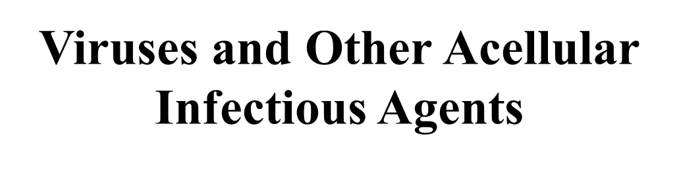
MICROBIOLOGY
Lecture 4
Chapter 6
张连茹

Slide 2
Review or recall
4. Provide two examples that illustrate the similarity of archaea to bacteria; list two examples of their similarity to eukaryotes.
5. Identify two other molecules that could be used to determine if a microbe having a typical prokaryotic architecture is a bacterium or an archaeon.
6. Compare and contrast nutrient uptake mechanisms observed in bacteria and archaea

Slide 3
Virus is bad or good?
Typically we think of them as major causes of disease.
Viruses as agents of good will come as a surprise to many.
Important members of aquatic world(move organic matter from particulate to dissolved)
Important in evolution transfer genes between bacteria, others
Important model systems in molecular biology(vector)
Bacterial viruses are being used in some European countries to treat infections caused by bacteria.

Slide 4
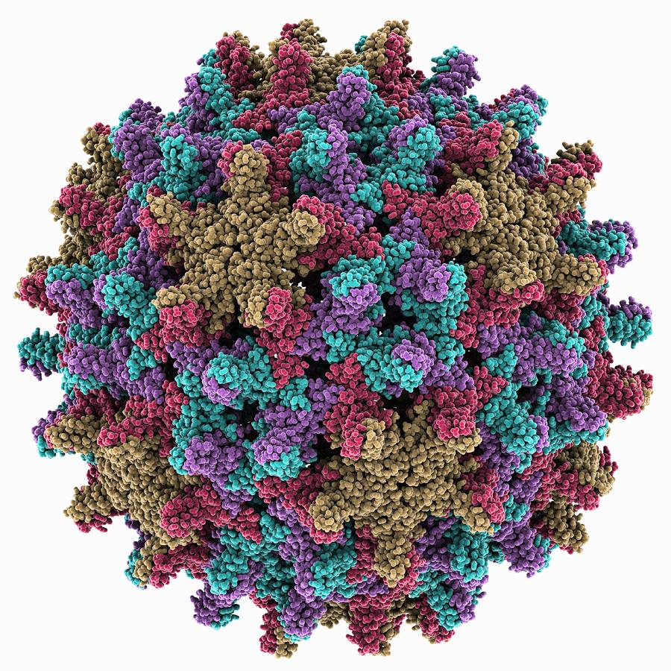
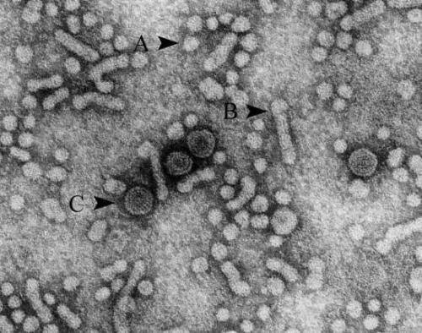
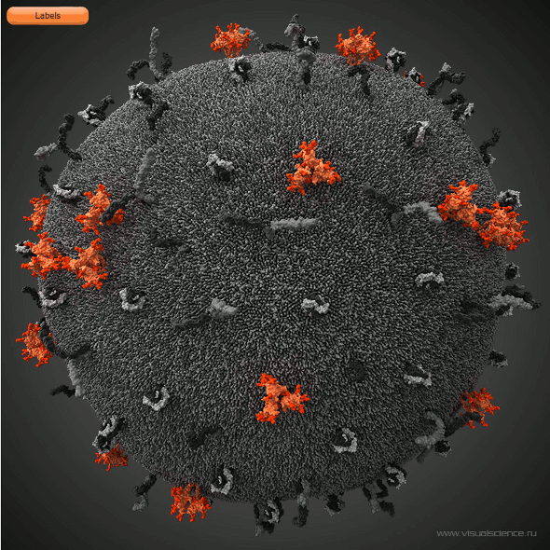
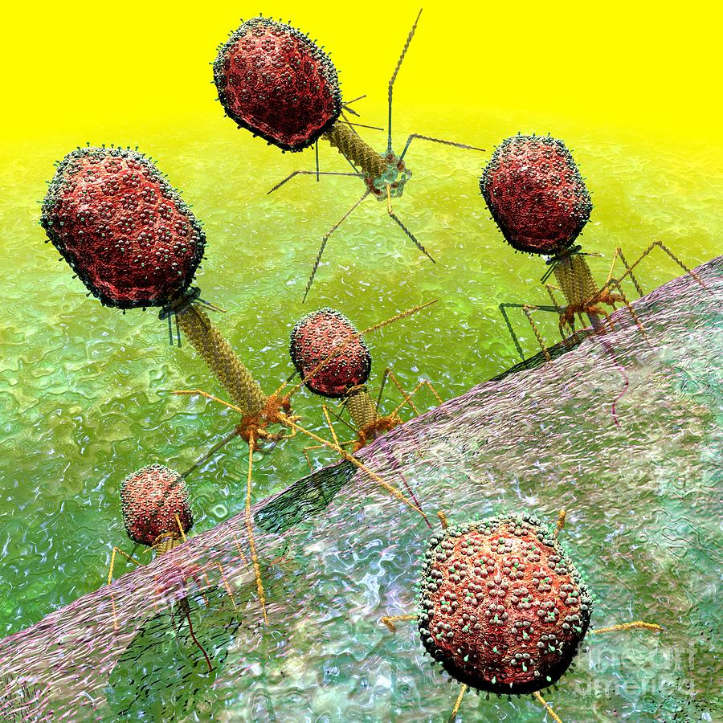
Outline
Discovery
General features
The structure of viruses
Types of virus
Viral multiplication

Slide 5
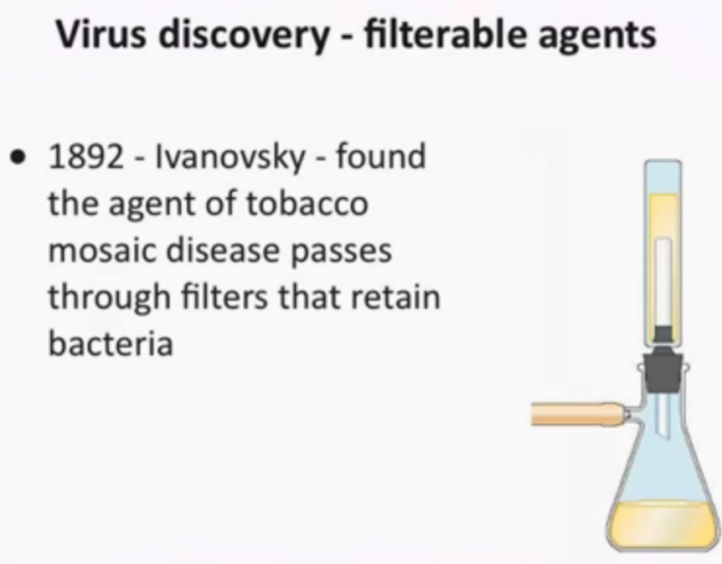
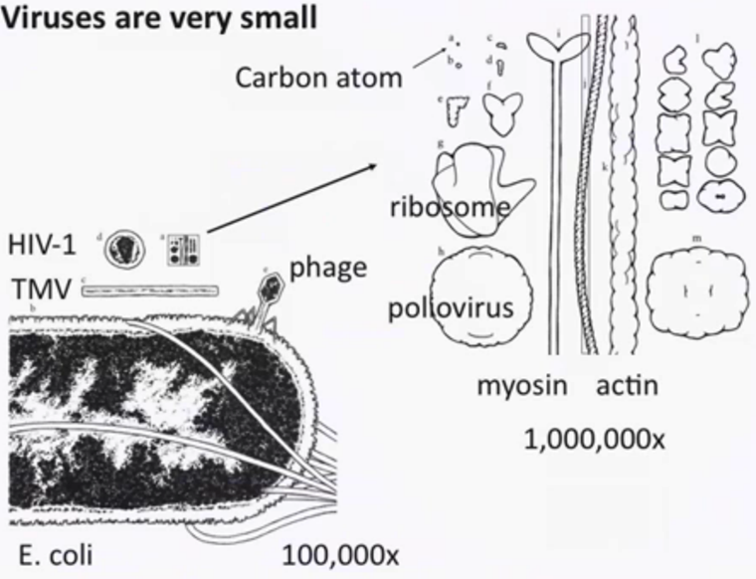
Discovery Virus

Slide 6
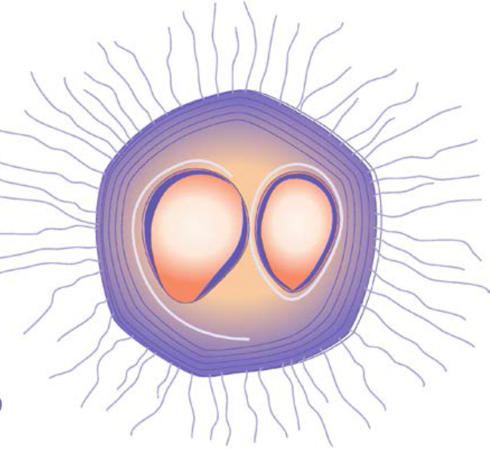
6.1 Viruses Concept
A unique group of infectious agents whose distinctiveness resides in their simple, acellular organization and pattern of multiplication.
Despite this simplicity, viruses are major causes of disease.
Viruses can exist either extracellularly(inactive) or intracellularly(active).

Slide 7
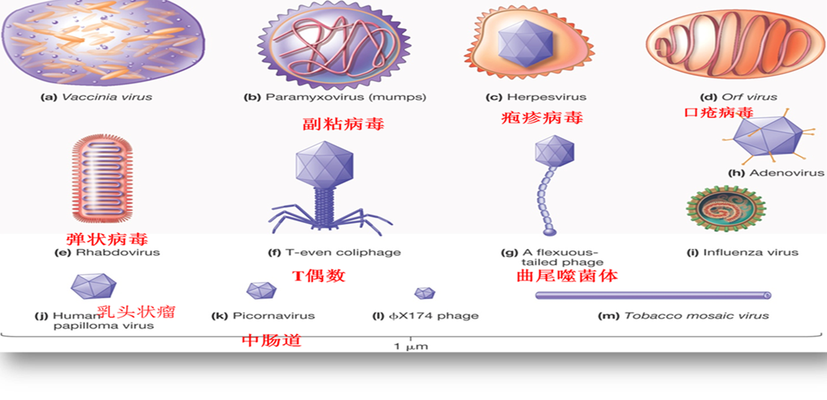
6.1 Viruses Types
Viruses can infect all cell types.
Bacterial viruses called bacteriophages (phages)
Few archaeal viruses. Most are eukaryotic viruses:plants, animals, protists, and fungi
Viruses have been classified into numerous families based primarily on genome structure, life cycle, morphology, and genetic relatedness (ICTV)

Slide 8
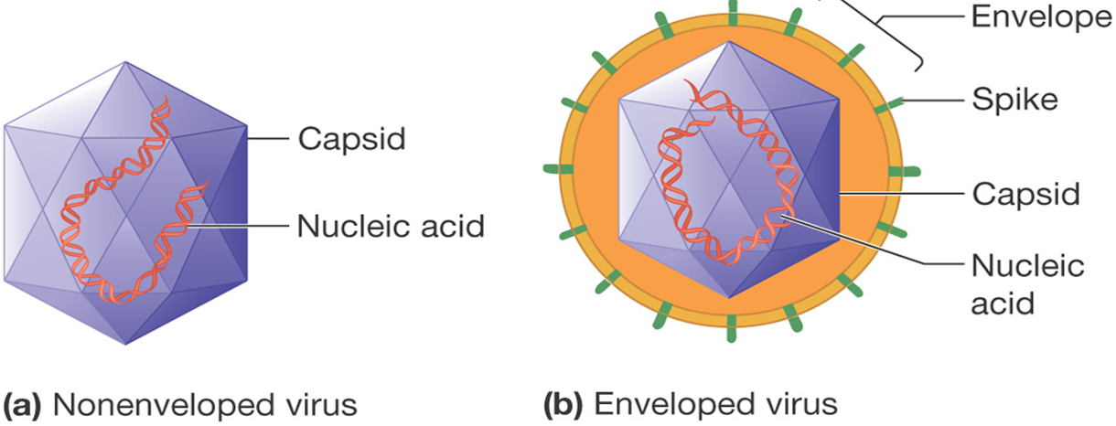
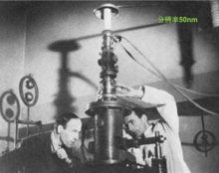
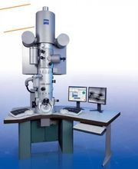
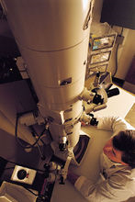
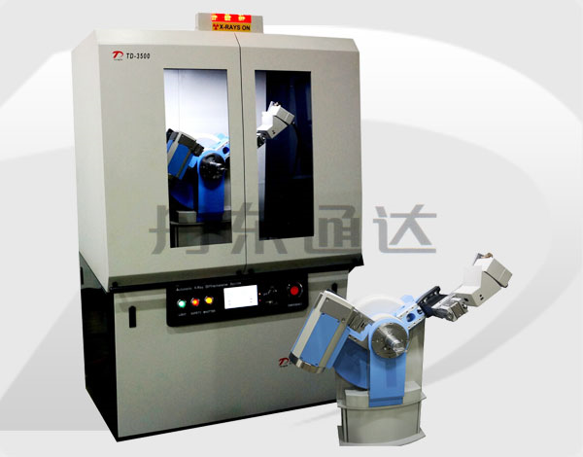
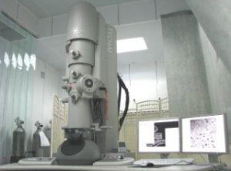
6.2 Virion Structure
What does virus look like?
How to study the virus?
Electron microscopy,
X-ray diffraction,
Biochemical analysis,
Immunology

Slide 9
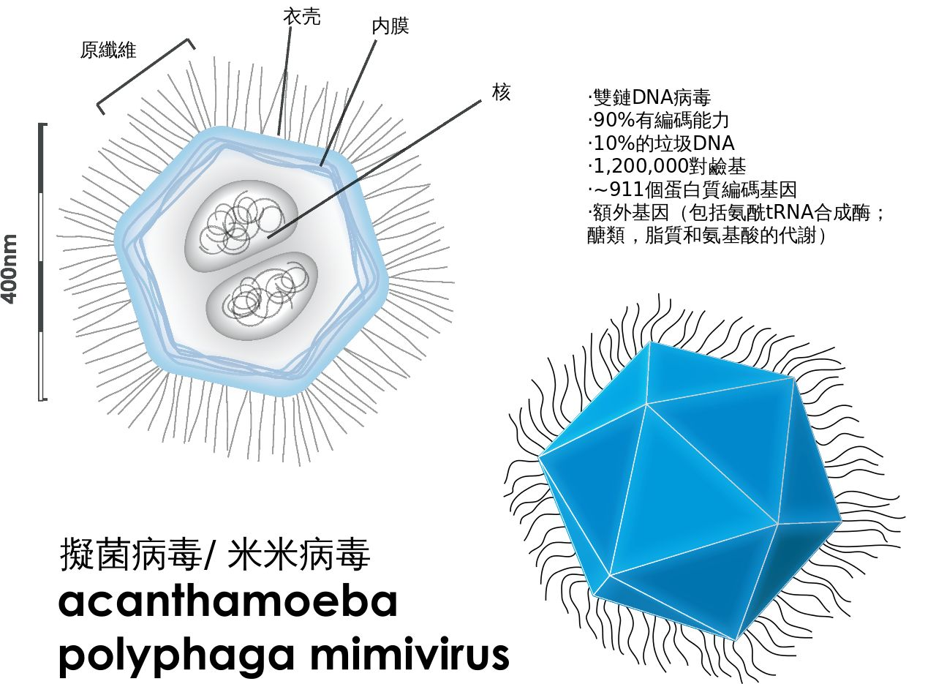
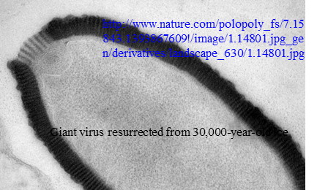
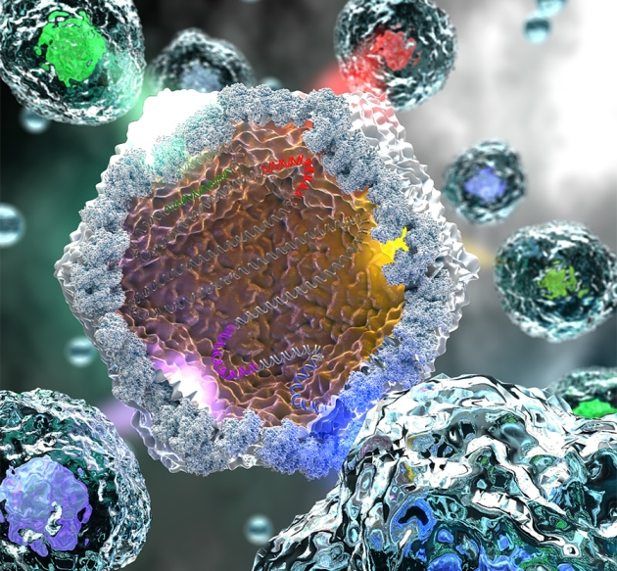
6.2.1 General Structural Properties
A complete virus particle is called a virion
Virions range in size from about 10 to 400 nm in diameter.
The smallest are a little larger than ribosomes,
Whereas mimiviruses, the largest viruses known, can be seen in the light microscope.

Slide 10
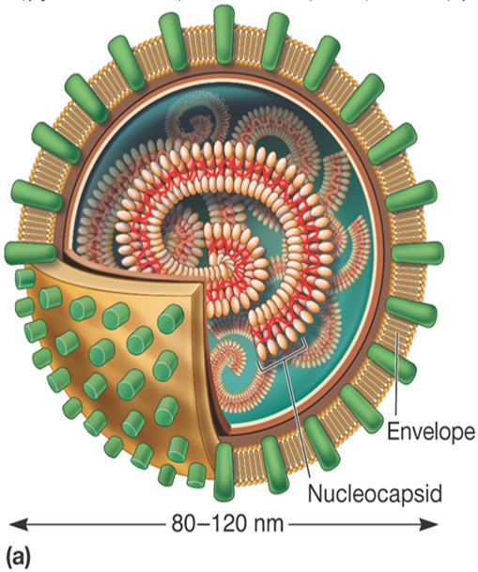
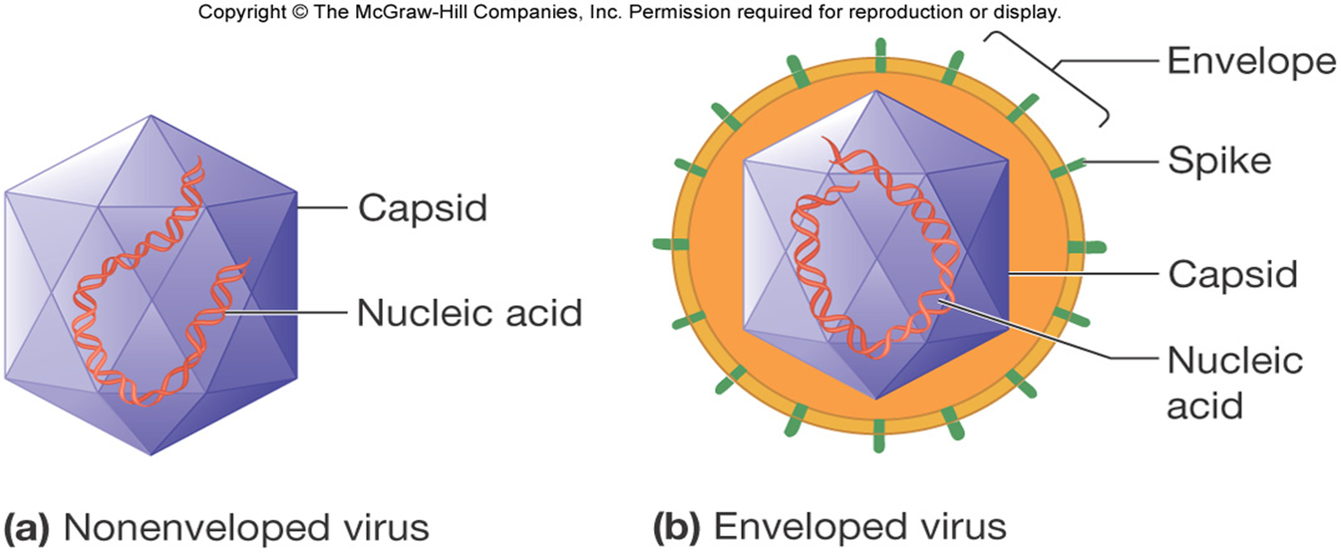
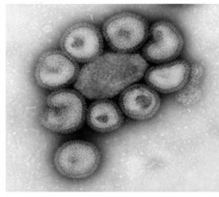
6.2.1 General Structural Properties
  Virions lacking envelopes- Naked viruses(a)
  Virions having envelopes-Enveloped viruses(b)
  The simplest virions are constructed of a nucleocapsid.
Nucleocapsid= genome+ capsid (protein coat, coded by viral genome)
Envelopes-outside of capsid
Influenza virus

Slide 11
6.2.1 General Structural Properties-Capsids 衣壳
Components: protein, are coded by the viral genome.
Function: protect viral genetic material and aids in its transfer between host cells
Arrange: several protomers原体(protein subunits)-capsomer壳体-capsomers(ring or knob shape)-capside
Virion morphology: capsids are helical, icosahedral二十面体病毒, or complex, result from capsid symmetry with the presence or absence of an envelope.

Slide 12
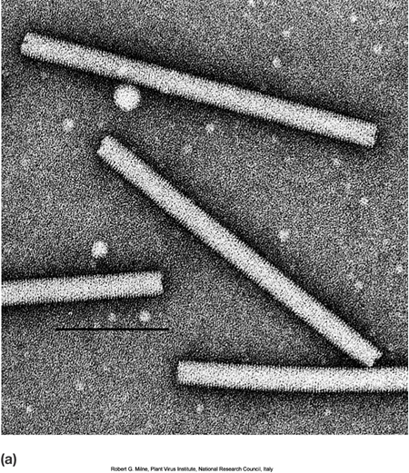
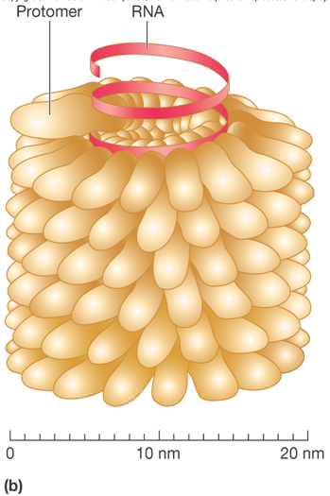
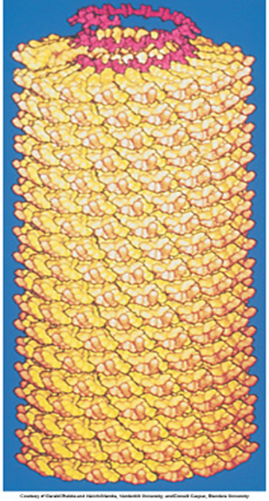
6.2.2 Helical Capsids
Helical capsids are shaped like hollow tubes with protein walls. The capsid encloses an RNA genome, which is wound in a spiral and lies within a groove formed by the protein subunits.
helical
Who decided the length and diameter?
Notes:
The size of a helical capsid is influenced by both its protamers
and the nucleic acid enclosed within the capsid.

Slide 13
6.2.3 Icosahedral(20) capsids
An icosahedron is a regular polyhedron正多面体with 20 equilateral faces and 12 vertices顶点
They are constructed from ring- or knob-shaped units called capsomers, each usually
made of five or six protomers.
Capsomer壳体
  Pentamers (pentons) – 5 protomers(vertices)
  Hexamers (hexons) – 6 protomers(faces)
Icosahedral capsids are the most efficient way to enclose a space. Why ?
Notes:
regular polyhedron正多面体2ionic coordination polyhedron离子配位多面体

Slide 14
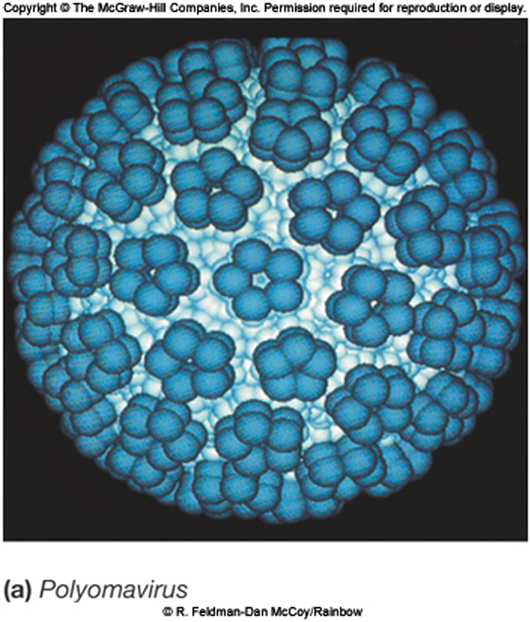
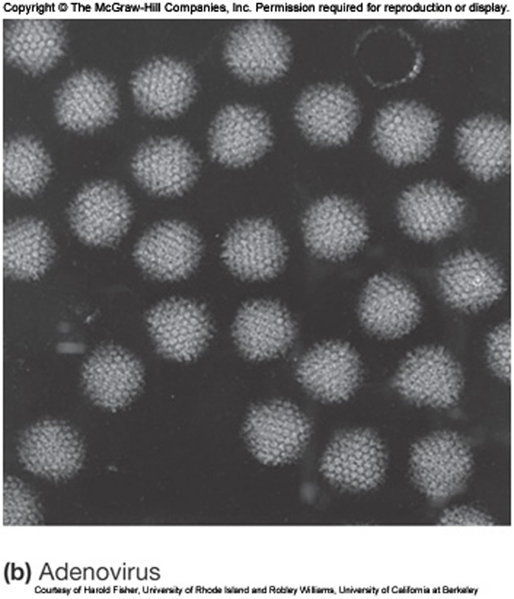
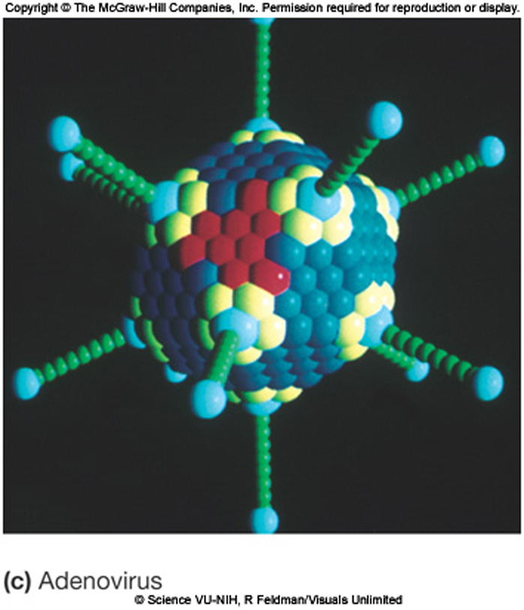

6.2.3 Icosahedral(20) capsids
pentamers
protomer
72capsomers
252capsomers
mimic
Notes:
乳多空病毒科（Papovaviridae）多瘤病毒属（Polyomavirus）。

Slide 15
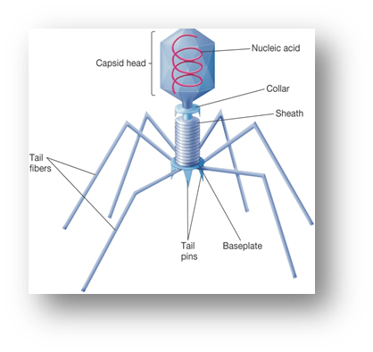
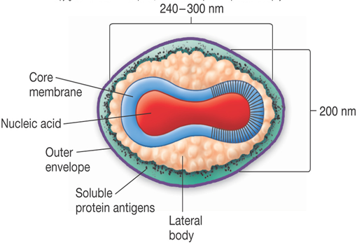
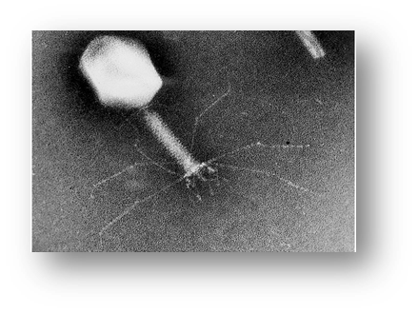
6.2.4 Capsids of Complex Symmetry
Some viruses do not fit into the category of having helical or icosahedral capsids
Examples
  Poxviruses – largest animal virus
  Large bacteriophages – binal symmetry head resembles icosahedral, tail is helical
Vaccinia virus
T4 phage

Slide 16
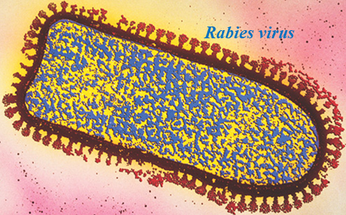
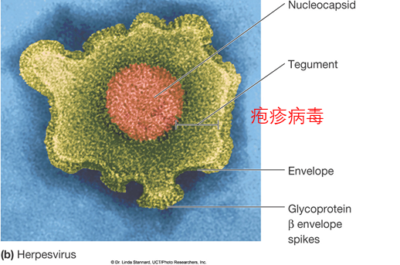
6.2.5 Viral Envelopes and Enzymes
Many viruses are bound by an outer, flexible, membranous layer called the envelope
Animal virus envelopes (lipids and carbohydrates) usually arise from host cell plasma or nuclear membranes.
Many enveloped viruses are pleomorphic(a). However, the bullet-shaped rabies viruses(b) are a constant, characteristic shape.
Where from of the protein?
Notes:
tegument - 被膜

Slide 17
6.2.5 Viral Envelopes and Enzymes
Envelope proteins are coded for by viral genes and may even project from the envelope surface as spikes or peplomers棒状包膜粒
Most of its envelope proteins are glycoproteins. A nonglycosylated protein, the M (matrix) protein, on the inner surface of the envelope and helps stabilize influenza virus.
Spikes are involved in viral attachment to host cell
    e.g., hemagglutin(HA) of influenza virus
  Used for identification of virus.
Notes:
spikes – 刺 peplomers蜱传脑炎病毒 棒状包膜粒(peplomers) poliovirus(脊髓灰质炎病毒)又叫小儿麻痹症 measles - 麻疹

Slide 18
Virion enzymes
6.2.5 Viral Envelopes and Enzymes
It was first erroneously thought that all virions lacked enzymes
A variety of virions have enzymes
  some are associated with the envelope or capsid but most are within the capsid
  Influnza virus carry an enzyme that synthesizes RNA
  Can you give an example?

Slide 19
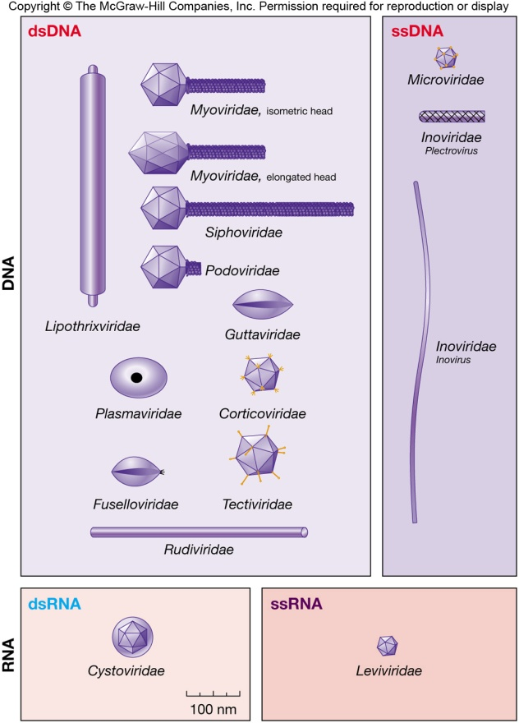
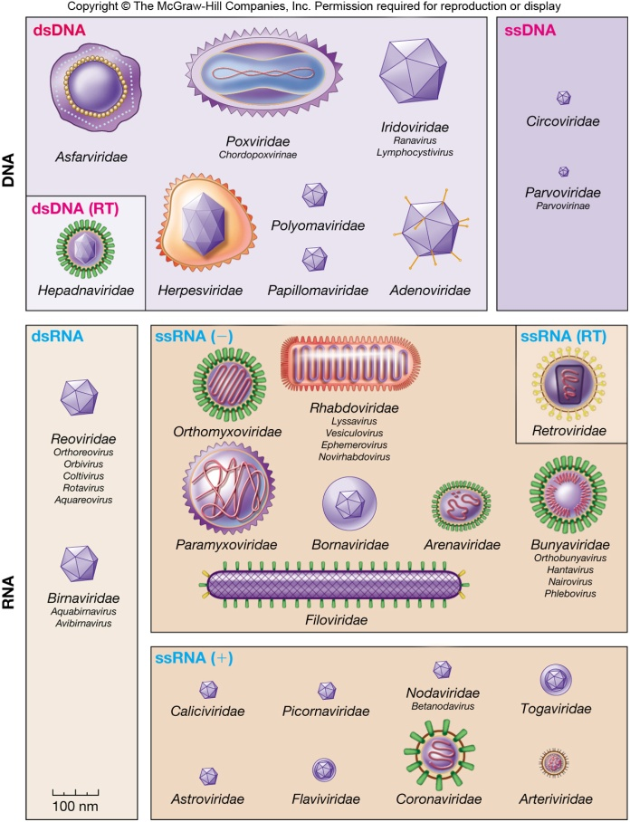
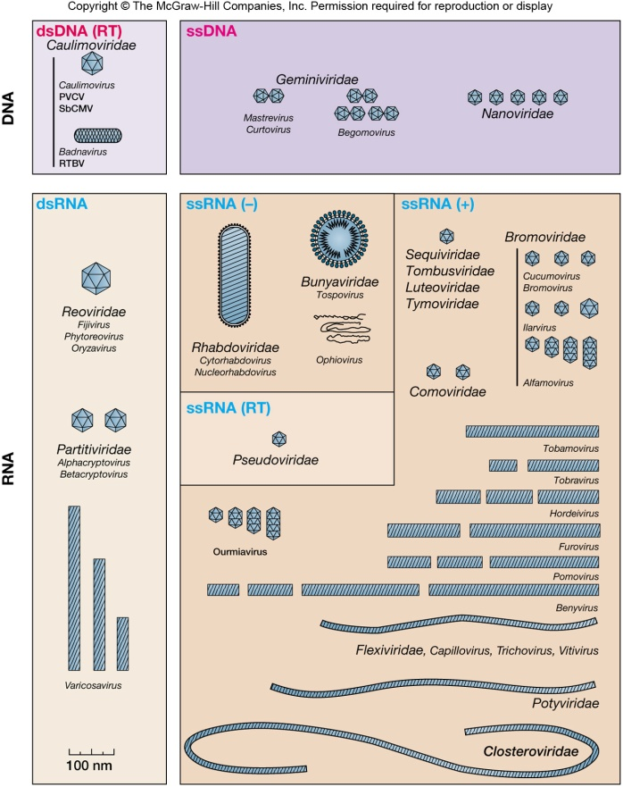
6.2.6 Viral genome
Cellular genomes are always double-stranded (ds) DNA.
A virus may have single or double stranded DNA or RNA(ds, ss)(how many?)
The size of the nucleic acid also varies from virus to virus(4Knt)
Genomes can be segmented or circular
Notes:
ssRNA in plant, four types of dsDNA, ssDNA, dsRNA, ssRNA in animal

Slide 20
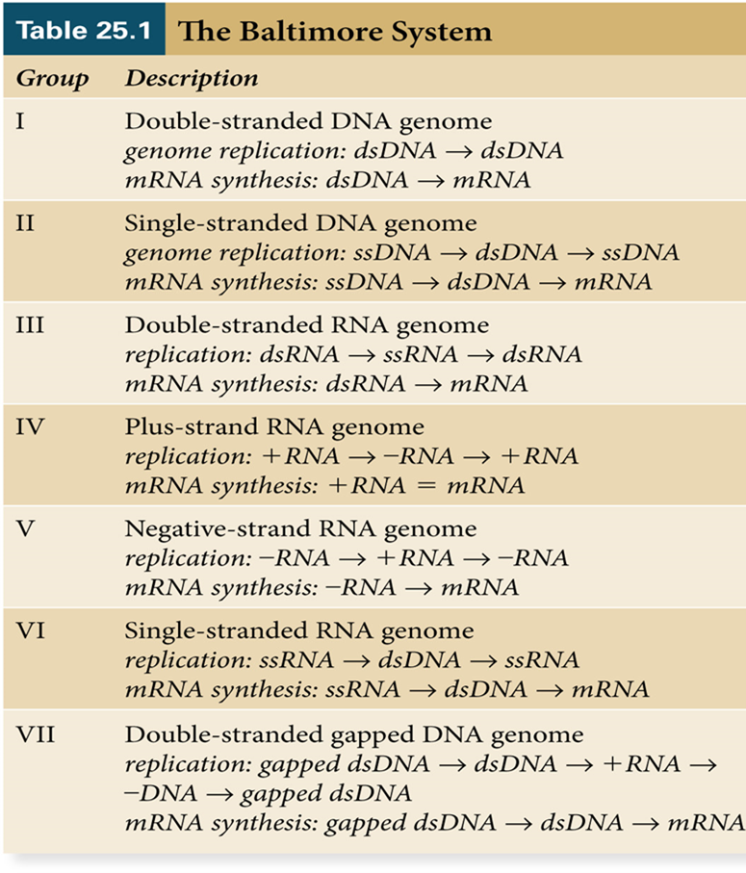
6.2.6 Viral genome and classification
  Focuses on viral genome and process used to synthesize viral mRNA
    (ds) DNA
    (ss) DNA
    dsRNA
    ssRNA (+/-)
    Retrovirus
    Gapped dsDNA
T4phage
Bacteriaphages ⱷx174
Rotavirus
Poliovirus
Influenza
Retroviruses(HIV)
HBV

Slide 21

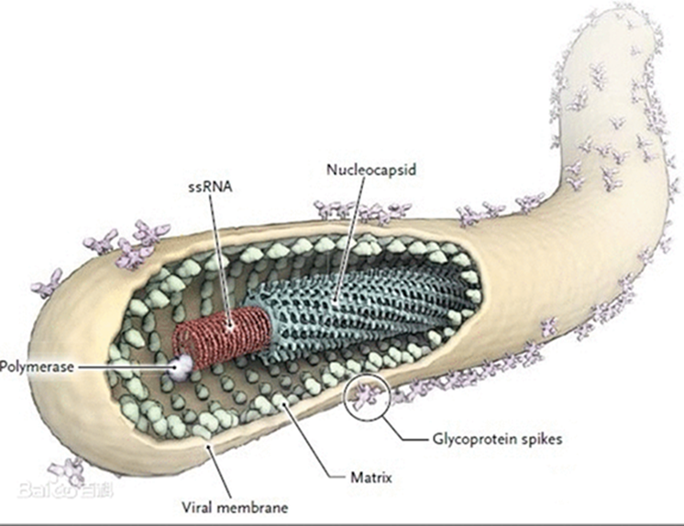
Ebola virus
The EBOV genome is a single-stranded RNA(-) approximately 19,000 nucleotides long.
cylindrical/tubular, and contain viral envelope, matrix, and nucleocapsid components.
The overall cylinders are generally approx. 80 nm in diameter, and having a virally encoded glycoprotein (GP) projecting as 7-10 nm long spikes from its lipid bilayer surface.
How to infect?

Slide 22
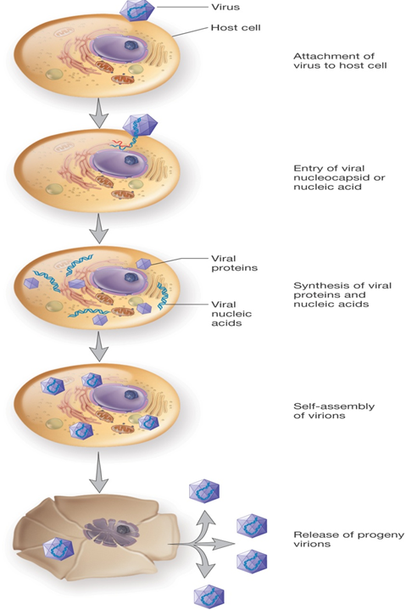
6.3 Viral multiplication繁殖
Mechanism used depends on viral structure and genome
Steps are similar
Attachment to host cell
Entry into host cell
Synthesis stage
Assembly
Release

Slide 23
6.3.1 Attachment (adsorption)
All viruses, must associate with a potential host cell long enough to gain entry into the cell (exception of plant viruses).(How?)
Attachment to the host specific receptor(?).
Bacteriophages attach to the LPS or TA of host.
Receptor determines host preference
  May be specific tissue (tropism - 向性)
  May be more than one host (rabies virus)
  May be more than one receptor(CD4, CCR5)
  May be in vital protein for cellular function(stable)
  May be in lipid rafts providing entry of virus
  (HIV and Ebola are concentrated in lipid rafts)
How about of plant viruses?
Notes:
tropism - 向性 spinal cord - 脊髓
paralytic - 瘫子 麻痹性的

Slide 24
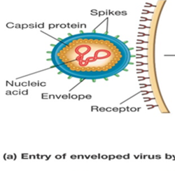
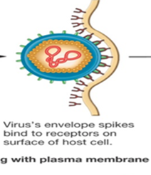
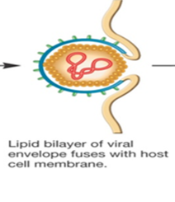
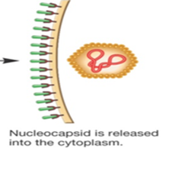
6.3.2 Entry into the Host
The virus's genome or the entire nucleocapsid enters the cytoplasm.
Three methods used
1)Fusion of the viral envelope with host membrane; nucleocapsid enters

Slide 25
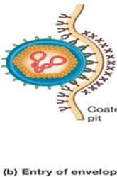
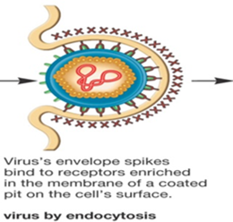
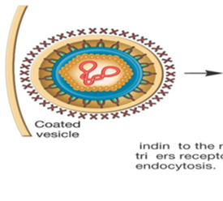
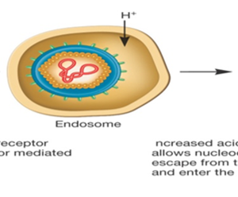
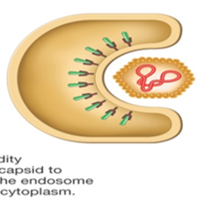
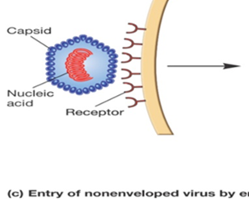
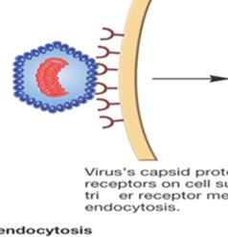
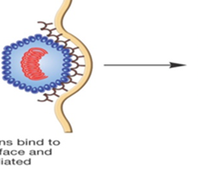

6.3.2 Entry into the Host
2) Endocytosis in vesicle; endosome aids in viral uncoating.(acidity)
low pH
3) Injection of nucleic acid(phage)

Slide 26
6.3.3 Synthesis stage
This stage differs dramatically among viruses because the genome of a virus dictates the events that occur.
DNA(ds) typical flow(transcription-translation)
RNA viruses(+/-RNA)-mRNA
  Virus must carry in or synthesize the proteins during the infection process.
Regardless of genome structure, synthesis of viral proteins is tightly regulated.
Early proteins are synthesized early (taking over the host cell);
Late proteins are synthesized later(capsid and assemble,release)

Slide 27

6.3.4 Assembly
Most are assembled in the cytoplasm, and some are assembled in the nucleus.
For many viruses, so-called "virus factories" are large paracrystalline clusters of either complete nucleocapsids or procapsids.
Late proteins are important in assembly.
Assembly is complicated but varies(e.g.bacteriophages)

Slide 28

6.3.5 Virion release.
Naked viruses lyse the host cell(lysozyme, holin)
  T4 phage may attack peptidoglycan(?) or membrane(holin)

Slide 29
6.3.5 Virion release.
How about of host?
Enveloped viruses use budding
Envelope formation and virion release are usually concurrent processes
Virus-encoded proteins are incorporated into the membrane.
Nucleocapsid is simultaneously released and the envelope formed by membrane budding
Envelop derived from host cell membrane, Golgi, ER, or other
Vaccinia virus may use host actin tails to propel directly into an adjacent cell(escape defense).

Slide 30
6.4 Types of Viral Infections
Lysis and Lysogeny(bacteria and archaea):
A virulent phage: to begin multiplying immediately upon entering its bacterial host, followed by release from the host by lysis.
Tem­perate phages : upon entry into the host, they can multiply and lyse the host cell, or they can remain within the host without destroying it.

Slide 31



6.4 Types of Viral Infections
Lysogeny: The relationship between a temperate phage and its host.
Prophage: The form of the virus that remains within its host.
Lysogens: The infected bacteria.
Induction: Cause the prophage to initiate synthesis of phage proteins and to assemble new viri­ons.

Slide 32
6.4 Types of Viral Infections(Eukaryotic Cells)
Cytocidal infection: An infection that results in cell death.
Cytopathic effects: Eukaryotic viruses can cause degenerative changes or abnormalities in host cells that are distinct from lysis.
Outcome: is the transformation of normal host cells into malignant or cancerous cells.

Slide 33

6.5 Cultivation and Enumeration of Viruses
1)Viruses are cultivated (using tissue cultures, embryonated eggs, bacterial cultures, and other living hosts).
To observe: plaques(bacterial); or pocks and plaques; localized necrotic lesions (plant).
2)Virions can be counted directly with the transmission electron microscope or indirectly by hemagglutination and plaque assays.
3)Infectivity assays can be used to estimate virion numbers in terms of plaque-forming units, lethal dose (LD50), or infectious dose (ID50)

Slide 34
6.6 Viroids and Satellites
Viroids are infectious agents that consist only of RNA.
Viroids are covalently closed, circular ssRNAs, about 250 to 370 nucleotides long, which forms double-stranded regions with single­ stranded loops.
Infection mechanism: replication (DNAdependent RNA polymerase and DsRNA silencing).
Satellites are similar to viroids in that they also consist only of a nucleic acid (either DNA or RNA). Need a helper virus to replicate and infect host cells.
Imagination: ncRNA as a viroids in cell(?)

Slide 35
6.7 Prions
Prions are small proteinaceous agents associated with at least six degenerative nervous system disorders.
Hypothesis: prion proteins exist in two forms: abnormally folded form and a normal cellular form.
The interaction between the PP and the NP converts the PP into the NP.
?

Slide 36
Summary
Virion structure and components
The structure of viruses
Types of virus
Viral multiplication (lysogeny)

Slide 37
Discussion!
1. Discuss whether you think viruses evolved before the first cell or whether they have coevolved and are perhaps still coevolving with their hosts.
2. Discuss the ways that viruses can be cultivated.
3. What advantages might a phage gain by being capable of lysogeny?
4. Explain why the receptors that viruses have evolved to use are host surface proteins that serve very important, and sometimes essential, functions for the host cell?
5. Consider the origin of viral envelopes and suggest why enveloped viruses that infect plants and bacteria are rare.
6. Compare and contrast in general terms viruses, viroids, satellites, and prions
Notes:
Beauveria bassiana白僵菌，Metarhizium anisopliae绿僵菌Plasmodium 疟原虫Anopheles桉蚊

Slide 38
作业和练习
1.请用任意一种文体，介绍细菌的相关知识（形态特征、结构及其功能等）。引力波会对细菌的结构有影响吗？
2.您认为细菌、古菌和真菌最主要的差别是什么？它们的细胞膜的组成或结构有什么异同？您能否举例说明2017年诺贝尔化学奖中的技术用于细胞膜蛋白质的研究，有何显著的特点？
3.根据病毒的组成及结构以及繁殖特点，以乙肝病毒为例设想病毒病的几种治疗策略。
同学间互评的翻译练习（不需要交）：第3章（星期二班）；第4章（星期五班）；第6章（星期三班）
说明：请在期中考试的前2周前提交作业；请在期中考试前完成翻译练习。

Slide 39
Summary
Bacteria, Archaea, Fungi and virus
Components, Structure and reproduction
The difference between them
The significant of them.
The relative diseases and benefits
virus
bacteria
yeast
mold
archaea

Slide 40
Thanks!
Next chapter 7

