Slide 1
Cancer Biology
Lecture 3
Fall 2018
Dr. Yongyou Zhang
张永有
Yongyouzhang@xmu.edu.cn, A218

Slide 2
References:
Book charter:
The Biology of Cancer ( second Edition, chapter 2.7-2.11, chapter 3, chapter 11.1-11.5)
Cancer and Environment: Gene-Environment interaction. Washington, DC: National Academy Press,2002
Papers:
1. Siegel RL, Miller KD, Jemal A. Cancer statistics, 2018. CA: a cancer journal for clinicians 2018, 68(1): 7-30.
2. Chen W, Zheng R, Baade PD, Zhang S, Zeng H, Bray F, Jemal A, Yu XQ, He J. Cancer statistics in China, 2015. CA: a cancer journal for clinicians 2016, 66(2): 115-132.
3. Brennan P. Gene-environment interaction and aetiology of cancer: what does it mean and how can we measure it? Carcinogenesis 2002, 23(3): 381-387.
4. Peto J. Cancer epidemiology in the last century and the next decade. Nature 2001, 411(6835): 390-395.

Slide 3
Causes of Cancer:
  Genetic (内因）
  Environmental（外因）
The Nature of Cancer suggests that it is a disease of chaos, a breakdown of existing biological order within the body. More specifically, the disorder seen in cancer appears to drive directly from malfunctioning of the controls that are normally responsible for determining when and where cells throughout the body will multiply.
Notes:
The Nature of Cancer suggests that it is a disease of chaos, a breakdown of existing biological order within the body. More specifically, the disorder seen in cancer appears to drive diretly from malfunctioning of the controls that are normally responsible for determining when and where cells throughout the body will multiply.
在唯物辩证法中，内外因作用原理表述如下：事物的发展是内外因共同起作用的结果，内因是事物发展的根据,它是第一位的,它决定着事物发展的基本趋向，外因是事物发展的外部条件,它是第二位的,它对事物的发展起着加速或延缓的作用,外因必须通过内因而起作用。
由内外因作用原理可以看出，事物发展的结果可以看作是内因和外因的积，即：结果=内因X外因。

Slide 4
The vast majority of cancers are non-hereditary ("sporadic cancers").
Hereditary cancers are primarily caused by an inherited genetic defect. Less than 0.3% of the population are carriers of a genetic mutation which has a large effect on cancer risk and these cause less than 3–10% of all cancer.
Some of these syndromes include: certain inherited mutations in the genes BRCA1 and BRCA2 with a more than 75% risk of breast cancer and ovarian cancer,
hereditary nonpolyposis colorectal cancer (HNPCC or Lynch syndrome) which is present in about 3% of people with colorectal cancer。

Slide 5
Cancer and Environment

Slide 6
Cancer Epidemiology
Population studies
Some cancers have similar risk/rates in all populations
Others have very different rates in different populations
→identification of risk factors
  Genetic
  Environmental
Epidemiology is the study and analysis of the patterns, causes, and effects of health and disease conditions in defined populations
Notes:
Epidemiology is the study and analysis of the patterns, causes, and effects of health and disease conditions in defined populations

Slide 7
Accuracy of replication
10¹³ cells/human body
10¹⁶ cells/whole life
1 cell → more than10¹⁶ cells
Human genome
= 3x10⁹ nucleotides (letters) haploid
6x10⁹ diploid
Need to copy ~ 10²⁶ letters
Notes:
个成年人身体里所有细胞的数量，从几十万亿到百万亿个不等，就看各位体重如何，像我这种身材的估计是最小的那个数量级。
面这个数字估计小了。一个人体细胞里的DNA连起来大约1米，所以如果把身体里所有细胞的DNA都拧成一股绳子，长度按最大算那么是100万亿米，即1000亿千米=667个天文单位(可以来回月球4000次

Slide 8
Origin of cancer cell
→ → → →
Cell
Gene
Environment

Slide 9
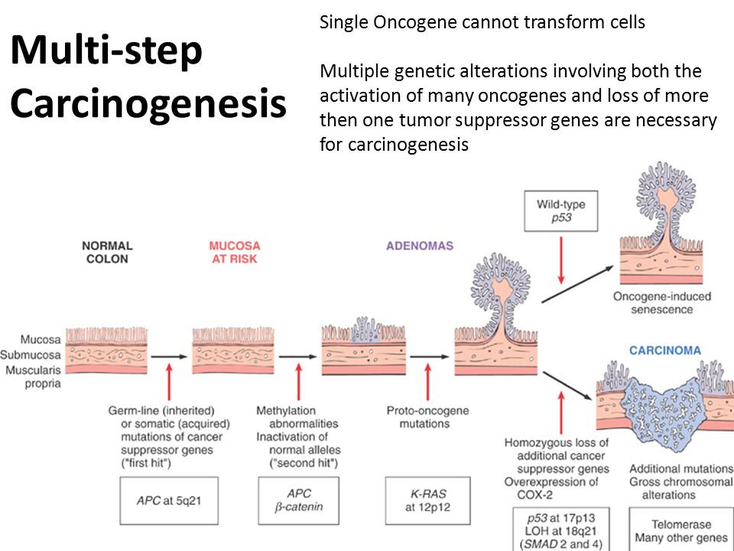
Tumor suppressor genes and colon carcinoma progression

Slide 10
Epidemiology of Cancer Based on Age

Slide 11
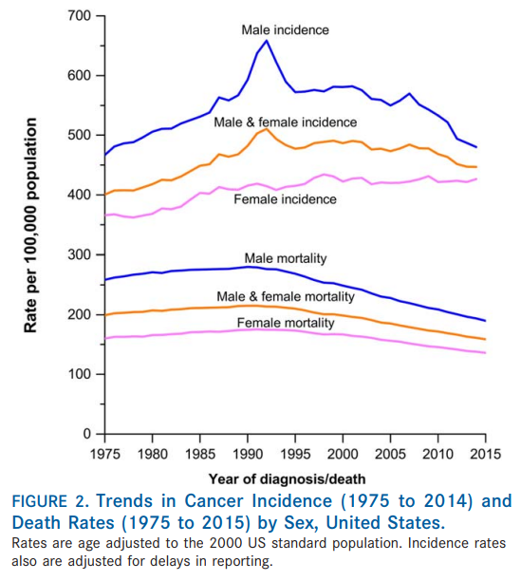
Cancer Incidence by Age
Siegel RL, Miller KD, Jemal A. Cancer statistics, 2018
Notes:
10万人中

Slide 12
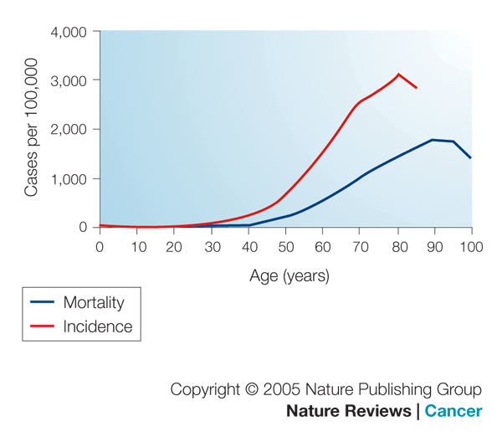
Cancer Incidence by Age

Slide 13
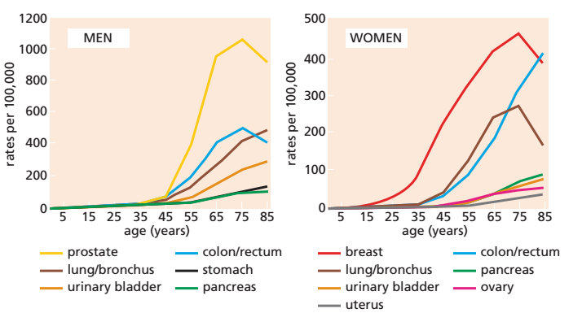
Cancer Incidence at Various Ages
Notes:
Discussion: why???
If population incidence is not representative of
many individuals’ cancer hazard, then there is importantly
heterogeneous susceptibility to cancer in the population.
It has been hypothesized that some of the population is
especially susceptible to cancer and that many of these
persons develop tumors before reaching old age.41 Then
the population of susceptibles becomes depleted, and the
overall cancer rate decreases among the elderly, a population
with fewer susceptibles remaining.41-

Slide 14
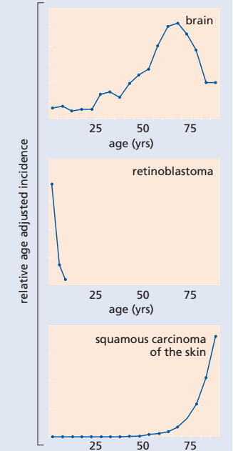
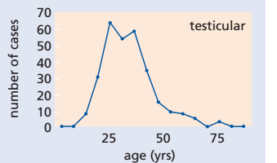
atypical
atypical
atypical
Most cancers( typical): increased with Age
Some cancers( atypical: Why????
typical

Slide 15
Cancer Epidemiology
Population studies
Some cancers have similar risk/rates in all populations
Others have very different rates in different populations
→identification of risk factors
  Genetic
  Environmental

Slide 16
Cancer type | Highest rate | Lowest rate | Ration H/L
Skin (Melanoma) | Australia (Queensland) | Japan | 155:1
Lip | Canada (Newfoundland) | Japan | 151:1
Nasopharynx | Hong Kong | United Kingdom | 100:1
Prostate | US (African American) | China | 70:1
Liver | China (Shanghai) | Canada (Nova Scotia) | 49:1
Penis | Brazil | Israel (Ashkenaz Jews) | 42:1
Cervix (Uterus) | Brazil | Israel (Non-Jews) | 28:1
Stomach | Japan | Kuwait | 22:1
Age adjusted death rate at 60 from a certain type of cancer. (Muir et al 1987)

Slide 17
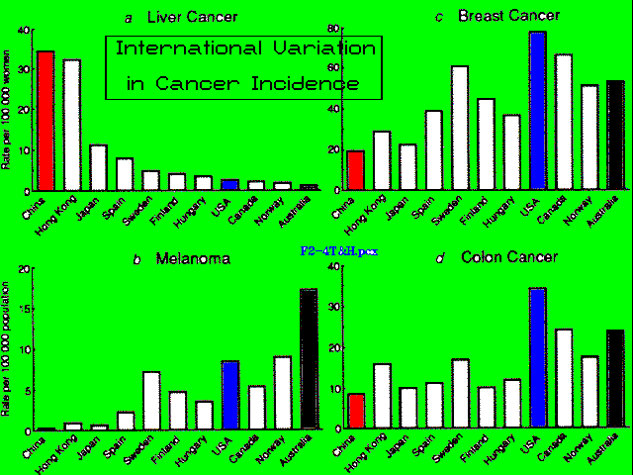
Notes:
Folder: Epidemiology
Different histological types of cancer appear in different countries and cultures with highly significant differences in frequency. These geographical and cultural differences in the incidence of different types of cancer tell us a great deal about what may be contributing the causation of these cancers.

Slide 18
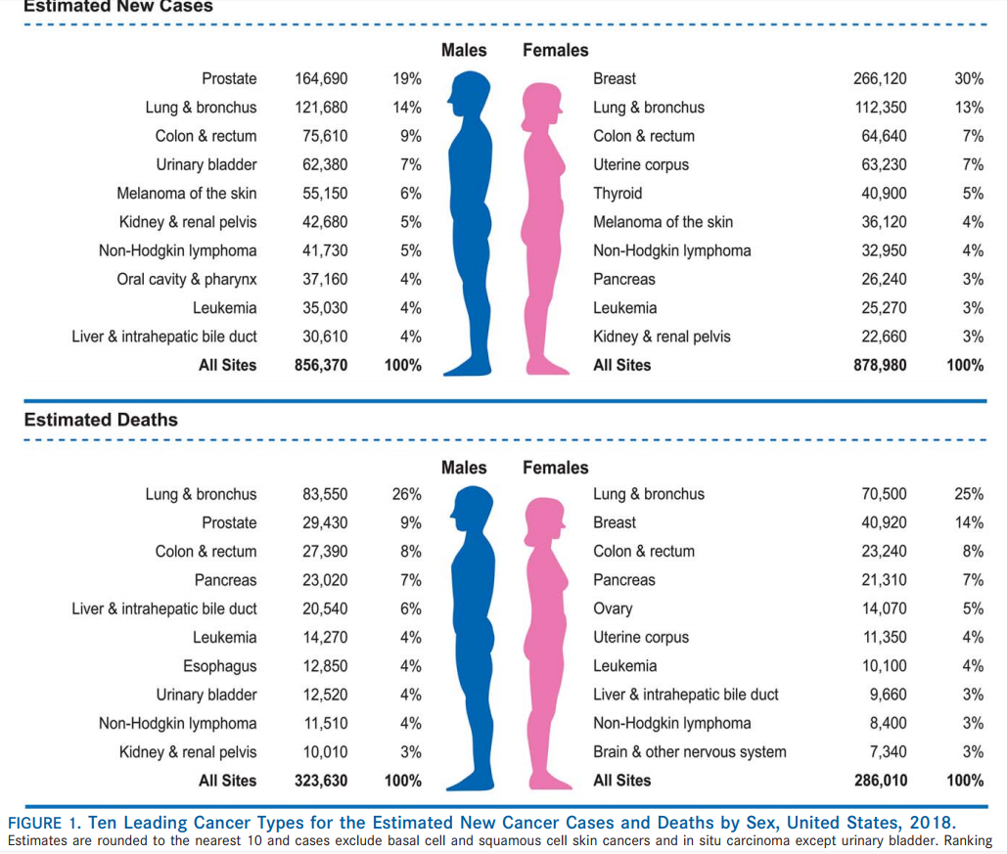
Cancer in USA
Siegel RL, Miller KD, Jemal A. Cancer statistics, 2018

Slide 19
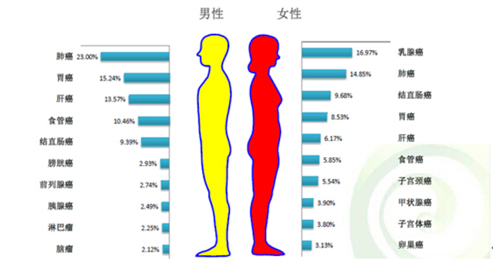
Cancer in China
All population
肺癌
胃癌
肝癌
结直肠癌
食管癌

Slide 20

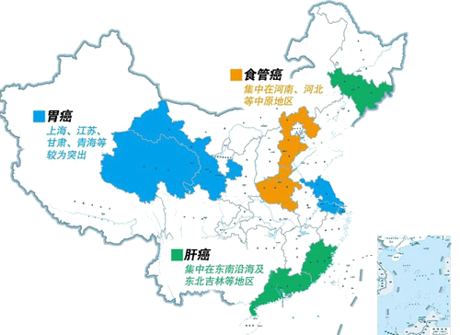
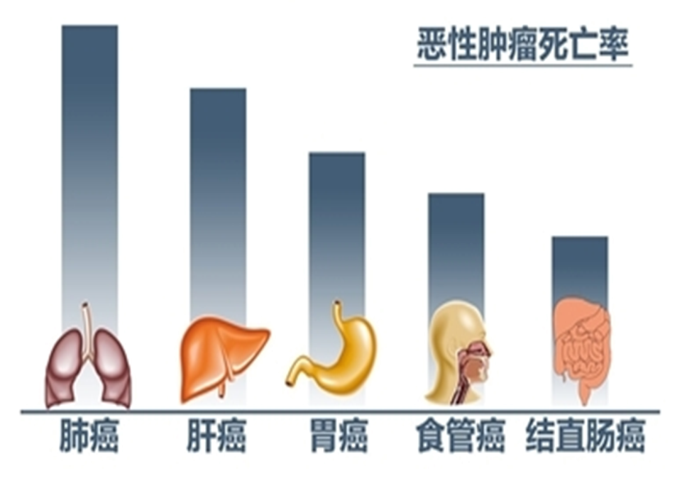
更令人关注的是，2012年中国新增癌症病例高居世界第一位，肝癌和食管癌患者约占 全球一半，死亡分别占全球的51%和49%；胃癌症例和死亡均占全球40%；鼻咽癌80% 发生在中国。

Slide 21
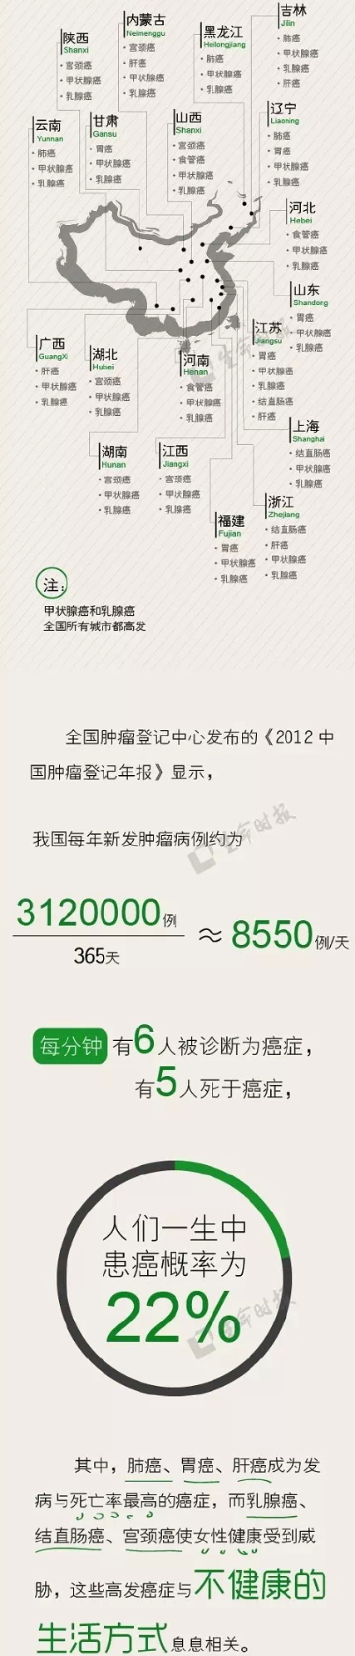
10000 例/Day
2016 年
33%
@ 85 years old

Slide 22
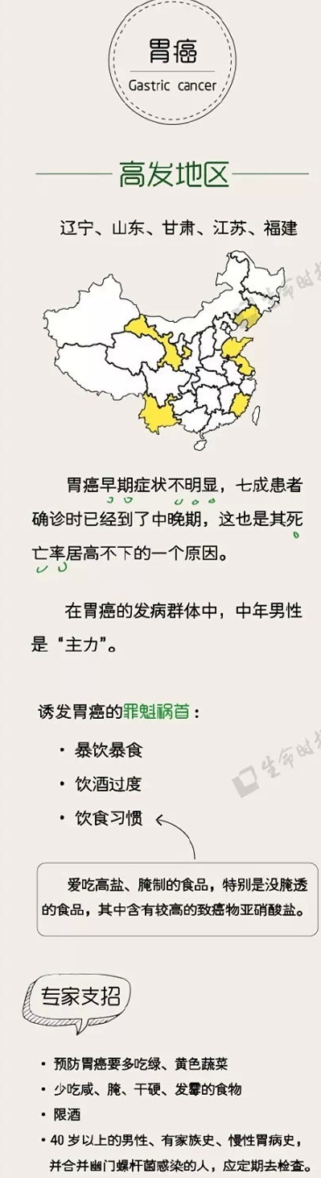
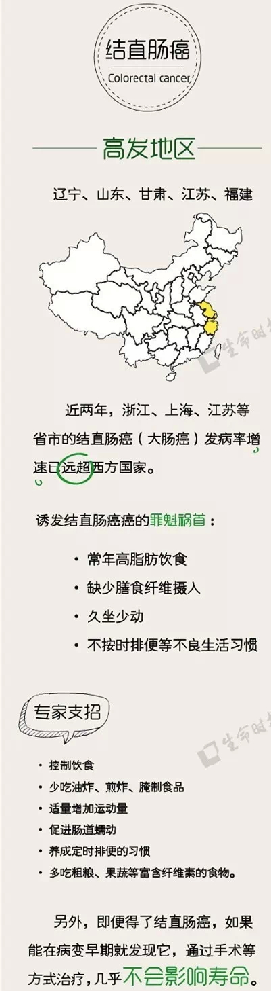
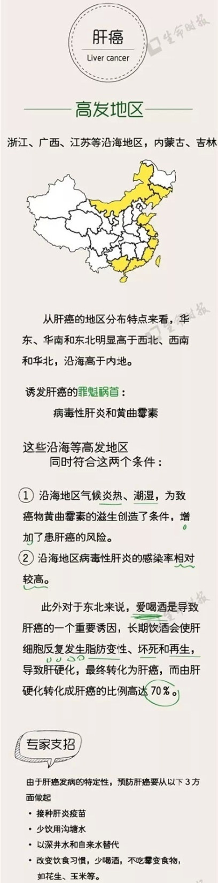
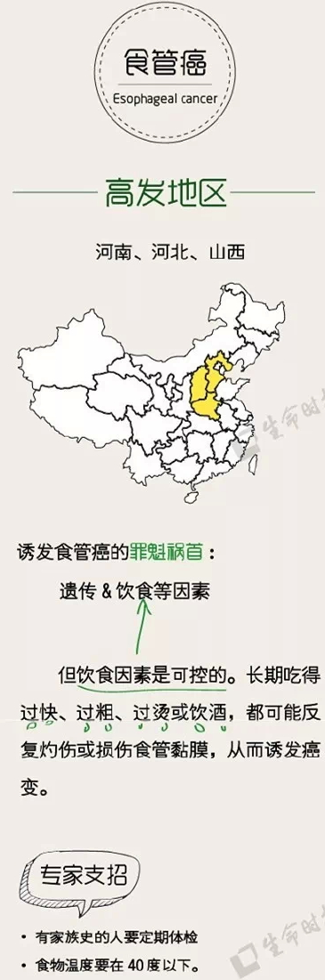

Slide 23
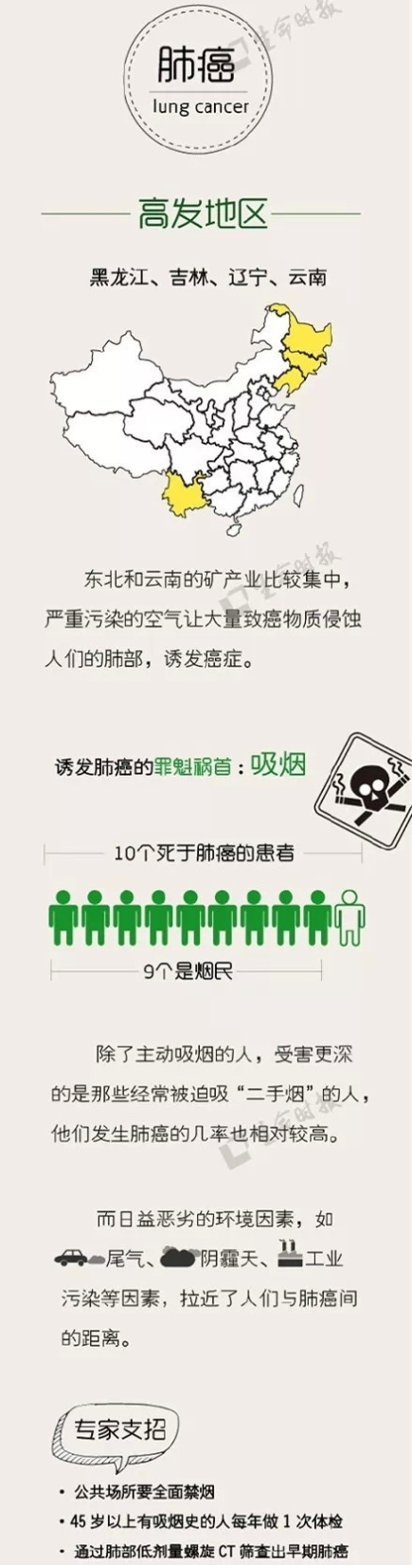
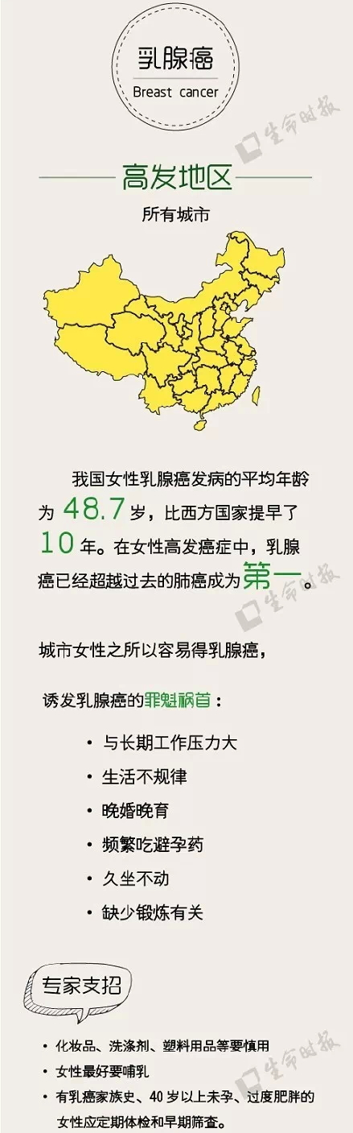
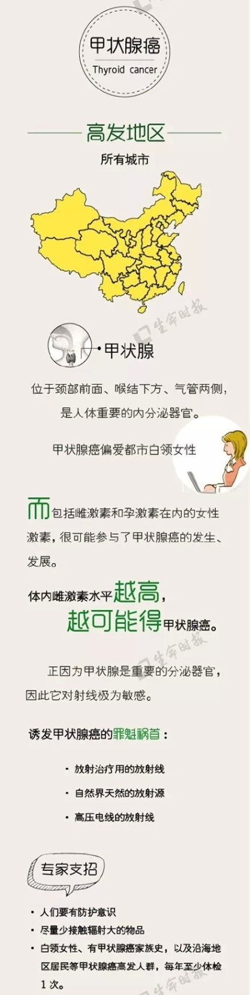

Slide 24
Examples of environmental risk factors
Lung cancer: 31% males, 25% females
1st cancer death
  Doll and Hill, 1950
  Most recent number of cigarettes smoked per day before the onset of lung cancer
Cigarettes /day | 0 | 1-4 | 5-14 | 15-24 | 25 or more
Life time risk | 1x | 8x | 12x | 14x | 27x

Slide 25
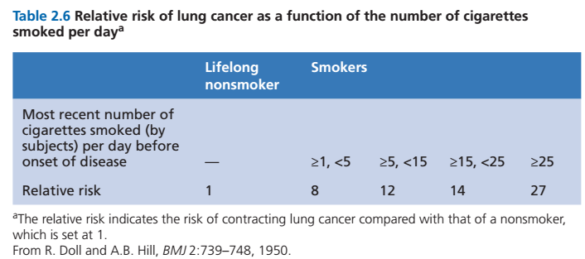
p. 59
Table 2.6 The Biology of Cancer (© Garland Science 2013)

Slide 26
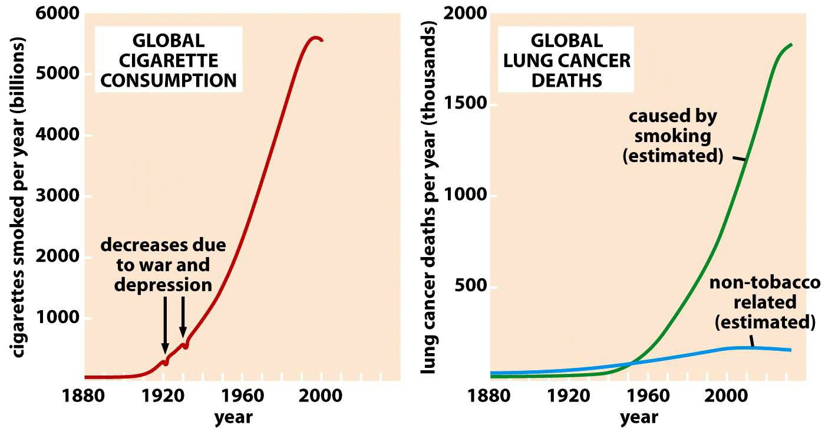
Cigarette Consumption and Lung Cancer: 1880 to 2000
Figure 11.2 The Biology of Cancer (© Garland Science 2007)

Slide 27
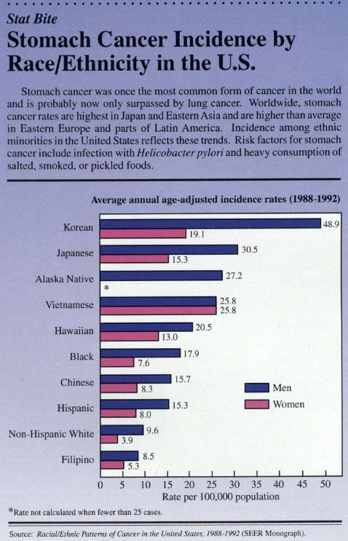
Journal of the National Cancer Institute October, 1996
StomCxEthnic

Slide 28
Cancer risk: Gene vs. Environment
Japanese immigrants in US
1st Generation
Japanese
in Japan
stomach cancer
colon cancer
Caucasian
in US
stomach cancer
colon cancer
2nd Generateion
?

Slide 29
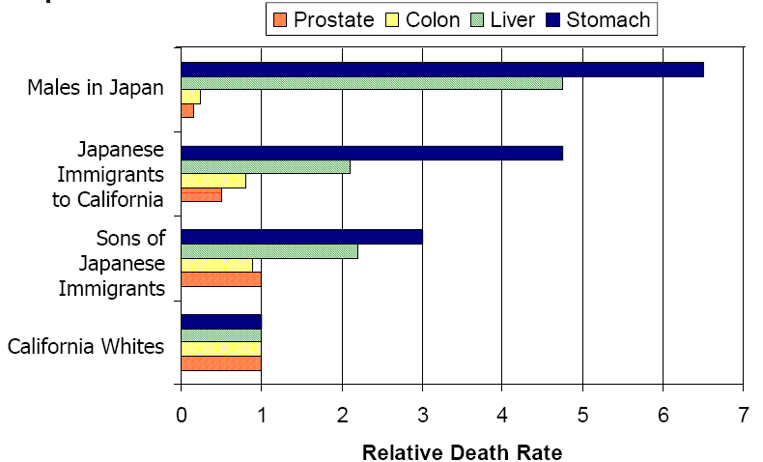
Migration and cancer rate

Slide 30


Cancer risk: Gene vs. Environment
Japanese immigrants in US 1st Generation
Japanese in Japan
Caucasian
in US
stomach cancer
colon cancer
stomach cancer
colon cancer
2nd Generateion

Slide 31
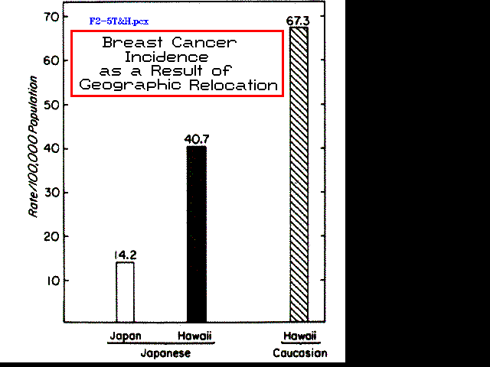
Notes:
Folder: Epidemio
One can distinguish genetic from environmental and cultural features in cancer causation by analyzing populations with similar genetic backgrounds living in different environments.

Slide 32
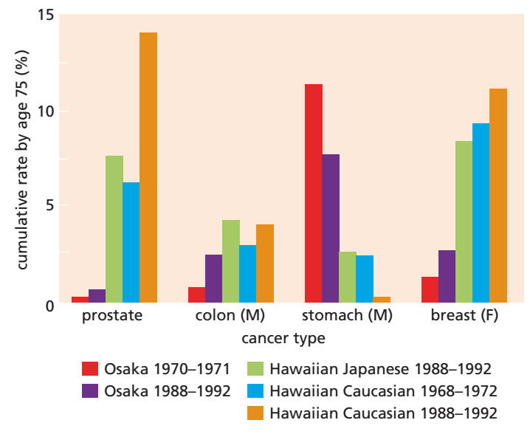
Cancer Incidence Following Migration
Figure 2.23 The Biology of Cancer (© Garland Science 2013)
p. 57

Slide 33
Epidemiological Data can also sometimes provide clues about the biological mechanisms underlying certain types of cancers.
Malignant Melanoma (Solar radiation exposure)
Burkitt’s Lymphoma
(Co-infection with virus transmitted by mosquitos also transmitting malaria)

Slide 34
U.S. Lifetime melanoma risk, 1935 - 2011 (Lens and Dawes, 2004).

Slide 35

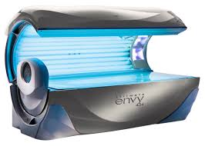
U.S. Lifetime melanoma risk, 1935 - 2011 (Lens and Dawes, 2004).
In 1988, 1% of Americans used a tanning bed. By 2007, that number increased to 27%
Nonetheless, the UV energy emitted by tanning beds is usually anywhere from two-to ten-fold more intense than direct sunlight

Slide 36
Epidemiological Data can also sometimes provide clues about the biological mechanisms underlying certain types of cancers.
Malignant Melanoma (Solar radiation exposure)
Burkitt’s Lymphoma
(Co-infection with virus transmitted by mosquitos also transmitting malaria)

Slide 37
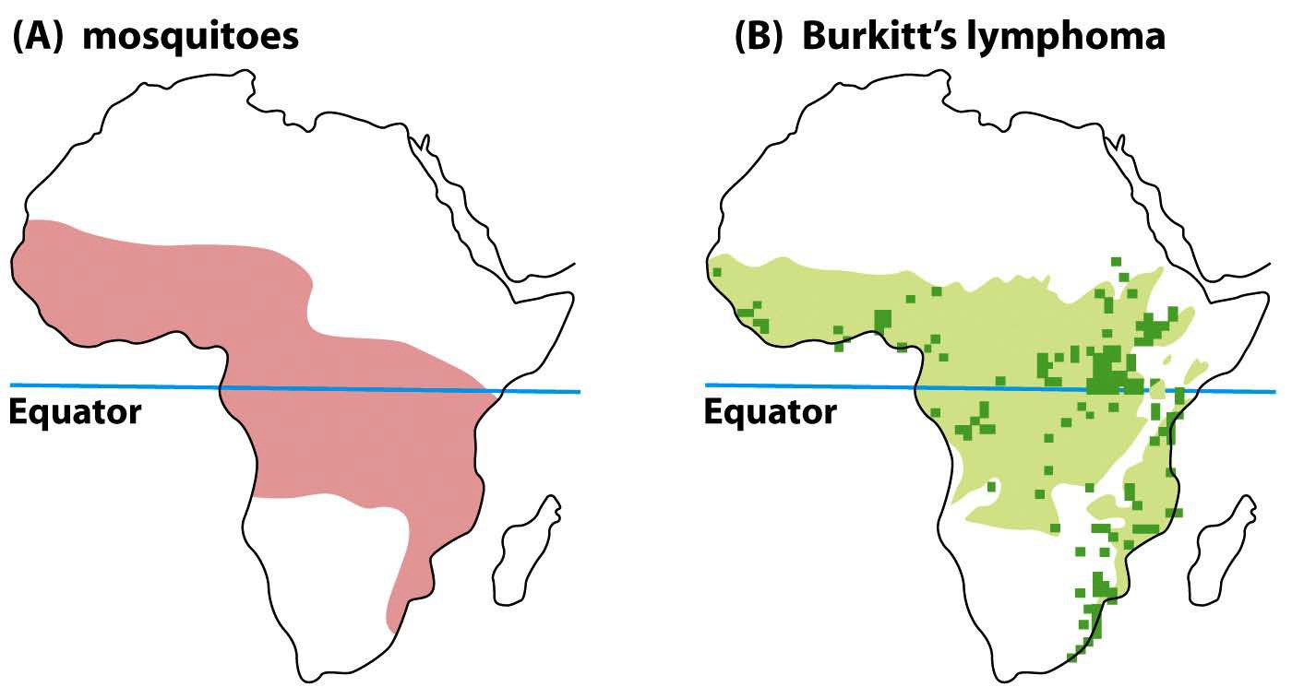
Incidence of Burkitt’s Lymphoma in Relation to Infectious Disease Etiology:
Aedes simpsoni mosquito transmission vector for malaria and Epstein Barr Virus co-infection
Figure 4.12 The Biology of Cancer (© Garland Science 2007)
Notes:
Burkitt淋巴瘤是1964年Epstein首先从非洲儿童Burkitt淋巴组织中分离出EB病毒，Burkitt淋巴瘤具有明显地方流行性，患者血清中有高价EB病毒抗体，患者淋巴组织培养，可见EB病毒颗粒，20%患者的RS细胞中可以找到EB病毒，是一种可能来源于滤泡生发中心细胞的高度恶性的B细胞肿瘤。现在世界各地都发现类似的病例。我国也有少数病例报道。患者主要为儿童和青年人。男性多于女性。Burkitt淋巴瘤临床上有非洲地区性、散发性和HIV相关性三种形式。EB病毒的潜伏感染和非洲地区性的Burkitt淋巴瘤有密切关系。

Slide 38
Introduction
What is cancer?
What causes cancer?
  Chemicals
  Virus
How do we deal with cancer?

Slide 39
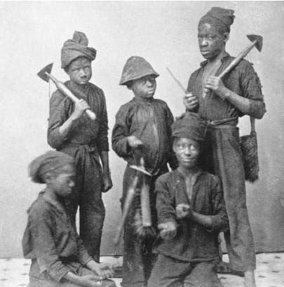
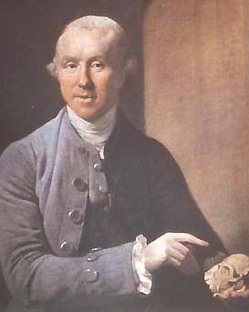
Carcinogen
1775: chimney sweep and scrotal (阴囊）carcinoma.
Sir Percivall Pott (1714-1788)

Slide 40
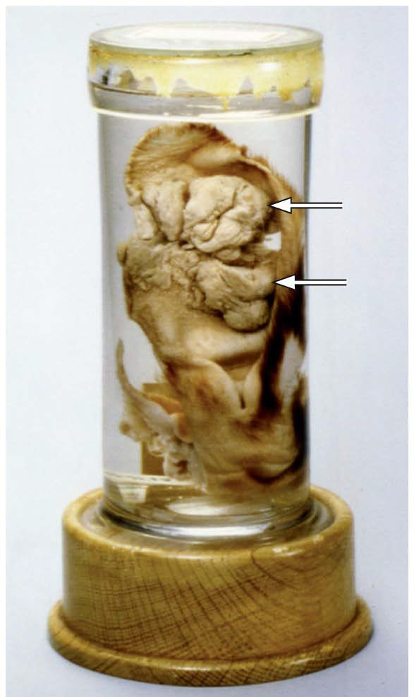
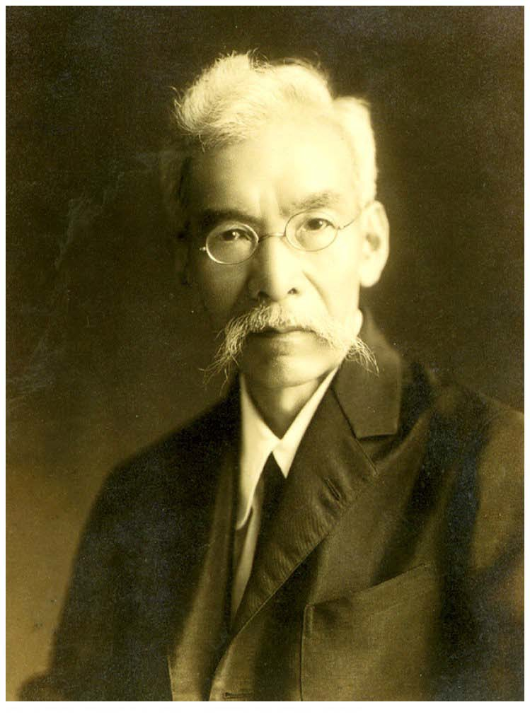

Carcinogen test
660 days Coal Tar
(焦油)
Skin carcinoma
Katsusaburo Yamagiwa, 1915 Japan

Slide 41
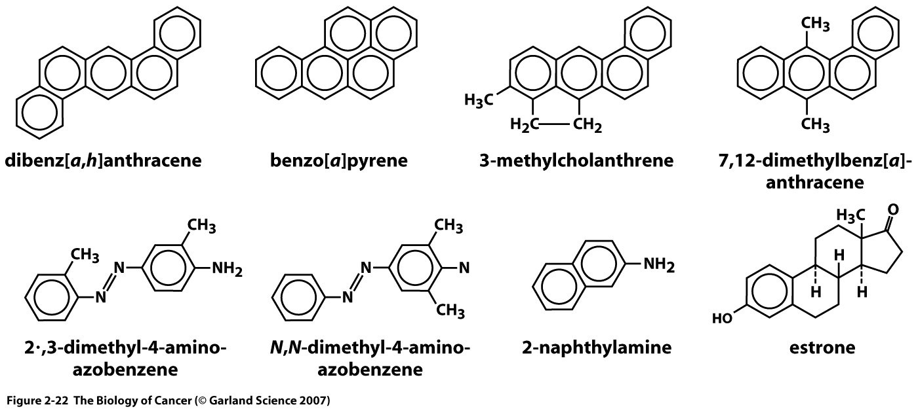
Carcinogens in tar
How to test for carcinogens?
Notes:
Benzopyrene: 苯并 芘

Slide 42



Ames Test
(1970s by Bruce Ames at UC Berkeley)
Test substance
Mutant bacteria Can’t make Histidine
Revert mutation
A layer of bacteria
Notes:
Mutagens identified via Ames test are also possible carcinogens, and early studies by Ames showed that 90% of known carcinogens may be identified via this test.^{[7]} Later studies however showed identification of 50–70% of known carcinogens.^{[citation needed]} The test was used to identify a number of compounds previously used in commercial products as potential carcinogens.^{[8]} Examples include tris(2,3-dibromopropyl)phosphate, which was used as a flame retardant in plastic and textiles such as children's sleepwear,^{[9]} and furylfuramide which was used as an antibacterial additive in food in Japan in 1960s and 1970s. Furylfuramide in fact had previously passed animal test, but more vigorous tests after its identification in the Ames test showed it to be carcinogenic.^{[10]} Their positive tests resulted in those chemicals being withdrawn from use in consumer products.
One interesting result from the Ames test is that the dose response curve using varying concentrations of chemical is almost always linear,^{[7]} indicating that there is no threshold concentration for mutagenesis. It therefore suggests that, as with radiations, there may be no safe threshold for chemical mutagens or carcinogens.^{[11][12]} However some proposed that organisms can tolerate low level of mutagens due to protective mechanisms such as DNA repair, and threshold may exist for certain chemical mutagens.^{[13]} Bruce Ames himself argued against linear dose-response extrapolation from the high dose used in carcinogenesis tests in animal systems to the lower dose of chemicals normally encountered in human exposure, as the results may be false positives due to mitogenic response caused by the artificially high dose of chemicals used in such tests.^{[14][15]} He also cautioned against the "hysteria over tiny traces of chemicals that may or may not cause cancer", that "completely drives out the major risks you should be aware of."^{[16]}
The Ames test is often used as one of the initial screens for potential drugs to weed out possible carcinogens, and it is one of the eight tests required under the Pesticide Act (USA) and one of six tests required under the Toxic Substances Control Act (USA).^{[17]}

Slide 43
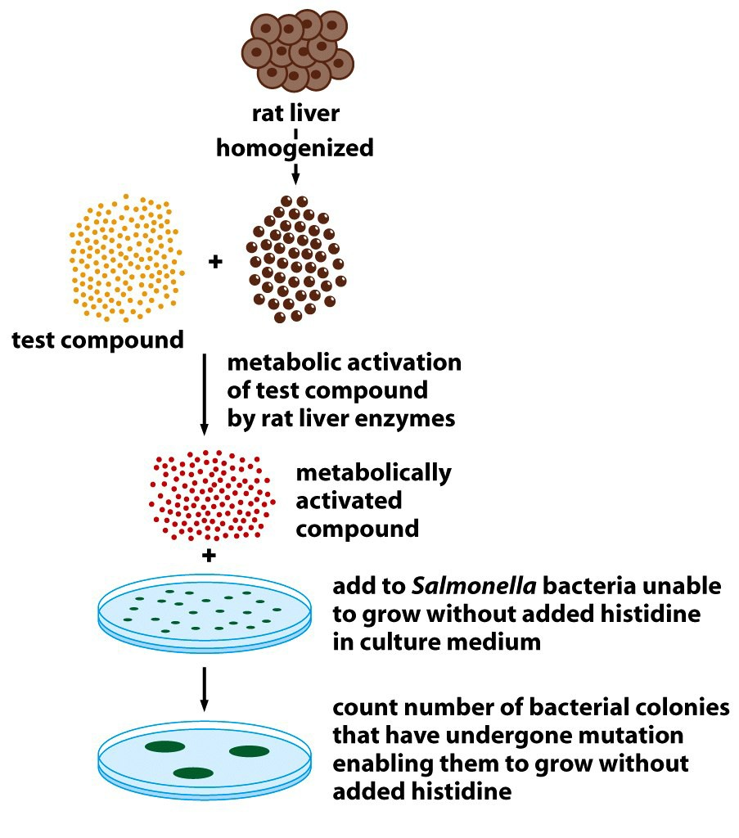
Ames test: Metabolic activation
Notes:
Salmonella typhimurium is a prokaryote, therefore it is not a perfect model for humans. Rat liver S9 fraction is used to mimic the mammalian metabolic conditions so that the mutagenic potential of metabolites formed by a parent molecule in the hepatic system can be assessed; however, there are differences in metabolism between human and rat that can affect the mutagenicity of chemicals being tested.^{[18]} The test may therefore be improved by the use of human liver S9 fraction; its use was previously limited by its availability, but it is now available commercially and therefore may be more feasible.^{[19]} An adapted in vitro model has been made for eukaryotic cells, for example yeast.
Mutagens identified in the Ames test need not necessarily be carcinogenic, and further tests are required for any potential carcinogen identified in the test. Drugs that contain the nitrate moiety sometimes come back positive for Ames when they are indeed safe. The nitrate compounds may generate nitric oxide, an important signal molecule that can give a false positive. Nitroglycerin is an example that gives a positive Ames yet is still used in treatment today. Nitrates in food however may be reduced by bacterial action to nitrites which are known to generate carcinogens by reacting with amines and amides. Long toxicology and outcome studies are needed with such compounds to disprove a positive Ames test.

Slide 44
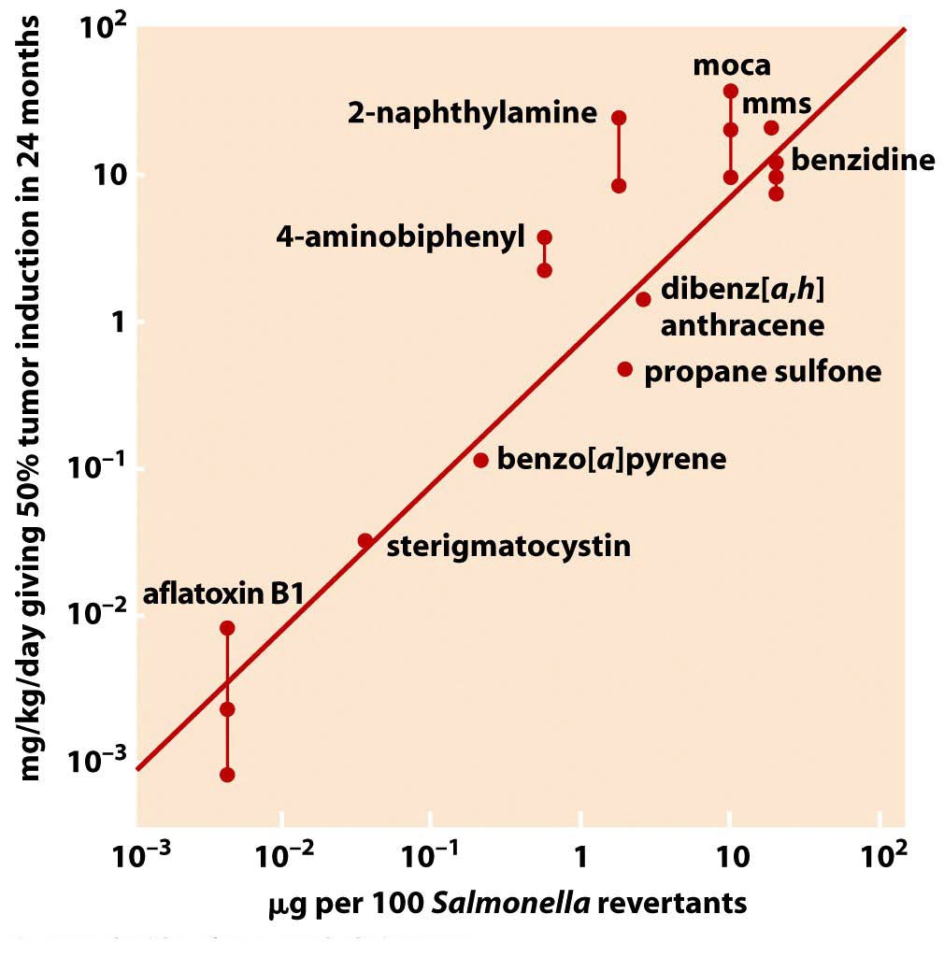

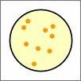
Mutagen ~ Carcinogen
黄曲霉毒素
Bacteria test

Slide 45


Limitation of tests
 | In vitro Ames test | In vivo Animal model | Epidemiology study
Tobacco smoke
Asbestos 石棉
Saccharin 糖精
Phenobarbital 催眠药
Isoniazid 抗结核药
Notes:
In 2000, President Clinton signed a bill to remove the warning label from products containing saccharin. To this day a salt derivative of saccharin, sodium saccharin, remains on the list of carcinogens and still requires warning labels.

Slide 46
Cancer News
Why the discrepancy?
Model system (Bacteria, rabbit) ≠ Human
Dose
Indirect Mechanism:
Asbestos → Lung damage → Inflammation
Notes:
Rabbit S9 fraction not equal to Human S9 fraction

Slide 47
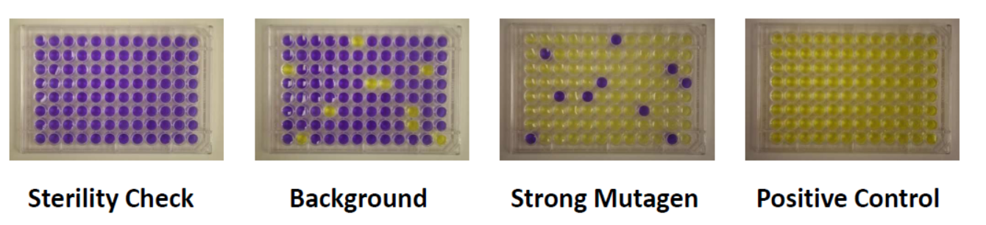
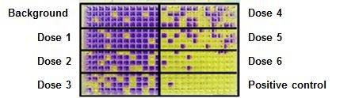
Fluctuation Method
Notes:
Fluctuation method

Slide 48
Introduction
What is cancer?
  Normal cells go bad.
What causes cancer?
  Carcinogens----such as chemical
  Infection?---such as Virus
How do we deal with cancer?

Slide 49
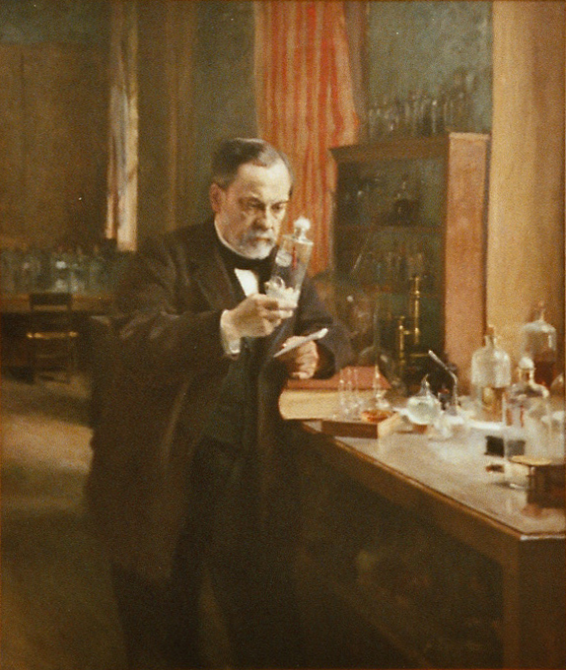
Louis Pasteur
1822-1895
French
Germ theory of Disease
Notes:
发明巴氏消毒法更多来源于巴斯德解决啤酒变酸问题的努力。他发现：以50~60摄氏度的温度加热啤酒半小时，就可以杀死啤酒里的乳酸杆菌和芽孢，而不必煮沸。
研制狂犬病疫苗更多把干燥的脊髓组织磨碎加水制成疫苗，注射到犬只脑中，再让打过疫苗的狗接触致命的病毒。接种疫苗的狗，即使脑中被注入狂犬病毒，也不会发病。

Slide 50
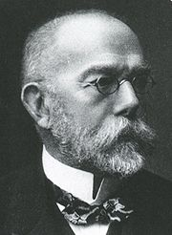
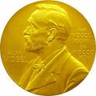
Disease and infection
Isolated
  anthrax (炭疽菌), tuberculosis (结核）, cholera （霍乱 ）
Koch Postulates:
  Germs → Diseases
Robert Koch (1843 –1910)
German physician
1905
Notes:
罗泊特·科赫（Robert Koch，炭疽病病原学，论炭疽杆菌发育史
科赫法则(Koch's postulates)包括：
1 在每一病例中都出现相同的微生物，且在健康者体内不存在；
2 要从寄主分离出这样的微生物并在培养基中得到纯培养（pure culture）；
3 用这种微生物的纯培养接种健康而敏感的寄主，同样的疾病会重复发生；
4 从试验发病的寄主中能再度分离培养出这种微生物来。
如果进行了上述4个步骤，并得到确实的证明，就可以确认该生物即为该病害的病原物。

Slide 51
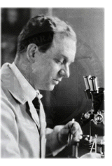
Chicken tumor
1909 Peyton Rous , Long island, New York
A farmer with sick chicken
1879-1970
Notes:
自劳斯（P．Rous）于1911年从鸡的可移植性肿瘤（劳斯肉瘤）中分离到病原病毒以来，在禽类中所分离到的许多肉瘤病毒均称Rous肉瘤病毒（Rous′sarcoma virus，RSV），或称为禽类肉瘤病毒（avian sarcoma virus，ASV）。
在小鼠中从小鼠白血病病毒的材料里以各种方式所分离到的病毒，都称为小鼠肉瘤病毒（murine sarc－ma virus，MuSV）。
除此之外还分离到猫肉瘤病毒（feline sarcoma virus，FeSV）。据报道从猴等的其他动物中也分离到此类病毒。

Slide 52
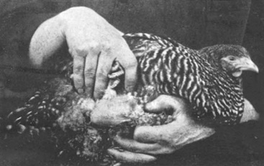
Cancer and infection

Slide 53
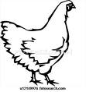

Rous experiment #1
Conclusion ?

Slide 54
Rous experiment #2
Conclusion ?
NEXT ?

Slide 55
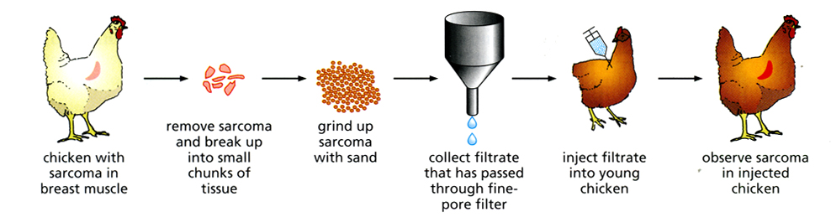
Rous experiment #3
Conclusion:
Tumor develops in a few weeks→good model for research
It can be passed again and again→ Something alive
It is very small→ Virus (Rous Sarcoma Virus: RSV)

Slide 56
Victory of infectious theory
1911 Rabbit virus→ Myxomas 黏液瘤
Rous and Collaborators: （1930-1970）
2 more chicken viruses→ papilloma
Rous sarcoma virus, now known to be a retrovirus
Cancer = Infectious disease
1966

Slide 57
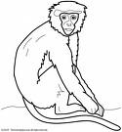
SV40 virus
(Simian vacuolating virus 40 or Simian virus 40)
Monkey cell lines → replicate → Kill cells
Lytic life cycle

Slide 58
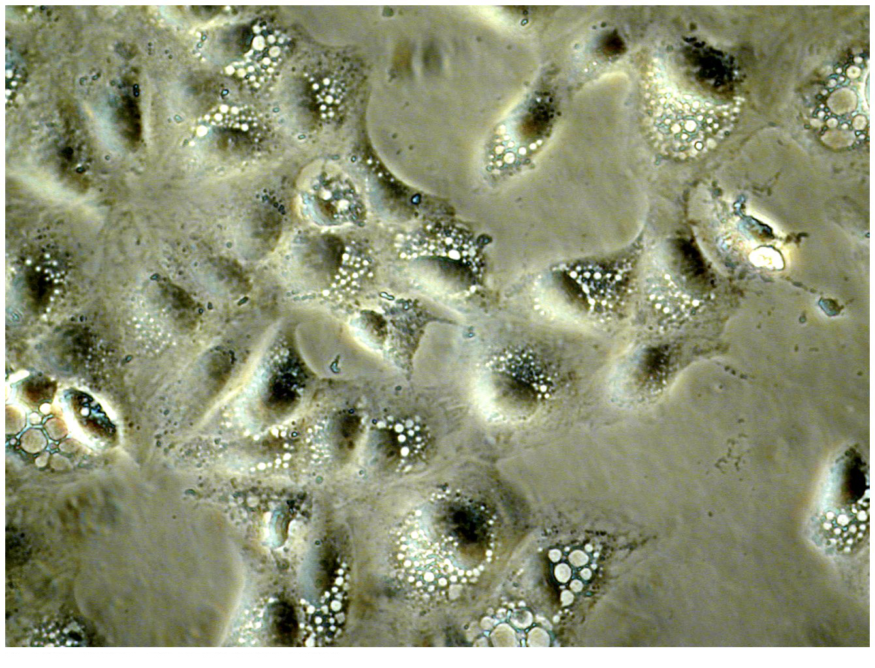
SV40 infected monkey cells

Slide 59
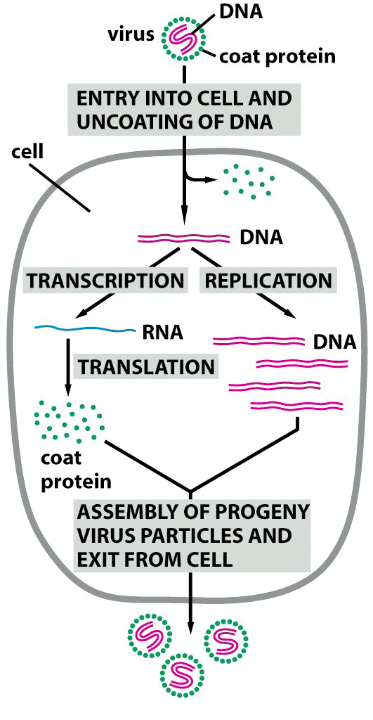

Slide 60
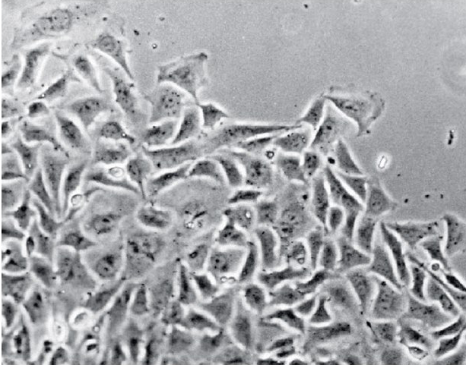
  Chicken embryonic fibroblasts
+ RSV
Cells survive !

Slide 61
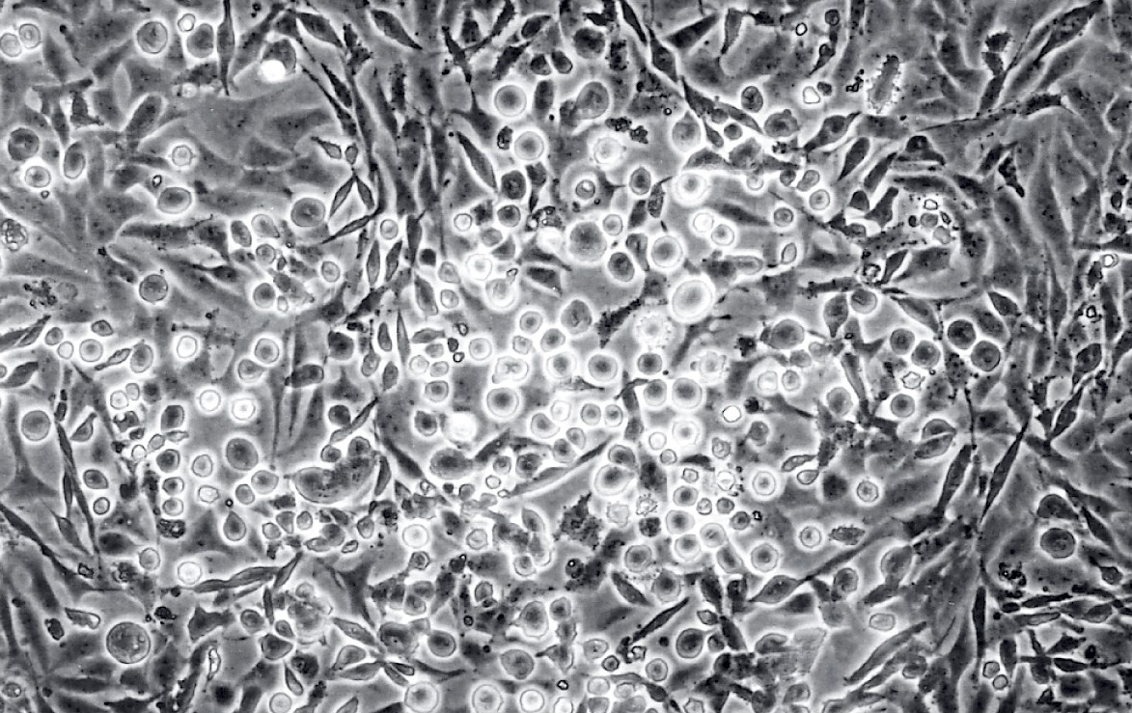
They look like sarcoma cells…

Slide 62

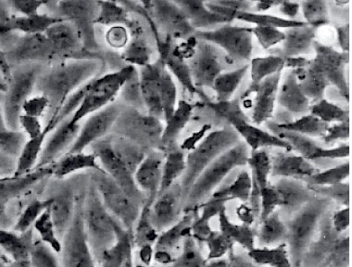

A new study system
1. Months,years
2. Several weeks
3. Several days
Transformation
+RSV

Slide 63
What is cancer? at cellular level…
Properties of transformed cells

Slide 64

Contact Inhibition

Slide 65

+RSV

Slide 66
Transformed cells
Change in cell shape
Loss of contact inhibition
Proliferate indefinitely
→ Your evaluation of the transformed cells:
  Neoplasia
  Metastatic tumor

Slide 67


Assay 1 for Transformed cells
Ability to grow without attachment
  Foci formation on soft agar dish

Slide 68



Assay 2 for Transformed cells
Nude mice
Lacks thymus
  Immuno-compromised
  Accept grafts from unrelated sources, such as human cells
No hair: Easy to see tumors

Slide 69
How bad are the cells?
2 functional assays
1. Foci formation on soft agar
2. Tumor formation in Nude mice

Slide 70
Other viruses can also induce cancer
Richard Shope: rabbit papillomas (Warts) DNA virus
SV40 – the 40th simian virus
MMLV- mouse mammary tumor virus (RNA)

Slide 71


Richard Shope, rabbit papilloma virus

Slide 72

SV40 virus

Slide 73

Peyton Rous:
Discovery of tumour-inducing viruses
1966
1909 Chicken sarcoma
(1879 - 1970)

Slide 74



Hit & Run, or dependence on virus
X
Normal cell Tumor cell

Slide 75

Need RSV continuously?

Slide 76


Summary: Causes of Cancer & Prevention

Slide 77
References:
Book charter:
The Biology of Cancer ( second Edition, chapter 2.7-2.11, chapter 3, chapter 11.1-11.5)
Cancer and Environment: Gene-Environment interaction. Washington, DC: National Academy Press,2002
Papers:
1. Siegel RL, Miller KD, Jemal A. Cancer statistics, 2018. CA: a cancer journal for clinicians 2018, 68(1): 7-30.
2. Chen W, Zheng R, Baade PD, Zhang S, Zeng H, Bray F, Jemal A, Yu XQ, He J. Cancer statistics in China, 2015. CA: a cancer journal for clinicians 2016, 66(2): 115-132.
3. Brennan P. Gene-environment interaction and aetiology of cancer: what does it mean and how can we measure it? Carcinogenesis 2002, 23(3): 381-387.
4. Peto J. Cancer epidemiology in the last century and the next decade. Nature 2001, 411(6835): 390-395.

